Slide 1
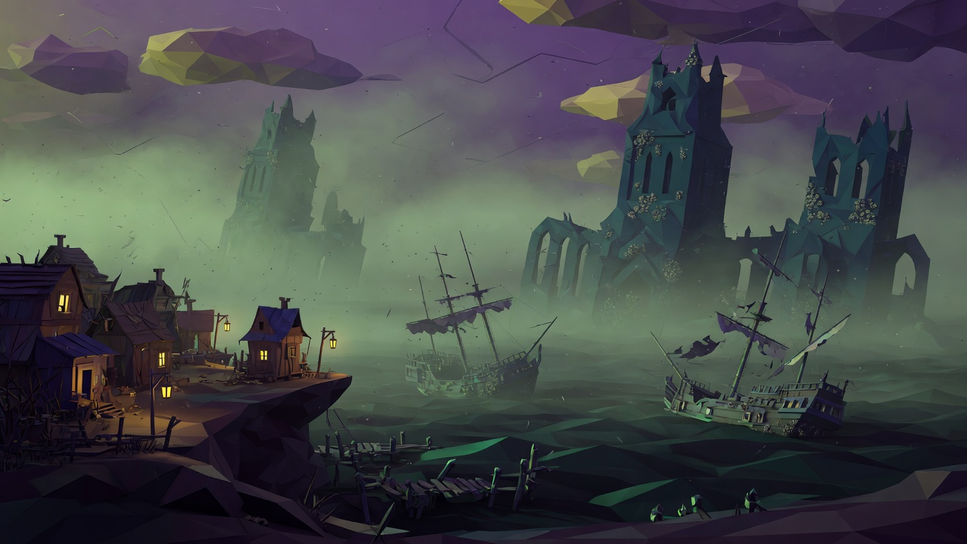
DESIGN BRIEF
Kindred
Siege
The Drowned City
Your army fights itself.
The city writes down how.
Drawn from the v4 design. The cube prototype is the rules. This is the room.
01

Slide 2
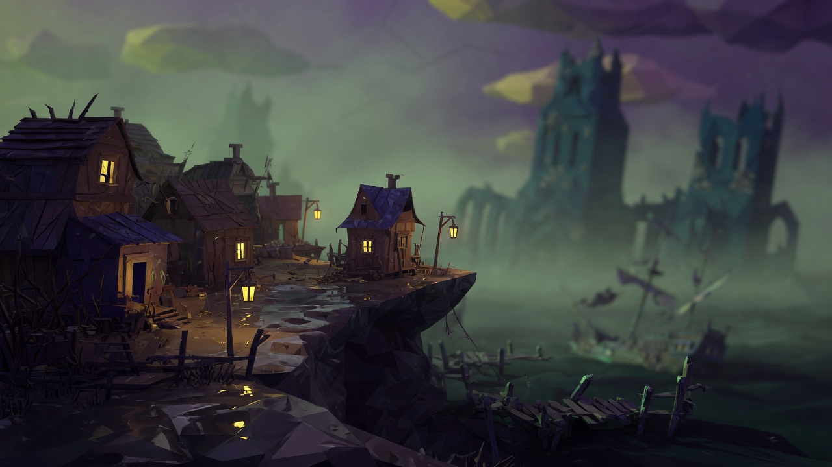
THE PROMISE
A Lovecraftian auto battler where the thinking hurts more than the hit.
You do not steer bodies.
You set habits, then watch them keep those habits under pressure.
Sanity is behaviour.
Below halfway the AI starts to hesitate, flee, or turn on its own.
Captains remember.
Lose to one and it comes back larger, with a grudge and your tactic in its pocket.
02

Slide 3
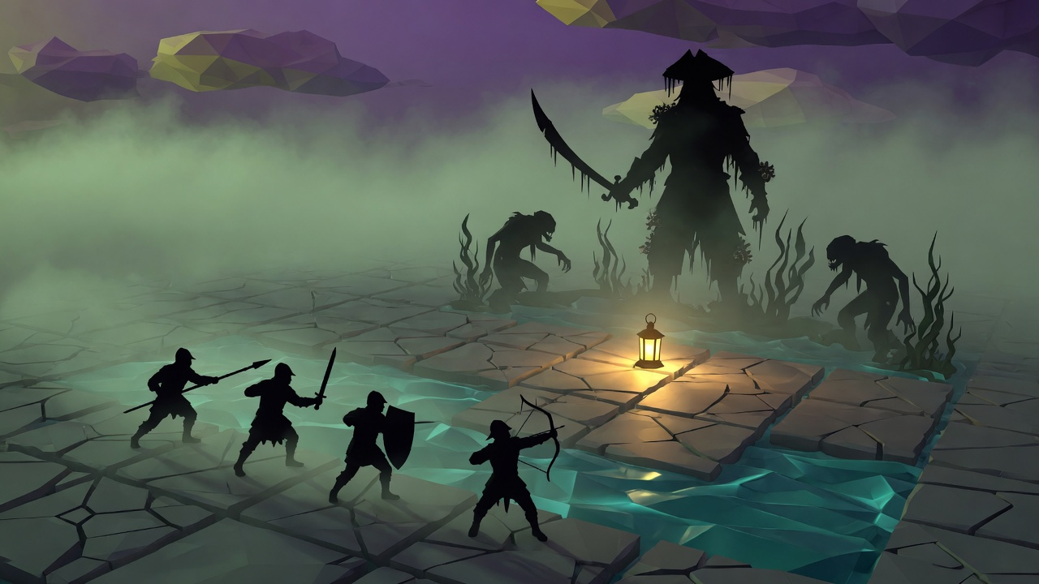
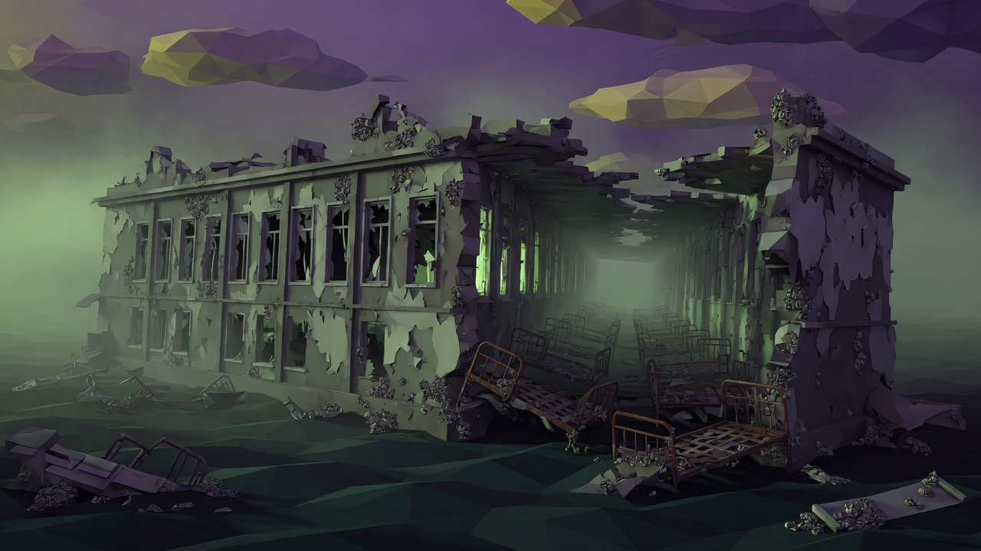
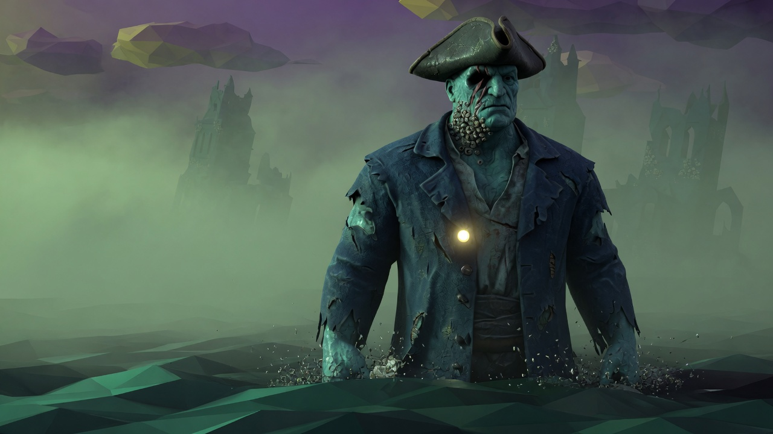
01
02
03
AI behaviour
The mind
The rivalry
Units fight on their own. Before the march you give each one two gambits. In the fight you have five directive points, then the tree is in charge.
Every unit has sanity. Stress makes the AI skip, fail a gambit, or break. At zero the unit is Lost, and everyone who watched loses 20.
Enemy leaders are generated, named, and kept. They adapt to what beat them. A few return after death as Undying.
03

Slide 4
WHERE THE PLAYER IS GOOD
The battle is the consequence of preparation.
BEFORE
DURING
AFTER
01
Pick the path
01
Watch the tree work
01
Mercy, or a real death
02
Read the mutation and the captain
02
Speed, pause, or one tick
02
The rival writes the result
03
Choose 4 to 6 units
03
Spend from 5 directive points
03
Fatigue sticks to who you sent
04
Give each unit two gambits
04
Intervene, then let go
04
Back up the cliff to the hamlet
04

Slide 5
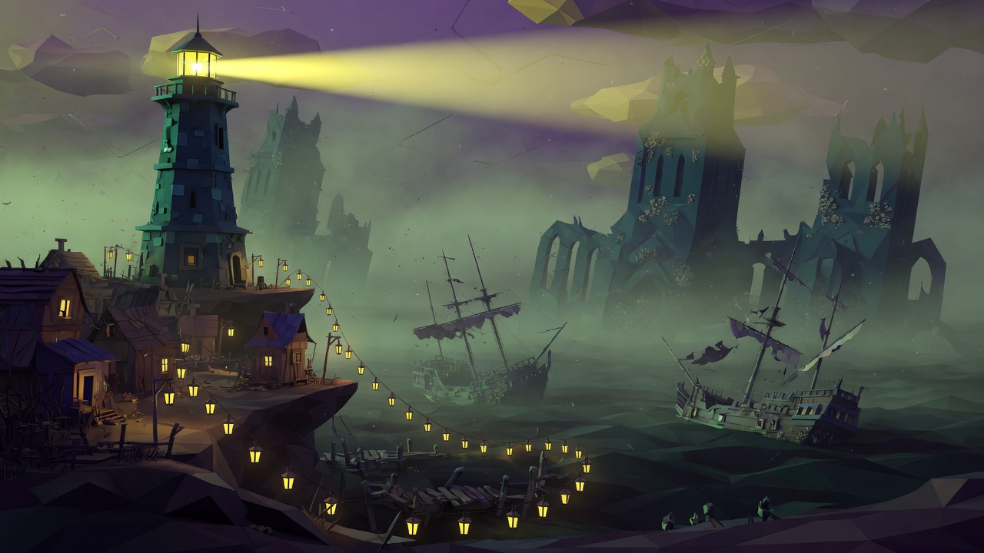
ONE EXPEDITION
Six beats. Then you are home, or you are lighter.
01
02
03
04
05
06
Hamlet
Lighthouse
Prepare
Battle
Mercy
Return
Heal, recruit, read the board.
Two or three paths. Risk is printed.
Roster, gambits, then commit.
They fight. You spend points.
A life, or a name you lose.
Scars, loot, fatigue, memory.
A path also names the job. Annihilation. Survival. Extraction. Rival hunt. Escort. Sanity siege.
15 to 20 expeditions. Four districts, then the Abyss, then one arch rival.
05

Slide 6
HOME
The hamlet
Gold is home.
Everything past the cliff is cold.
Not a city builder. Six buildings, three upgrades each, paid for with what you carry out of the water.
06

Slide 7
SIX DOORS
Each door does one job. Upgrades make that job sharper.
01
02
03
Barracks
Sanatorium
War Table
Recruit. Higher tiers open new classes and a larger roster.
Rest sanity. Level 3 can treat a phobia, at the cost of a full rest.
The rivalry board. Later it shows a weakness, a spawn, a mutation.
04
05
06
Archive
Lighthouse
Shrine
The gambit list. Level 3 opens a third slot on a unit.
Choose the path. Later it reveals the mutation and a hidden road.
Mercy tokens, and the ledger of lives you refused to spend.
07

Slide 8
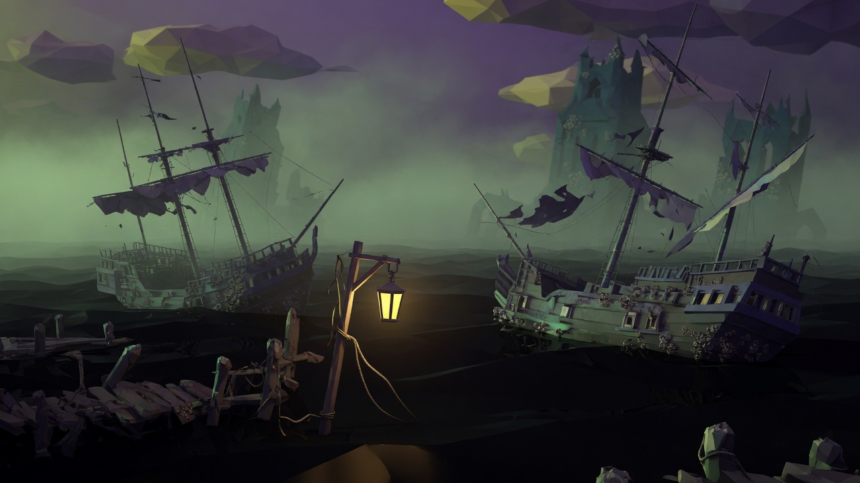
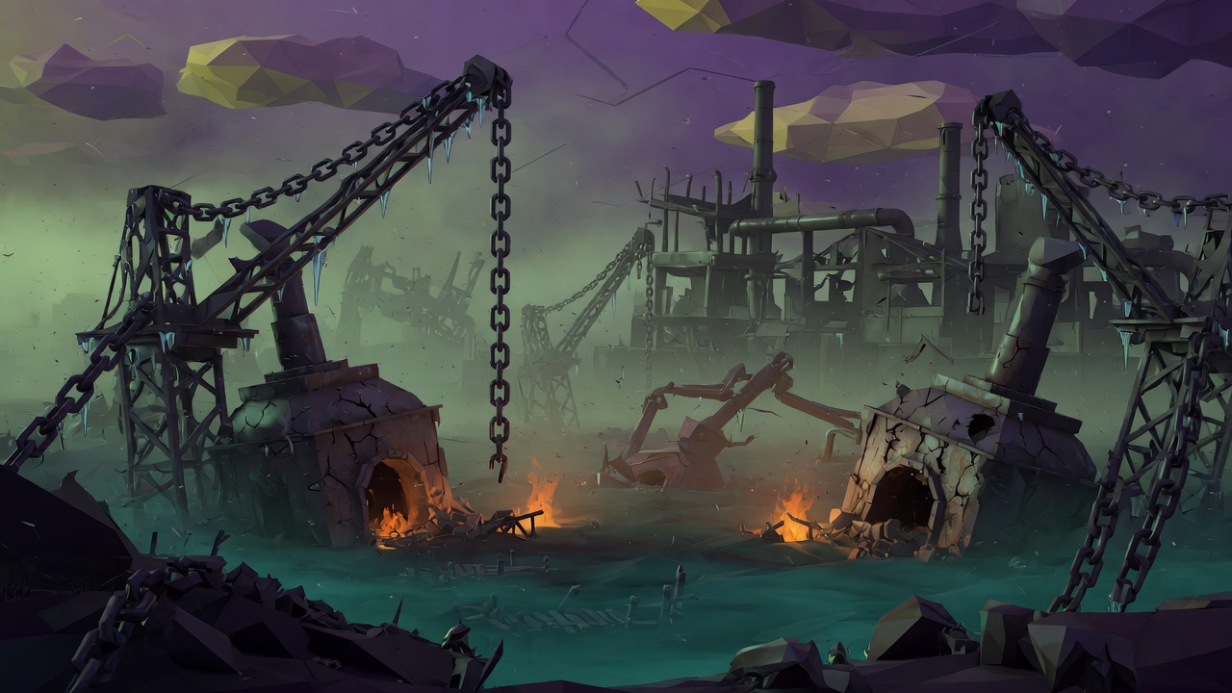
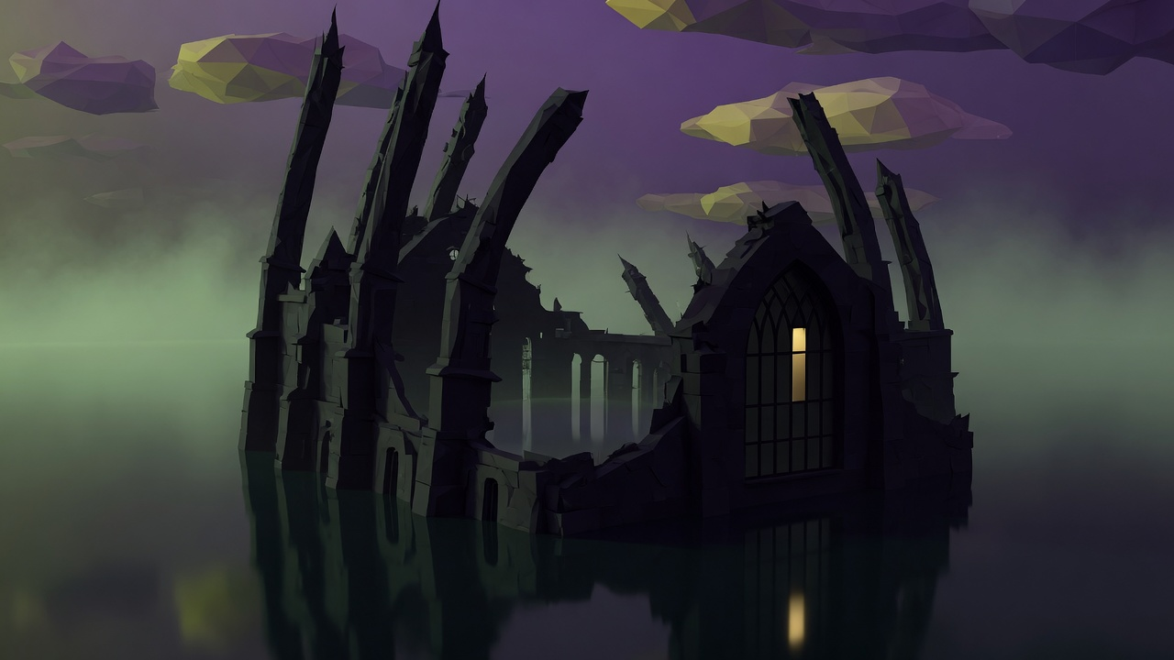
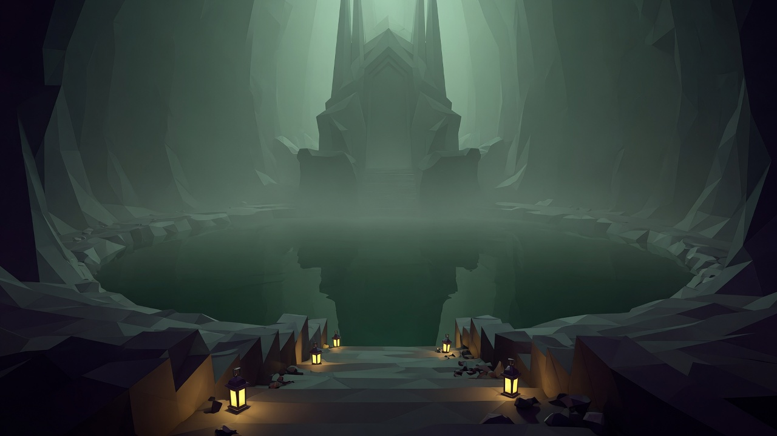
THE DESCENT
Clear a district and the hamlet keeps a piece of it.
Harbour
+1 directive point a battle
Tide
Asylum
Treat two units at once
Mind
Foundry
+2 roster slots
Flesh
Cathedral
Tier 3 gambits
Void
Abyss
The campaign ends here
All of them
08

Slide 9
HARBOUR
ASYLUM
Tide
Mind
The Deep Calls. Bodies are pulled toward the centre of the grid. Water tiles cost sanity and time.
Madness Spreads. When one unit gains an affliction, a friend may take one too.
09

Slide 10
FOUNDRY
CATHEDRAL
Flesh
Void
Pain is Shared. Thirty percent of a blow also lands on the nearest friend.
The Rival Knows. Your first gambit fails. The captain already read it.
10

Slide 11
THE FAR ROOM
The Abyss
Past a point, one rule covers every fight. You do not walk around it. You kill the captain who is still writing it.
Mythos exposure only rises. At the last tier, recruits arrive with less mind, and every rival carries a horror rating.
11

Slide 12
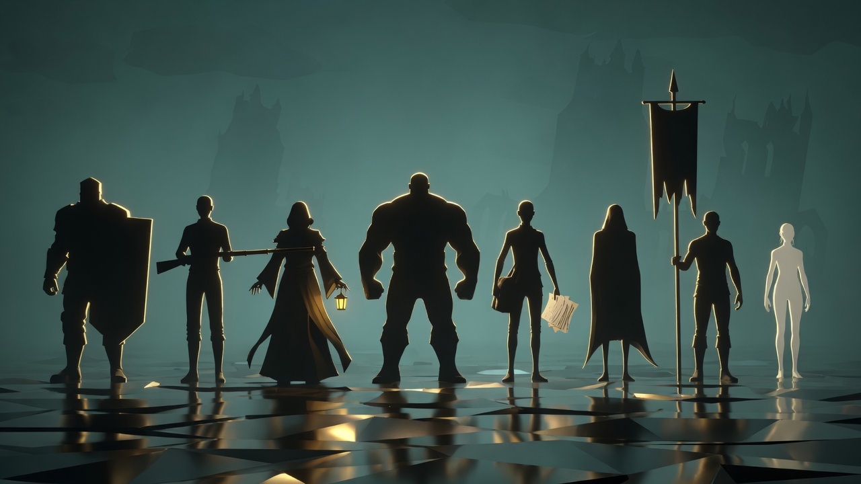
THE COMPANY
Eight shapes. The face can wait.
Warden
Marksman
Occultist
Berserker
Investigator
Shadow
Herald
Vessel
Tank
Range
Heal
Melee
Read
Kill
Steady
Mercy
Silhouette first. Class has to read at thumbnail size. Teal water. Gold only where a person still lives.
12

Slide 13
SANITY
The mind is what the AI is allowed to do.
80 to 100
Resolute
Full effect. Pressure can mint a virtue.
WHEN IT ROLLS
First time under 50, a trait lands.
50 to 79
Stressed
About one tick in ten, they hesitate.
Veterans, five expeditions or more, find a virtue 30 percent of the time. Rookies, 10.
25 to 49
Afflicted
Gambits fray. A trait rolls in.
Stalwart. Focused. Courageous. Resolute.
1 to 24
Broken
Half their ticks fail. They cower.
Or Paranoid, Hopeless, Selfish, Irrational.
0
Lost
Removed. Witnesses lose 20.
13

Slide 14
COMPREHENSION
The ones who understand it pay more.
Multiplier on every horror hit to sanity. An Investigator who studies a rival also loses max sanity for good, down to a floor of 60 percent.
Berserker
0.5
Warden
0.6
Shadow
0.7
Marksman
0.8
Vessel
1.0
Herald
1.1
Occultist
1.3
Investigator
1.5
14

Slide 15
A CAPTAIN
Vhaal the Drowned
Spawned
A Grunt. Two to four traits. One weakness.
Promoted
You lost. Rank, a trait, more HP, more size.
Scarred
They lived. They learn what hurt them.
Defeated
Loot. A subordinate may take the grudge.
Returned
12 percent. Undying. At least a Captain.
Horror rating, every five seconds, the whole field. Lieutenant 2. Captain 4. Overlord 8. Undying adds 2. Then multiply by comprehension.
A grunt taunting a steady Warden does nothing. An overlord taunting a broken unit can lock them still.
15

Slide 16
REALITY, FOR ONE FIGHT
Printed on the path before you step onto it.
TIDE
MIND
FLESH
VOID
The Deep Calls
Madness Spreads
Pain is Shared
The Rival Knows
Every body is drawn one step toward the centre.
An affliction copies onto someone standing near.
Part of every blow also hits the nearest friend.
The first gambit you packed does not fire.
16

Slide 17
NO SCRIPT
Seven systems, one accident.
An ally dies.
The Herald drops under 50.
01
05
The others lose 15 sanity.
The roll says Courageous.
Someone drops under 50.
The aura gives sanity back.
02
06
The roll says Paranoid.
A virtue, not a speech.
Paranoid strikes a friend.
The paranoid one steadies.
03
07
The tree has turned around.
The accident stops itself.
That friend is a Herald.
04
Empathy doubles the loss.
17

Slide 18
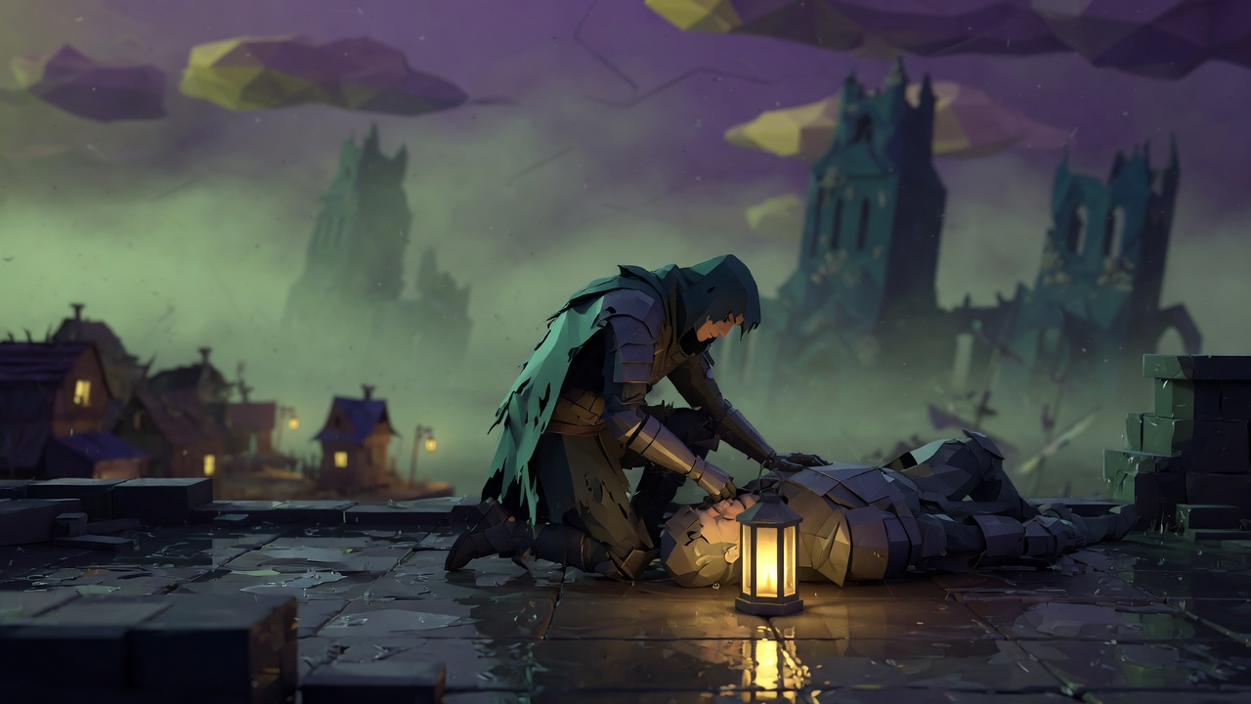
MERCY
The fight stops
at zero.
You see the name, the expeditions, the bond, the phobia. Then two doors.
KEEP THEM
One token. Back at 30 percent HP. Plus 15 sanity.
OR THEY ARE GONE
The talent points go with them.
The design cuts 10 to 15 percent of the sale to charity. Mind is the partner named first. No shop. No loot box.
18

Slide 19
THE FLOW YOU TOUCH
One expedition, five screens.
WAR TABLE
LIGHTHOUSE
ARCHIVE
BATTLE
MERCY
Vhaal the Drowned
Captain
Grudge: marksmen
Weakness still shut
Rank can rise
Path A
Fear is Power
Rare gambit
Path B
Iron Blood
Ordinary pay
Warden
Hold the Line
Protect the Weak
Two slots.
A third is an upgrade.
Speed 1x Pause
Directives 3 / 5
Elara SAN 41
Afflicted
You are watching.
Elara is down
Marksman
The captain has her name
KEEP or GONE
30% HP, +15 sanity
19

Slide 20
The city is the size of the threat.
The lantern is the size of the point.
A person you could name. A token you might spend. Then the water, which kept the lesson.
Kindred Siege The Drowned City Design brief
20

