Slide 1
作业列表（2015-2016（1））

Slide 2
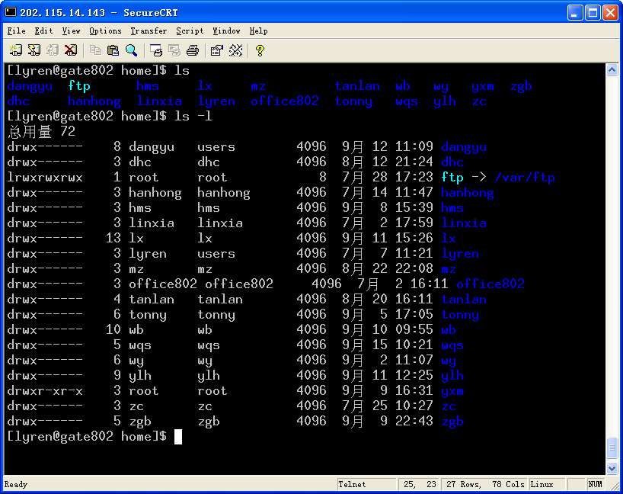
Exercise 1
Write a program similar to ls，to support two kinds of command operation:with no options and with the option “-l”.

Slide 3
Exercise I
1.Is the COW technique same with running in the parent’s address space ?
2.What are the differences between fork and vfork ? Write a program to verify your answer.
3.Write a program to show the child process wait the parent process with a block style and a noblock style to terminate.Then show the changing of memory layout.

Slide 4
Exercise No 3
1.*Write a program to handle the exception of divided by 0 .

