Slide 1
Spring
yuqing,wang
1354202

Slide 2
History and design object
written by:Rod Johnson in the document:
Expert One-On-One Java EE Design and Development
Release time:2003 June
2004 March:release the version1.0
2004 Sep and 2005 March release more
Spring Framework--design object
Core support for dependency injection, transaction management, web applications, data access, messaging, testing and more.

Slide 3
Introduction
The Spring Framework provides a comprehensive programming and configuration model for modern Java-based enterprise applications - on any kind of deployment platform. A key element of Spring is infrastructural support at the application level: Spring focuses on the "plumbing" of enterprise applications so that teams can focus on application-level business logic, without unnecessary ties to specific deployment environments.
configuration model and infrastructual support

Slide 4
Features
Dependency Injection
Aspect-Oriented Programming including Spring's declarative transaction management
Spring MVC web application and RESTful web service framework
Foundational support for JDBC, JPA, JMS
Much more...
All avaible features and modules are described in the Modules section of the reference documentation. Their maven/gradle coordinates are also described there.

Slide 5
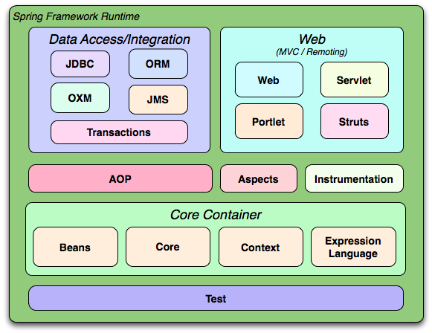
Franmwork

Slide 6
powerful functions
Spring AMQP：
Spring for Android：
Spring Batch：
Spring Data：
Spring Framework：
Spring Gemfire：
Spring Integration：
Spring Mobile：
Spring .NET：
Spring ROO：
Spring Security：
Spring Social：
Spring Web Flow：
Spring Web Services：

Slide 7
important packages
1. annotation (一些注解支持)
2. covert (转换器 -- 一些基本的基本底层的转换器支持)
3. enums(废弃)
4. env (环境运行配置信息 -- 这当然是非常必要的)
5. io (用于加载框架使用的不同资源)
6. serializer 序列化 必不可少 可归纳为特殊工具
7. style (对象的格式化输出 / 没有看到太多的实现 可归类为特殊工具)
8. task 任务调度
9. type 对于BEAN 的定义class进行一个元数据分析(用于细粒度的控制)

Slide 8
start
Accessing Relational Data using JDBC with Spring
You’ll build an application using Spring’s JdbcTemplate to access data stored in a relational database
A text editor or IDE
JDK 1.8 or later
Gradle 2.3+ or Maven 3.0+

Slide 9
Create a Customer object
The simple data access logic you will work with below below manages first and last names of customers. To represent this data at the application level, create a Customer class.
package hello;
public class Customer {
private long id;
private String firstName, lastName;
public Customer(long id, String firstName, String lastName) {
this.id = id;
this.firstName = firstName;
this.lastName = lastName;
}

Slide 10
@Override
public String toString() {
return String.format(
"Customer[id=%d, firstName='%s', lastName='%s']",
id, firstName, lastName);
}
// getters & setters omitted for brevity
}

Slide 11
Store and retrieve data
Spring provides a template class called JdbcTemplate that makes it easy to work with SQL relational databases and JDBC. Most JDBC code is mired in resource acquisition, connection management, exception handling, and general error checking that is wholly unrelated to what the code is meant to achieve. The JdbcTemplate takes care of all of that for you. All you have to do is focus on the task at hand.

Slide 12
package hello;
import org.slf4j.Logger;
import org.slf4j.LoggerFactory;
import org.springframework.beans.factory.annotation.Autowired;
import org.springframework.boot.CommandLineRunner;
import org.springframework.boot.SpringApplication;
import org.springframework.boot.autoconfigure.SpringBootApplication;
import org.springframework.jdbc.core.JdbcTemplate;
import java.util.Arrays;
import java.util.List;
import java.util.stream.Collectors;

Slide 13
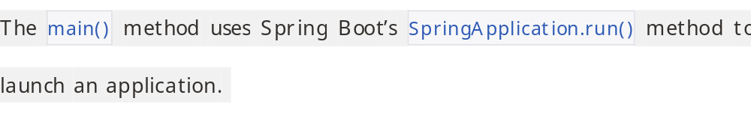
@SpringBootApplication
public class Application implements CommandLineRunner {
private static final Logger log = LoggerFactory.getLogger(Application.class);
public static void main(String args[]) {
SpringApplication.run(Application.class, args);
}

Slide 14
@Autowired
JdbcTemplate jdbcTemplate;
@Override
public void run(String... strings) throws Exception {
log.info("Creating tables");
jdbcTemplate.execute("DROP TABLE customers IF EXISTS");
jdbcTemplate.execute("CREATE TABLE customers(" +
"id SERIAL, first_name VARCHAR(255), last_name VARCHAR(255))");
// Split up the array of whole names into an array of first/last names
List<Object[]> splitUpNames = Arrays.asList("John Woo", "Jeff Dean", "Josh Bloch", "Josh Long").stream()
.map(name -> name.split(" "))
.collect(Collectors.toList());

Slide 15
// Use a Java 8 stream to print out each tuple of the list
splitUpNames.forEach(name -> log.info(String.format("Inserting customer record for %s %s", name[0], name[1])));
// Uses JdbcTemplate's batchUpdate operation to bulk load data
jdbcTemplate.batchUpdate("INSERT INTO customers(first_name, last_name) VALUES (?,?)", splitUpNames);
log.info("Querying for customer records where first_name = 'Josh':");
jdbcTemplate.query(
"SELECT id, first_name, last_name FROM customers WHERE first_name = ?", new Object[] { "Josh" },
(rs, rowNum) -> new Customer(rs.getLong("id"), rs.getString("first_name"), rs.getString("last_name"))
).forEach(customer -> log.info(customer.toString()));
}
}

Slide 16
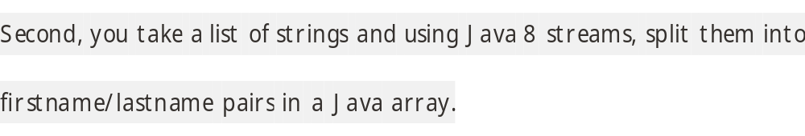
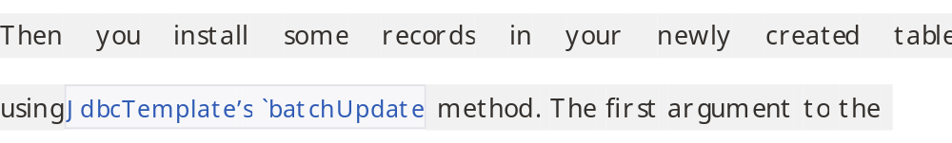
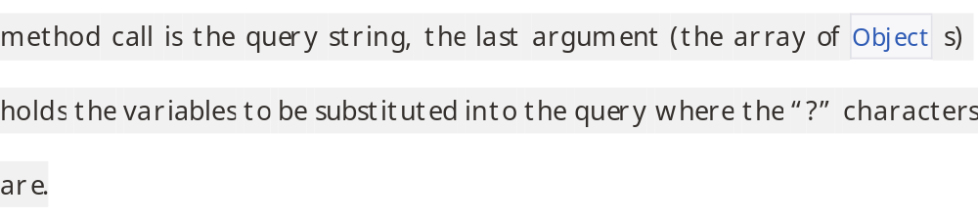
what you've done?

Slide 17
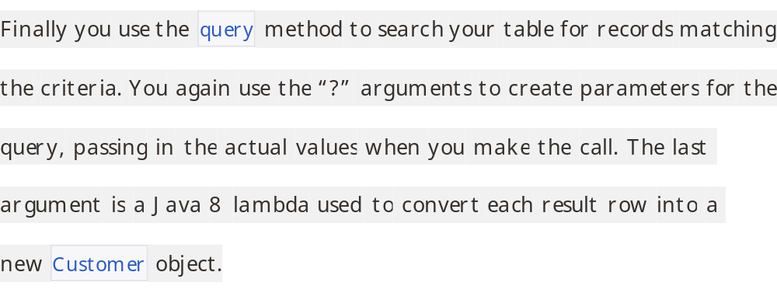

Slide 18
Build an executable JAR
If you are using Gradle, you can run the application using ./gradlew bootRun.
You can build a single executable JAR file that contains all the necessary dependencies, classes, and resources. This makes it easy to ship, version, and deploy the service as an application throughout the development lifecycle, across different environments, and so forth.
./gradlew build
Then you can run the JAR file:
java -jar build/libs/gs-relational-data-access-0.1.0.jar

Slide 19
If you are using Maven, you can run the application using mvn spring-boot:run. Or you can build the JAR file with mvn clean package and run the JAR by typing:
java -jar target/gs-relational-data-access-0.1.0.jar
The procedure above will create a runnable JAR. You can also opt to build a classic WAR file instead.

Slide 20
2015-11-19 10:58:31.152 INFO 67731 --- [ main] hello.Application : Creating tables
2015-11-19 10:58:31.219 INFO 67731 --- [ main] hello.Application : Inserting customer record for John Woo
2015-11-19 10:58:31.220 INFO 67731 --- [ main] hello.Application : Inserting customer record for Jeff Dean
2015-11-19 10:58:31.220 INFO 67731 --- [ main] hello.Application : Inserting customer record for Josh Bloch
2015-11-19 10:58:31.220 INFO 67731 --- [ main] hello.Application : Insertin customer record for Josh Long
2015-11-19 10:58:31.230 INFO 67731 --- [ main] hello.Application : Querying for customer records where first_name = 'Josh':
2015-11-19 10:58:31.242 INFO 67731 --- [ main] hello.Application : Customer[id=3, firstName='Josh', lastName='Bloch']
2015-11-19 10:58:31.242 INFO 67731 --- [ main] hello.Application : Customer[id=4, firstName='Josh', lastName='Long']
2015-11-19 10:58:31.244 INFO 67731 --- [ main] hello.Application : Started Application in 1.693 seconds (JVM running for 2.054)

