Slide 1
File System Security

Slide 2
What does a file system do?
A file system is a method for storing and organizing computer files and the data they contain to make it easy to find and access them.
File systems exist on hard drives, pen drives, cd’s, dvd’s and any other form of data storage medium
Most data storage devices have array of fixed-size blocks, sometimes called sectors, and file system is in charge of organizing these sectors into files and directories. It is also in charge of indexing the media so it knows where and what each file is

Slide 3
Types of File Systems
Disk file systems – FAT (File Allocation Table), NTFS, HFS (Hierarchical File System), ext2, ext3, ISO9660 and UDF
FAT(FAT12, FAT16, FAT32), and especially NTFS are primarily used on Windows operating systems. FAT is also the standard file system for floppy drives and is still used today
HFS is used by Mac OS, and ext2, ext3 are used on various linux operating systems
ISO9660 and UDF are used on optical media

Slide 4
How does the file system handle security?
The file system is crucial to data integrity.
Main method of protection is through access control
Accessing file system operations (ex. modifying or deleting a file) are controlled through access control lists or capabilities
Capabilities are more secure so they tend to be used by operating systems on file systems like NTFS or ext3.
Secondary method of protection is through the use of backup and recovery systems

Slide 5
Attacks on the file system
Race Condition Attacks
Using ADS to hide files
Directory traversal

Slide 6
Race Condition Attacks
Occurs when a process performs a sequence of operations on a file, under the assumption that they are executed atomically.
Can be used by the attacker to change the characteristics of that file between two successive operations on it resulting in the victim process to operate on the modified file.

Slide 7
Using ADS to hide Files
Alternate Data Streams(ADS) allows multiple data streams to be attached to a single file.
A file can be hidden behind a file as an attached stream that could be hundreds of megabytes in size, however a directory listing will only display the file’s normal size.

Slide 8
Directory Traversal
An exploit caused by lack of insufficient security validation of user supplied input file names
For example the attacker would pass this as input. ../../../../../../../../../etc/password to retrieve the password file from the server.

Slide 9
How does the file system ensure data integrity?
There are various methods of protecting the files on a file system.
Access Controls
Encryption
RAID
Recovery when data is corrupted

Slide 10
Access Control
Access Control plays a huge part in file system security
The system should only allow access to files that the user is permitted to access
Almost all major file systems support ACL’s or capabilities in order to prevent malicious activity on the file system
Depending on the users rights they can be allowed to read, write and/or execute and object. In some file systems schemes only certain users are allowed to alter the ACL on a file or see if a file even exists.
Ultimately the less the user has access to the less that can go wrong and the integrity of the disk can be more guaranteed.

Slide 11
General File System Encryption
Encryption is also a method used by file systems to secure data, NTFS for example offers file encryption using DESX
Two method of disk encryption
  Full Disk Encryption
  File System Encryption
File system encryption has a few advantages over full disk encryption for example
    File based key management
    Individual management of encrypted files
    Access control can be further strengthened through the use of public key cryptography
    Keys are only held in memory while the file is being used

Slide 12
Encrypting File System(EFS)
Provides security beyond user authentication and access control lists. For example when the attacker has physical access to the computer.
EFS uses public key cryptography however it is susceptible to brute-force attacks against the user account passwords.

Slide 13
EFS Encryption
EFS works by encrypting a file with a bulk symmetric key, aka File Encryption Key or FEK.
The FEK is encrypted with a public key that is associated with the user that encrypted the file.

Slide 14
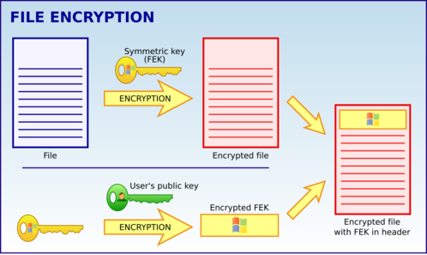
EFS Encryption

Slide 15
EFS Decryption
The EFS uses the private key that matches the EFS digital certificate (that was used to encrypt the file) to decrypt the symmetric key.
The resulting symmetric key is then used to decrypt the file.

Slide 16
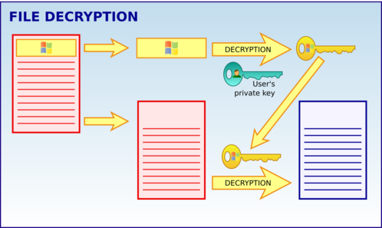
EFS Decryption

Slide 17
RAID
RAID stands for Redundant Array of Independent Disks
Offers drawbacks and advantages over a single disk, each with different applications
Types of RAID
  RAID 0 “Striping set without parity”
  RAID 1 “Mirrored set without parity”
  RAID 3 “Striped set with byte level parity”
  RAID 4 “Striped set with block level parity”
  RAID 5 “Striped set with distributed parity”
  RAID 6 “Striped set with dual distributed parity”

Slide 18
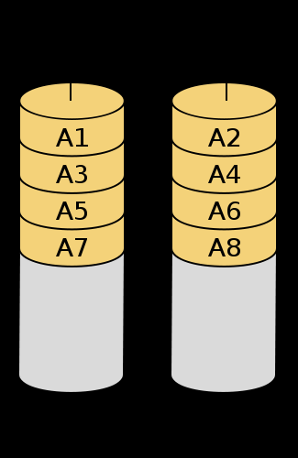
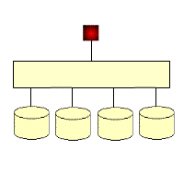
RAID 0
Striping set without parity

Slide 19
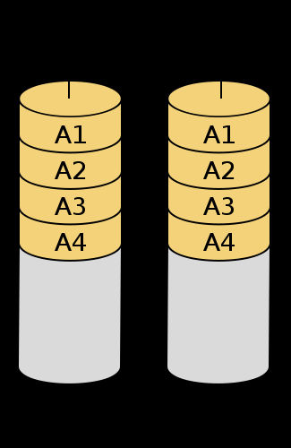
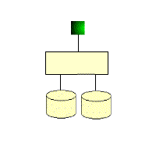
RAID 1
Mirrored set without parity

Slide 20
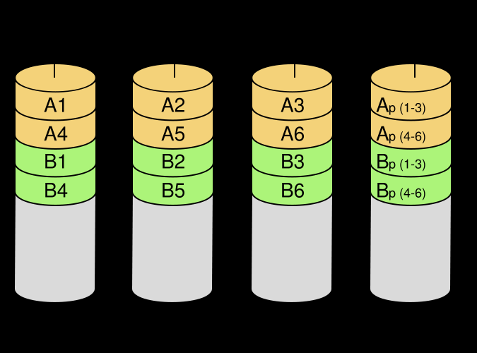
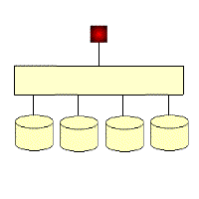
RAID 3
Striped set with byte level parity

Slide 21
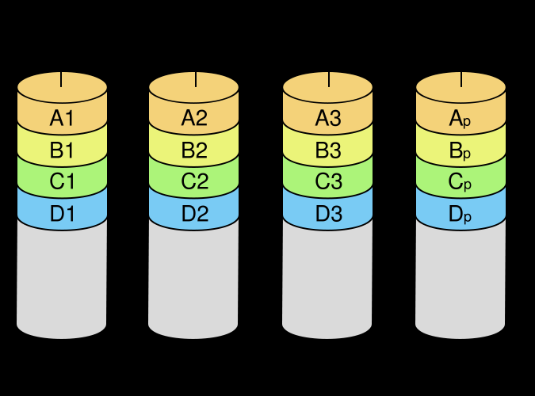
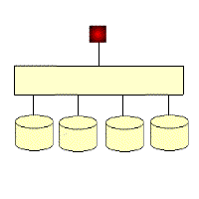
RAID 4
Striped set with block level parity

Slide 22
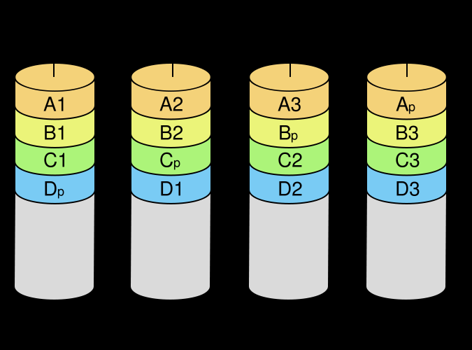
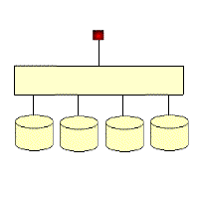
RAID 5
Striped set with distributed parity

Slide 23
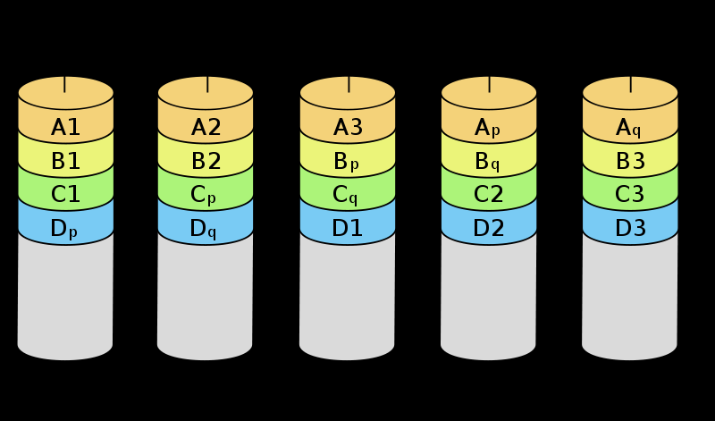
RAID 6
Striped set with dual distributed parity

Slide 24
What happens when something is corrupted?
Checksum codes
Reed Soloman Codes (cd’s to fix errors caused by scratches)
Given the right type of RAID, the system can recover easily.
  Parity Schemes
  Protection against individual drive failure

Slide 25
File System Security’s Future
Example: Sun’s ZFS
  Released in 2006
  Marked a departure from file systems of previous years by integrating new methods of storage, access and security
Has two advantages in computer security compared with other file systems
  Copy-on-write technology
  Self Healing File system

