Slide 1
Cryptography and Network Security
Dr. S.R. Shinde

Slide 2
Web Security
Web now widely used by business, government, individuals
but Internet & Web are vulnerable
have a variety of threats
integrity
confidentiality
denial of service
authentication
need added security mechanisms

Slide 3
SSL (Secure Socket Layer)
transport layer security service
originally developed by Netscape
version 3 designed with public input
subsequently became Internet standard known as TLS (Transport Layer Security)
uses TCP to provide a reliable end-to-end service
SSL has two layers of protocols

Slide 4
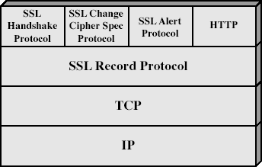
SSL Architecture

Slide 5
SSL Architecture
SSL session
an association between client & server
created by the Handshake Protocol
define a set of cryptographic parameters
may be shared by multiple SSL connections
SSL connection
a transient, peer-to-peer, communications link
associated with 1 SSL session

Slide 6
parameters defining session state
Session identifier
arbitrary byte sequence chosen by the server to identify an active or resumable session state
Peer certificate
X509.v3 certificate of the peer. This element of the state may be null
Compression method
The algorithm used to compress data prior to encryption.

Slide 7
parameters defining session state
Cipher spec
Specifies the bulk data encryption algorithm
(such as null, DES, etc.) and hash algorithm
(such as MD5 or SHA-l) used for MAC calculation. It also defines cryptographic attributes such as the hash_size.
Master secret
48-byte secret shared between the client and server.
Is resumable
flag indicating whether the session can be used to initiate new connections.

Slide 8
parameters defining connection state
Server and client random
Byte sequences that are chosen by the server and client for each connection.
Server write MAC secret
The secret key used in MAC operations on data
sent by the server
Client write MAC secret
The secret key used in MAC operations on data sent by the client.
Server write key
The conventional encryption key for data
encrypted by the server and decrypted by the
client

Slide 9
parameters defining connection state
Client write key
The conventional encryption key for data
encrypted by the client and decrypted by the server.
Initialization vectors
When a block cipher in CBC mode is used, an
initialization vector (IV) is maintained for each key. This field is first initialized by the SSL
Handshake Protocol. Thereafter the final
ciphertext block from each record is
preserved for use as the IV with the following record

Slide 10
parameters defining connection state
Sequence numbers
Each party maintains separate sequence numbers for transmitted and received messages for each connection. When a party sends or receives a change cipher spec message, the appropriate sequence number is set to zero. Sequence numbers may not exceed 2⁶⁴- 1.

Slide 11
SSL Record Protocol
confidentiality
using symmetric encryption with a shared secret key defined by Handshake Protocol
IDEA, RC2-40, DES-40, DES, 3DES, Fortezza, RC4-40, RC4-128
message is compressed before encryption
message integrity
using a MAC with shared secret key
similar to HMAC but with different padding

Slide 12
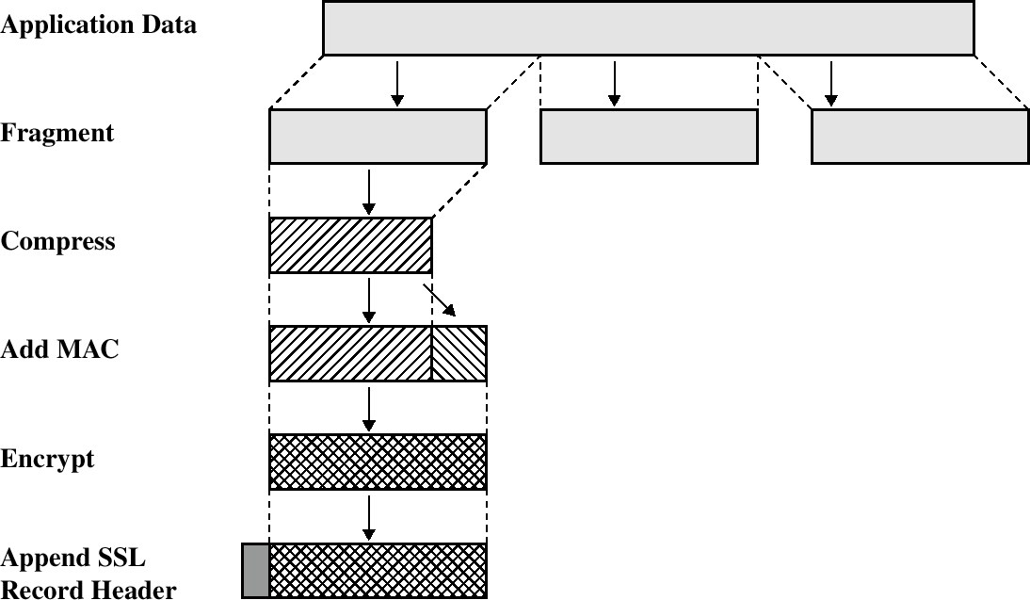
SSL - Record Protocol

Slide 13
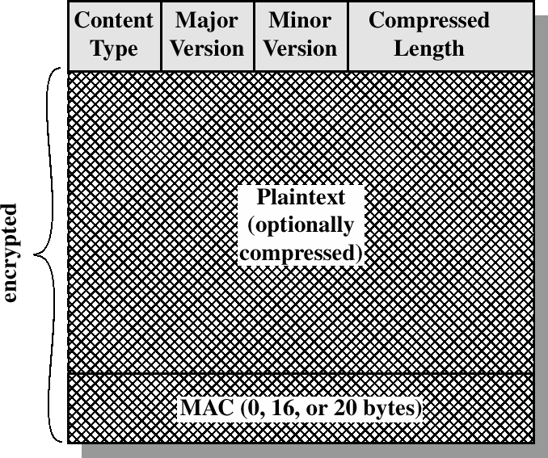
SSL - record
fields of the header

Slide 14
fields
Content Type (8 bits)
The higher layer protocol used to process the enclosed fragment (change_cipher_spec, alert, handshake, and application_data. The first three are the SSL-specific protocols; no distinction is made among the various applications (e.g., HTTP) that might use SSL)
Major Version (8 bits)
Indicates major version of SSL in use. For SSLv3, the value is 3
Minor Version (8 bits)
Indicates minor version in use. For SSLv3, the value is O
Compressed Length (16 its)
The length in bytes of thbe plaintext fragment (or
compressed fragment if compression is used).

Slide 15
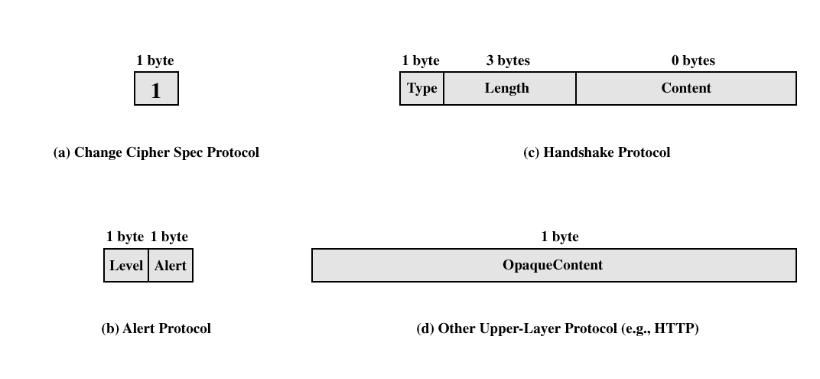
SSL - Payload

Slide 16
SSL Change Cipher Spec Protocol
one of 3 SSL specific protocols which use the SSL Record protocol
a single message
causes pending state to become current
hence updating the cipher suite in use

Slide 17
SSL Alert Protocol
conveys SSL-related alerts to peer entity
severity
warning or fatal
specific alert
unexpected message, bad record mac, decompression failure, handshake failure, illegal parameter
close notify, no certificate, bad certificate, unsupported certificate, certificate revoked, certificate expired, certificate unknown
compressed & encrypted like all SSL data

Slide 18
SSL Handshake Protocol
allows server & client to:
authenticate each other
to negotiate encryption & MAC algorithms
to negotiate cryptographic keys to be used
comprises a series of messages in phases
Establish Security Capabilities
Server Authentication and Key Exchange
Client Authentication and Key Exchange
Finish

Slide 19
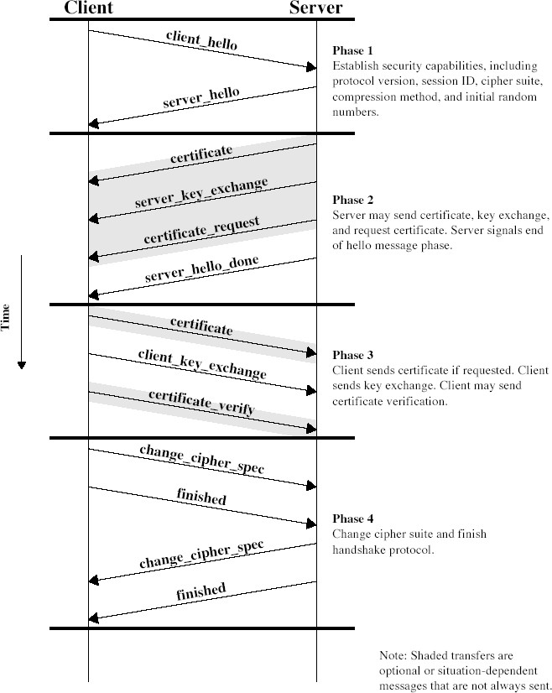
SSL Handshake Protocol

Slide 20
Handshake protocol
4 steps
Hello: determine security capabilities
Server sends certificate, asks for certificate and starts exchange session keys
Client sends certificate and continues exchanges of keys
End of handshake protocol: encoded methods changes
Note: some requests are optional
clear separation between handshake and the rest (to avoid attacks)

Slide 21
TLS (Transport Layer Security)
IETF standard RFC 2246 similar to SSLv3
with minor differences
in record format version number
uses HMAC for MAC
a pseudo-random function expands secrets
has additional alert codes
some changes in supported ciphers
changes in certificate negotiations
changes in use of padding

Slide 22
Secure Electronic Transactions (SET)
open encryption & security specification
to protect Internet credit card transactions
developed in 1996 by Mastercard, Visa etc
not a payment system
rather a set of security protocols & formats
secure communications amongst parties
trust from use of X.509v3 certificates
privacy by restricted info to those who need it

Slide 23
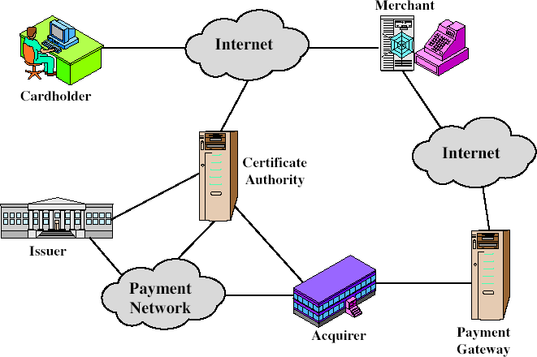
SET Components

Slide 24
SET Transaction
customer opens account
customer receives a certificate
merchants have their own certificates
customer places an order
merchant is verified
order and payment are sent
merchant requests payment authorization
merchant confirms order
merchant provides goods or service
merchant requests payment

Slide 25
Dual Signature
customer creates dual messages
order information (OI) for merchant
payment information (PI) for bank
neither party needs details of other
but must know they are linked
use a dual signature for this
signed concatenated hashes of OI & PI

Slide 26
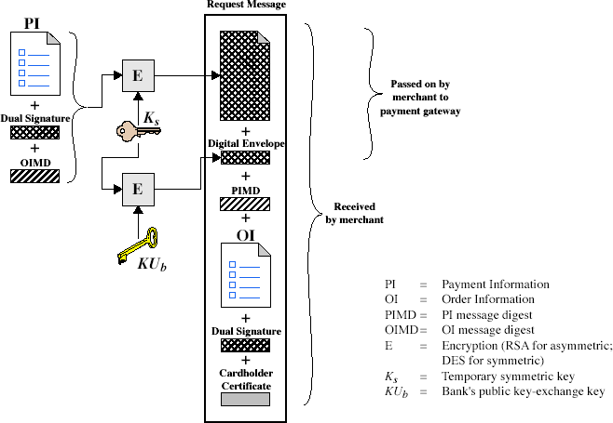
Purchase Request – Customer

Slide 27
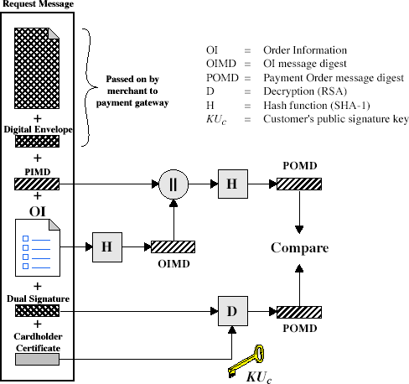
Purchase Request – Merchant

Slide 28
Purchase Request – Merchant
verifies cardholder certificates using CA sigs
verifies dual signature using customer's public signature key to ensure order has not been tampered with in transit & that it was signed using cardholder's private signature key
processes order and forwards the payment information to the payment gateway for authorization (described later)
sends a purchase response to cardholder

Slide 29
Payment Gateway Authorization
verifies all certificates
decrypts digital envelope of authorization block to obtain symmetric key & then decrypts authorization block
verifies merchant's signature on authorization block
decrypts digital envelope of payment block to obtain symmetric key & then decrypts payment block
verifies dual signature on payment block
verifies that transaction ID received from merchant
matches that in PI received (indirectly) from customer
requests & receives an authorization from issuer
sends authorization response back to merchant

Slide 30
Payment Capture
merchant sends payment gateway a payment capture request
gateway checks request
then causes funds to be transferred to merchants account
notifies merchant using capture response

Slide 31
Summary
have considered:
need for web security
SSL/TLS transport layer security protocols
SET secure credit card payment protocols

