Slide 1

Parallelizing Compilers
Presented by Yiwei Zhang

Slide 2
Reference Paper
Rudolf Eigenmann and Jay Hoeflinger, ”Parallelizing and Vectorizing Compilers”, Purdue Univ. School of ECE, High-Performance Computing Lab. ECE-HPCLab-99201, January 2000

Slide 3
Importance of parallelizing
With the rapid development of multi-core processors, parallelized programs can take such advantage to run much faster than serial programs
Compilers created to convert serial programs to run in parallel are parallelizing compilers

Slide 4
Role of parallelizing compilers
Attempt to relieve the programmer from dealing with the machine details
They allow the programmer to concentrate on solving the object problem, while the compiler concerns itself with the complexities of the machine

Slide 5
Role of parallelizing compilers
Much more sophisticated analysis is required of the compiler to generate efficient machine code for different types of machines

Slide 6
How to Parallelizing a Program
Find the dependency in the program
Try to avoid or eliminate the dependency
Reduce overhead cost

Slide 7
Dependence Elimination and
Avoidance
A data dependence between two sections of a program indicates that during execution those two sections of code must be run in certain order
anti dependence: READ before WRITE
flow dependence: WRITE before READ
output dependence: WRITE before WRITE

Slide 8
Data Privatization and Expansion
Data privatization can remove anti and output dependences.
These dependences are not due to computation having to wait for data values produced by others. Instead, it waits because it wants to assign a value to a variable that is still in use
The basic idea is to use a new storage location so that the new assignment does not overwrite the old value too soon

Slide 9
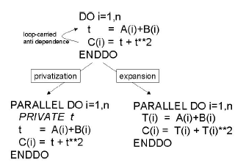
Data Privatization and Expansion
Example:

Slide 10
Idiom Recognition: Inductions, Reductions, Recurrences
These transformations can remove true dependence, e.g., flow dependence
This is the case where one computation has to wait for another to produce a needed data value
The elimination is only possible if we can express the computation in a different way

Slide 11
Induction Variable Substitution
Finds variables which form arithmetic and geometric progressions which can be expressed as functions of the indices of enclosing loops
Replaces these variables with the expressions involving loop indices

Slide 12
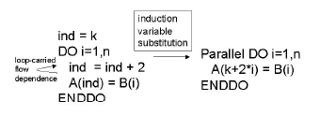
Induction Variable Substitution
Example:
We can replace variable ‘ind’ with an arithmetic form of indice i

Slide 13
Identification of induction variables
Through pattern matching (e.g., the compiler finds statements that modify variables in the described way)
Through abstract interpretation (identifying the sequence of values assumed by a variable in a loop)

Slide 14
Reductions
Reduction operations abstract the values of an array into a form with lesser dimensionality.
The typical example is an array being summed up into a scalar variable

Slide 15
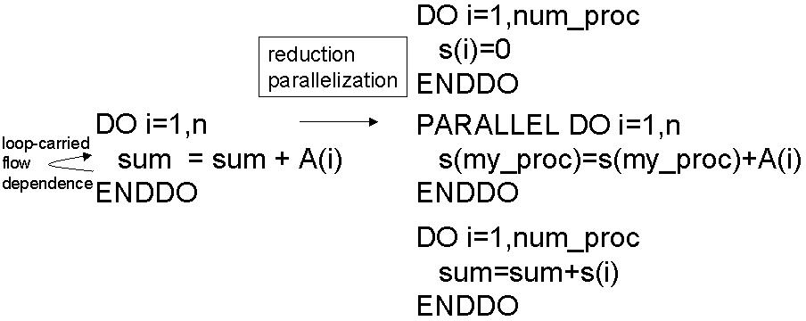
Reductions
We can split the array into p parts, sum them up individually by different processors, and then combine the results.
The transformed code has two additional loops, for initializing and combining the partial results.

Slide 16
Recurrence
Recurrences use the result of one or several previous loop iterations for computing the value of next iteration
However, for certain forms of linear recurrences, algorithms are known that can be parallelized

Slide 17
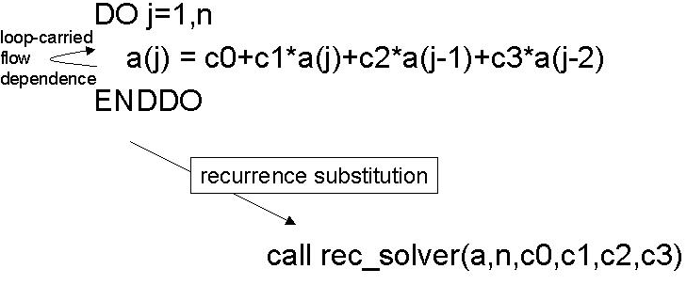
Recurrence
Compiler has recognized a pattern of linear recurrences for which a parallel solver is known. The compiler then replaces this code by a call to a mathematical library that contains the corresponding parallel solver algorithm

Slide 18
Parallel Loop Restructuring
A parallel computation usually incurs an overhead when starting and terminating
The larger the computation in the loop, the better this overhead can be amortized
Use techniques such as loop fusion, loop coalescing, and loop interchange to optimize performance

Slide 19
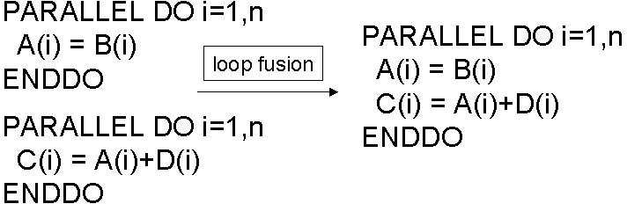
Loop fusion
Loop fusion combines two adjacent loops into a single loop.

Slide 20
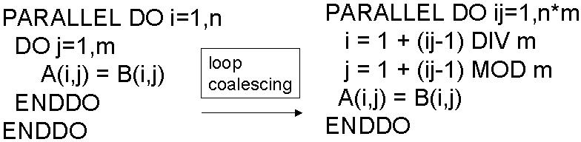
Loop coalescing
Loop coalescing merges two nested loops into a single loop

Slide 21
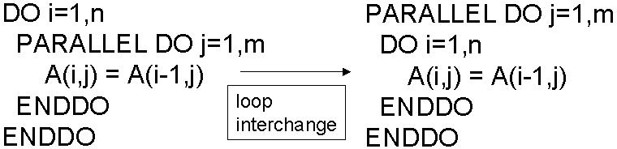
Loop interchange
Move an inner parallel loop to an outer position in a loop nest
As a result, overhead is only incurred once

Slide 22
Questions?

