Slide 1
Data Flow Analysis

Slide 2
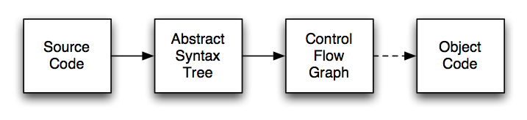
Compiler Structure
Source code parsed to produce AST
AST transformed to CFG
Data flow analysis operates on control flow graph (and other intermediate representations)

Slide 3
ASTs
ASTs are abstract
  They don’t contain all information in the program
    E.g., spacing, comments, brackets, parentheses
  Any ambiguity has been resolved
    E.g., a + b + c produces the same AST as (a + b) + c

Slide 4
Disadvantages of ASTs
AST has many similar forms
  E.g., for, while, repeat...until
  E.g., if, ?:, switch
Expressions in AST may be complex, nested
  (42 * y) + (z > 5 ? 12 * z : z + 20)
Want simpler representation for analysis
  ...at least, for dataflow analysis

Slide 5
Control-Flow Graph (CFG)
A directed graph where
  Each node represents a statement
  Edges represent control flow
Statements may be
  Assignments x := y op z or x := op z
  Copy statements x := y
  Branches goto L or if x relop y goto L
  etc.

Slide 6
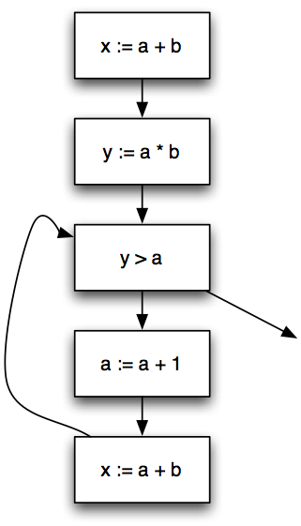
Control-Flow Graph Example
x := a + b;
y := a * b;
while (y > a) {
a := a + 1;
x := a + b
}

Slide 7
Variations on CFGs
We usually don’t include declarations (e.g., int x;)
  But there’s usually something in the implementation
May want a unique entry and exit node
  Won’t matter for the examples we give
May group statements into basic blocks
  A sequence of instructions with no branches into or out of the block

Slide 8
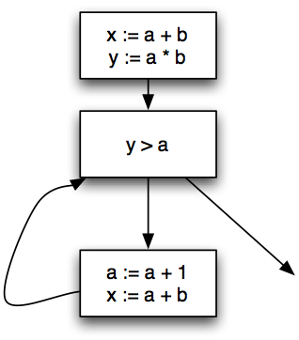
Control-Flow Graph w/Basic Blocks
x := a + b;
y := a * b;
while (y > a + b) {
a := a + 1;
x := a + b
}
Can lead to more efficient implementations
But more complicated to explain, so...
  We’ll use single-statement blocks in lecture today

Slide 9
CFG vs. AST
CFGs are much simpler than ASTs
  Fewer forms, less redundancy, only simple expressions
But...AST is a more faithful representation
  CFGs introduce temporaries
  Lose block structure of program
So for AST,
  Easier to report error + other messages
  Easier to explain to programmer
  Easier to unparse to produce readable code

Slide 10
Data Flow Analysis
A framework for proving facts about programs
Reasons about lots of little facts
Little or no interaction between facts
  Works best on properties about how program computes
Based on all paths through program
  Including infeasible paths

Slide 11
Available Expressions
An expression e is available at program point p if
  e is computed on every path to p, and
  the value of e has not changed since the last time e is computed on p
Optimization
  If an expression is available, need not be recomputed
    (At least, if it’s still in a register somewhere)

Slide 12
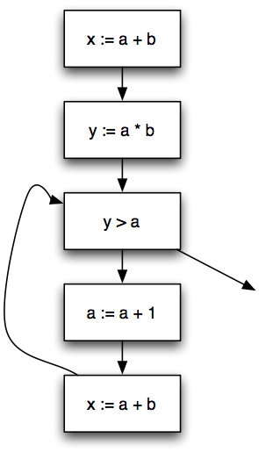
Data Flow Facts
Is expression e available?
Facts:
  a + b is available
  a * b is available
  a + 1 is available

Slide 13
Gen and Kill
What is the effect of each statement on the set of facts?
Stmt | Gen | Kill
x := a + b | a + b
y := a * b | a * b
a := a + 1 |  | a + 1, a + b, a * b

Slide 14
Computing Available Expressions
∅
{a + b}
{a + b, a * b}
{a + b}
{a + b, a * b}
{a + b}
{a + b}
Ø
{a + b}

Slide 15
Terminology
A joint point is a program point where two branches meet
Available expressions is a forward must problem
  Forward = Data flow from in to out
  Must = At join point, property must hold on all paths that are joined

Slide 16
Data Flow Equations
Let s be a statement
  succ(s) = { immediate successor statements of s }
  pred(s) = { immediate predecessor statements of s}
  In(s) = program point just before executing s
  Out(s) = program point just after executing s
In(s) = ∩_{s′ ∊ pred(s)} Out(s′)
Out(s) = Gen(s) ∪ (In(s) - Kill(s))
  Note: These are also called transfer functions

Slide 17
Liveness Analysis
A variable v is live at program point p if
  v will be used on some execution path originating from p...
  before v is overwritten
Optimization
  If a variable is not live, no need to keep it in a register
  If variable is dead at assignment, can eliminate assignment

Slide 18
Data Flow Equations
Available expressions is a forward must analysis
  Data flow propagate in same dir as CFG edges
  Expr is available only if available on all paths
Liveness is a backward may problem
  To know if variable live, need to look at future uses
  Variable is live if used on some path
Out(s) = ∪_{s′ ∊ succ(s)} In(s′)
In(s) = Gen(s) ∪ (Out(s) - Kill(s))

Slide 19
Gen and Kill
What is the effect of each statement on the set of facts?
Stmt | Gen | Kill
x := a + b | a, b | x
y := a * b | a, b | y
y > a | a, y
a := a + 1 | a | a

Slide 20
Computing Live Variables
{a, b}
{x, a, b}
{x, y, a, b}
{x, y, a}
{y, a, b}
{x}
{y, a, b}
{x, y, a, b}
{x, y, a}

Slide 21
Very Busy Expressions
An expression e is very busy at point p if
  On every path from p, expression e is evaluated before the value of e is changed
Optimization
  Can hoist very busy expression computation
What kind of problem?
  Forward or backward?
  May or must?
backward
must

Slide 22
Reaching Definitions
A definition of a variable v is an assignment to v
A definition of variable v reaches point p if
  There is no intervening assignment to v
Also called def-use information
What kind of problem?
  Forward or backward?
  May or must?
forward
may

Slide 23
Space of Data Flow Analyses
 | May | Must
Forward | Reaching definitions | Available expressions
Backward | Live variables | Very busy expressions
Most data flow analyses can be classified this way
  A few don’t fit: bidirectional analysis
Lots of literature on data flow analysis

Slide 24
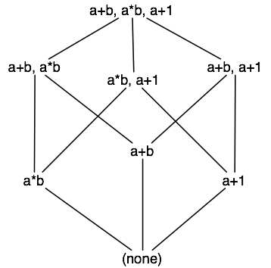
Data Flow Facts and Lattices
Typically, data flow facts form a lattice
  Example: Available expressions
“top”
“bottom”

Slide 25


Partial Orders
A partial order is a pair such that

Slide 26
Lattices
A partial order is a lattice if and are defined on any set:
  is the meet or greatest lower bound operation:
  is the join or least upper bound operation:

Slide 27

Lattices (cont’d)
A finite partial order is a lattice if meet and join exist for every pair of elements
A lattice has unique elements and such that
In a lattice,

Slide 28
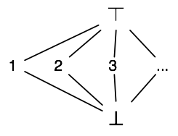
Useful Lattices
(2^{S}, ⊆) forms a lattice for any set S
  2^{S} is the powerset of S (set of all subsets)
If (S, ≤) is a lattice, so is (S, ≥)
  I.e., lattices can be flipped
The lattice for constant propagation

Slide 29
Forward Must Data Flow Algorithm
Out(s) = Top for all statements s
  // Slight acceleration: Could set Out(s) = Gen(s) ∪(Top - Kill(s))
W := { all statements } (worklist)
repeat
  Take s from W
  In(s) := ∩_{s′ ∊ pred(s)} Out(s′)
  temp := Gen(s) ∪ (In(s) - Kill(s))
  if (temp != Out(s)) {
    Out(s) := temp
    W := W ∪ succ(s)
  }
until W = ∅

Slide 30


Monotonicity
A function f on a partial order is monotonic if
Easy to check that operations to compute In and Out are monotonic
  In(s) := ∩_{s′ ∊ pred(s)} Out(s′)
  temp := Gen(s) ∪ (In(s) - Kill(s))
Putting these two together,
  temp :=

Slide 31
Termination
We know the algorithm terminates because
  The lattice has finite height
  The operations to compute In and Out are monotonic
  On every iteration, we remove a statement from the worklist and/or move down the lattice

Slide 32
Forward Data Flow, Again
Out(s) = Top for all statements s
W := { all statements } (worklist)
repeat
  Take s from W
  temp := f_{s}(⊓_{s′ ∊ pred(s)} Out(s′)) (f_{s} monotonic transfer fn)
  if (temp != Out(s)) {
    Out(s) := temp
    W := W ∪ succ(s)
  }
until W = ∅

Slide 33
Lattices (P, ≤)
Available expressions
  P = sets of expressions
  S1 ⊓ S2 = S1 ∩ S2
  Top = set of all expressions
Reaching Definitions
  P = set of definitions (assignment statements)
  S1 ⊓ S2 = S1 ∪ S2
  Top = empty set

Slide 34
Fixpoints
We always start with Top
  Every expression is available, no defns reach this point
  Most optimistic assumption
  Strongest possible hypothesis
    = true of fewest number of states
Revise as we encounter contradictions
  Always move down in the lattice (with meet)
Result: A greatest fixpoint

Slide 35
Lattices (P, ≤), cont’d
Live variables
  P = sets of variables
  S1 ⊓ S2 = S1 ∪ S2
  Top = empty set
Very busy expressions
  P = set of expressions
  S1 ⊓ S2 = S1 ∩ S2
  Top = set of all expressions

Slide 36
Forward vs. Backward
Out(s) = Top for all s
W := { all statements }
repeat
Take s from W
temp := f_{s}(⊓_{s′ ∊ pred(s)} Out(s′))
if (temp != Out(s)) {
Out(s) := temp
W := W ∪ succ(s)
}
until W = ∅
In(s) = Top for all s
W := { all statements }
repeat
Take s from W
temp := f_{s}(⊓_{s′ ∊ succ(s)} In(s′))
if (temp != In(s)) {
In(s) := temp
W := W ∪ pred(s)
}
until W = ∅

Slide 37
Termination Revisited
How many times can we apply this step:
  temp := f_{s}(⊓_{s′ ∊ pred(s)} Out(s′))
  if (temp != Out(s)) { ... }
  Claim: Out(s) only shrinks
    Proof: Out(s) starts out as top
      So temp must be ≤ than Top after first step
    Assume Out(s′) shrinks for all predecessors s′ of s
    Then ⊓_{s′ ∊ pred(s)} Out(s′) shrinks
    Since f_{s} monotonic, f_{s}(⊓_{s′ ∊ pred(s)} Out(s′)) shrinks

Slide 38
Termination Revisited (cont’d)
A descending chain in a lattice is a sequence
  x0 ⊐ x1 ⊐ x2 ⊐ ...
The height of a lattice is the length of the longest descending chain in the lattice
Then, dataflow must terminate in O(n k) time
  n = # of statements in program
  k = height of lattice
  assumes meet operation takes O(1) time

Slide 39
Relationship to Section 2.4 of Book (NNH)
MFP (Maximal Fixed Point) solution – general iterative algorithm for monotone frameworks
  always terminates
  always computes the right solution

Slide 40
Least vs. Greatest Fixpoints
Dataflow tradition: Start with Top, use meet
  To do this, we need a meet semilattice with top
  meet semilattice = meets defined for any set
  Computes greatest fixpoint
Denotational semantics tradition: Start with Bottom, use join
  Computes least fixpoint

Slide 41


Distributive Data Flow Problems
By monotonicity, we also have
A function f is distributive if

Slide 42
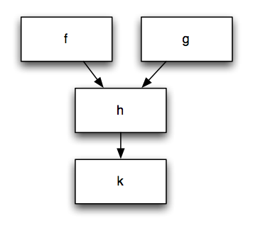
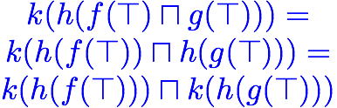
Benefit of Distributivity
Joins lose no information

Slide 43

Accuracy of Data Flow Analysis
Ideally, we would like to compute the meet over all paths (MOP) solution:
  Let f_{s} be the transfer function for statement s
  If p is a path {s₁, ..., s_{n}}, let f_{p} = f_{n};...;f₁
  Let path(s) be the set of paths from the entry to s
If a data flow problem is distributive, then solving the data flow equations in the standard way yields the MOP solution, i.e., MFP = MOP

Slide 44
What Problems are Distributive?
Analyses of how the program computes
  Live variables
  Available expressions
  Reaching definitions
  Very busy expressions
All Gen/Kill problems are distributive

Slide 45
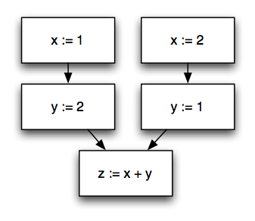
A Non-Distributive Example
Constant propagation
In general, analysis of what the program computes in not distributive

Slide 46
MOP vs MFP
Computing MFP is always safe: MFP ⊑ MOP
When distributive: MOP = MFP
When non-distributive: MOP may not be computable (decidable)
  e.g., MOP for constant propagation (see Lemma 2.31 of NNH)

Slide 47
Practical Implementation
Data flow facts = assertions that are true or false at a program point
Represent set of facts as bit vector
  Fact_{i} represented by bit i
  Intersection = bitwise and, union = bitwise or, etc
“Only” a constant factor speedup
  But very useful in practice

Slide 48
Basic Blocks
A basic block is a sequence of statements s.t.
  No statement except the last in a branch
  There are no branches to any statement in the block except the first
In practical data flow implementations,
  Compute Gen/Kill for each basic block
    Compose transfer functions
  Store only In/Out for each basic block
  Typical basic block ~5 statements

Slide 49
Order Matters
Assume forward data flow problem
  Let G = (V, E) be the CFG
  Let k be the height of the lattice
If G acyclic, visit in topological order
  Visit head before tail of edge
Running time O(|E|)
  No matter what size the lattice

Slide 50


Order Matters — Cycles
If G has cycles, visit in reverse postorder
  Order from depth-first search
Let Q = max # back edges on cycle-free path
  Nesting depth
  Back edge is from node to ancestor on DFS tree
Then if (sufficient, but not necessary)
  Running time is
    Note direction of req’t depends on top vs. bottom

Slide 51
Flow-Sensitivity
Data flow analysis is flow-sensitive
  The order of statements is taken into account
  I.e., we keep track of facts per program point
Alternative: Flow-insensitive analysis
  Analysis the same regardless of statement order
  Standard example: types
    /* x : int */ x := ... /* x : int */

Slide 52
Terminology Review
Must vs. May
  (Not always followed in literature)
Forwards vs. Backwards
Flow-sensitive vs. Flow-insensitive
Distributive vs. Non-distributive

Slide 53
Another Approach: Elimination
Recall in practice, one transfer function per basic block
Why not generalize this idea beyond a basic block?
  “Collapse” larger constructs into smaller ones, combining data flow equations
  Eventually program collapsed into a single node!
  “Expand out” back to original constructs, rebuilding information

Slide 54
Lattices of Functions
Let (P, ≤) be a lattice
Let M be the set of monotonic functions on P
Define f ≤_{f} g if for all x, f(x) ≤ g(x)
Define the function f ⊓ g as
  (f ⊓ g) (x) = f(x) ⊓ g(x)
Claim: (M, ≤_{f}) forms a lattice

Slide 55
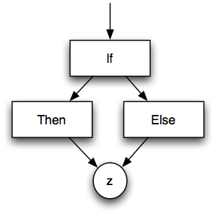
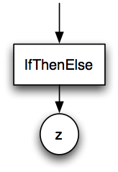
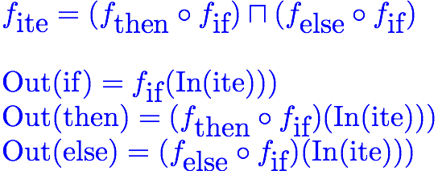
Elimination Methods: Conditionals

Slide 56
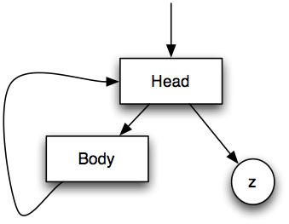
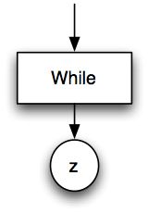
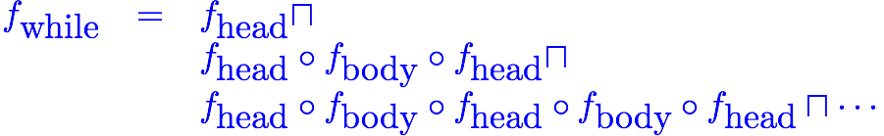
Elimination Methods: Loops

Slide 57
Elimination Methods: Loops (cont’d)
Let f ^{i} = f o f o ... o f (i times)
  f ⁰ = id
Let
Need to compute limit as j goes to infinity
  Does such a thing exist?
Observe: g(j+1) ≤ g(j)

Slide 58
Height of Function Lattice
Assume underlying lattice (P, ≤) has finite height
  What is height of lattice of monotonic functions?
  Claim: finite
Therefore, g(j) converges

Slide 59
Non-Reducible Flow Graphs
Elimination methods usually only applied to reducible flow graphs
  Ones that can be collapsed
  Standard constructs yield only reducible flow graphs
Unrestricted goto can yield non-reducible graphs

Slide 60
Comments
Can also do backwards elimination
  Not quite as nice (regions are usually single entry but often not single exit)
For bit-vector problems, elimination efficient
  Easy to compose functions, compute meet, etc.
Elimination originally seemed like it might be faster than iteration
  Not really the case

Slide 61
Data Flow Analysis and Functions
What happens at a function call?
  Lots of proposed solutions in data flow analysis literature
In practice, only analyze one procedure at a time
Consequences
  Call to function kills all data flow facts
  May be able to improve depending on language, e.g., function call may not affect locals

Slide 62
More Terminology
An analysis that models only a single function at a time is intraprocedural
An analysis that takes multiple functions into account is interprocedural
An analysis that takes the whole program into account is...guess?
Note: global analysis means “more than one basic block,” but still within a function

Slide 63
Data Flow Analysis and The Heap
Data Flow is good at analyzing local variables
  But what about values stored in the heap?
  Not modeled in traditional data flow
In practice: *x := e
  Assume all data flow facts killed (!)
  Or, assume write through x may affect any variable whose address has been taken
In general, hard to analyze pointers

Slide 64
Data Flow Analysis and Optimization
Moore’s Law: Hardware advances double computing power every 18 months.
Proebsting’s Law: Compiler advances double computing power every 18 years.

