Slide 1

Saubecity’s tech tips :)
The « horse trojan »
The type of virus that destroy
The type of app that easy to make

Slide 2


Server-side types:
File hosting
Sending malicious file
>_ $Bin/bash
$node index.js
>_ $Bin/bash
$node index.js
>_ $Bin/bash
$node index.js
>_ $Bin/bash
$node index.js
>_ $Bin/bash
$node index.js

Slide 3


Server-side types:
server-client remote
Open internet
>_ $Bin/bash
$node index.js
>_ $Bin/bash
$node index.js
>_ $Bin/bash
$node index.js
client
>_ $Bin/bash
$node index.js
>_ $Bin/bash
$node index.js

Slide 4
Client-side types:
Client as server
>_ $Bin/bash
$node index.js
>_ $Bin/bash
$node index.js
>_ $Bin/bash
$node index.js
>_ $Bin/bash
$node index.js
>_ $Bin/bash
$node index.js
>_ $Bin/bash
$node index.js
client
>_ $Bin/bash
$node index.js
>_ $Bin/bash
$node index.js

Slide 5



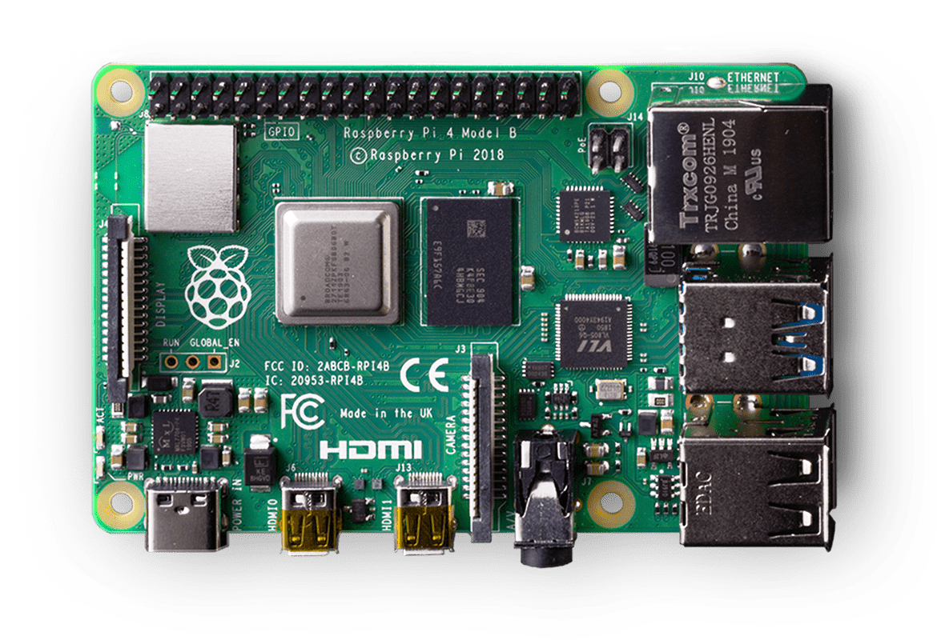
Client-side types:
Client as server
client
clients

Slide 6
Client-side types:
Client as open server
Open internet
>_ $Bin/bash
$node index.js
>_ $Bin/bash
$node index.js
>_ $Bin/bash
$node index.js
>_ $Bin/bash
$node index.js
>_ $Bin/bash
$node index.js
>_ $Bin/bash
$node index.js
client
>_ $Bin/bash
$node index.js
>_ $Bin/bash
$node index.js

Slide 7
Client-side types:
Client as open server
Open internet
clients
client

Slide 8
1rst (and worst) experiment
Vulnebarility
Yeah am dumb i have to use the command line!

Slide 9
2nd experiment
Intentional bugs

