Slide 1
Mid-Term Project REPORT
Bug and Fault prediction using ML
Saubhagya chopra
(209302107)
Arihant Sogani
(209302345) IT – VI Semester​

Slide 2
AGENDA
Introduction​
Related Work
Methodology Used
Results
​Timeline
Snapshots
References

Slide 3
Introduction
The vast area of software development and various applications makes it difficult for software developers as well as customers to monitor, maintain, and manage software applications. The size and complexity of today's software are growing by the day. As a result, software engineers must contend with flaws from the start of the development process. The classification of software faults is critical in real-time; otherwise, the effort and cost of discovering defects hidden in an application are increasing rapidly. This motivates the creation of automated fault prediction models for software fault prediction, which can forecast software defects. Hence the most prominent use case among researchers and the software community is software fault prediction using machine learning techniques.
We used three PROMISE Software Engineering Repository data sets (JM1, CM1, and PC1) and 22 different attributes.We preprocessed our selected data in order to allocate correlated columns, and we also investigated data imbalance issues using various computational techniques. As a result, this provides a comparative analysis for software fault prediction within a software.

Slide 4
RELATED WORK
2016 : Hotzkow et al described that the application can automatically learning user expectations from the semantic contexts over multiple applications. Many researchers are enthusiastic about their works in the discipline of automated fault tolerance inside a software system.
2017: Qiao Yu et al developed a new feature subset selection and feature classifying techniques to investigate the effectiveness of feature selection for cross-project defect prediction (CPDP). Their experiment shows that the CPDP feature selection approaches can improve the performance of software defect analysis.
2019: Zhou Xu et al introduced a defect prediction framework which is called KPWE. And it combines two approaches, i.e. Kernel Principal Component Analysis (KPCA) and Weighted Extreme Learning Machine (WELM). The contribution of this study is used to 44 software projects data and that indicates KPWE is an excellent technique to the baseline methods in utmost cases.

Slide 5
Methodology used
Data Collection:
We used three open source publicly available data sets from the PROMISE Software Engineering Database in this experiment.
Tim Menzies used these datasets in their research paper.
Jureczko created a software fault prediction model to predict software defects using machine learning algorithms in another study. In our research, we used 22 attributes to construct our project. The table below displays 22 attributes from software defect datasets, including 21 independent metrics and one outcome information. That is, which is faulty and which is not.

Slide 6
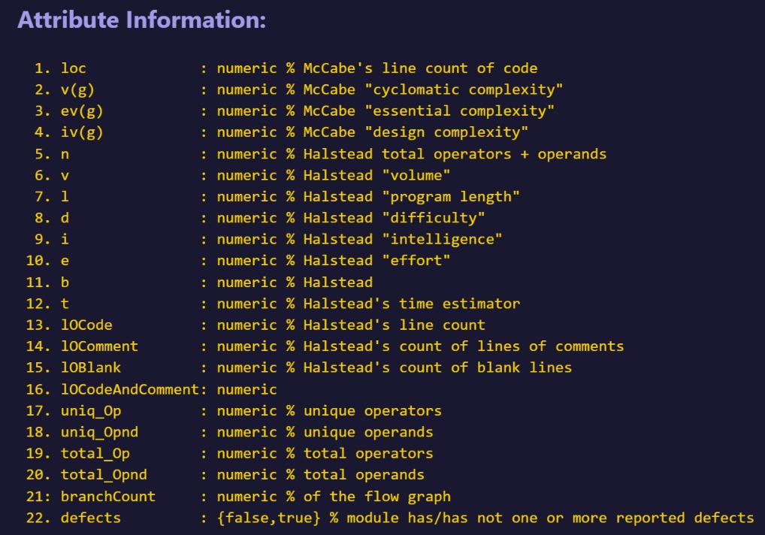
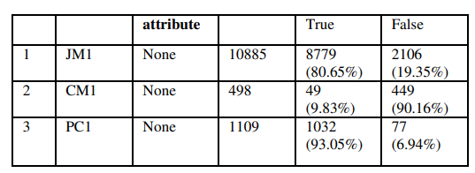

Slide 7
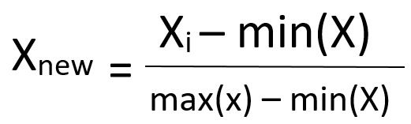
Feature Extraction:
In this method, we have used the min max normalization algorithm to transform raw data into numerical features that can be processed while preserving the information in the original data sets.
Min max scaling is rescaling the features into the range of [0,1]

Slide 8
Model Training:
To train the models on the selected features, machine learning algorithms such as Decision Tree and KNN is used.
A decision tree is a type of supervised machine learning used to categorize or make predictions based on how a previous set of questions were answered.
The KNN is a supervised learning classifier, which uses proximity to make classifications or predictions about the grouping of an individual data point.

Slide 9
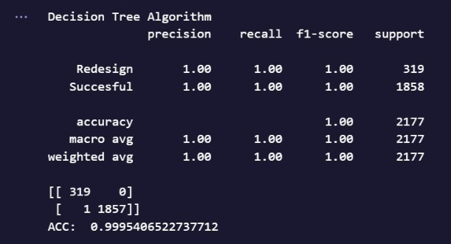
Model Evaluation:
The trained models' performance will be assessed using metrics such as accuracy, precision, and recall.
Dataset JM 1

Slide 10
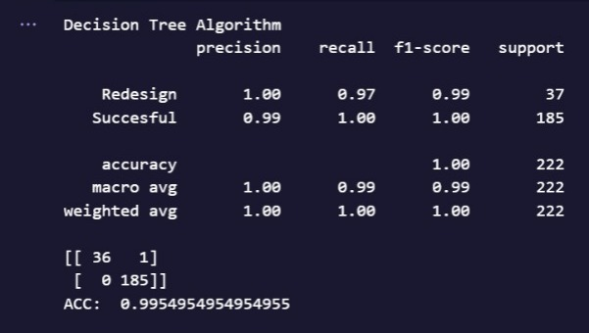
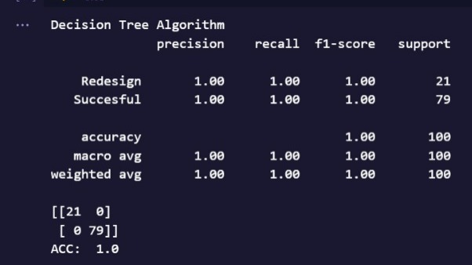
Dataset PC 1
Dataset CM 1

Slide 11
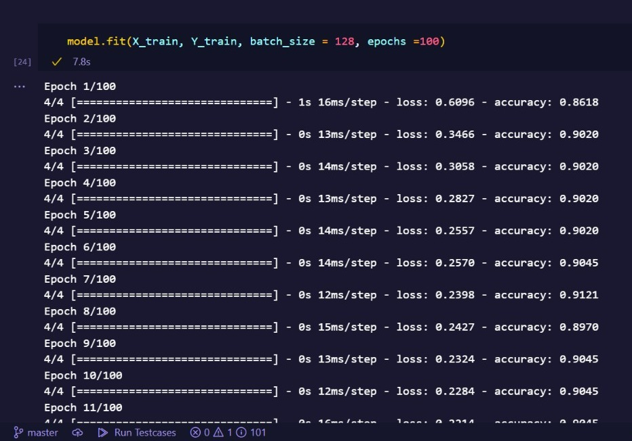
Results
In our experiment, we used a 10-fold cross-validation technique to assess the performance of different classification techniques. We used various data preprocessing methods to determine the parameters for the software defect model, which improved the classification model's accuracy and consistency.
Following are the results of decision tree and Knn for all the three datasets used .
Dataset CM 1

Slide 12
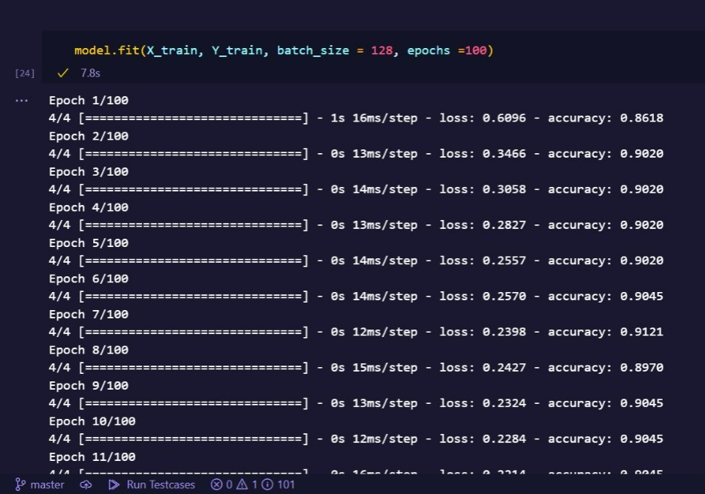
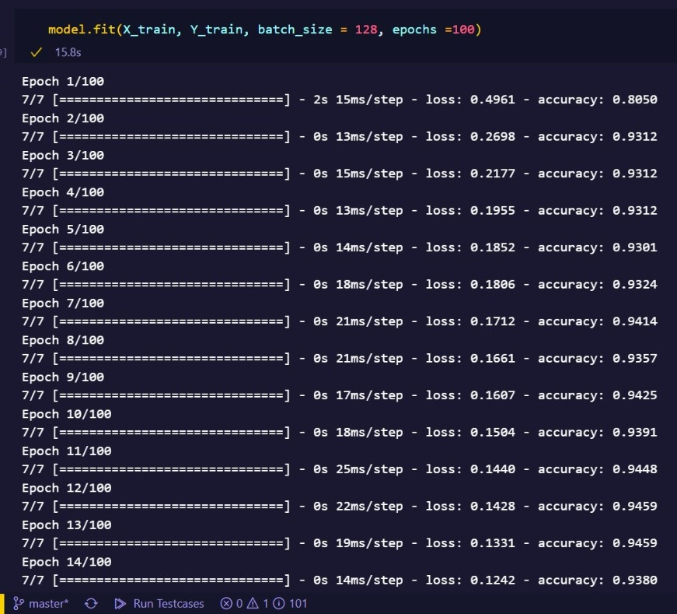
Dataset JM 1
Dataset PC 1

Slide 13





TECHNOLOGY USED
Python
Jupyter notebook
HTML/CSS/JS
Google Colab
FLASK
Used for solving ML and DL problems
Used for creating and sharing computational documents
Used to create web elements.
Jupyter notebook environment that runs entirely in cloud
Used to deploy model locally

Slide 14
TIMELINE
1st – 15th FEB
16th – 28th FEB
1ST – 2o^{th} MARCH
21ST – 10th APR
Data Collection
Feature Extraction
Model Training
Model Evaluation

Slide 15
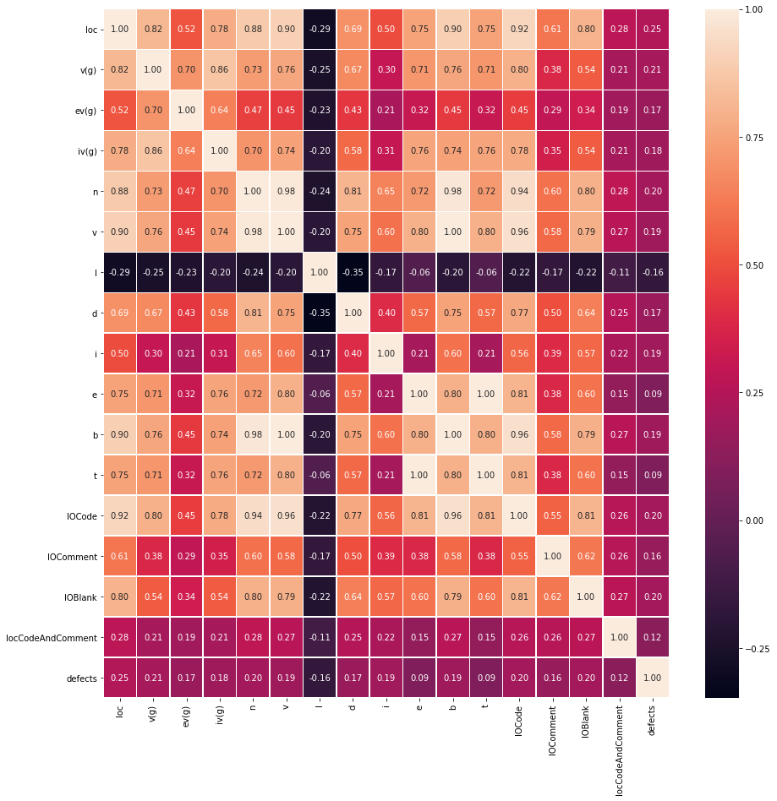
SNAPSHOTS
Heat Map of DATASET CM1

Slide 16
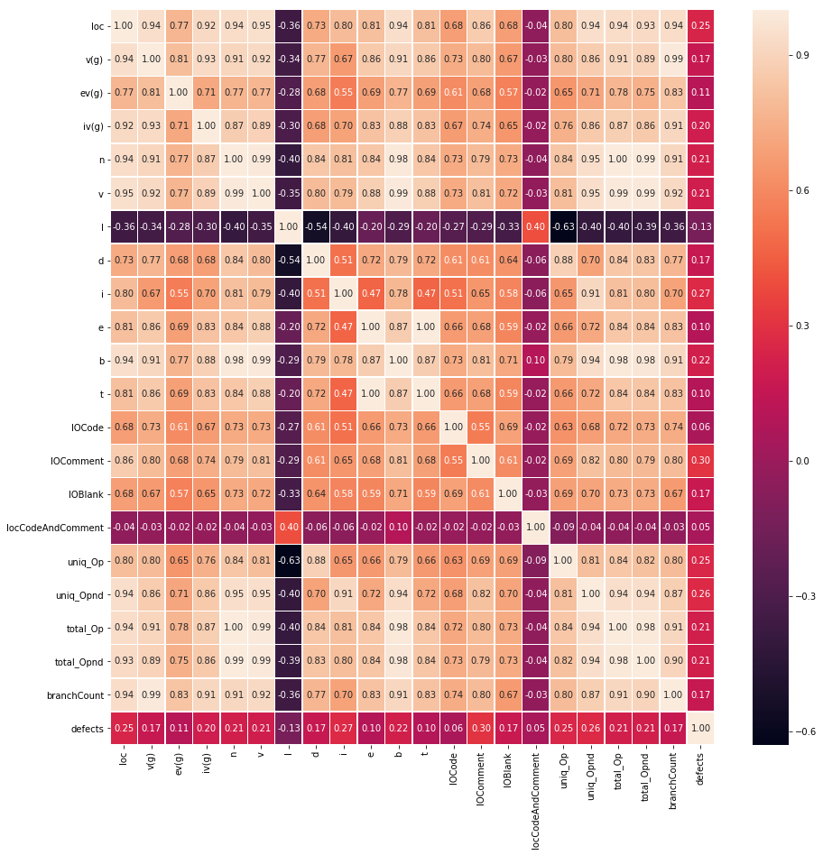
Heat Map of DATASET PC1

Slide 17
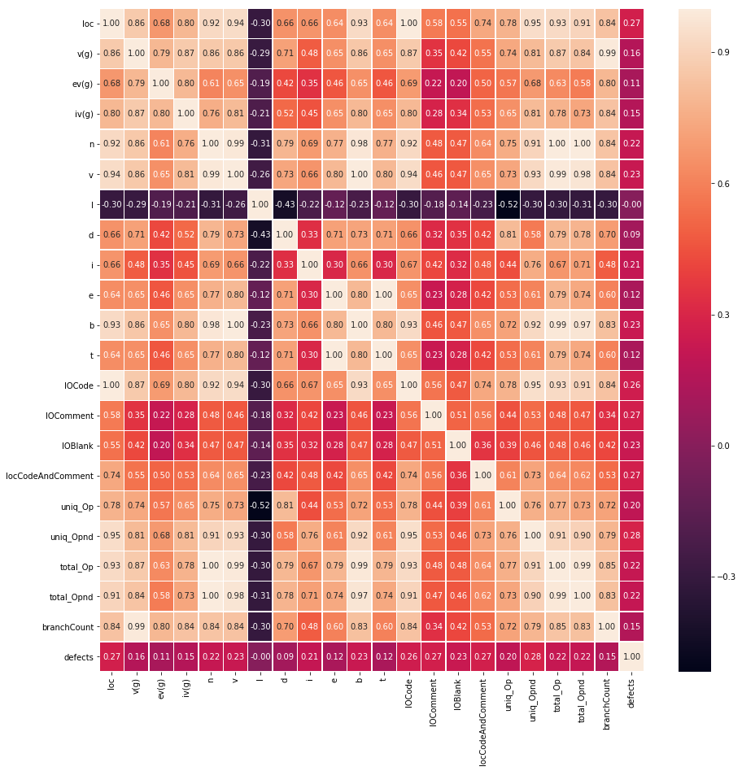

Slide 18
References
1)H. B. Bolat, G. T. Temur, and IGI Global, Agile approaches for successfully managing and executing projects in the fourth industrial revolution.
2) R. Malhotra, “A systematic review of machine learning techniques for software fault prediction,” Appl. Soft Comput., vol. 27, pp. 504–518, Feb. 2015.
3) H. Tanwar and M. Kakkar, “A Review of Software Defect Prediction Models,” Springer, Singapore, 2019, pp. 89–97.

Slide 19
THANK YOU

