Slide 1
Capstone Project - 1
Team Space: Hotel Booking Analysis
Team Members:
Saubhagya Verma
Harsh Mudgil
Tawheed Yousuf
Sai Krishna Reddy Palle

Slide 2

The in’s and out’s of a Hotel Booking Business
Problem Statement
Data Summary
Hypothesis and Insights
Challenges
Conclusion

Slide 3
Problem Statement
We have been put into the shoes of a marketing team for a new hotel startup that wants to know about the hotel industry.
We have been provided a dataset of the hotel industry of the region in which our startup aims to begin its initial operations.
Our primary goal is to understand the market of this particular region and try to use our data analysis techniques to draw out key features of the market.
Our secondary goal is to draw out actionable insights from our analysis and give conclusions about key aspects of the market such as cancellation rate, distribution channels, and alike.

Slide 4
Data Summary
The data set contains booking information for a city hotel and a resort hotel, and includes information such as when the booking was made, length of stay, the number of adults, children, and/or babies, and the number of available parking spaces, among other things.
Some important columns: distribution_channel, arrival_date_month, hotel, Booking_status, lead_time, is_reapeated_guest, reserved_room_type, assigned_room_type, country, meal, is_cancelled, days_in_waiting_list

Slide 5
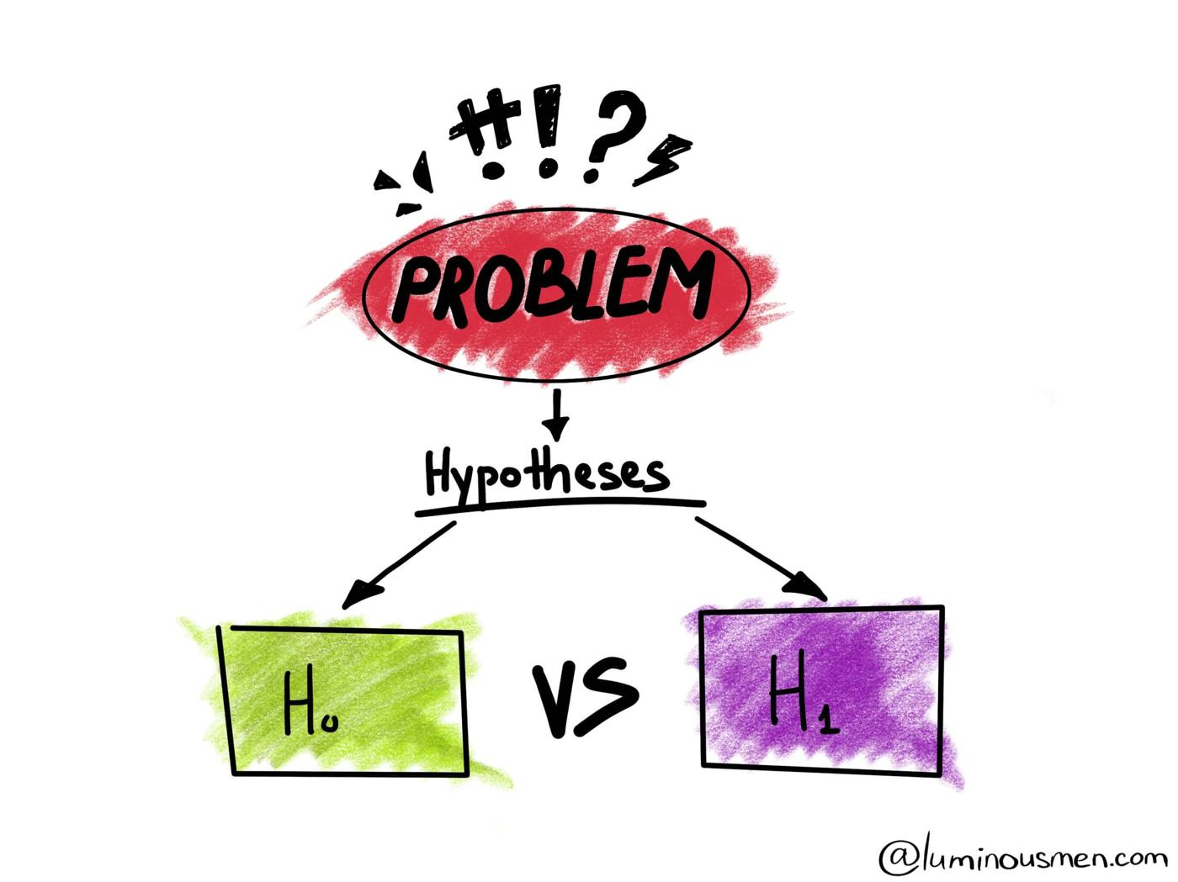
Hypotheses and Insights

Slide 6

Hypothesis 1: Booking traffic remains constant across all months

Slide 7
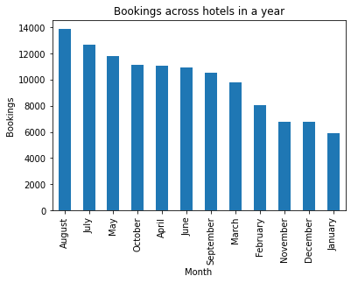
Busiest Months Across the Year.
Month, most preferred by customers for booking
Insights
Booking traffic varies unevenly across months.
Booking traffic doesn’t remain constant across months and so the hypothesis is not true.

Slide 8

Hypothesis 2: Booking cancellation across countries remains constant.

Slide 9
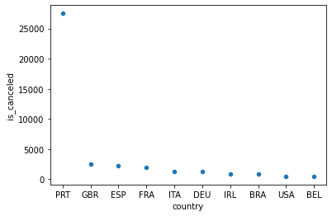
Which country’s customers make most frequent cancellations
Insights
Booking cancellations for most countries remain largely constant. But it is unusually higher for Portugal
Hypothesis is, thus, partially true.

Slide 10

Hypothesis 3: Number of waiting days remain constant across all market segment

Slide 11
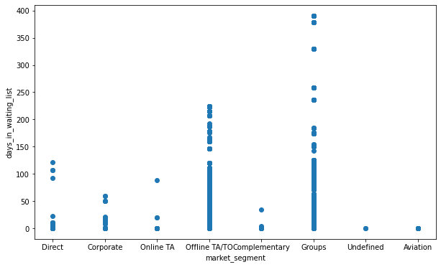
Market Segment with the least number of waiting days
Insights
Number of waiting days vastly differs for different market segment
Hypothesis is, thus, not true

Slide 12

Hypothesis 4: Demand is more in city hotel & so its median price should also be high, following the demand & supply rule

Slide 13
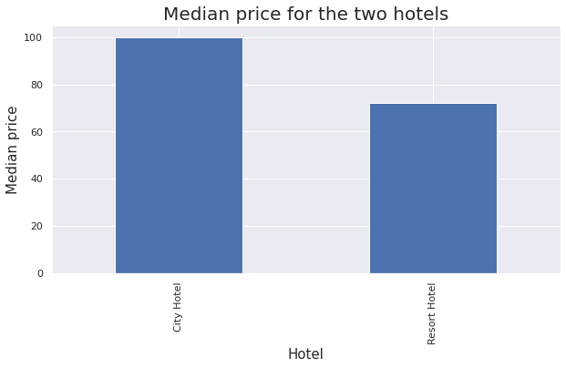
Median Price of two hotels types
Insights
Our Hypothesis has stood its ground the median price asked by City Hotel is in general more than the median price asked by resort Hotel

Slide 14

Hypothesis 5: People in general prefer to eat outside the hotels they are staying in.

Slide 15
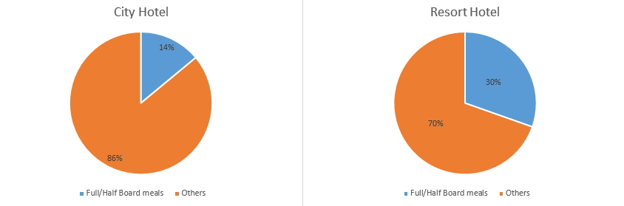
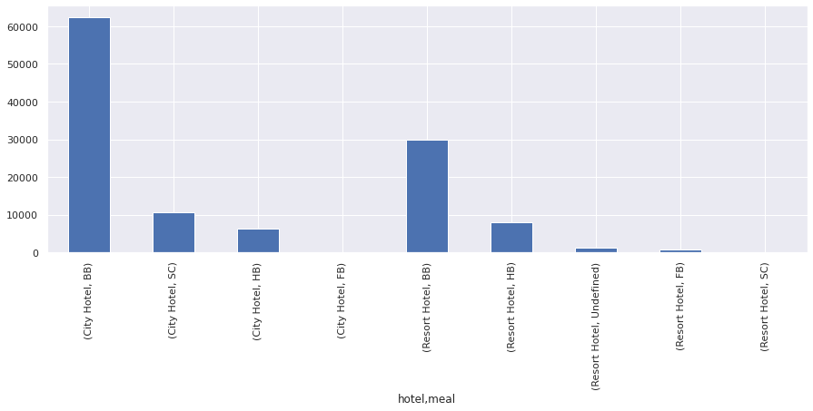
People who actually chose to eat at the hotels
Meal packages in two hotels

Slide 16
Insights
In any of the hotels people generally opt for only Bread and Breakfast instead of a full-fledged meal for entire day. So our hypothesis has proven right.
This information is particularly useful for a hotel manager or whosoever is in charge of the hotel’s mess section.

Slide 17

Hypothesis 6: Customers, travelling alone, mostly book A-B category rooms. The same will be the case if there are only children customers

Slide 18
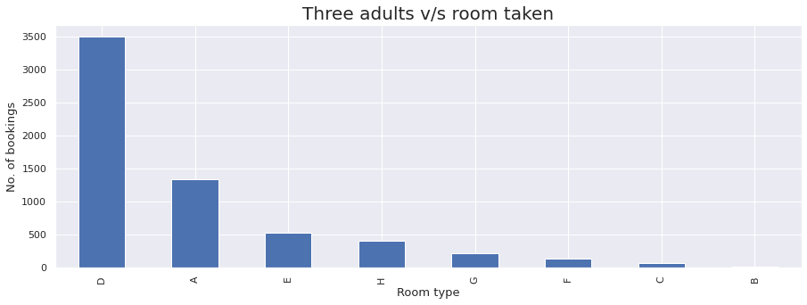
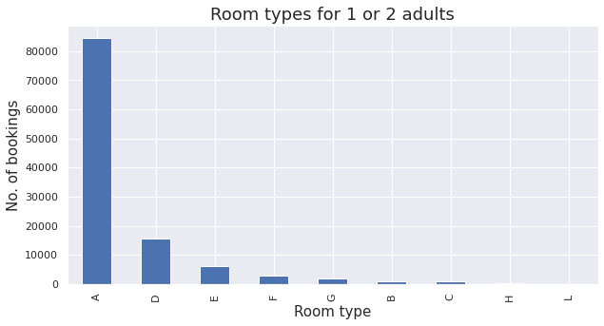
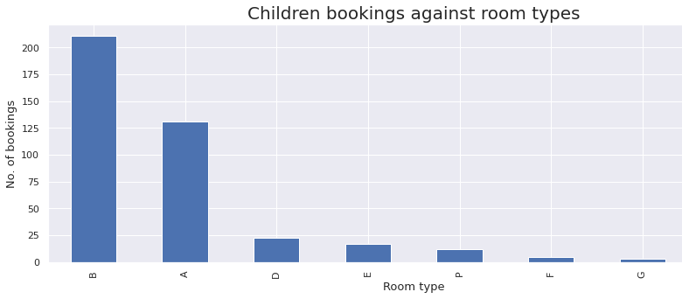
Insights
Customers who are travelling alone or are children only have indeed chosen Type-A or Type-B rooms mostly, hence our hypothesis is correct.

Slide 19

Some questions a marketing manager would ask

Slide 20
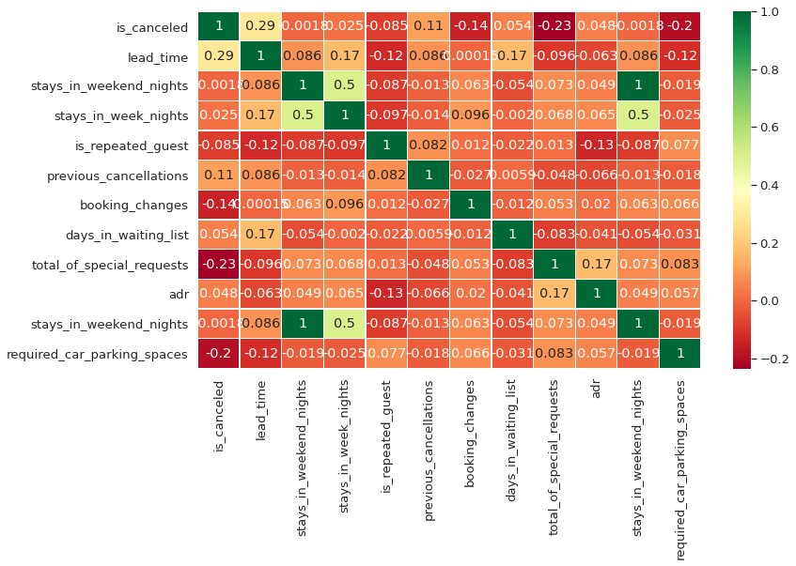
Quest. 1: What is the level of correlation b/w "is_canceled" variable & other variables?
Insights
lead_time is the only variable that has some significant level of positive correlation with our target variable is_cancelled.
Most of the variables have an insignificant level of correlation with the is_cancelled.
Total_of_special_requests and required_car_parking_spaces have a significant level of negative correlation with is_cancelled variable.

Slide 21
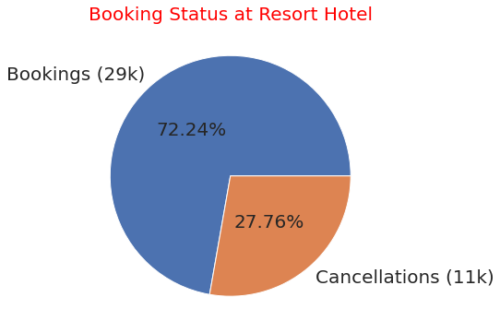
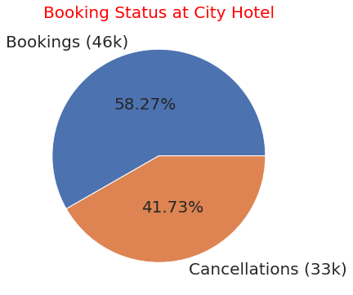
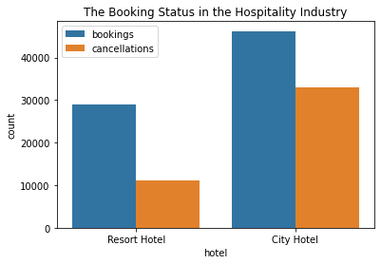
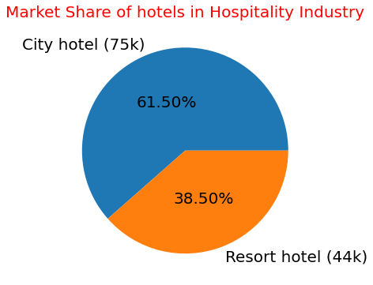
Quest. 2: What are the percentage of cancellations in hotels? Which Hotel has the highest percentage of cancellations?
Insights
The Booking percentage of City Hotel (66.45%) is almost twice the percentage of bookings in Resort Hotel(33.55%).
The Cancellation percentage of City Hotel is quite large(41.73%) compared to the Resort Hotel Cancellations(27.76%), approximately half the bookings of City Hotel are cancelled.

Slide 22
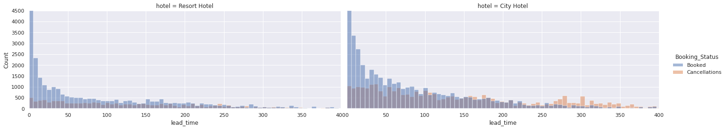
Quest. 3: Does Early Bookings with high lead time results in more cancellations by customers?
Insights
Data Manipulation
Here the name of the column “is_canceled” is changed to “Booking_Status” & its row value 0 is replaced with “Booked” & row value 1 with “cancellations”.
Used seaborn displot to do the graphical analysis for the question.
As the lead time increases, the proportion of cancellations with respect to the total bookings becomes higher.
It is visible that for both the hotels when the lead time is above 100 days, the chances of the bookings getting cancelled is more than 50%.

Slide 23

Hypothesis 7: The cancellation rate must be higher in case the customer didn't get the room for which they reserved.

Slide 24
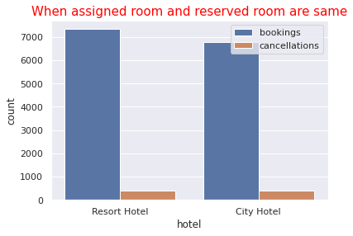
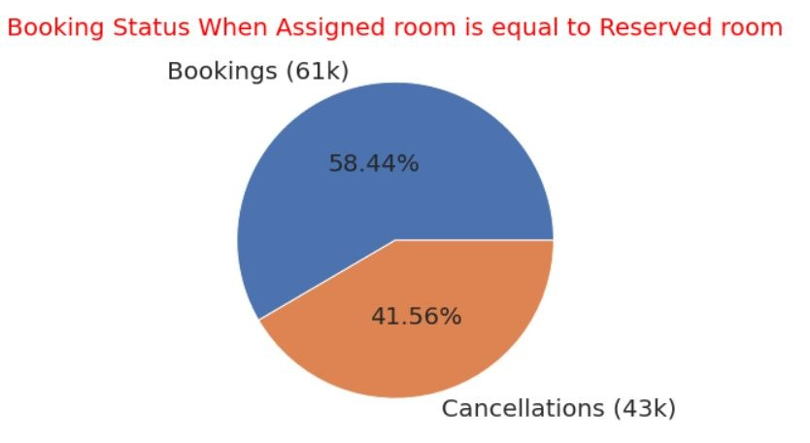
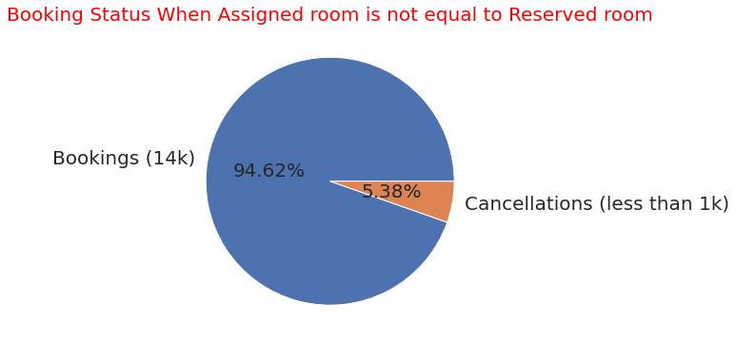
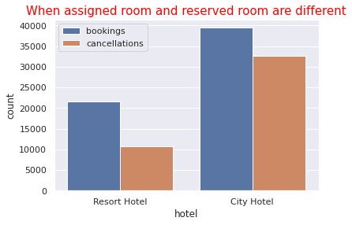
Booking status vs Assigned Room
Insights
Thus our hypothesis is wrong, cancellation rates do not depend upon whether the customer could get the room that he reserved for while booking.

Slide 25

Hypothesis 8: There is more cancellation among new customers as compared to repeated customers.

Slide 26
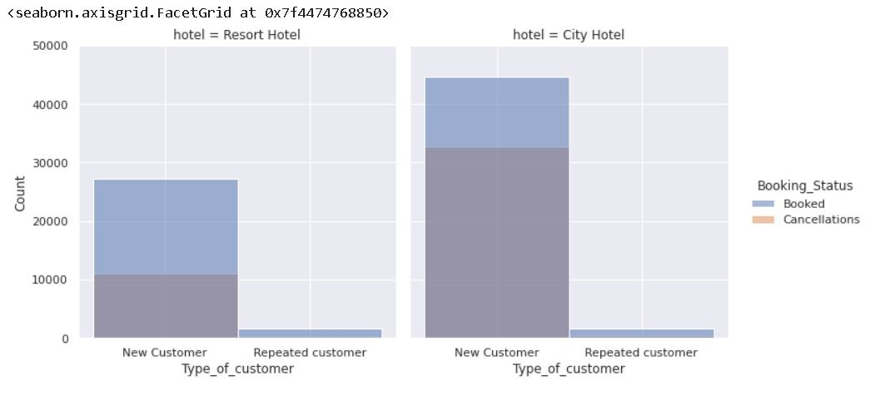
Booking status vs Customer Type
Our hypothesis was correct, there is large number of cancellations from new customers as compared to repeated customers.
Data Manipulation
For checking this assumption, I have renamed the is_repeated_guest column of the dataset into Type_of_customer and replaced its row value 0 with “New Customer” and row value 1 with “Repeated Customer”.
Insights

Slide 27

Hypothesis 9: Average monthly ADR for ‘Direct’ distribution channel is the highest across all months, since other channels rely on discounted pricing.

Slide 28
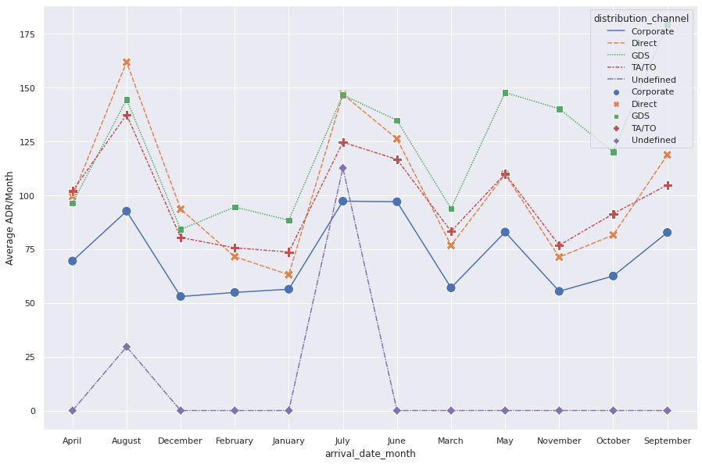
Variations of average monthly ADR
Insights
AM-ADR generated from ‘Direct’ channel doesn’t remain the highest across all months.
The hypothesis is only partially true. ‘Direct’, ‘GDS’ and ‘TA/TO’ channels deliver highest AM-ADR across all the months.

Slide 29

Hypothesis 10: ‘Corporate’ distribution channel should deliver most number of repeated guests per month, since business related affairs are recurring

Slide 30
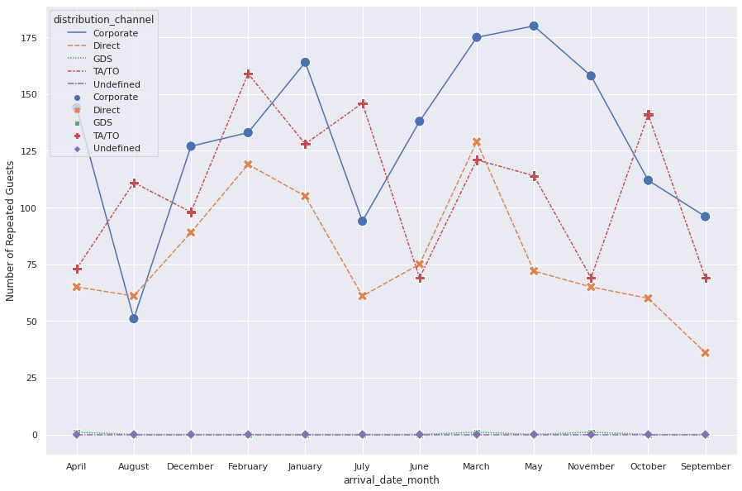
Variations in repeated Guests per month
Insights
Number of repeated guests, remains highest for ‘Corporate’ distribution channel for most of the months.
For the months of August, February, July and October the number of repeated guests delivered by ‘TA/TO’ channel is highest and exceeds the number of repeated guests delivered by ‘Corporate’ channel

Slide 31

Hypothesis 11: Cancellation % for ‘TA/TO’ channel should be the highest across months, since agents & operators sell holiday packages, which are subject to change as per people’s conveniences.

Slide 32
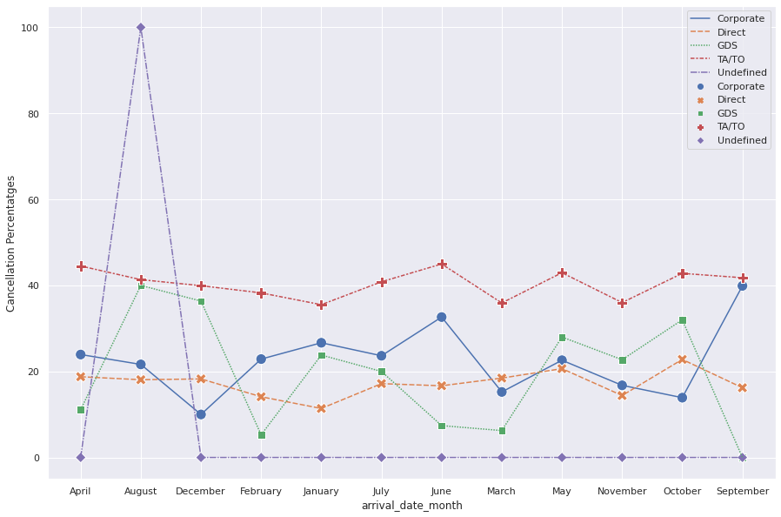
Variations in cancellation requests per month
Insights
Cancellation percentage for guests delivered by ‘TA/TO’ channel remains constantly the highest across all months.
The hypothesis remains largely true, except for the month of August, which is an anomaly in a largely true trend.

Slide 33
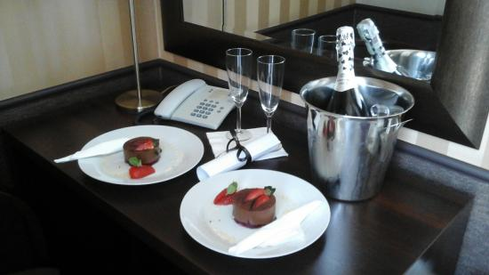
Hypothesis 12: ‘TA/TO’ channel should make the highest special requests, across all months, since agents and operators sell holiday packages which can change as per people’s conveniences.

Slide 34
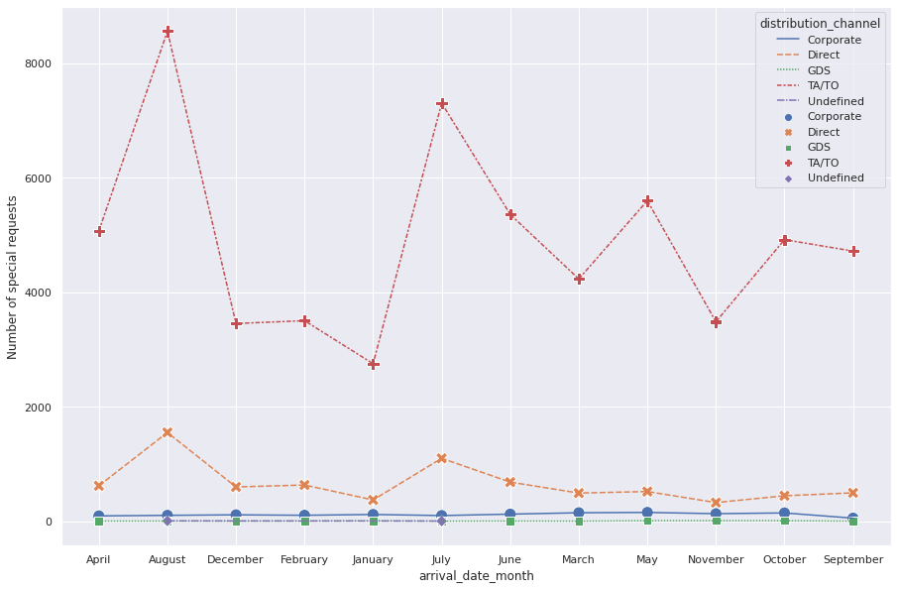
Variations in Special Requests per month
Insights
Guests, delivered through agents and operators, consistently make the highest special requests across all months.
Guests, delivered through ‘Direct’ channel, consistently make the second-highest number of special requests across all months

Slide 35
Actionable Insights Based on Multivariate Analysis of Distribution Channels
‘Direct’, ‘GDS’ and ‘TA/TO’ channels deliver highest AM-ADR across months. More marketing budget could be allocated to these channels to increase AM-ADR.
‘Corporate’ channel delivers most repeated guests. New Letters, updates & promotional material should be sent to corporate clients, to increase the number of repeated guests.
Cancellation % is consistently high for ‘TA/TO’ channel across months. A deposit should be taken from ‘TA/TO’ channel guests to cut down losses & operational inefficiencies.
‘TA/TO’ channel guests make the most special requests across all months, followed by guests delivered by ‘Direct’ channel. Special requests add to the revenue. Customers from these channels should be offered to avail special requests by the staff more frequently to increase the special requests that are made

Slide 36
Challenges
Selecting an appropriate representational plot for the available data was challenging.
Initially we worked on a lot of variables and dealing with them all at once was getting a little out of hand.
Formulating the hypothesis to test our assumptions was challenging.
Deadlines felt a little strained. But it all worked out for the best.

Slide 37
Conclusions
Booking traffic varies unevenly across months.
People in general prefer to eat outside the hotels they are staying in.
Cancellation rates do not depend upon whether the customer could get the room that he reserved for while booking.
Cancellation percentages are consistently high for ‘TA/TO’ distribution channel across all months. A deposit should be taken from guests delivered by ‘TA/TO’ distribution channel to cut down losses and operational inefficiencies

Slide 38
QnA

