Slide 1
Capstone Project - 2
Team 4 : Retail Sales Prediction
Team Members
Yagnik Pandya
Rohan Datta Purkayastha
Monika Shinde
Pranav Thimmaiah
Saubhagya Verma

Slide 2
Content
g
Problem Statement
Data Summary
Analysis of Data
Data Preprocessing
Feature Engineering
Model Selection
Stacking

Slide 3
Problem Statement
Rossmann operates over 3000 drug stores in 7 European countries.
Rossmann Managers are tasked with predicting their sales for 6 weeks in advance.
The sales are influenced by many parameters and the task is to predict the sales based on the parameters.

Slide 4
Data Summary
The dataset spans over three years - 2013, 2014 and 2015.
Below are few important features:
Customer : - The Number of customers on a given day in a store.
State Holiday :- Indicates a state holiday.
Store Type : Differentiate between 4 different store models.
Assortment : Describes an assortment level i.e a : basic, b : extra and c : extended.
Competition Distance : Distance in meters to the nearest competition store.

Slide 5
Data Summary(Contd.)
7. CompetitionOpenSince[Year/Month] :- Gives the approximate year and month of the time the nearest competitor is opened.
8. Promo :- Indicates whether a store is running a promo on that day.
9. Promo2 :- Indicates whether a store is continuing promotion.
10. Promo2Since[Year/Week] :- Gives the approximate year and calendar week of the time when the store started participating in Promo2.
11. PromoInterval :- Describes an interval or name of months when the store runs Promo2.

Slide 6
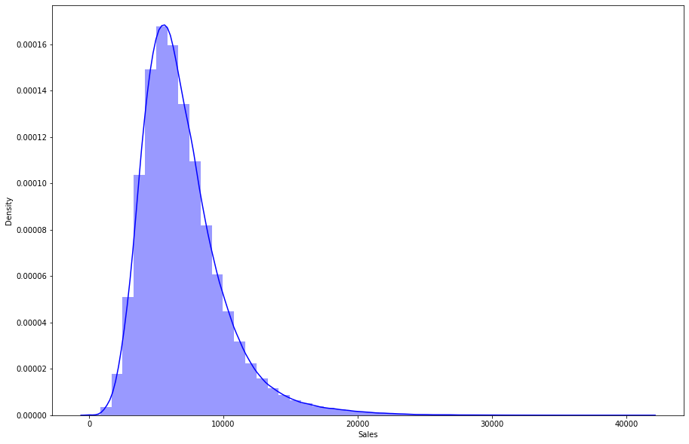
Sales - Distribution
The Sales distribution lived up to the expectation with no irregularities.
It seems to be a perfect gaussian distribution with small positive skewness.

Slide 7
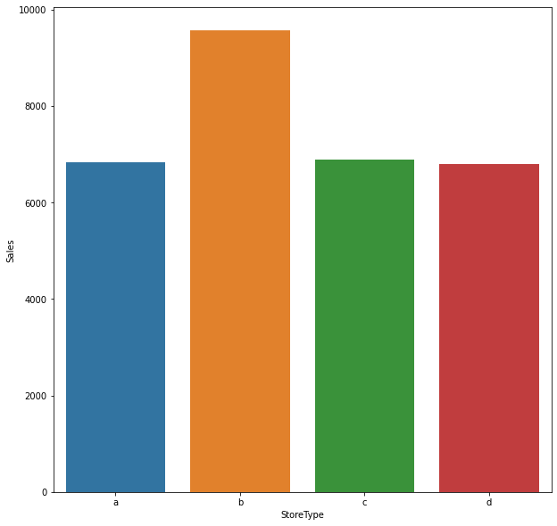
Sales VS Store Type

Slide 8
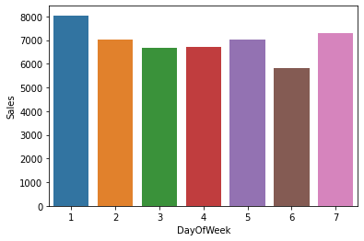
Weekly Sales Trend
fd

Slide 9
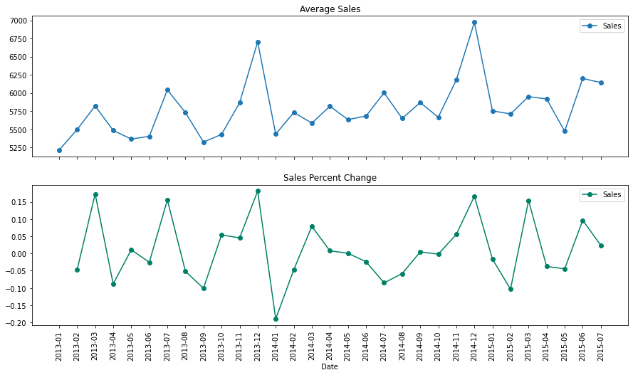
Sales Trend over the years

Slide 10
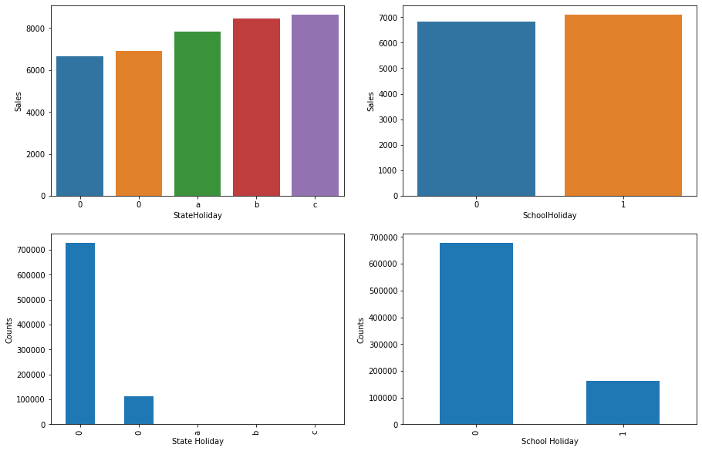
Holiday Sales

Slide 11
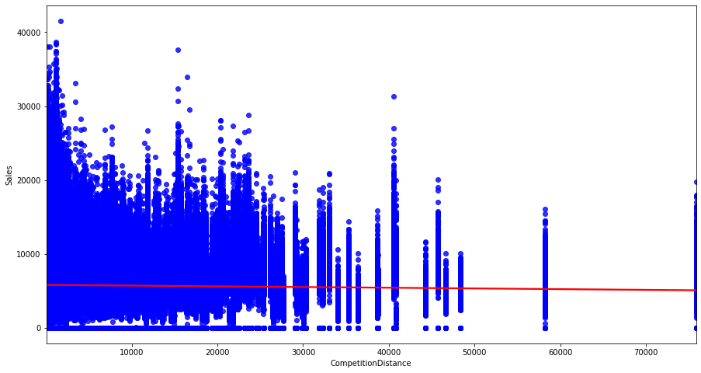
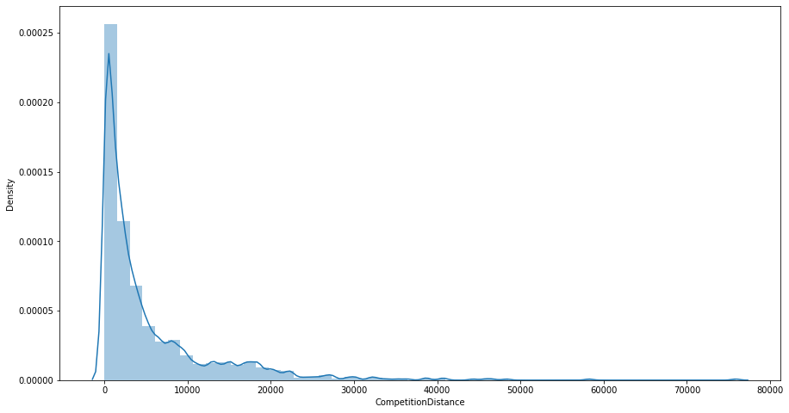
How Competition affects Sales
Sales VS Competition Distance
Competition Distance Distribution

Slide 12
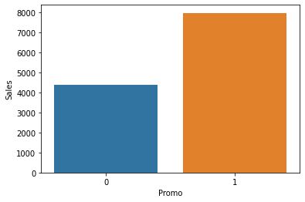
Sales and Promotions
Sales are increasing because of Promotion. Let’s just go ahead with Promotion

Slide 13
EDA Conclusion
There are very few stores open on ‘State Holiday’ and they make a good profit on those days then any average day.
On School Holidays there is no large difference in sale. So promos running on School holidays can be reduced.
Sales for assortment type a and c seems to be less as compared to assortment type b.
At the start of month the sales increases. People might be planning to shop for the entire month in its beginning.

Slide 14
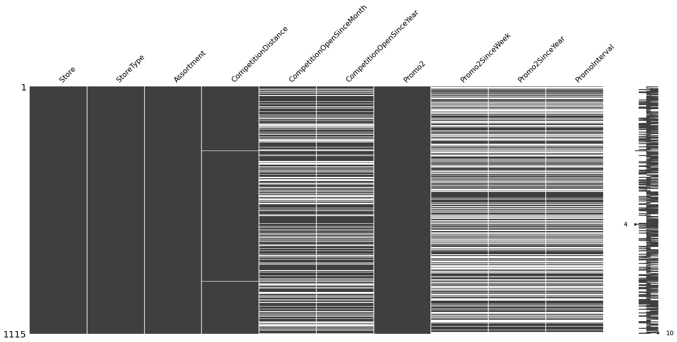
How Our Null Values Look...

Slide 15
Data Preprocessing
Columns related to promotions had a lot of null values, which we figured out are not actually null values but are these null values signifies there is no continuation in Promotion i.e Promo2 is 0. So simply filled it with 0.
Null values in ‘CompetitionDistance’ is imputed with its mean based on the type of stores.
Null values in ‘CompetitonOpenSinceMonth’ and ‘CompetitionOpenSinceYear’ are filled with backfill and forward fill.

Slide 16
Feature Engineering
Extraction of Year, Month and Date from the Date column.
One hot encoding for Stateholiday, Storetype, Assortment and Promo Interval.
Creating Total Competition month as a new feature by using ‘CompetitionOpenSinceYear’ and ‘CompetitionOpenSinceMonth’.
Creating Total Promotion Year and Total Promotion Week as new features by using ‘Promo2SinceYear’ and ‘Promo2SinceWeek’.
Creating ‘IsPromoMonth’ as a new feature to account for whether a month is promotional or not using ‘PromoInterval’ feature.
Creating ‘Average Sales’ and ‘Average Customers’ columns and dropping the ‘Customers’ column.

Slide 17
Models Used So Far For Prediction
Linear Regression (Baseline Model)
Decision Tree Regressor
Random Forest Regressor
Light GBM

Slide 18
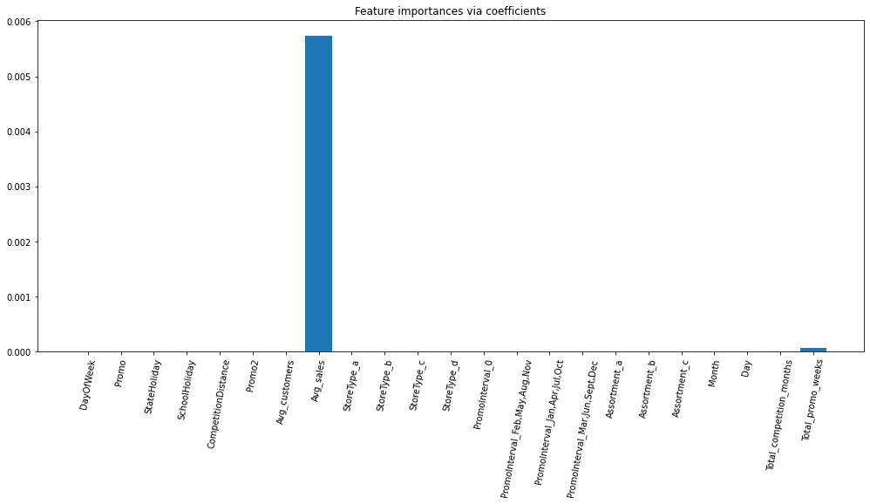
Feature Importance From Linear Regression

Slide 19
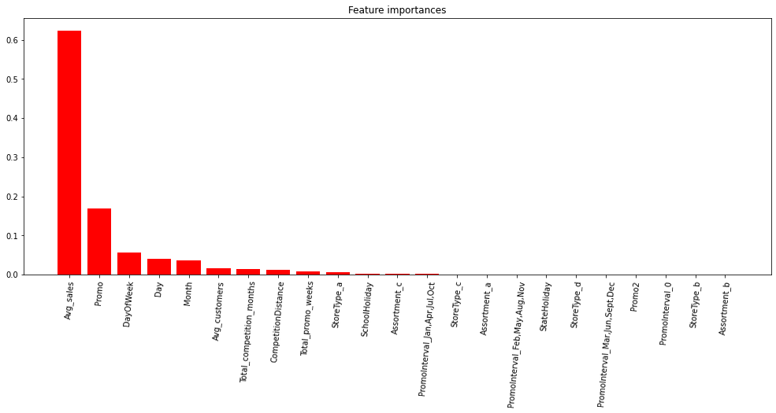
Feature Importance From Decision Tree

Slide 20
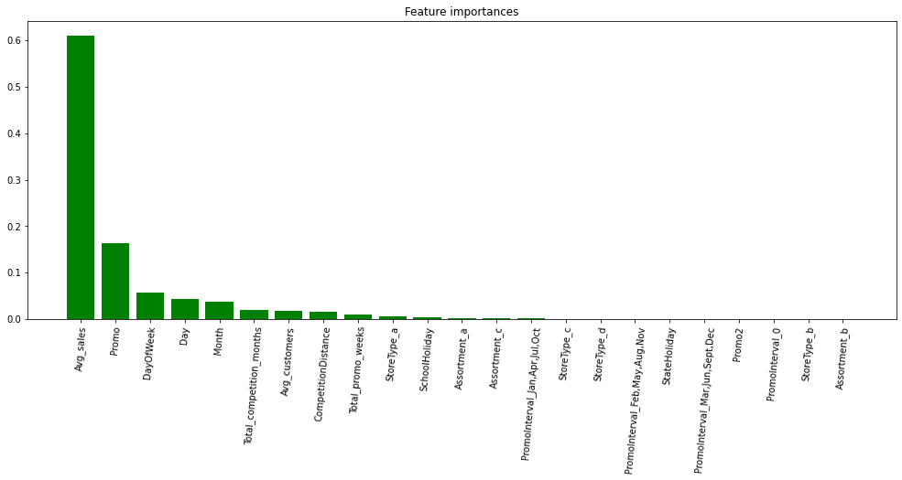
Feature Importance From Random Forest

Slide 21
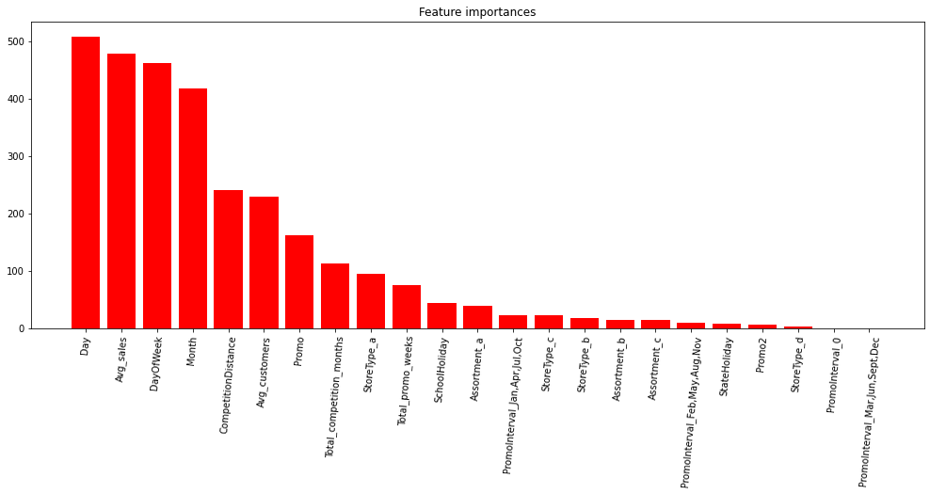
Feature Importance From Light GBM

Slide 22
Let’s Stack...
Even though Random forest gave a 92% R2-Score, but was overfitting on the train dataset.
Decision Tree Regressor, Random Forest Regressor and Light GBM participated in stacking to overcome the issue of overfitting.
XGBoost Regressor has been used as meta learning algorithm.
Finally overfitting was resolved with stacking.

Slide 23
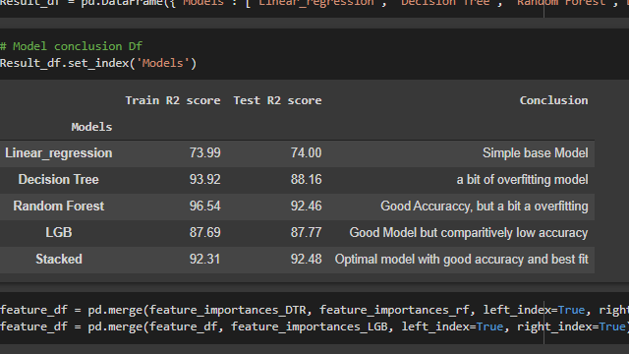
Evaluation of Models

Slide 24
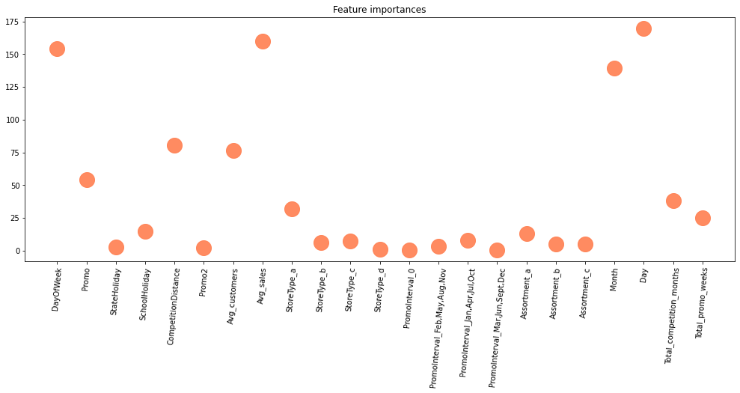
Conclusion for features

Slide 25
Challenges
Handling large amount of sales data (10,17,210 observations on 13 variable).
Prediction of sales of individual stores(out of 1115) and most of stores have different pattern of sales.

Slide 26
Conclusion
Our final optimal model would be the stack model as it resolves the issue of overfitting and gives us an R2- score of 92%.
Moreover it shows lowest RMSE value than other models.
Applied only three model for stacking. So there are scope of applying more algorithms.

Slide 27
Q & A

