Slide 1

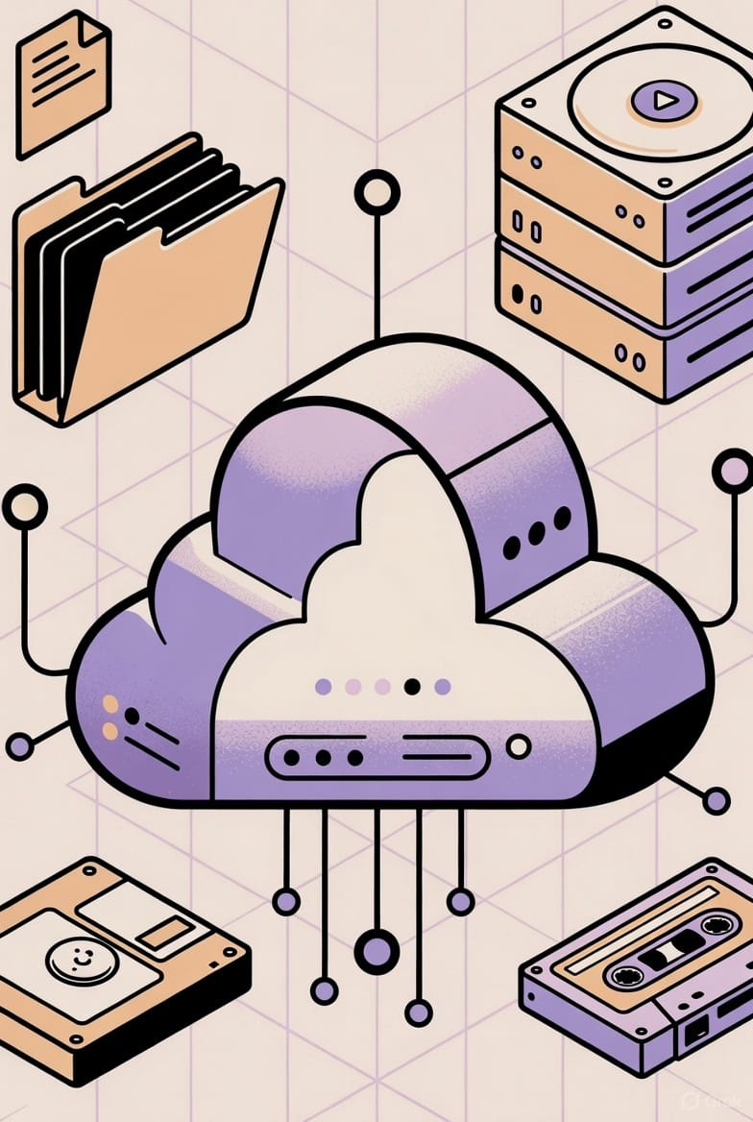

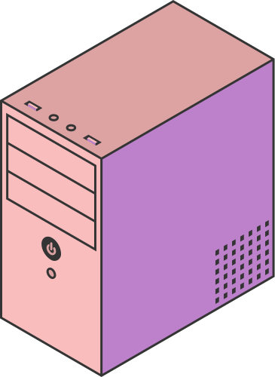
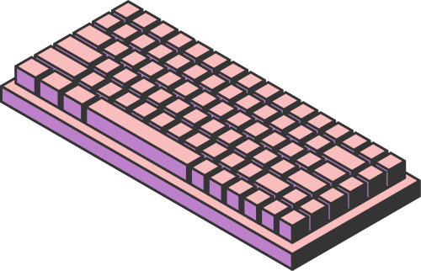
CLOUD COMPUTING
IN MODERN DATA SCIENCE
Page 01

Slide 2


INTRODUCTION
DATA SCIENCE = EXTRACTING INSIGHTS FROM DATA USING STATISTICS, MACHINE LEARNING & ANALYTICS
HUGE GROWTH OF DATA FROM SOCIAL MEDIA, IOT, E-COMMERCE, BANKING, HEALTHCARE, ETC.
TRADITIONAL COMPUTERS CANNOT STORE OR PROCESS MASSIVE DATASETS
➡️ CLOUD COMPUTING PROVIDES SCALABLE STORAGE & COMPUTING POWER
Page 02

Slide 3
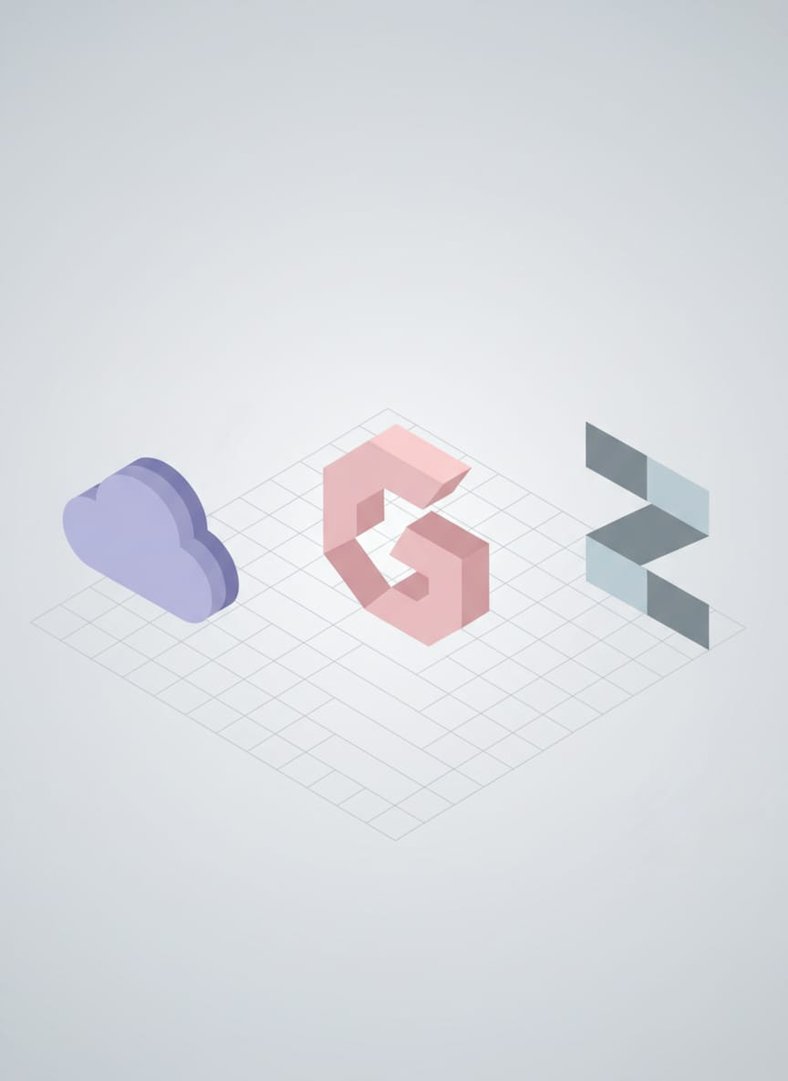

WHAT IS CLOUD COMPUTING
On-demand delivery of computing resources over the internet
Examples of cloud platforms:
AWS, Google Cloud, Microsoft Azure
Pay only for what you use (like electricity)
REAL LIFE EXAMPLE
Watching movies on Netflix without downloading – similar to using cloud services without needing local hardware.
Page 03

Slide 4

CONNECTION BETWEEN CLOUD & DATA SCIENCE
Data Scientists need:
Massive storage for big datasets
Powerful servers to train AI & ML models
Tools for collaboration and deployment
➡️ Cloud provides all these instantly without buying machines.
Page 04

Slide 5

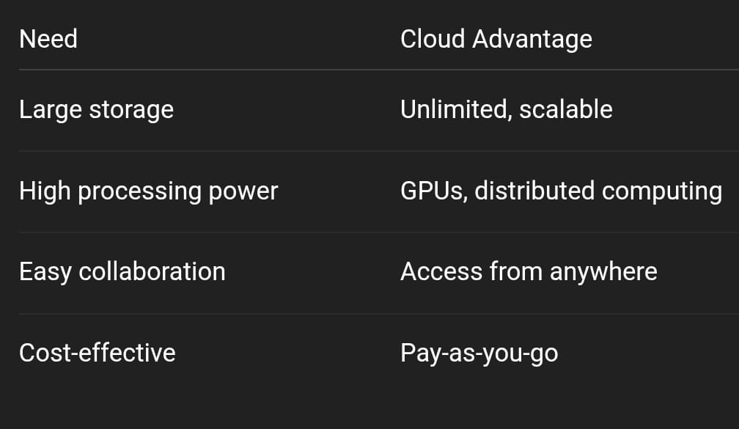
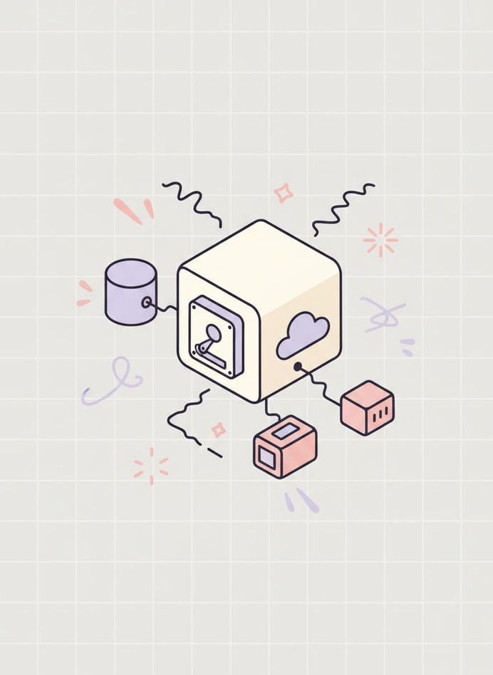
WHY CLOUD IS IMPORTANT FOR DATA SCIENCE
EXAMPLE: A SMALL STARTUP ANALYZING 5 TB OF CUSTOMER DATA CAN RENT CLOUD SERVERS INSTEAD OF BUYING EXPENSIVE HARDWARE.
Page 05

Slide 6
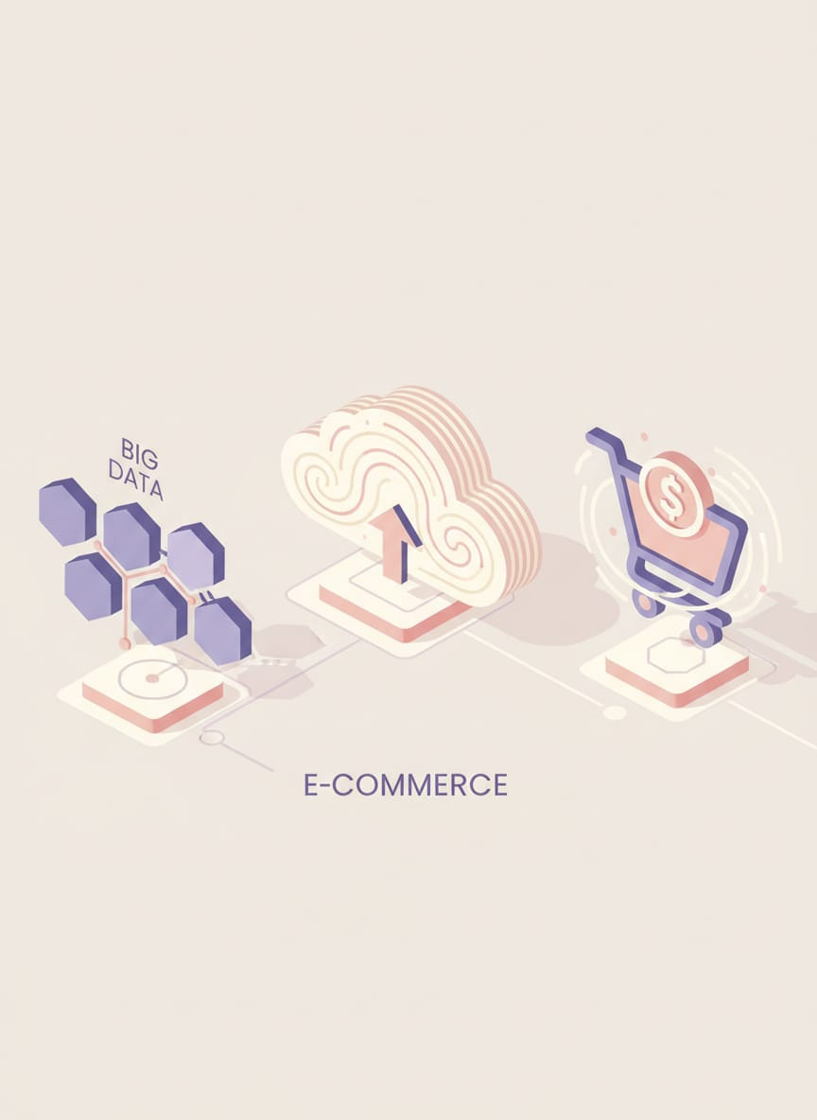
BIG DATA & CLOUD COMPUTING
Big Data = Volume, Velocity, Variety
Tools used in cloud for big data:
Hadoop, Spark, Databricks
EXAMPLE :
E-commerce websites like Amazon analyze millions of orders per day using cloud big-data tools to recommend products.
Page 06

Slide 7

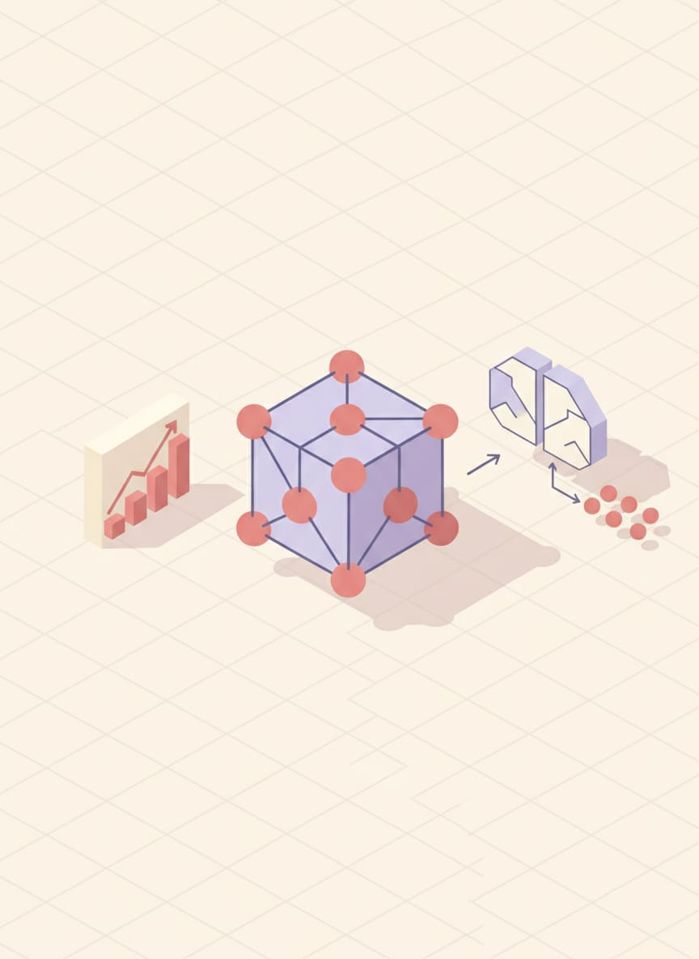
MACHINE LEARNING ON CLOUD
Cloud platforms provide ML services:
AWS SageMaker
Google Vertex AI
Azure ML Studio
EXAMPLE :
Training a face recognition model on a laptop may take 10 days — on cloud GPU clusters, it completes in 2 hours.
Page 07

Slide 8

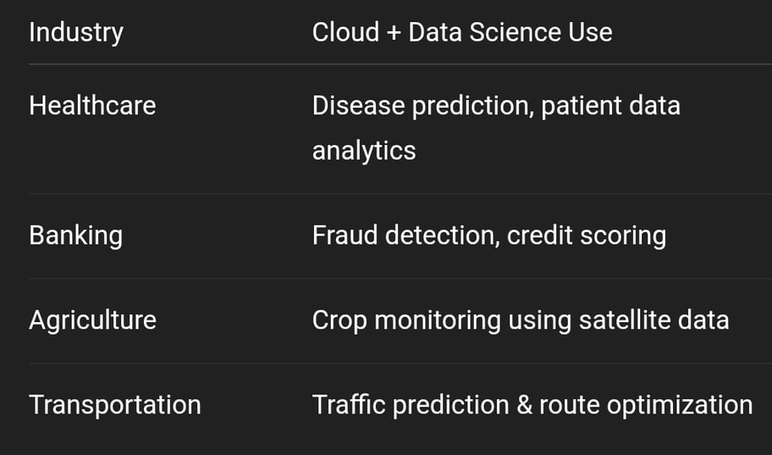
REAL-WORLD APPLICATIONS
Page 08

Slide 9

BENEFITS OF CLOUD IN DATA SCIENCE
Faster processing
Reduce Ifrastructure Cost
Better Security and Backup
Support for real-time analytics
Example :
Ride-sharing apps like Uber/Ola analyze real-time GPS data to match drivers & riders instantly.
Page 09

Slide 10

CHALLENGES
Data privacy & security concerns
Internet dependency
Vendor lock-in issues
High cost for long-term heavy computing
Page 10

Slide 11


CONCLUSION
Cloud computing is the backbone of modern data science
Enables large-scale data storage, fast computation & AI model deploymentUsed widely in business, healthcare, government & research
➡️ Future: More automation, edge computing, and AI-powered cloud platforms

Slide 12




THANK YOU
Page 10

