Slide 1
NSE Risk Intelligence Console
Forecasting accuracy, Value-at-Risk backtesting, and macro enrichment — one reusable pipeline
Generated 2026-07-31T07:53:50 · Data through 2026-07-30

Slide 2
The Question
Does a risk framework built on an index's own history hold up in the conditions that matter most — or does it quietly understate risk exactly when markets are stressed?

Slide 3
Headline Results This Run
1/4
indices in a Stressed regime today
4/4
GARCH-based VaR passes backtest
3/4
Historical-sim VaR passes backtest
4/4
Parametric VaR passes backtest

Slide 4
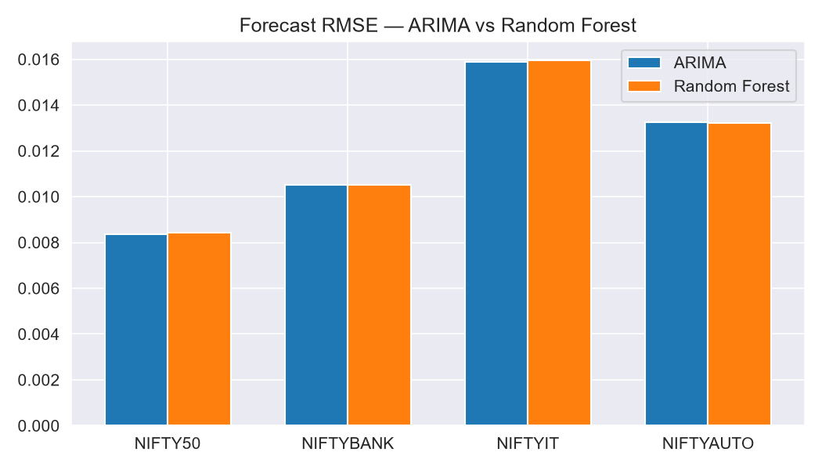
Can the Past Predict Tomorrow?
Average RMSE gap between ARIMA and Random Forest: 0.00005. Neither model shows a consistent edge across all four indices.

Slide 5
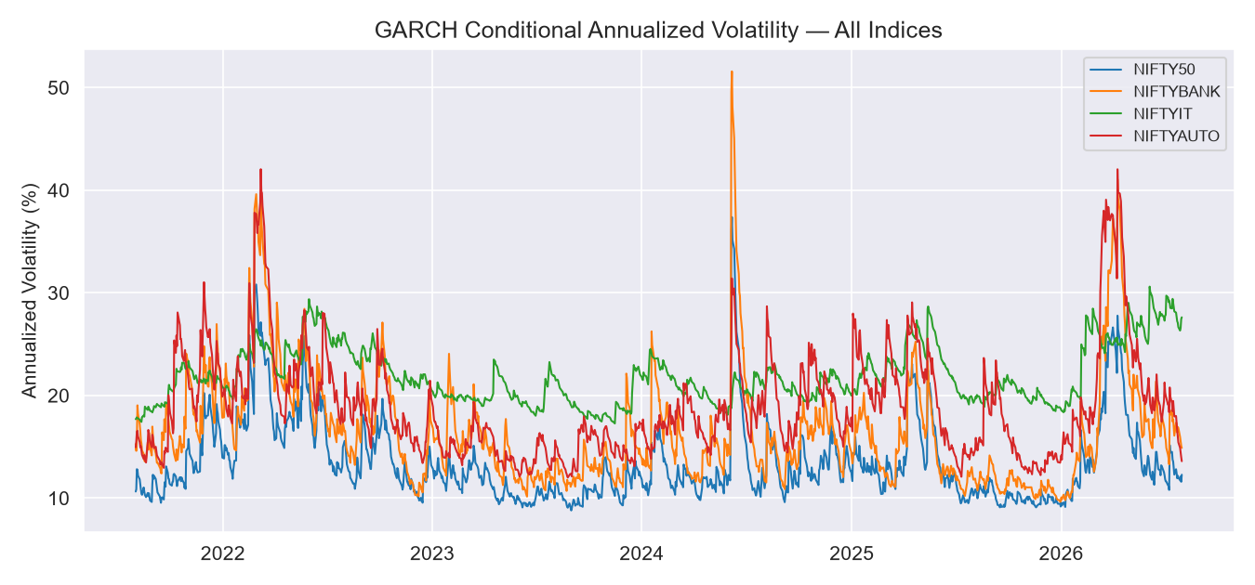
Predicting the Rough Days

Slide 6
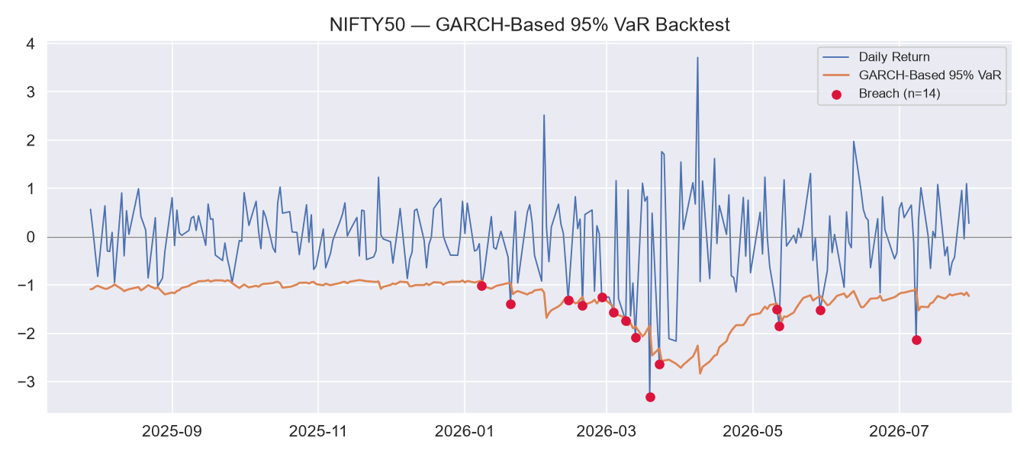
When “Safe” Isn't Safe
At the 95% level, all three VaR methods look reasonable. GARCH-based estimation held up most consistently across indices when backtested formally.

Slide 7
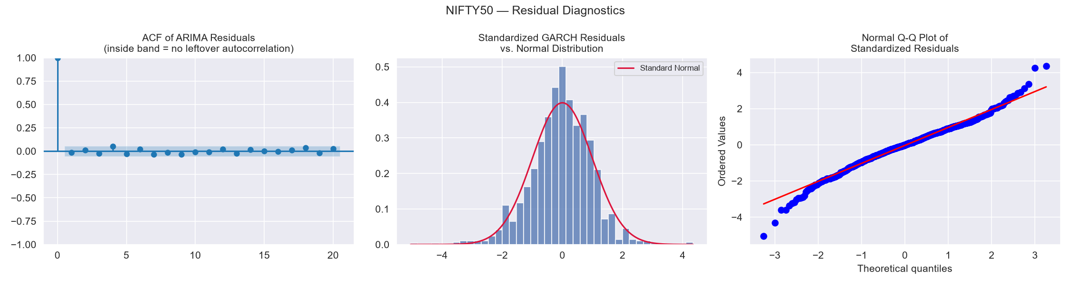
Model Diagnostics — Did These Models Actually Fit?
141.565
Jarque-Bera statistic
p-value = 0.0
Rejects normality (expected fat tails)
Index | Stationary | Clean Resid. | Vol. Captured | Normal | R²
NIFTY50 | Yes | Yes | No | No | -0.0
NIFTYBANK | Yes | Yes | No | No | -0.0
NIFTYIT | Yes | Yes | Yes | No | 0.0019
NIFTYAUTO | Yes | No | Yes | No | 0.0017
Order chosen by AIC comparison across 5 candidates, not asserted. Jarque-Bera commonly fails for daily returns — expected, not a defect — which is why VaR is backtested empirically in the next slide rather than assumed.

Slide 8
From Theory to Action: Basel Zones and Rupee Risk
Index | Basel Zone | Exceptions/250d | Today's 99% VaR (₹10cr notional)
NIFTY50 | Green | 3 | ₹1,754,088
NIFTYBANK | Green | 3 | ₹2,133,115
NIFTYIT | Yellow | 8 | ₹4,031,659
NIFTYAUTO | Green | 2 | ₹1,905,815
Index | Recommended Action
NIFTY50 | STANDARD: Calm/Normal regime, Green Basel zone — no action beyond rout...
NIFTYBANK | STANDARD: Calm/Normal regime, Green Basel zone — no action beyond rout...
NIFTYIT | HEIGHTENED MONITORING: Stressed regime with elevated exceptions — incr...
NIFTYAUTO | STANDARD: Calm/Normal regime, Green Basel zone — no action beyond rout...

Slide 9
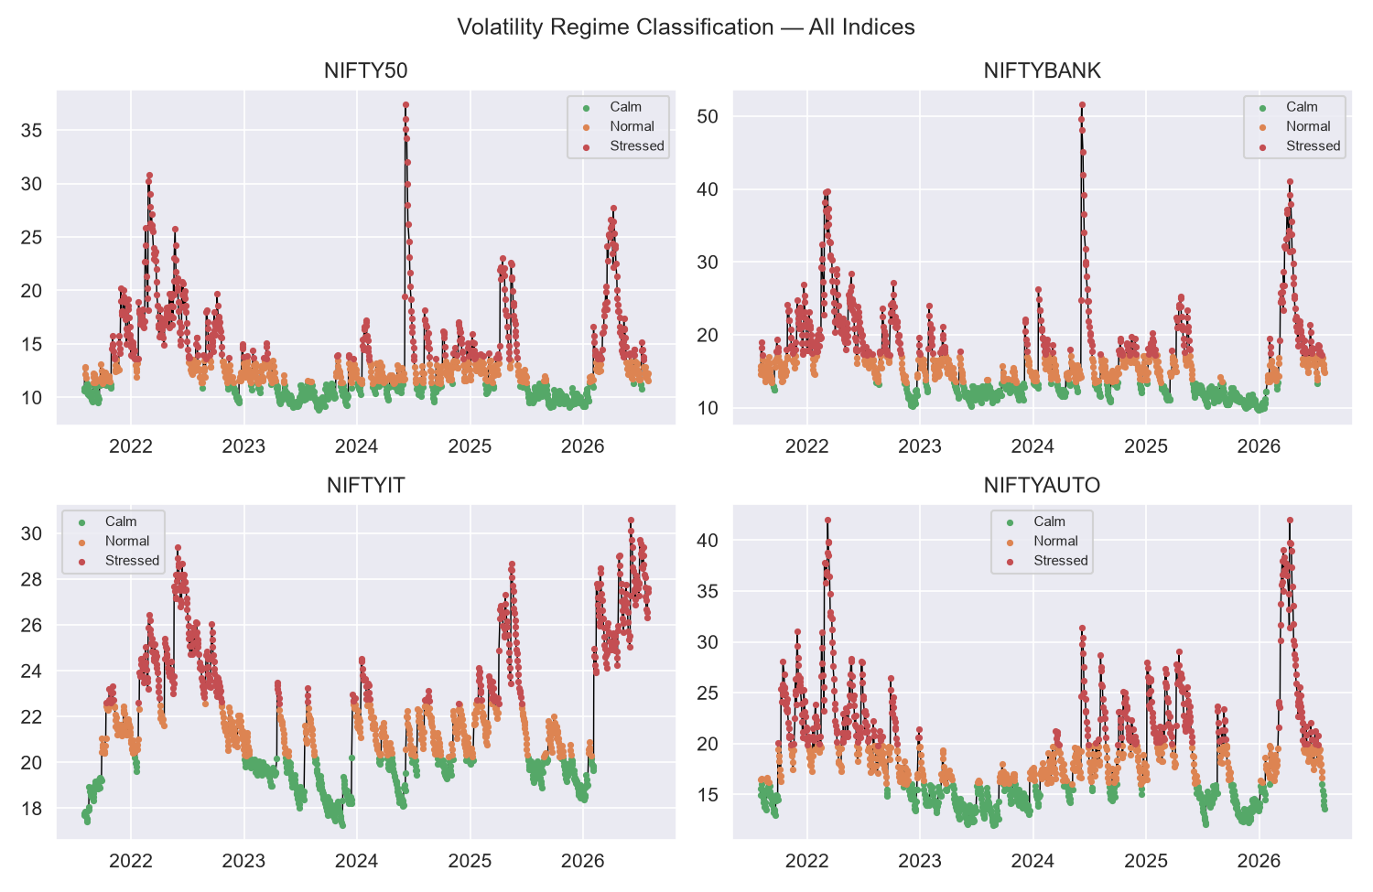
Regime Classification, All Indices

Slide 10
Does the Early-Warning Flag Actually Work?
Backtested against each index's 10 worst historical single-day losses: was the Stressed flag already showing within the prior 5 trading days?
Index | Worst Days With Advance Warning | Average Lead Time
NIFTY50 | 9/10 (90.0%) | 1.0 days
NIFTYBANK | 6/10 (60.0%) | 1.0 days
NIFTYIT | 8/10 (80.0%) | 1.0 days
NIFTYAUTO | 8/10 (80.0%) | 1.0 days

Slide 11
What This Means
A live regime + VaR monitoring view, built on this same pipeline, would turn this backtested finding into a daily, actionable signal — flagging the moment conditions shift into Stressed, rather than only visible in hindsight.

Slide 12
Thank You
Full data, code, and this deck are version-controlled in the project's GitHub repository.

