Slide 1
Powerlist
COMS W4995 002: Parallel Functional Programming Fall 2021
Yash Datta (yd2590)

Slide 2
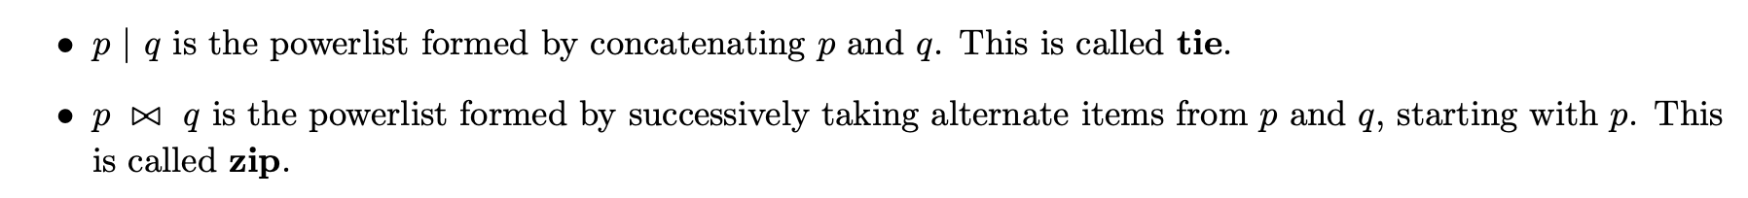
Powerlist
A new recursive DS for data parallel algorithms
Base case : A list of 1 element
Longer power lists constructed from 2 powerlist of same length and having similar elements using 2 operators

Slide 3
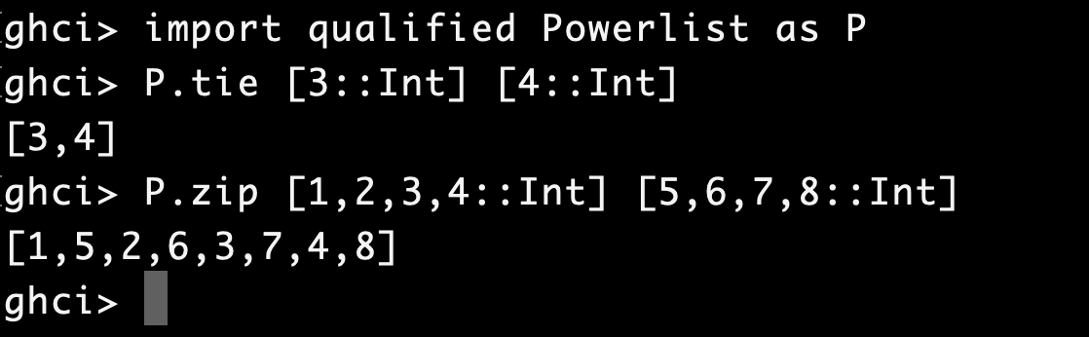
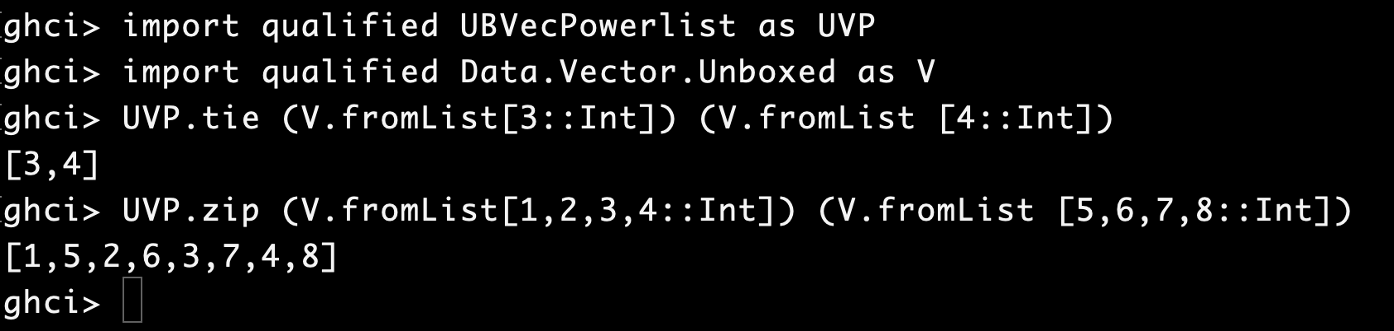
2 implementations
Using List : Powerlist
Using Unboxed Vectors: UBVecPowerlist

Slide 4
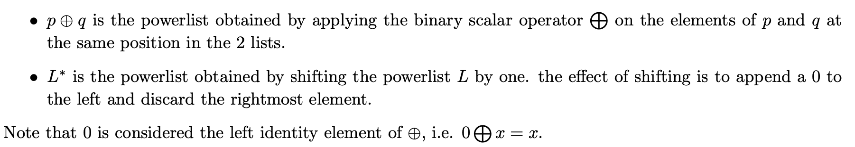
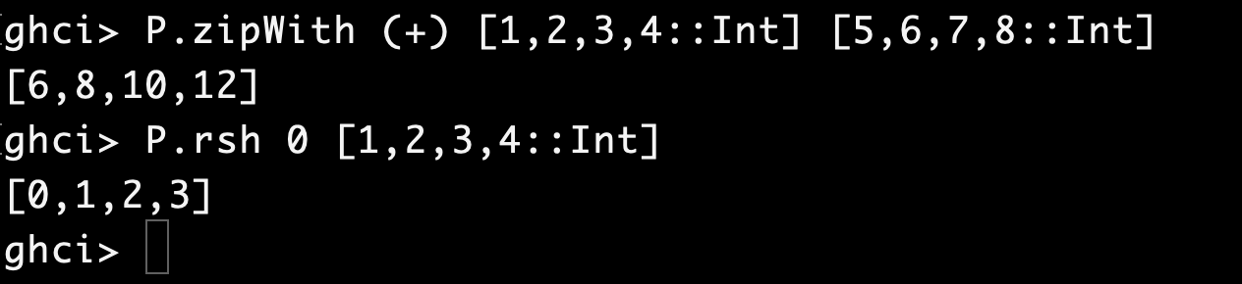
Powerlist Operators

Slide 5
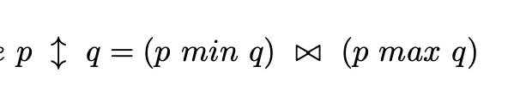
Powerlist Operators
Another operator for sorting

Slide 6
Algorithms
Demonstrate use of powerlist in
Scan
Simple Prefix Sum
SPSPL
SPSPLPar1
SPSPLPar2
SPSPLPar3
SPSUBVecPLPar
Ladner Fischer Scheme
LDFPar
LDFUBVecPLPar
LDFChunkUBVecPLPar
Sort
Batcher Merge Sort

Slide 7
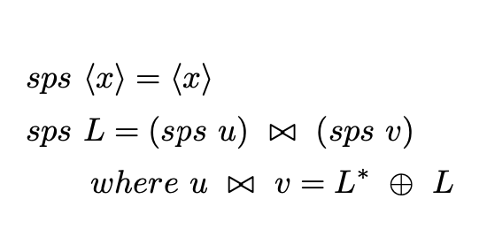
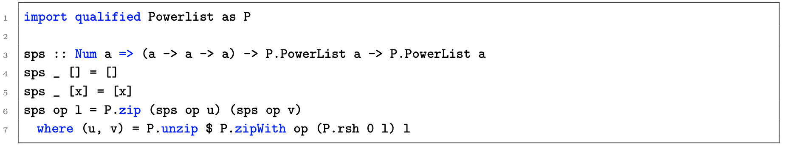
Simple Prefix Sum
In Haskell:

Slide 8
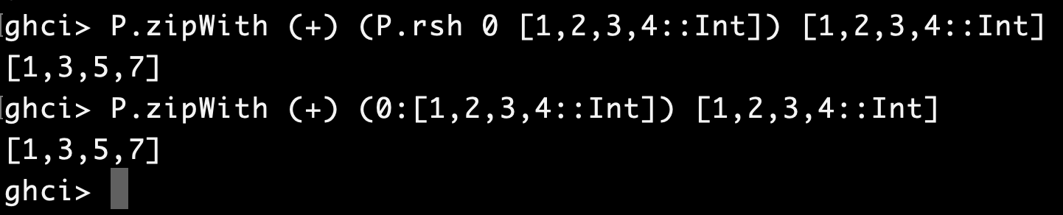
Parallelizing SPS
Algorithm divides the input into 2 halves, calls recursively
Parallelize the “unzip” operation to deconstruct the list
Parallelize “zipWith” by breaking input into chunks
P.zipWith op (P.rsh 0 t) t can be rewritten as P.zipWith op (0:t) t
(since zipWith only considers intersection of 2 lists)

Slide 9
Parallelizing SPS
Use Unboxed Vector implementation to reduce GC
Introduce “shiftAdd” and “filterUsing” methods to directly execute certain operations over mutable vectors.

Slide 10
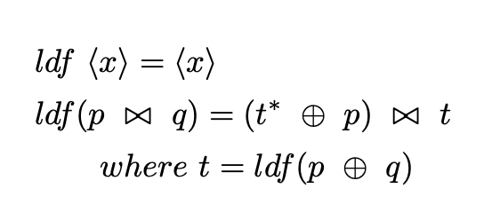
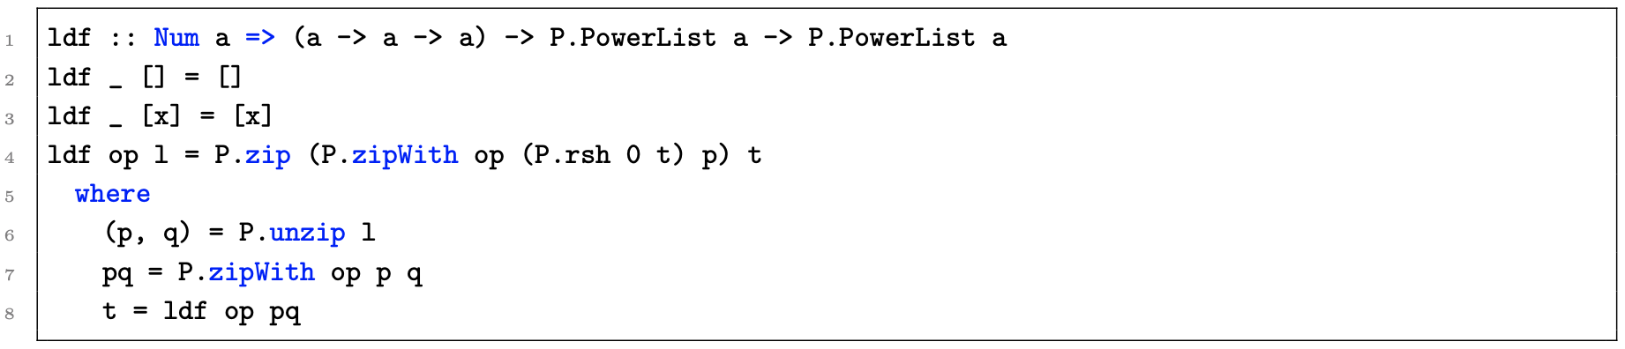
Ladner Fischer
In Haskell:
Similar techniques were used to parallelize LDF

Slide 11
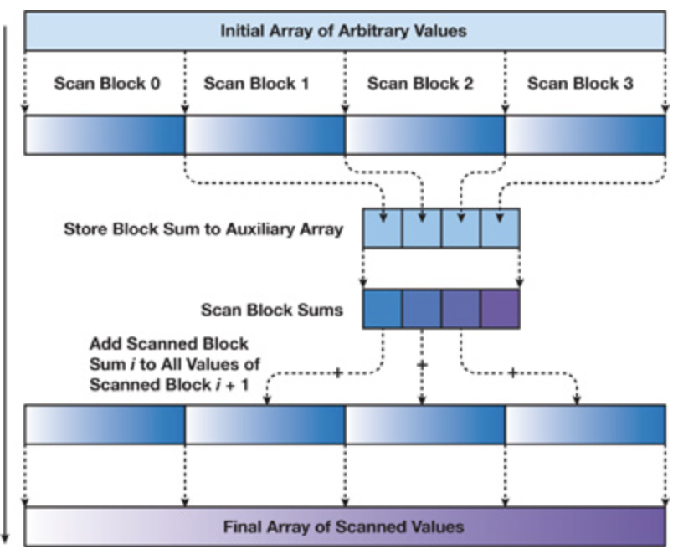
LDFChunkUBVecPLPar
A hybrid approach, where input is split into chunks first, then LDF is applied in parallel to all chunks.
Bleloch style merge is used to combine the results

Slide 12
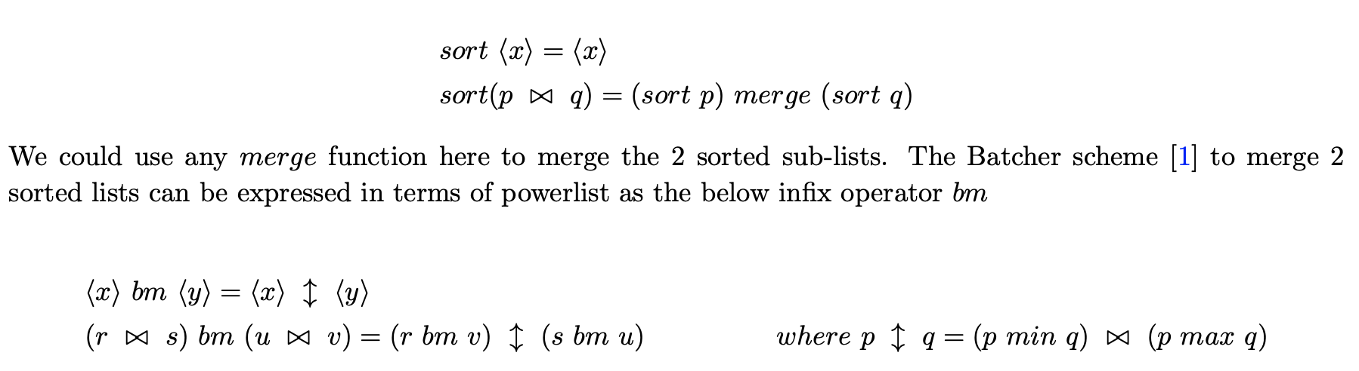
Batcher merge sort

Slide 13
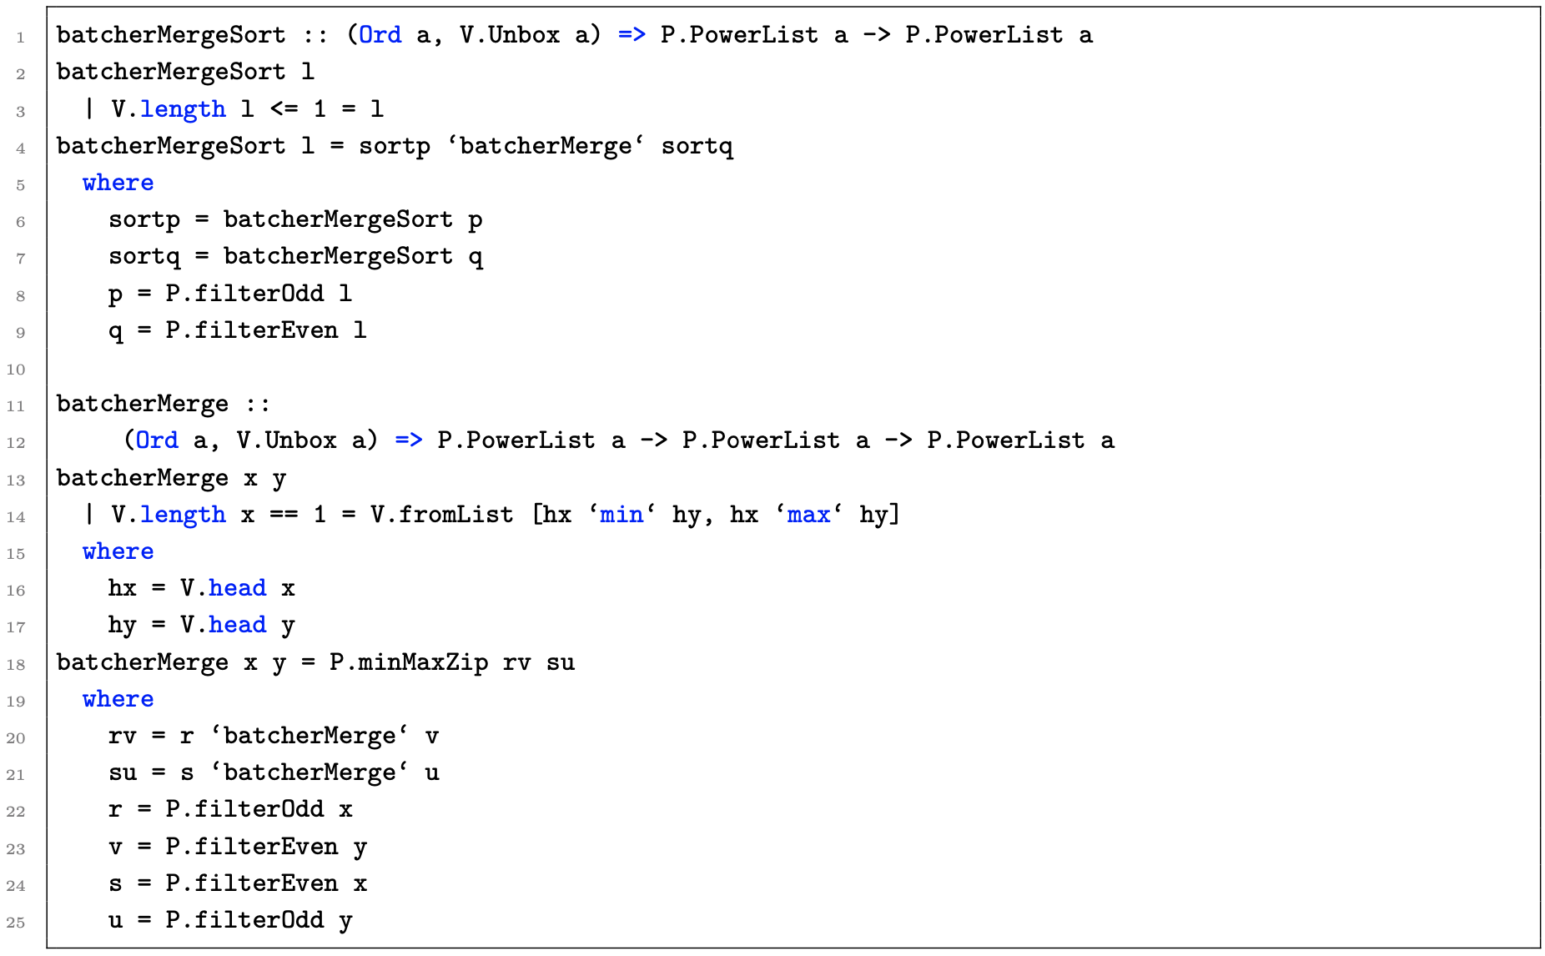
Batcher merge sort

Slide 14
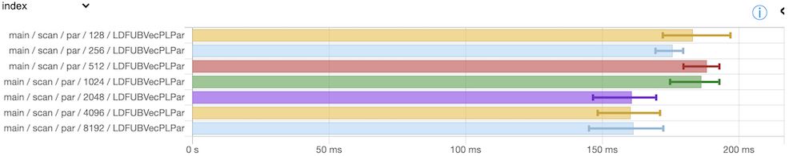
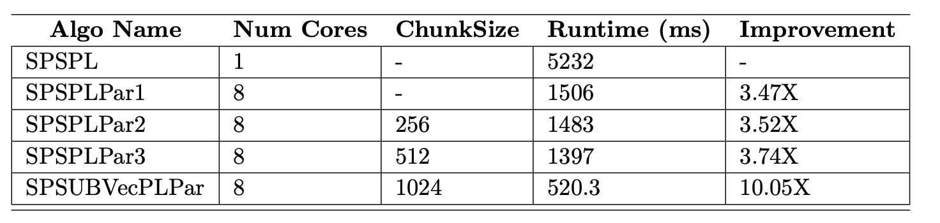
Results
Run benchmarks on Intel 8 core Intel i9-9900K CPU @ 3.60 GHZ (32G memory) on Debian 11 (bullseye)
Use criterion package to benchmark algorithms over arrays of length 2^20
Different chunk sizes tried
Scan results

Slide 15
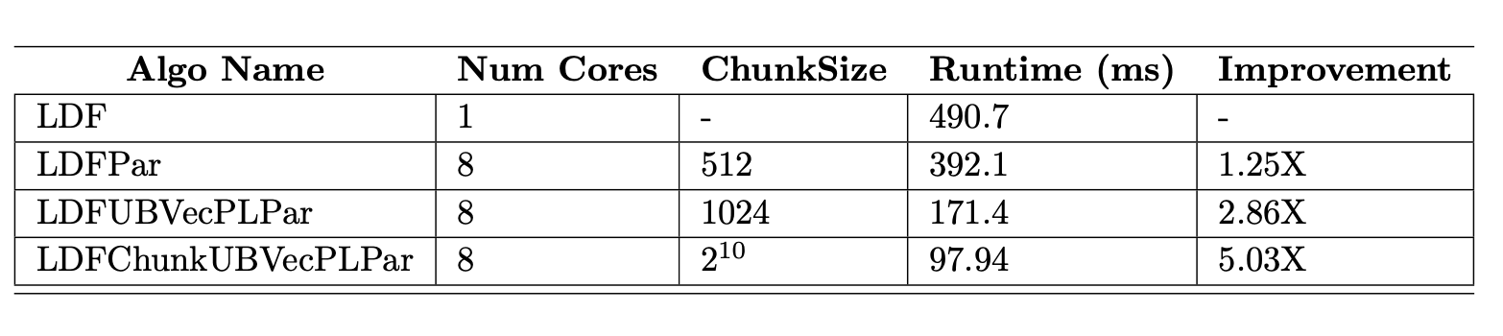
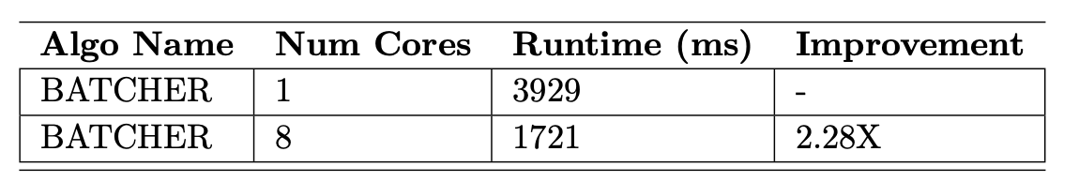
Results
LDF scan
sort

Slide 16
Project Materials
Everything accessible at github: https://github.com/saucam/powerlist
Extensive benchmarks: https://github.com/saucam/powerlist/blob/main/docs/Benchmark.md
Project report: https://github.com/saucam/powerlist/blob/main/docs/project_report.pdf

