Slide 1
CAPSTONE PRESENTATION · 2026
Movie Rails
8K
Films
Personalized Film Discovery
Through Narrative DNA
1,016
Matt Tonks · Colton Wedell · Alex Zermeno · Alexxis Saucedo
Features
125
Rails

Slide 2
THE CHALLENGE
Generic Recommendations Bury Niche and Cross-Cultural Films
The Problem
Our Opportunity
Genre tags alone can't capture narrative complexity
Bollywood, East Asian & arthouse films are under-surfaced
Similarity scores miss cross-cultural story relationships
Users can't discover what the algorithm can't see
248 tropes (scored 0–3) plus genre & language features per film
8,000 films spanning 3 major language regions
ML pipeline surfaces story DNA, not just metadata
125 intelligent rails replace blunt genre buckets

Slide 3
SYSTEM ARCHITECTURE
A 5-Stage ML Pipeline Transforms 8,000 Films Into 125 Intelligent Rails
01
02
03
04
05
Ingest & Segment
Compress
Cluster
Optimize
Label & Deploy
8K films
3 regions
1,016 features
SVD → 50D
UMAP → 64D
Noise stripped
HDBSCAN
Soul Groups
2–29 per region
K-Means
30–150 per rail
125 rails
LLaMA 3.1
116 unique names
Soulmates
›
›
›
›

Slide 4
STAGE 01 · DATA FOUNDATION
248 Tropes Scored 0–3 Plus Genre & Language Capture Story DNA
8,000
1,016
3
Films in corpus
Trope features (scored 0–3, 4 dummy levels each)
Language super-regions
Scraped from IMDB with full metadata
248 tropes × 4 levels + 22 genres + 2 appended
Bollywood · East Asian · Global / Other
REGIONAL BREAKDOWN
Bollywood
3%
Hindi · Tamil · Telugu
East Asian
8%
Japanese · Korean · Cantonese
Global / Other
89%
English + all remaining languages

Slide 5
STAGES 02–03 · COMPRESSION & CLUSTERING
SVD Strips Noise to 50D; UMAP Reshapes to 64D; HDBSCAN Finds Story Groups
HDBSCAN · Soul Groups
1,016D
Raw Features
◆
No preset k — discovers natural cluster shapes
↓
◆
Produces 2–29 soul groups per geo segment
50D
After SVD
◆
min_cluster_size = 30 enforces meaningful groups
↓
64D
◆
Noise points (label = –1) recovered in secondary pass
After UMAP
◆
~3% of films fall into sub-threshold niche rails
50 SVD components strip noise; UMAP expands to 64D for density clustering

Slide 6
STAGES 04–05 · OPTIMIZATION, NAMING & DISCOVERY
K-Means Builds the Rails · LLaMA Names Them · Soulmates Bridges Cultures
125
116
40
Total Rails
Unique Names
Cross-Regional Links
K-Means (Constrained)
LLaMA 3.1 Labeling
Global Soulmates
k swept per Soul Group for best fit
Hard constraint: 30–150 films per rail
k selected by highest silhouette score
78.4% of rails meet minimum size
125 total rails across all regions
Input: top-20 defining tropes per rail
Plus mean release year + sample titles
Outputs archetype name + description
116 unique rail names generated
Names are human-readable, not IDs
40 cross-regional centroids computed
Euclidean distance < 0.75 = a match
Reveals shared narrative DNA globally
e.g. Bollywood ↔ Hollywood noir
Powers cross-cultural recommendations

Slide 7
RESULTS
125 Named Rails Surface Films No Genre Tag Can Find
125
116
78.4%
Intelligent rails
Unique archetype names
Rails meet size floor
across 3 language regions
LLM-generated, human-readable
30–150 films per rail enforced
3.1%
40
64D
Films in niche rails
Cross-cultural bridges
Embedding space
27 rails below 30-film size floor
Soulmates across language divides
SVD + UMAP compressed narrative

Slide 8
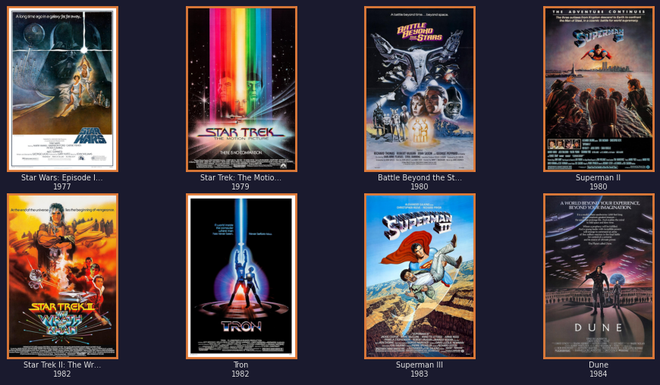
RAIL SPOTLIGHT 01 · S1_Other_0_N3
Epic Sci-Fi Adventures
135 hard-assigned films
Interstellar battles, alien worlds, and humanity pushed to its limits. Blockbuster epics united by grand-scale sci-fi world-building — Star Wars to Dune.
SAMPLE FILMS FROM RAIL
Star Wars: Ep. IV (1977)
Star Trek: TMP (1979)
Battle Beyond the Stars (1980)
Tron (1982)
Dune (1984)

Slide 9
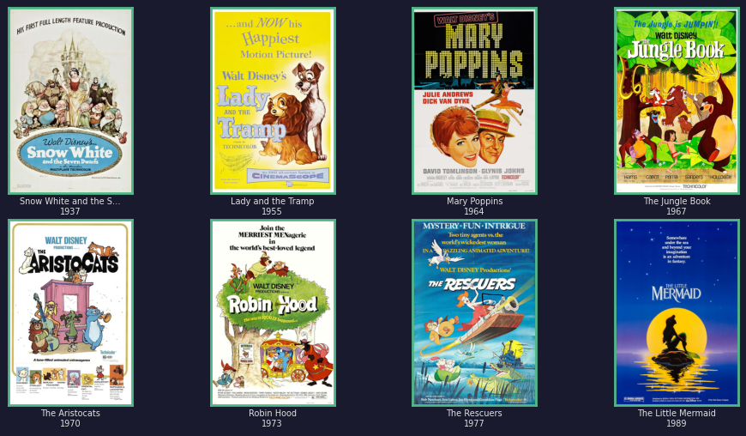
RAIL SPOTLIGHT 02 · S2_Other_0_N1
Classic Animated Family Favorites
150 hard-assigned films
Timeless animated classics and family adventures. From Disney fairy tales to modern superhero animations — Snow White to Spider-Verse.
SAMPLE FILMS FROM RAIL
Snow White (1937)
Lady and the Tramp (1955)
The Jungle Book (1967)
Robin Hood (1973)
The Little Mermaid (1989)

Slide 10
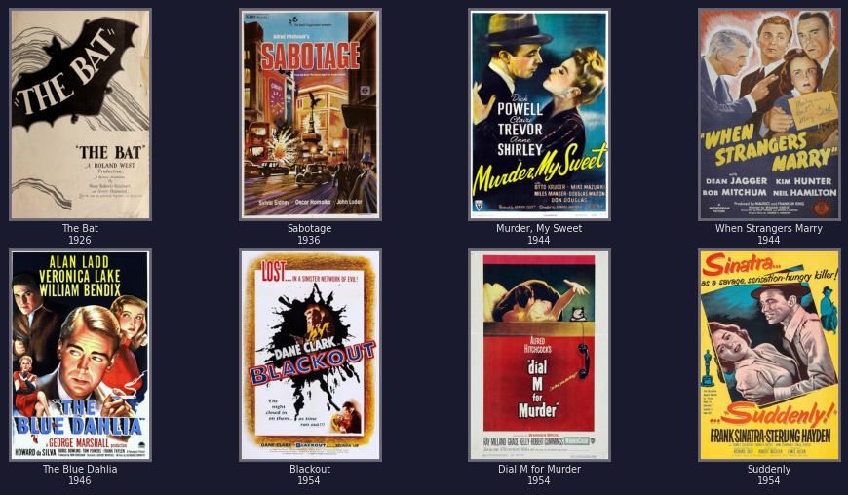
RAIL SPOTLIGHT 03 · S7_Other_0_N0
Dark Noir Classics
137 hard-assigned films
Shadowy detectives, moral ambiguity, and twist-laden crime. These films trade in deception and atmosphere — 1940s Chandler to contemporary whodunits.
SAMPLE FILMS FROM RAIL
The Bat (1926)
Murder, My Sweet (1944)
Blue Dahlia (1946)
Dial M for Murder (1954)
The Invisible Guest (2016)

Slide 11
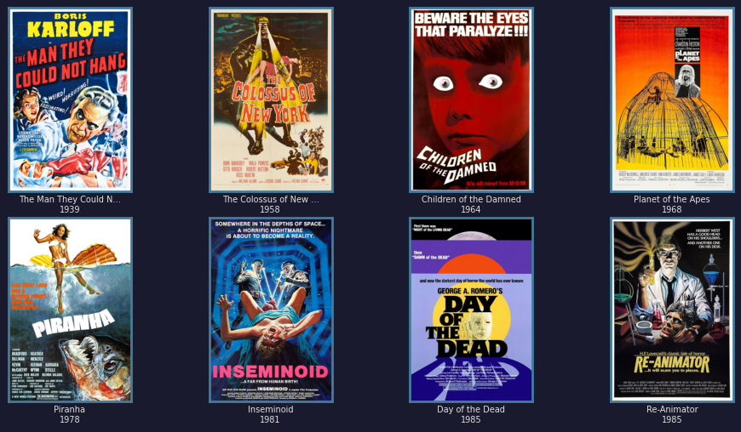
RAIL SPOTLIGHT 04 · S1_Other_0_N4
Retro Sci-Fi Horror Classics
127 hard-assigned films
Mind-bending sci-fi and retro horror where science goes wrong. Twisted timelines, dystopian societies, and creatures from the unknown.
SAMPLE FILMS FROM RAIL
Man They Couldn't Hang (1939)
Children of the Damned (1964)
Planet of the Apes (1968)
Day of the Dead (1985)
Re-Animator (1985)

Slide 12
CONCLUSION
BY THE NUMBERS
Narrative DNA Unlocks Discovery
That Metadata Alone Cannot
8K
Films
248 tropes scored 0–3 capture story nuance genre tags miss
HDBSCAN + K-Means produce organic, human-curated-feeling rails
LLaMA naming makes clusters interpretable to end users
Soulmates bridge Bollywood, East Asian & Western narratives
125 rails now power horizontally scrollable personalized discovery
125
Rails
116
Named Archetypes
40
Soulmate Bridges
Matt Tonks · Colton Wedell · Alex Zermeno · Alexxis Saucedo · 2026

