Slide 1
Image Manipulation Samuel Chan 5/10/19
Abstract: Images are very potent descriptors and are often used to demonstrate or show a point, but sometimes, some details in them may be distorted, unclear, or difficult to notice. This project would be able to enunciate certain parts of images by highlighting edges, blurring/distorting unimportant parts, adjusting colors, and improving contrast. Images can be represented as matrices of numeric values, which can be mathematically manipulated into transformations such as contrast enhancement, rotation, scaling, and edge detection. These transformations allow for better analysis of an image and should be able to enhance its demonstrative effectiveness as the user sees fit.

Slide 2
Background
Certain parts of images can be difficult to see
Certain parts of images are oriented differently than what the user would like (for example, there is an upside down sign in an image)
Certain images are murky and the objects are difficult to discern due to their less visible edges
Certain colors are too strong compared to others
This project aims to alleviate these issues by leveling contrast, allowing for transformation of certain parts of images, finding the edges of objects, and give the user color control.

Slide 3
Technical Approach
Contrast enhancement^{[1]}: Details are difficult to discern in dark images because the intensity/color of the pixels of objects are low and are not very diverse. By using a logarithmic scaling on an image, the lower ranges of intensity will begin to widen much more than the higher ranges of intensity (the slope of a log function is larger at smaller values than higher values). In the case of images, the values will scale up to 255 at the most and 0 at the least.
Smoothing^{[2]}: Edges in images appear sharp when values in one part of an image drastically change in a very short distance. To alleviate this issue, an averaging filter is used in order to make those drastic changes much smaller.

Slide 4
Technical Approach 2
Finding Edges: MATLAB contains a function for finding edges as well as creating masks for structuring purposes. Strong changes in contrast levels are evident in the image’s gradient which allows for the creation of a binary mask (a logical matrix that tells where the edges are located). The mask will not completely show the silhouette of the image’s objects until it is dilated and filled. At that point, a perimeter of the outline can be found to either highlight the edge and overlay it (edge tracing) or to blur the background while maintaining the integrity of the subject.
The rotation/scaling functions make use of a different type of grid where the image center becomes the origin in order to focus on a center during transformations. With this grid system, it becomes easier to perform multiplication/exponential operations on the image’s matrix.

Slide 5
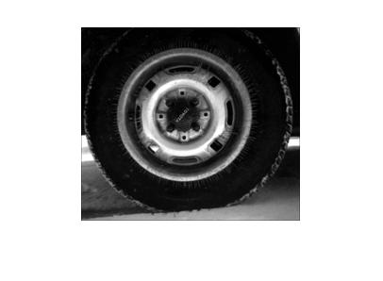
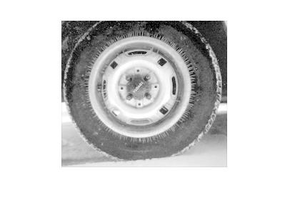
Results
A simple example of the Contrast Enhancement is with MATLAB’s in-built “tire.tif” image as it is appropriately dark (and MATLAB has an example of what a contrast boosted version of that image should look like).
Original “tire.tif”^{[6]}
Using ContrastEnhance.m

Slide 6
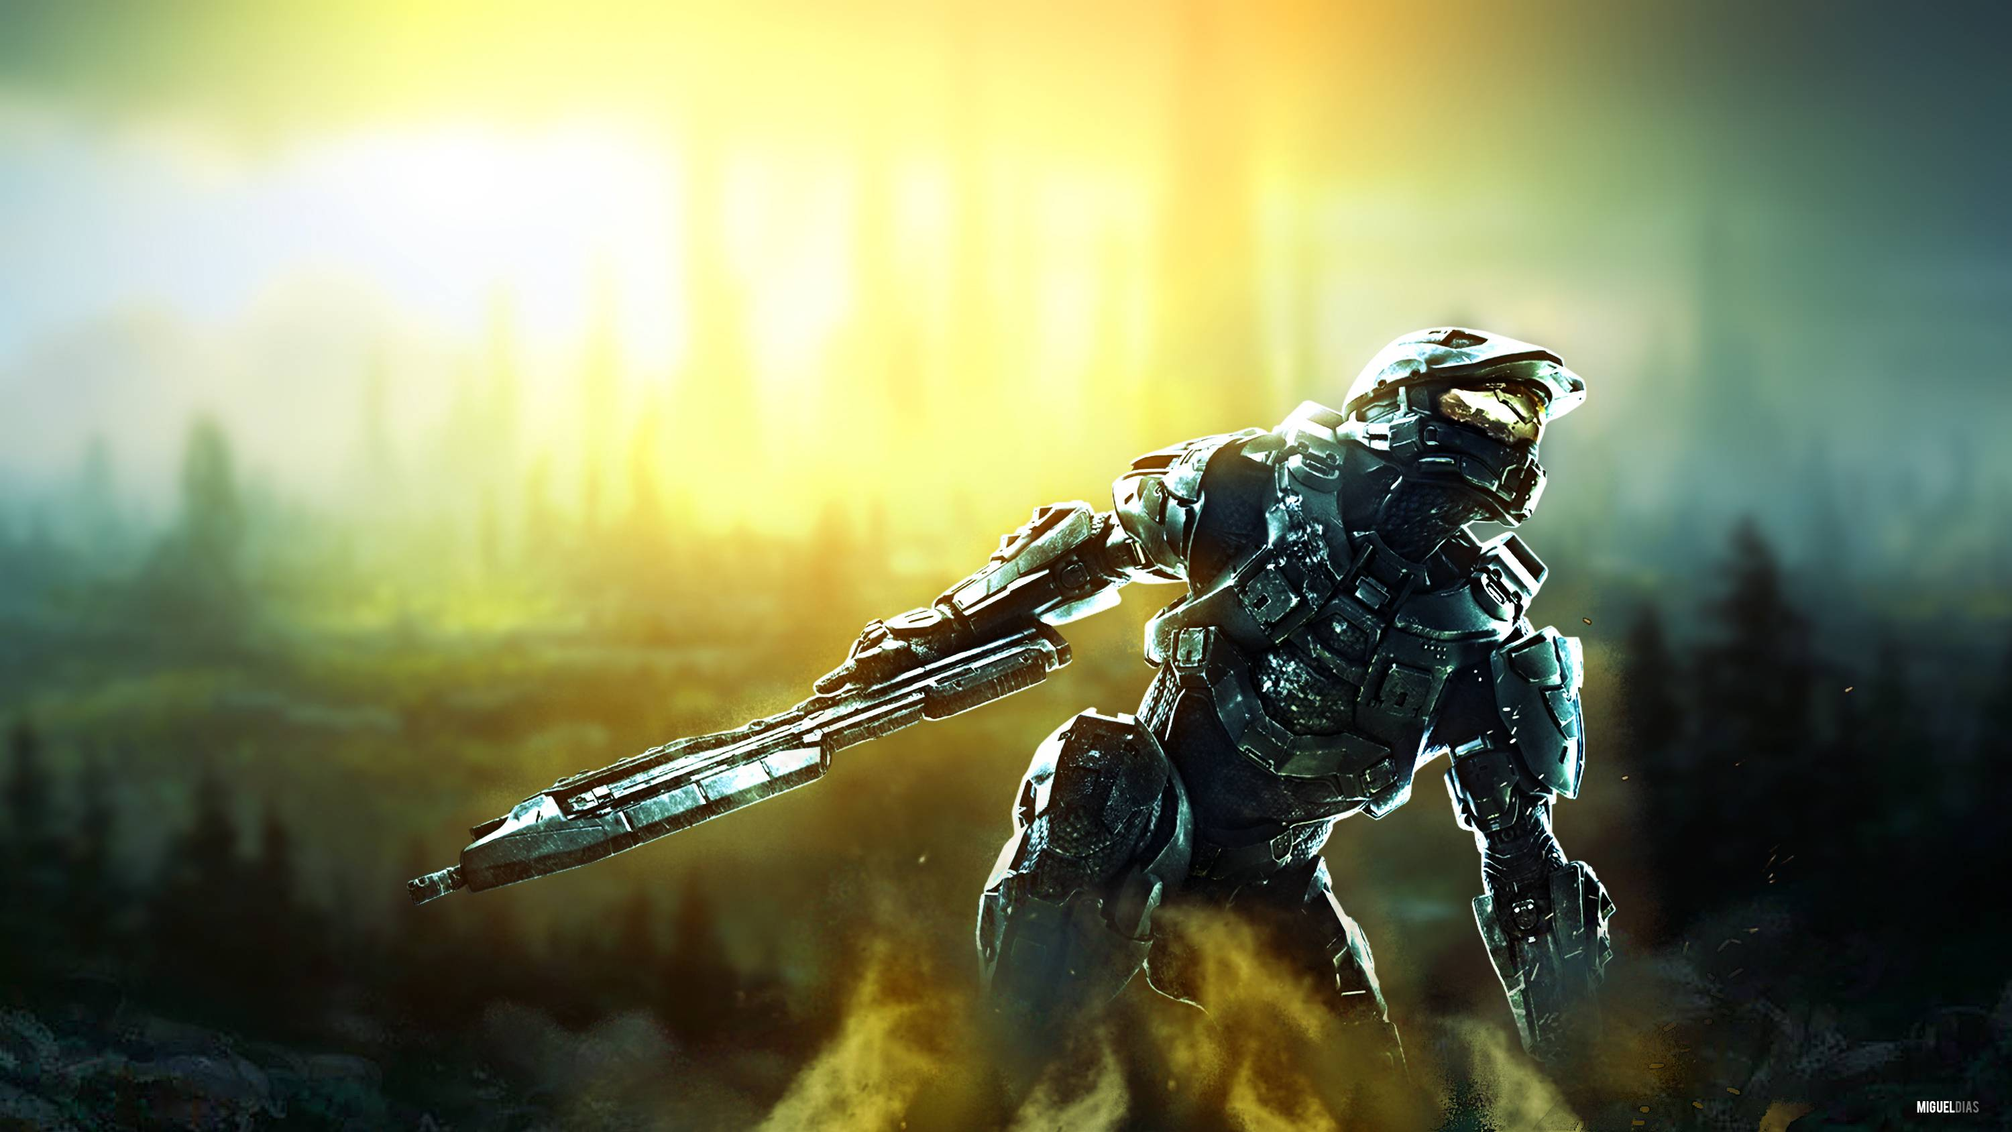
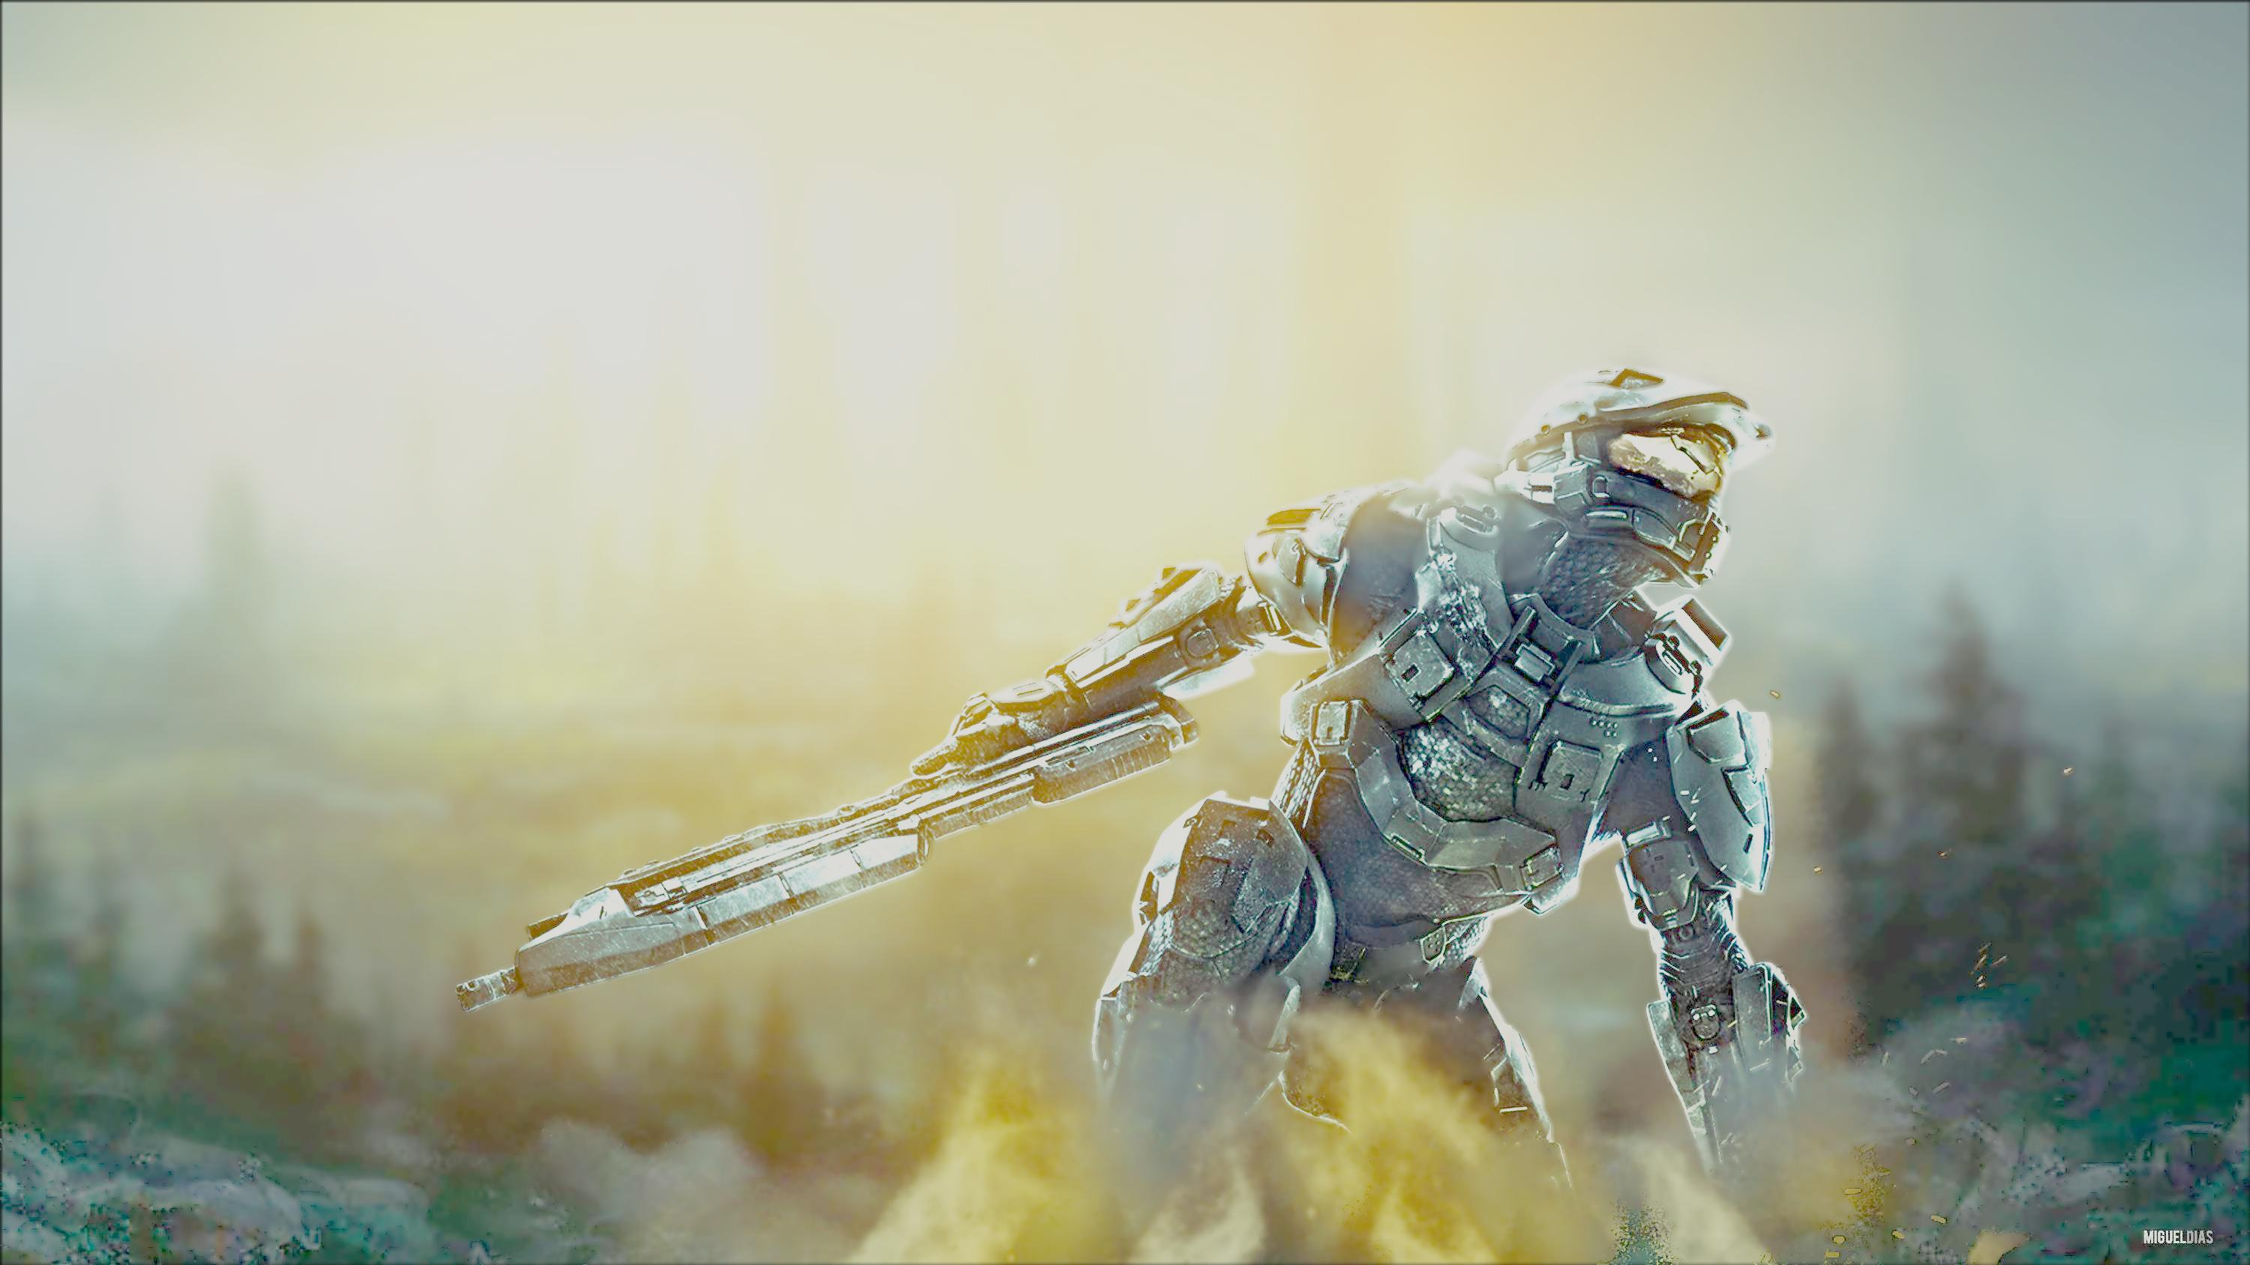
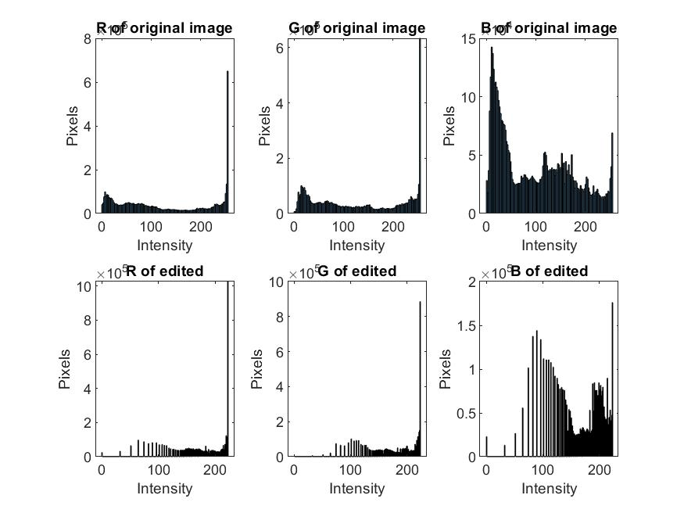
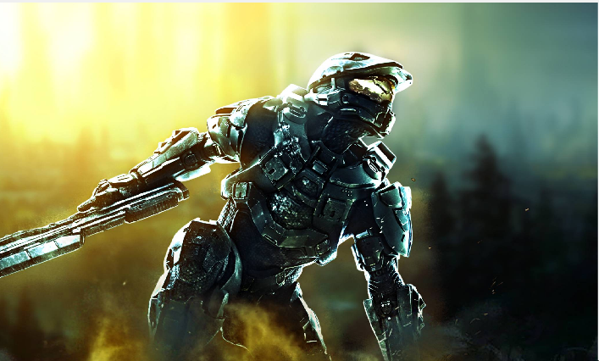
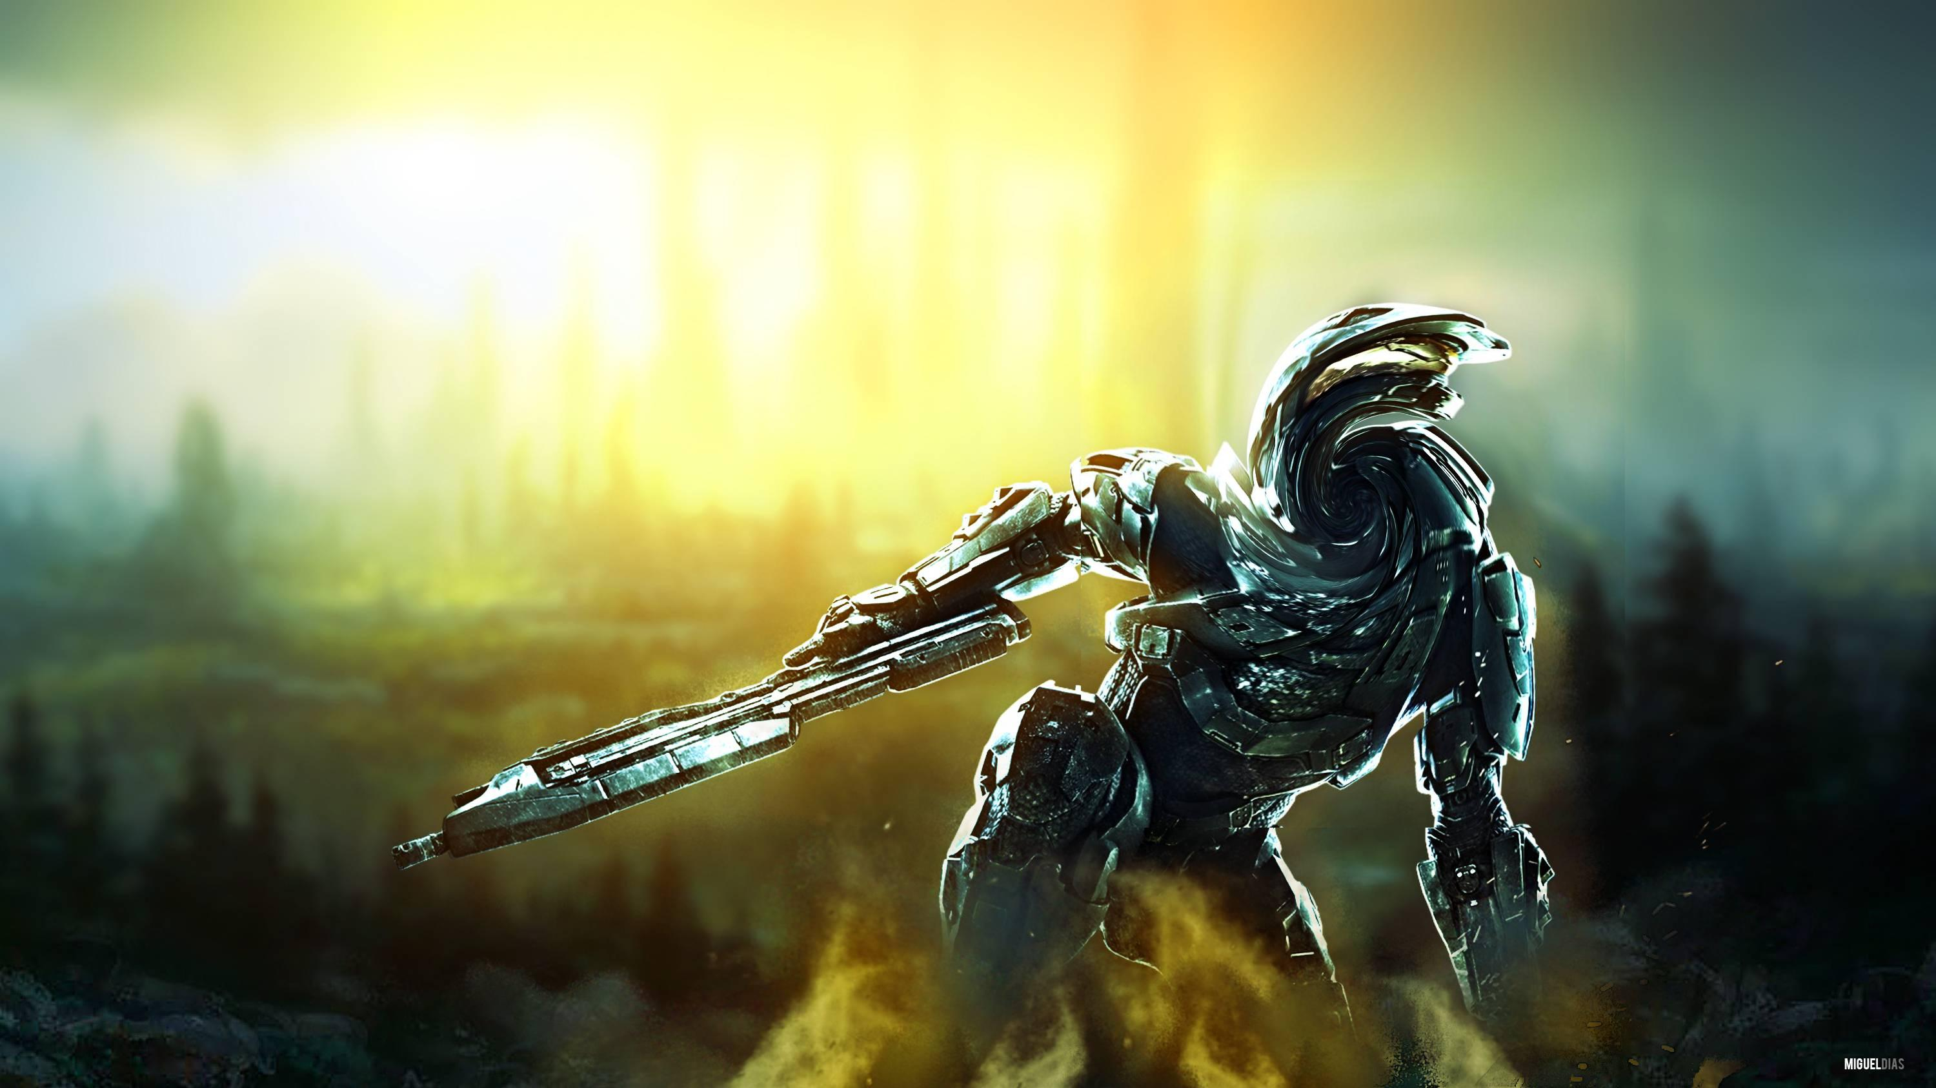
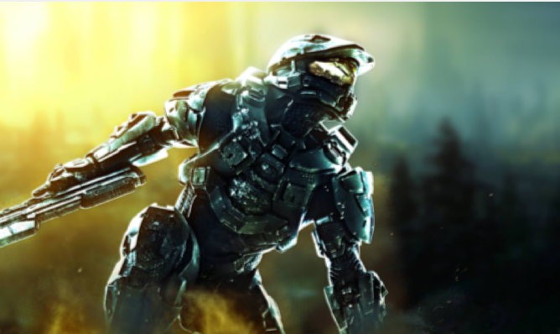
Results 2
- Another example of Contrast Enhance (image by “MiguelDias”)^{[7]}
Non-uniform rotation
Original
Smoothed

Slide 7
Conclusion
The contrast enhancement alleviates difficulties in vision to a certain extent, but it is not as effective for all dark images. There are several methods to contrast enhancement besides this type of logarithmic stretching, so it would be better to develop a function that could find the best type of enhancement to do instead of just this one.
The portrait mode that incorporates edge detection with blurring is incomplete and can sometimes blur the subject instead of the background. The next step would be to find a better way to mask the subject onto an edgemap or to modify the edgemap to better suit masking.
The non-uniform rotation/scaling functions could be modified to allow more freedom to the user. It could also be modified to have fewer black spots after transformation (then a user would be able to rotate a small part of a picture with less surrounding distortion).

Slide 8
References
[1] Miller, (2009), “Image Enhancement”, Tufts University,
https://canvas.tufts.edu/courses/7818/files/folder/FinalProjects/projectIdeas/imageProcessingBackgroundMiller?preview=816136
Date accessed: May 1, 2019
[2] Miller, (2009), “Region Processing II”, Tufts University,
https://canvas.tufts.edu/courses/7818/files/folder/FinalProjects/projectIdeas/imageProcessingBackgroundMiller?preview=816135
Date accessed: May 1, 2019
[3] Miller, (2009), “Region Processing III”, Tufts University,
https://canvas.tufts.edu/courses/7818/files/folder/FinalProjects/projectIdeas/imageProcessingBackgroundMiller?preview=816138
Date accessed: May 1, 2019
[4] Miller, (2009), “Image Warping”, Tufts University,
https://canvas.tufts.edu/courses/7818/files/folder/FinalProjects/projectIdeas/imageProcessingBackgroundMiller?preview=816134
Date Accessed: May 1, 2019
[5] “Detect Cell Using Edge Detection and Morphology”, MathWorks,
https://www.mathworks.com/help/images/detecting-a-cell-using-image-segmentation.html
Date Accessed: May 1, 2019
[6] MATLAB image library (built-in)
[7] Image created by user named “MiguelDias”
https://static1.fjcdn.com/comments/My+current+wallpaper+ill+post+a+few+other+cool+ones+_b656aac86190a1cdab682738fcc47244.jpg
Date accessed: May 1, 2019

