Slide 1

信：主耶稣基督血所立的新约
Faith: The New Covenant in the Blood of the Lord Jesus Christ
马太福音 26:26-30
Matthew 26:26-30

Slide 2
26 他们吃的时候，耶稣拿起饼来，祝福，就擘开，递给门徒，说：你们拿着吃，这是我的身体；
27 又拿起杯来，祝谢了，递给他们，说：你们都喝这个；
28 因为这是我立约的血，为多人流出来，使罪得赦。
29 但我告诉你们，从今以後，我不再喝这葡萄汁，直到我在我父的国里同你们喝新的那日子。
30 他们唱了诗，就出来往橄榄山去。
（马太福音 26:26-30）

Slide 3
26 And while they were eating, Jesus having taken the bread, and having blessed, did brake, and was giving to the disciples, and said, `Take, eat, this is my body;'
27 and having taken the cup, and having given thanks, he gave to them, saying, `Drink ye of it -- all;
28 for this is my blood of the new covenant, that for many is being poured out -- to remission of sins;
29 and I say to you, that I may not drink henceforth on this produce of the vine, till that day when I may drink it with you new in the reign of my Father.'
30 And having sung a hymn, they went forth to the mount of the Olives;
(Matthew 26:26-30, YLT)

Slide 4
你的信心旅程如今如何？
你现在在哪一站？

Slide 5
How is your faith journey doing?
Which stop are you in now?

Slide 6
信：主耶稣基督血所立的新约
1. 信的中心 —— 主耶稣基督
2. 信的内容 —— 基督的十字架与复活
3. 信的果效 —— 罪得赦免
4. 信的完成 —— 直到我们在神的国里同君王耶稣喝新的那日

Slide 7
Faith: The New Covenant in the Blood of the Lord Jesus Christ
1. Center of Faith — The Lord Jesus Christ
2. Content of Faith — The Cross and Resurrection of Christ
3. Consequence of Faith — The Forgiveness of Sin
4. Consummation of Faith — Until we drink it anew with King Jesus in the Kingdom of God

Slide 8
信的果效 — 三、罪得赦免
承 (真理) —— 罪得赦免
委 (自己) —— 归向耶稣
顺 (于神) —— 于神独生爱子、主耶稣基督的主权
传 (从神到人) —— 藉神的话语、道成肉身的活道，并神的灵，使生命更新变化

Slide 9
Consequence of Faith — The Forgiveness of Sin
A Admit (Truth) — the forgiveness of sin
C Commit (Yourself) — to Jesus
S Submit (to God) — to the lordship of God's only begotten Son, the Lord Jesus Christ
T Transmit (From God to Man) — life transformation via the Word of God, the Living Word of God, and the Spirit of God

Slide 10
信：主耶稣基督血所立的新约
1. 信的中心 —— 主耶稣基督
2. 信的内容 —— 基督的十字架与复活
3. 信的果效 —— 罪得赦免
承 (真理) —— 罪得赦免
委 (自己) —— 归向耶稣
顺 (于神) —— 于神独生爱子、主耶稣基督的主权
传 (从神到人) —— 使生命更新变化
4. 信的完成 —— 直到我们在神的国里同君王耶稣喝新的那日

Slide 11
Faith: The New Covenant in the Blood of the Lord Jesus Christ
1. Center of Faith — The Lord Jesus Christ
2. Content of Faith — The Cross and Resurrection of Christ
3. Consequence of Faith — The Forgiveness of Sin
A Admit (Truth) — the forgiveness of sin
C Commit (Yourself) — to Jesus
S Submit (to God) — to the lordship of God's Son, the Lord Jesus Christ
T Transmit (From God to Man) — life transformation
4. Consummation of Faith — Until we drink it anew with King Jesus in the Kingdom of God

Slide 12
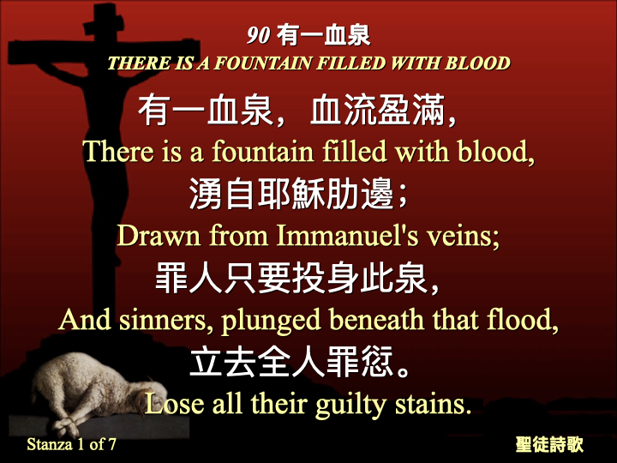

Slide 13
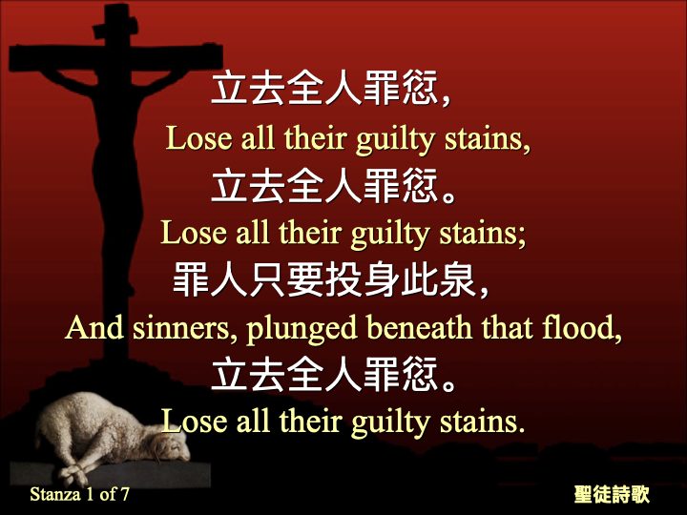

Slide 14
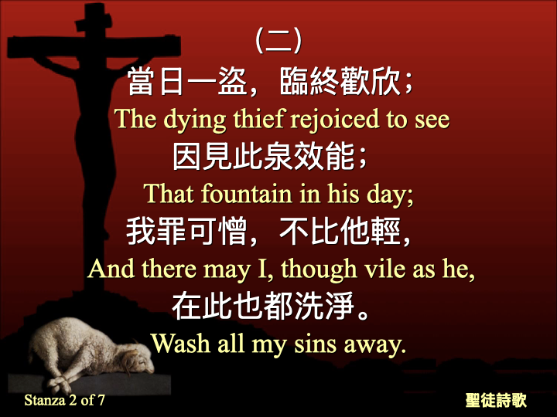

Slide 15
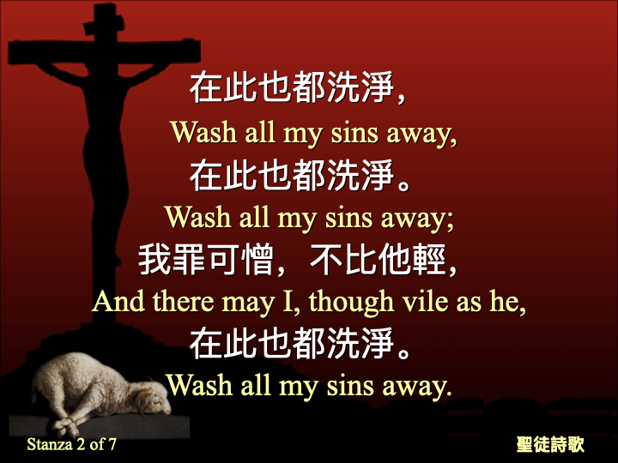

Slide 16
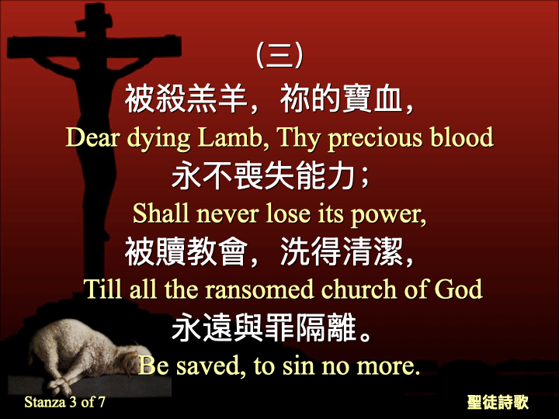

Slide 17
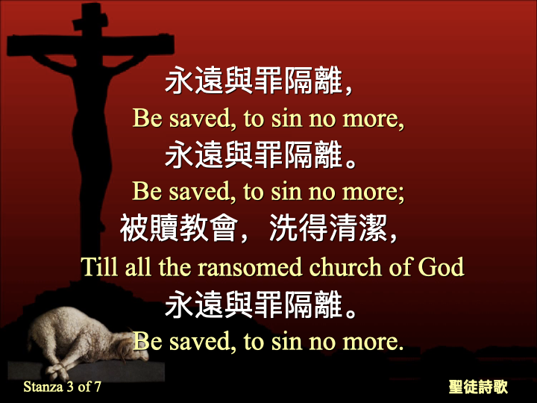

Slide 18
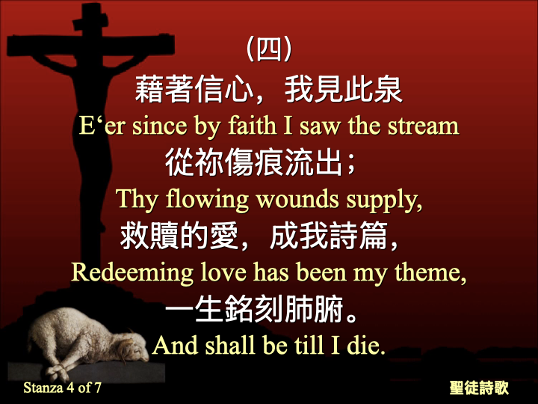

Slide 19
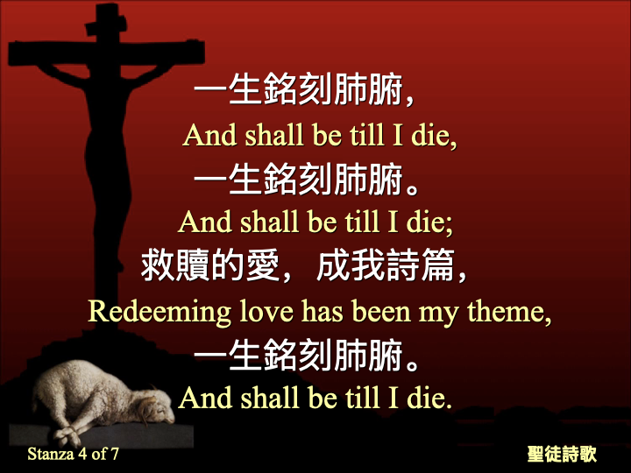

Slide 20
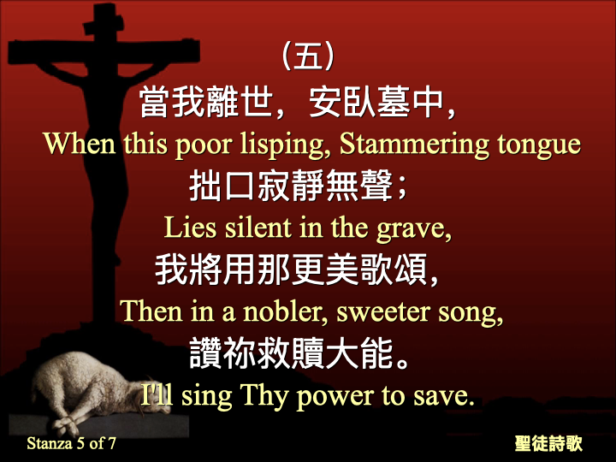

Slide 21
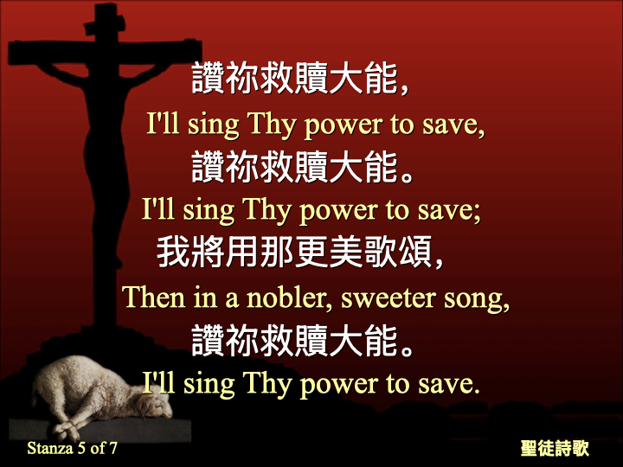

Slide 22
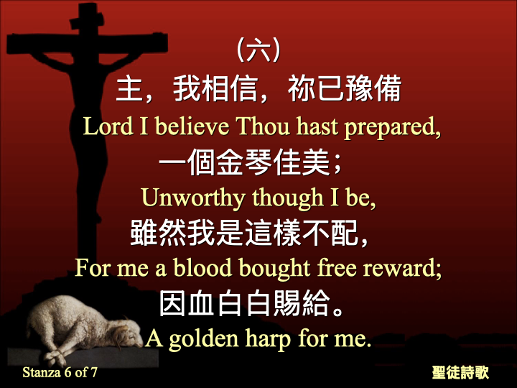

Slide 23
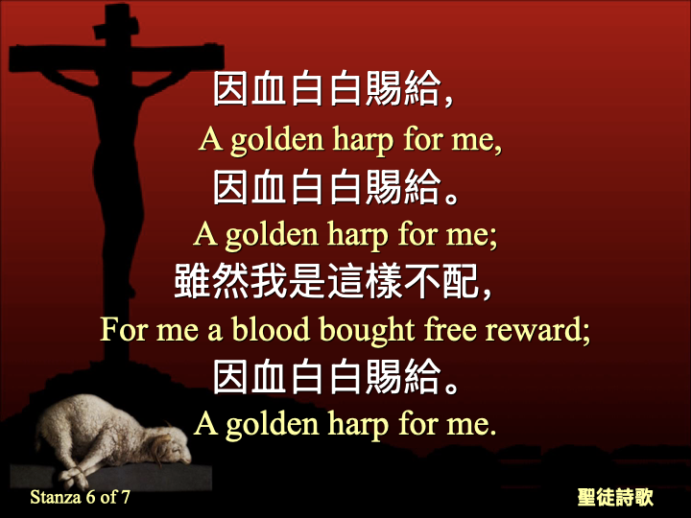

Slide 24
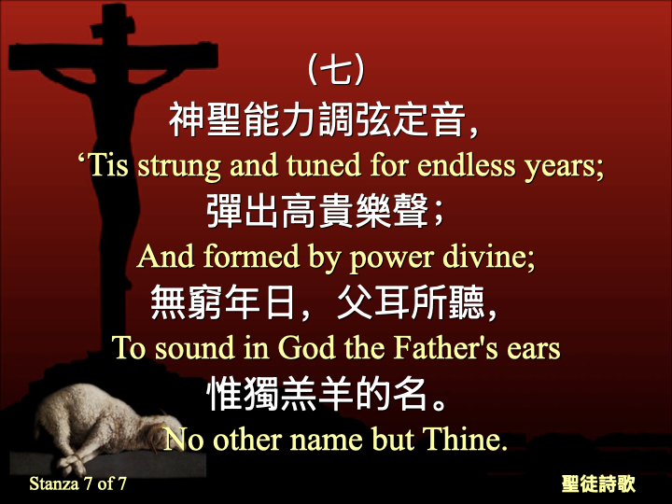

Slide 25
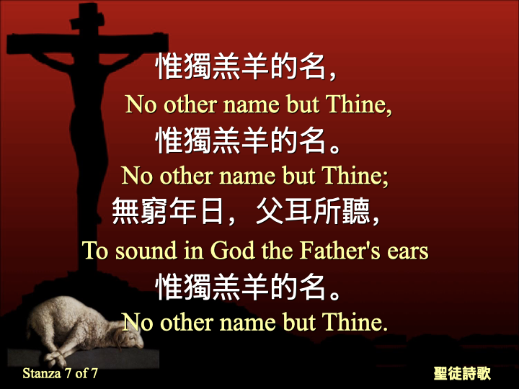

Slide 26
1 神既在古时藉着众先知多次多方的晓谕列祖，
2 就在这末世藉着他儿子晓谕我们；又早已立他为承受万有的，也曾藉着他创造诸世界。
3 他是神荣耀所发的光辉，是神本体的真像，常用他权能的命令托住万有。他洗净了人的罪，就坐在高天至大者的右边。
4 他所承受的名，既比天使的名更尊贵，就远超过天使。
（希伯来书 1:1-4）

Slide 27
1 In many parts, and many ways, God of old having spoken to the fathers in the prophets,
2 in these last days did speak to us in a Son, whom He appointed heir of all things, through whom also He did make the ages;
3 who being the brightness of the glory, and the impress of His subsistence, bearing up also the all things by the saying of his might -- through himself having made a cleansing of our sins, sat down at the right hand of the greatness in the highest,
4 having become so much better than the messengers, as he did inherit a more excellent name than they.
(Hebrews 1:1-4, YLT)

Slide 28
20 但愿赐平安的神，就是那凭永约之血、使群羊的大牧人─我主耶稣从死里复活的神，
21 在各样善事上成全你们，叫你们遵行他的旨意；又藉着耶稣基督在你们心里行他所喜悦的事。愿荣耀归给他，直到永永远远。阿们！
（希伯来书 13:20-21）

Slide 29
20 And the God of the peace, who did bring up out of the dead the great shepherd of the sheep -- in the blood of an age-during covenant -- our Lord Jesus,
21 make you perfect in every good work to do His will, doing in you that which is well-pleasing before Him, through Jesus Christ, to whom [is] the glory -- to the ages of the ages! Amen.
(Hebrews 13:20-21, YLT)

Slide 30
1 （大卫的诗。）耶和华是我的牧者，我必不致缺乏。
2 他使我躺卧在青草地上，领我在可安歇的水边。
3 他使我的灵魂苏醒，为自己的名引导我走义路。
4 我虽然行过死荫的幽谷，也不怕遭害，因为你与我同在；你的杖，你的竿，都安慰我。
5 在我敌人面前，你为我摆设筵席；你用油膏了我的头，使我的福杯满溢。
6 我一生一世必有恩惠慈爱随着我；我且要住在耶和华的殿中，直到永远。
（诗篇 23篇）

Slide 31
1 A Psalm of David. Jehovah [is] my shepherd, I do not lack,
2 In pastures of tender grass He causeth me to lie down, By quiet waters He doth lead me.
3 My soul He refresheth, He leadeth me in paths of righteousness, For His name's sake,
4 Also -- when I walk in a valley of death-shade, I fear no evil, for Thou [art] with me, Thy rod and Thy staff -- they comfort me.
5 Thou arrangest before me a table, Over-against my adversaries, Thou hast anointed with oil my head, My cup is full!
6 Only -- goodness and kindness pursue me, All the days of my life, And my dwelling [is] in the house of Jehovah, For a length of days!
(Psalm 23, YLT)

