Slide 1
Haplotype reconstruction
Dagný Ásta Rúnarsdóttir & Sara Duarri Redondo

Slide 2
Overview
Problem and framework
Haploreconstruct
Exercise
Discussion and recap
Break
Haplovalidate
Exercise
Discussion and recap

Slide 3
Genetic variation
Insertions and deletions (indels)
Frameshifts
Single nucleotide polymorphisms
A → T
Linkage disequilibrium

Slide 4
Haplotypes
Composition of genetic variants (SNPs) which are inherited together on a stretch of DNA
Due to linkage disequilibrium (LD)
Can be large stretches which depend on the LD landscape
Figure

Slide 5
Why would we care about haplotypes?
Narrow down the selection target
Many responding dependent SNPs
Quantify the number of selection targets
Characterization of the selection response
Figure

Slide 6
In the absence of haplotype data …
The resolution of LD information in Pool-seq is only up to the read length
Much shorter than actual haplotypes and targets of selection
How could we maneuver this problem?

Slide 7
… and presence of time series pool-sed data
Time series of pooled individuals allows us to track the frequency of SNPs across generation
→ This information can be used to reconstruct haplotypes
Figure when converted to pptx

Slide 8
Introduction to haplotype reconstruction
HaploReconstruct (Franssen et.al., 2017)
Reconstructs selected haplotypes from replicated time series using pool-seq data
identification of selected haplotypes through correlated frequencies of alleles
No individual sequencing of founder chromosomes are needed

Slide 9
Experimental design
Simulated data of Drosophila simulans
10 replicates
over 60 generations (data every 10th generation)
Chromosome 2 & 3
Figure when transported to pptx

Slide 10
Open the data

Slide 11
Data and code
Available functions
EE.freq.traj.R → plot allele frequency trajectories of one haplotype block
EEC.manhattan.plot.R → plots -log(pval) across genome
Dumm-data-EEC.manhattan.plot.R → example how to use EEC.manhattan.plot.R
Main code
Takes sync file and bunch of parameters
Formats time series data
performs reconstruction of haplotypes
saves your results are RDS
Returns a data frame with the marker SNPs for each haplotype

Slide 12
Exercice 0
How many targets of selection have there been simulated per chromosome?
Is there a relationship between starting allele frequency and selection coefficient?

Slide 13
Exercice 1
Run the clustering and explore the output
What is the difference between stringent and relaxed clustering?
What could min.cl.cor mean?
Franssen et.al. (2017), Mol Bio Evol, table 1
How many blocks are reconstructed with min.cl.cor = 0.6/0.2
How is the number of marker SNPs affected by min.cl.cor?
How is the haplotype block length affected min.cl.cor?

Slide 14
Exercice 2
How many of your targets are assigned to a haplotype block with min.cl.cor = 0.6/0.2
Compare to the number of reconstructed haplotype blocks. (min.cl.cor = 0.6/0.2)
How can you explain these results?
For the min.cl.cor = 0.6 results: Investigate the frequency and s of detected vs. missed targets.
Do you observe any interesting patterns? What does this mean?

Slide 15
Exercice 3
Change the window size parameter from 3 Mb to 0.5 Mb and 10 Mb (min.cl.cor = 0.2)
Call perform_clustering() with the changed window size
l.win.size
How does window size affect your haplotype reconstruction?
Repeat with min.cl.cor = 0.6, what do you observe here?

Slide 16
Discussion
How do you pick a “good” window size?
How do we pick a “good” minimum correlation?

Slide 17
BREAK
30m

Slide 18
Problems encountered
WINDOW SIZE
CORRELATION
too big: less resolution, more computationally expensive
too small: restrict haplotype length, but perhaps not enough SNPs
too stringent correlation: Too many blocks, blocks are artificially split, regions of selection are over-estimated.
too relaxed correlation: Too few blocks, blocks are artificially merged, regions of selection are under-estimated

Slide 19
Importance of the parameters
Parameters that affect the clustering
Parameters for the clustering
Filtering of snp (SNP density)
Minimum correlation
Windows size
Fixed
Allele frequencies
Number of replicates
Generation information
Selected snps
Data-dependent
window size
minimum correlation

Slide 20
Window size
Fit window size to data-set:
number of SNPs
cmh-score (proxy for SNPs effect size)
Approach: (within chromosome)
same fraction of total candidate SNP effect size per window (to make haplotype reconstruction comparable)
Enough SNPs to reconstruct a block
median normalized CMH score sum (MNCS) of 1%
MNCS = median(( ∑ −log(p)window )∕( ∑ −log(p)total ))
Notes:
if not enough snps mncs up to 3%

Slide 21
Minimum correlation
How are we sure our haplotypes are properly correlated?
Stringent correlation & too relaxed correlation will produce incorrect blocks
Where to stop?
Correlation of blocks we wouldn't expect to correlate (unliked blocks)
Haplotype blocks from different chromosomes behave independently (No linkage)
need of different chromosomes to compare!
Analyze the correlation between blocks (focal vs background)!
Use correlation between background blocks to establish a minimum.
Notes:
if not enough snps mncs up to 3%

Slide 22
Haplovalidate approach overview
Define window size
Small stringer blocks
Extend the blocks
According to our data
number of SNP
p-values
Given the window size, reconstruct haplotypes with high allele frequency trajectory
If correlation with blocks close by is bigger than with blocks in other chromosomes, extend

Slide 23
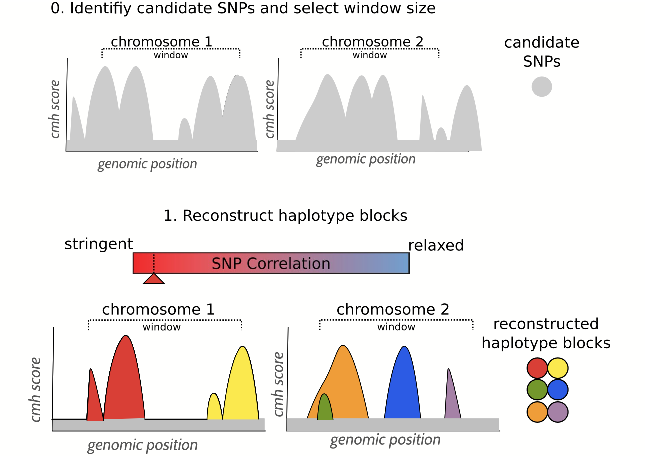
Haplovalidate: block reconstruction
Windows size can be different for each chromosome
Reconstruct clusters for each chromosome, with a stringent correlation

Slide 24
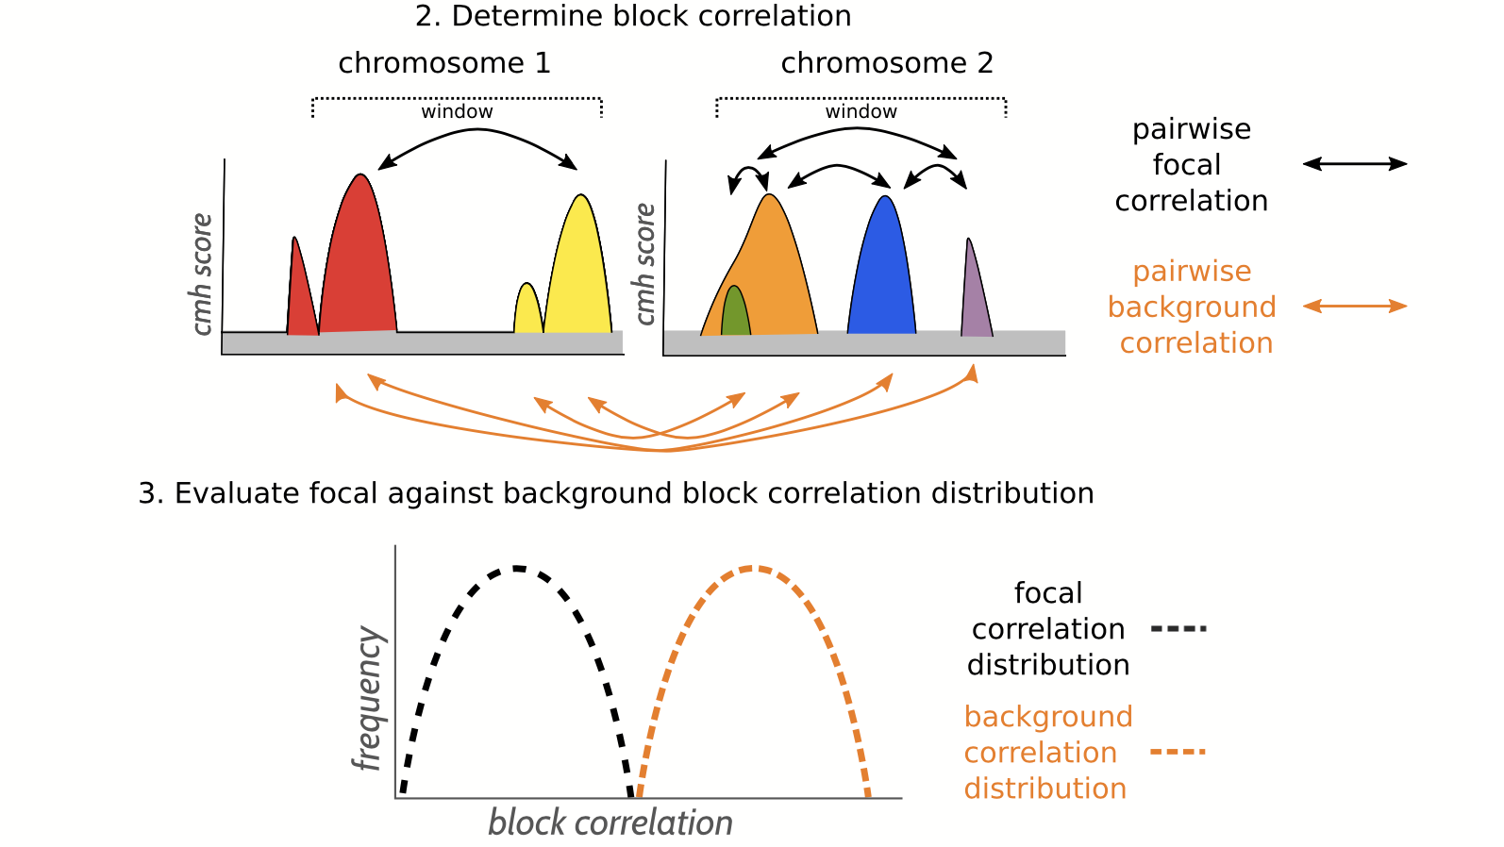
Haplovalidate: block correlation
focal correlation: within chromosome
background correlation: across chromosomes
one sided t-test
H0: focal correlation =< background correlation
H1: focal correlation > background correlation

Slide 25
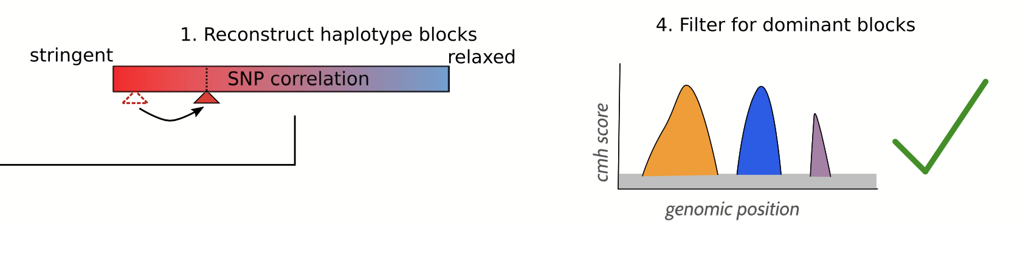
Haplovalidate: block extension
pvalue < 0.025 (H1, focal correlation is higher)
pvalue >0.025 (H0, focal correlation is NOT higher)
start again, with more relaxed correlation
Repeat 1-3 until p value >0.025
Reconstruction is finished

Slide 26
HANDS ON: haplotype reconstruction
Open the code again, go to haplovalidate

Slide 27
Recap
A generalized approach to detect selected haplotype blocks in E&R experiments
Without haplotype data
Need of time series data, several chromosomes
Notes:
if not enough snps mncs up to 3%

Slide 28
How to plot haplotype trajectories
Haplotype information: chromosome, starting position, end position, contributing snps
Get allele trajectories from all SNPs from the haplotype block
Estimate median AF for each time point
Plot median AF
(Optional) Plot a line for each SNP trajectory on the background

Slide 29
HANDS ON: plotting haplotype trajectories
How would you plot the trajectories of your haplotype blocks?

Slide 30
Thanks for the attention!

