Slide 1
WHO’S AFRAID OF THE HYPE BEAST?

Slide 2
An investigation into individual Brands affect on listing price.
Want to focus on T-Shirts
Only want brands that have >1000 listings
Attempt to establish a “multiplier effect” that a brand’s label has on resale price.

Slide 3
But where are we going to look?
We’ve scraped Grailed.com for this project, a notorious website for relisting expensive streetware. (Givenchy, Burberry, Off-White, etc)
The website also has more “affordable” brands, such as Hanes, Fruit of the Loom, and Gildan.
We’ll look to establish a “base price” of T-shirts based on the lowest established price.
We also know that the brands affect price much more on a resale market.

Slide 4
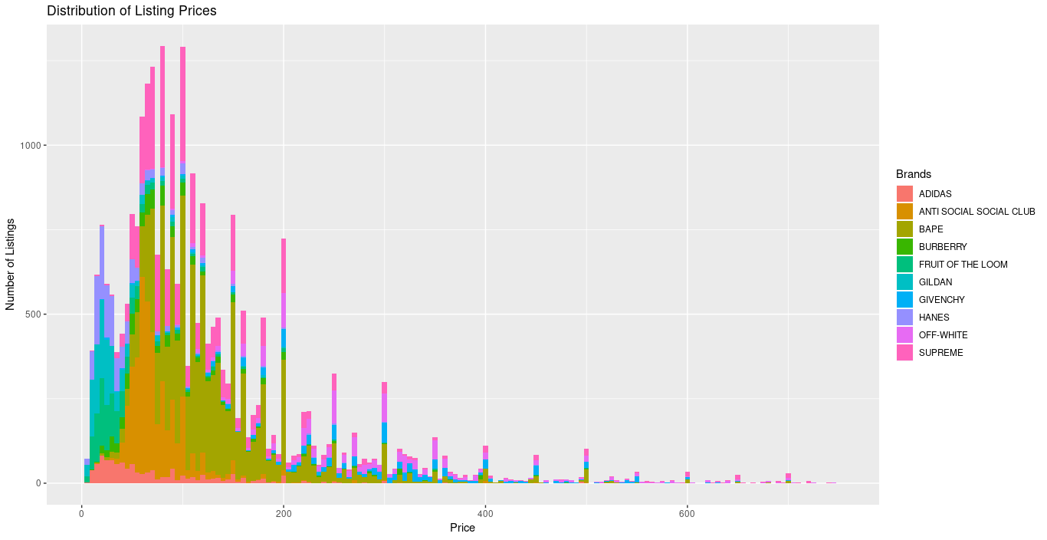

Slide 5
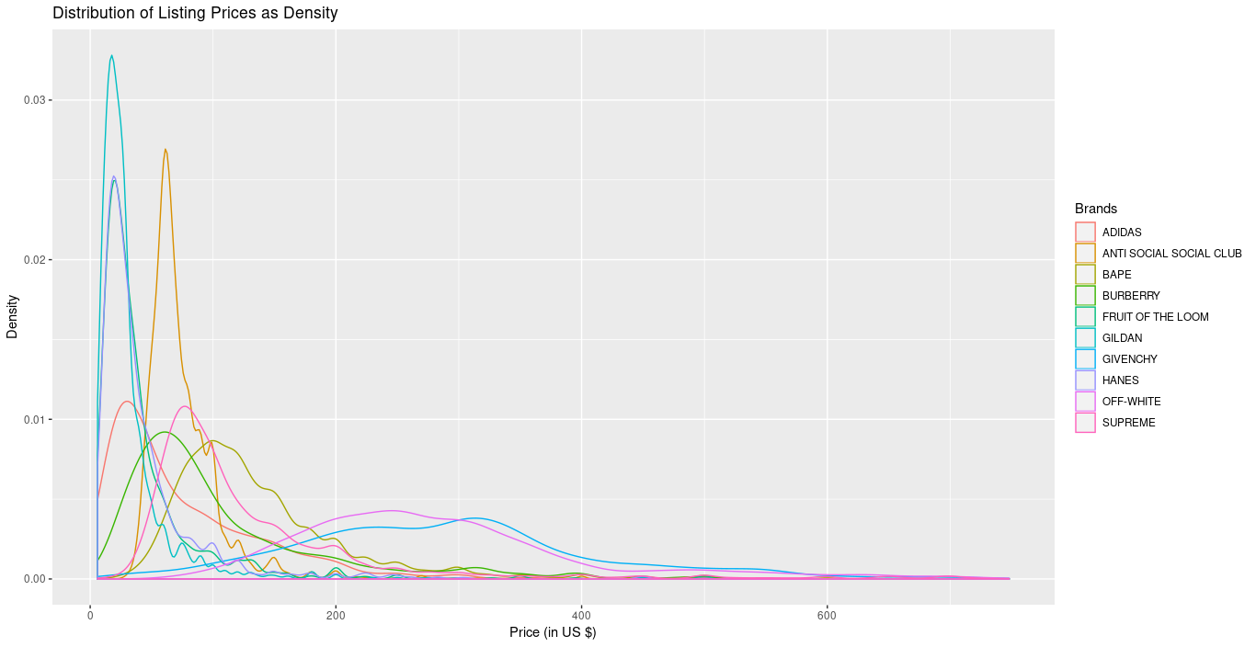

Slide 6
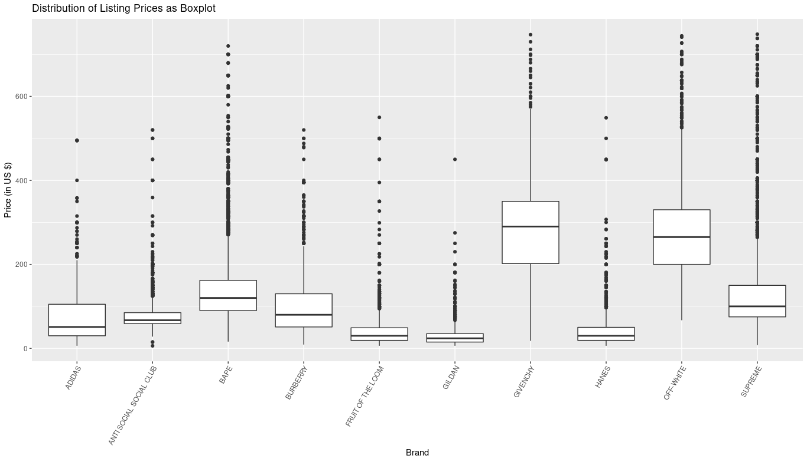

Slide 7
A tale as old as ANOVA
We can see from the previous graphs that certain brands occupy a similar spot near the bottom of the chart.
Running simple ANOVA tests between the lowest means results in showing that GILDAN & the NFL brand are the two lowest means.
We decidely go to use GILDAN as our metric for the multiplier, as the NFL shirts are not representative of a “regular” t-shirt.

Slide 8
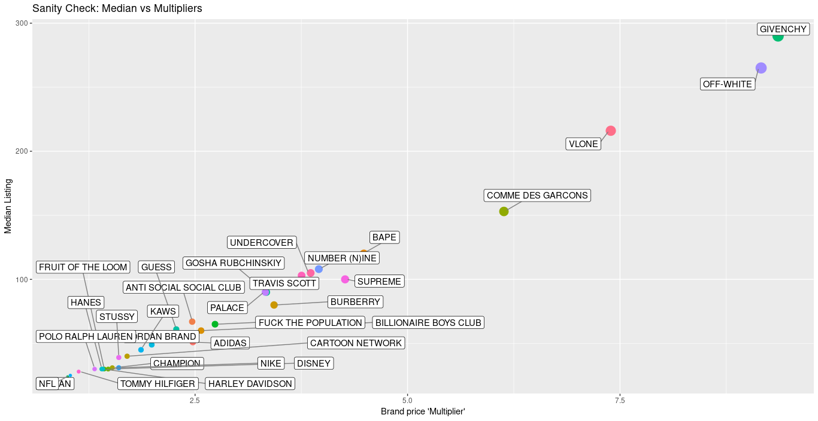

Slide 9
Where do we go from here?
(or, how to make money from Grailed without ever really trying)
Given this information, we can identify the highest profit brands on the website.
Combining with the information of seller’s habits
Write a scrapper that looks for “price dropped” items
????
Profit

Slide 10
A Few Notes on the Process
The overall runtime of the program was 40HRS to collect nearly 210,000 entries from Grailed.
Due to the nature of the Grailed website, countermeasures had to be employed to actually get all of the T-shirt data
driver.execute_script("arguments[0].scrollIntoView();", designers_list[-1]) >>> ActionChains all day long
Crashing issues and solutions

Slide 11

Thank you!
And remember, with this information you too can:

