Slide 1
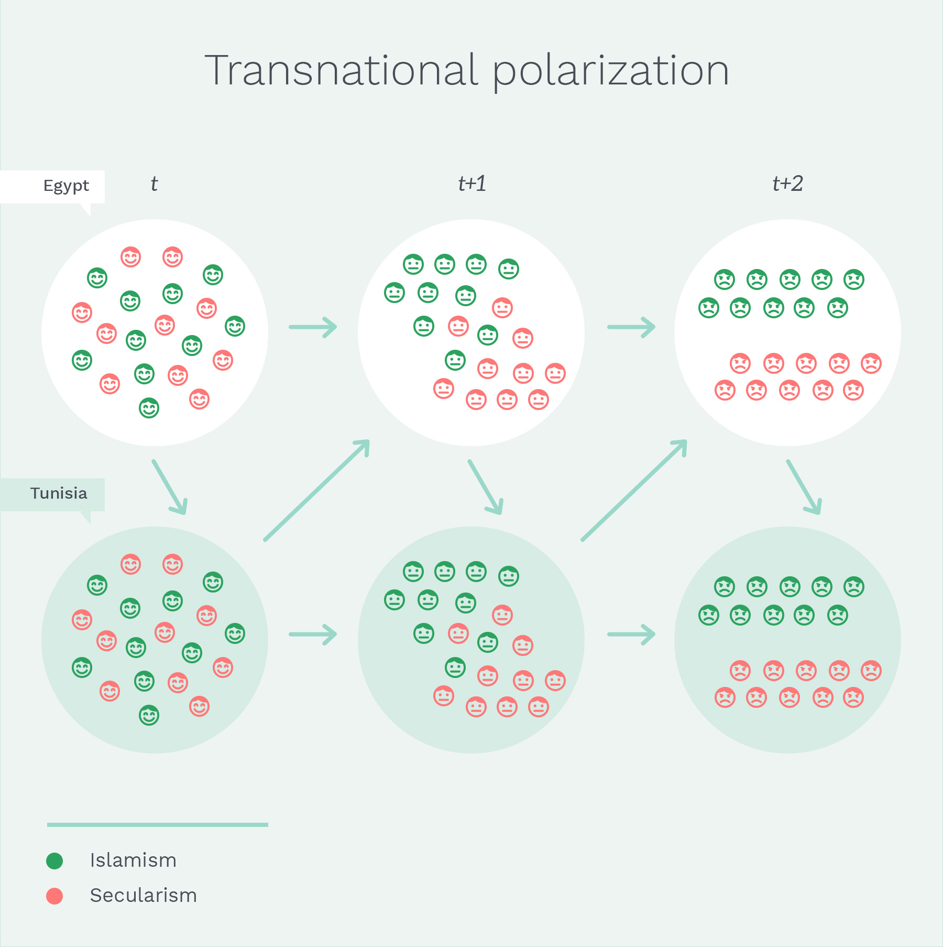
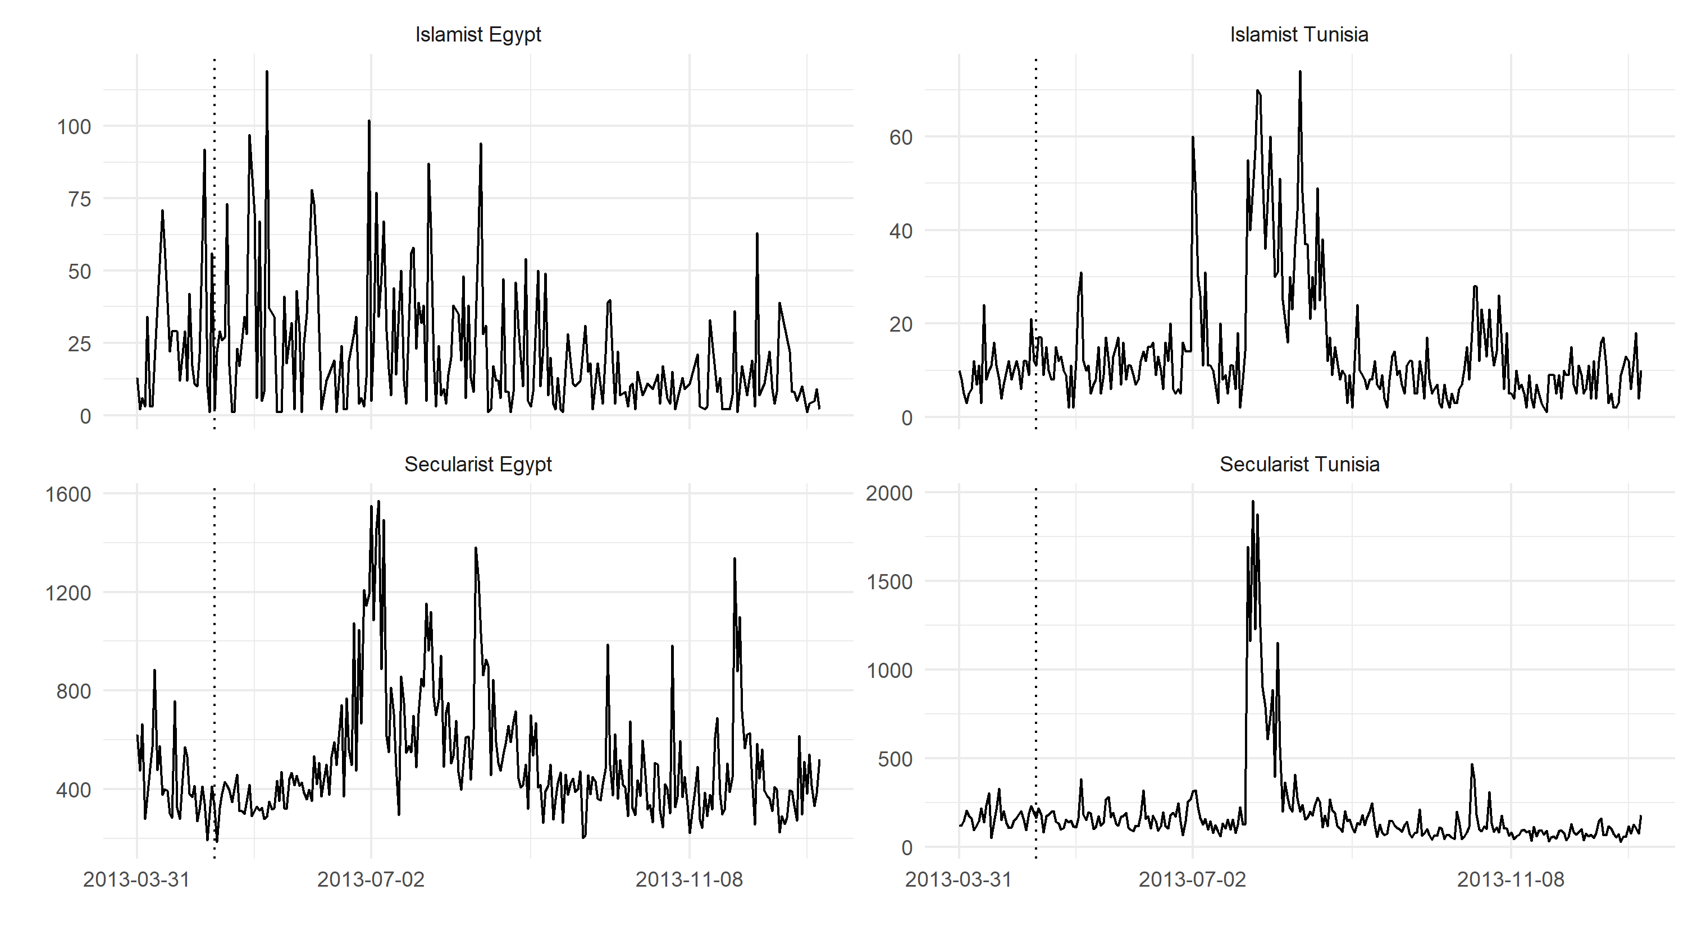
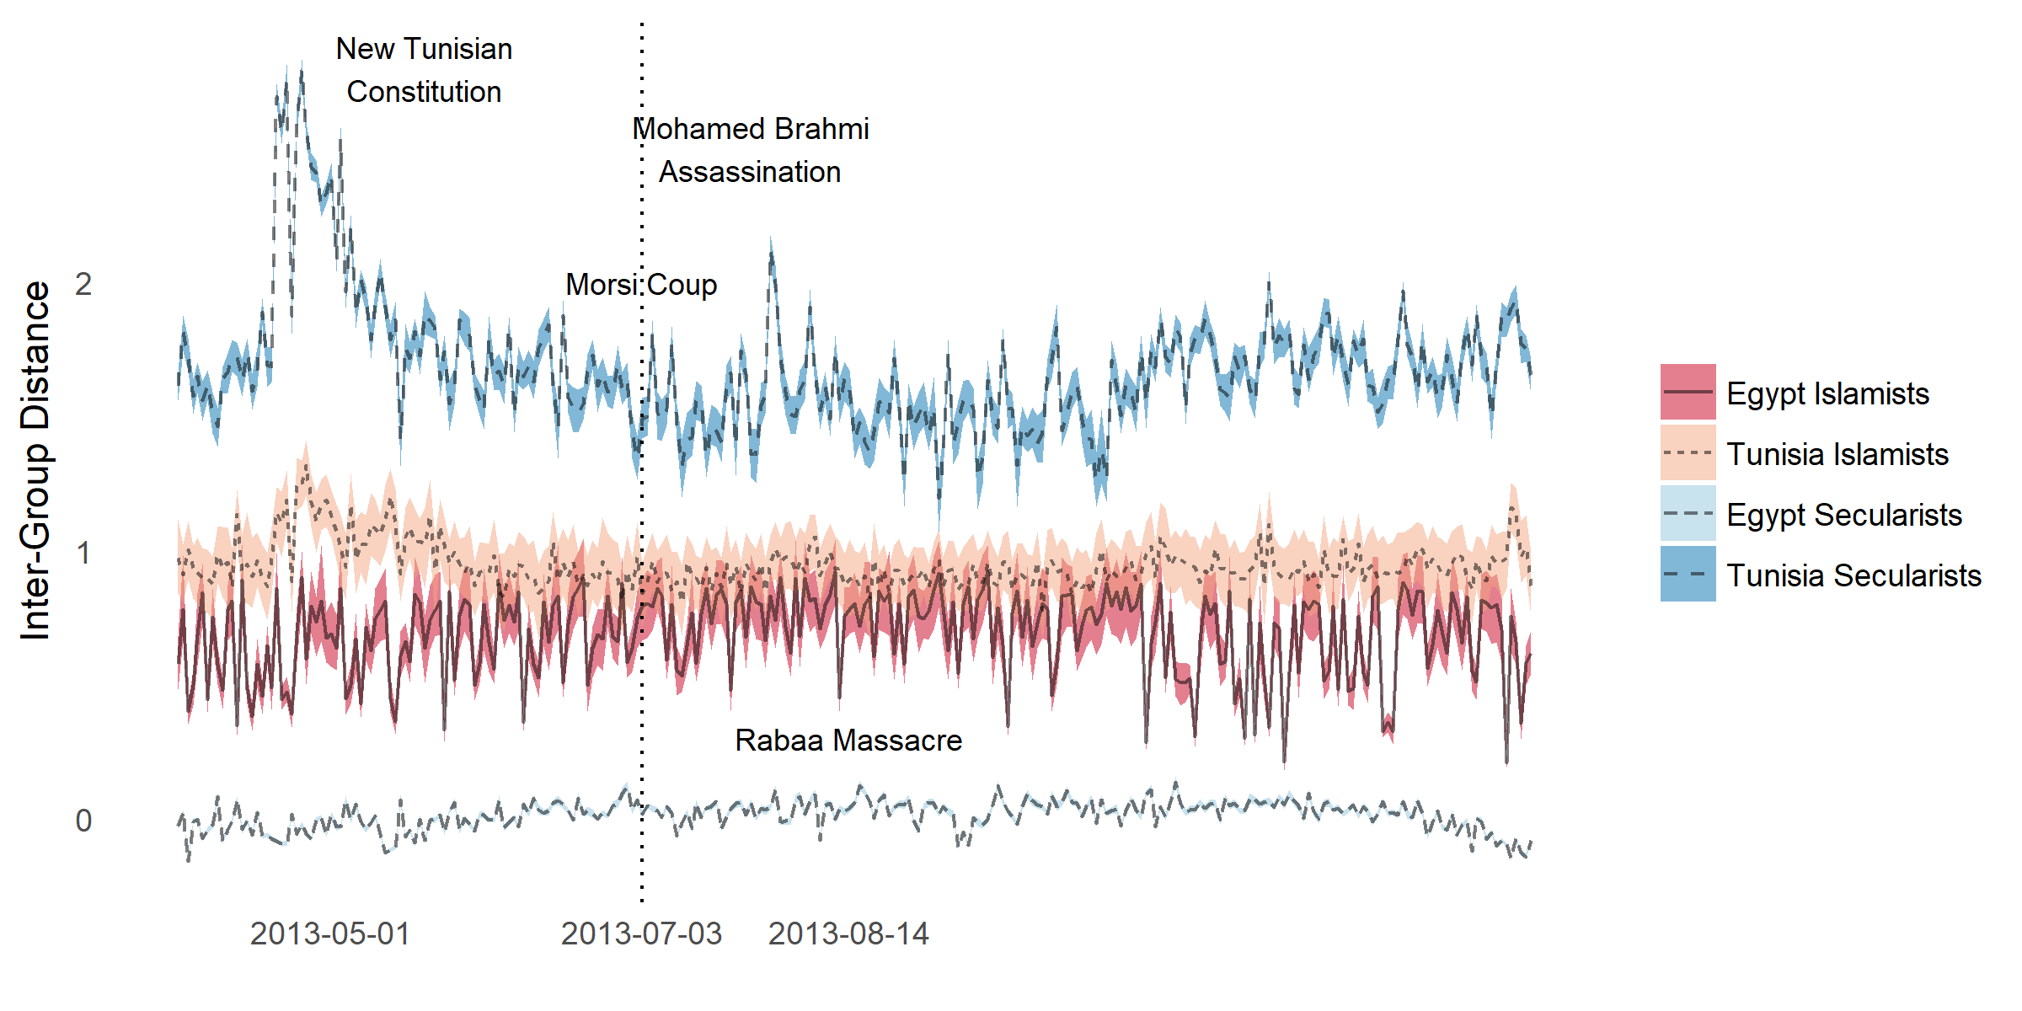
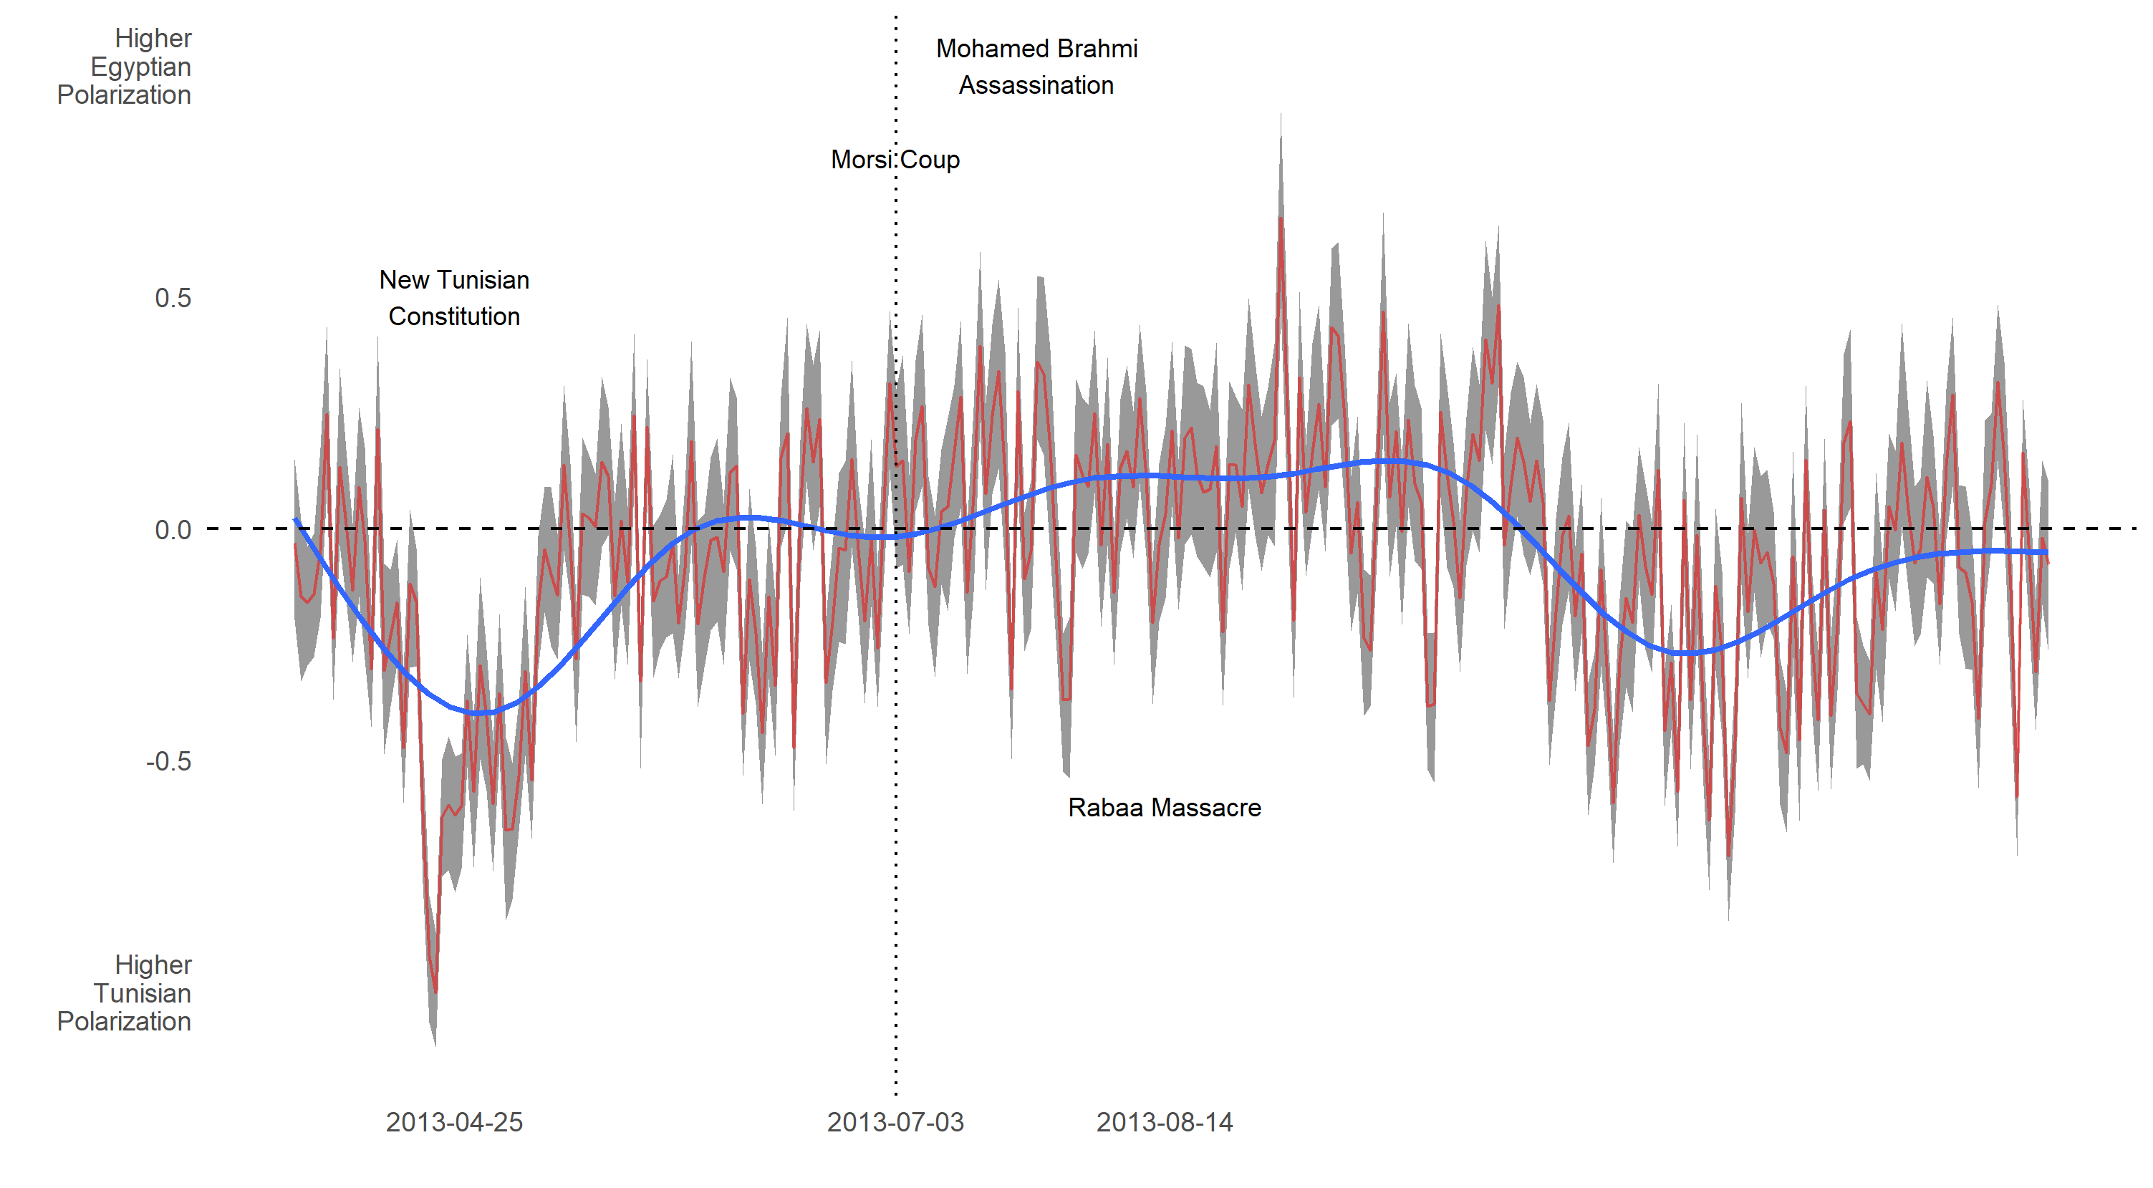
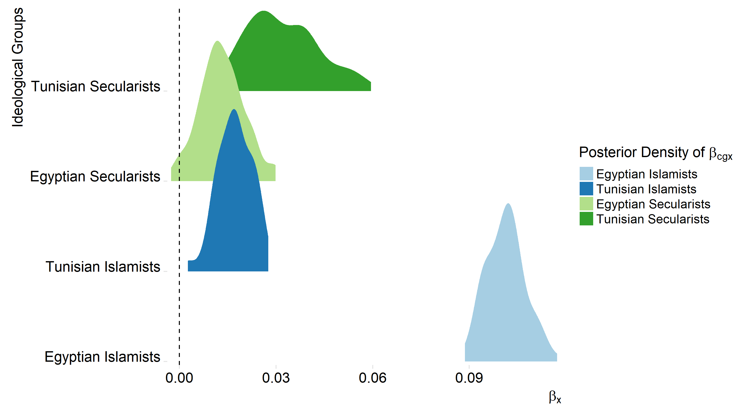
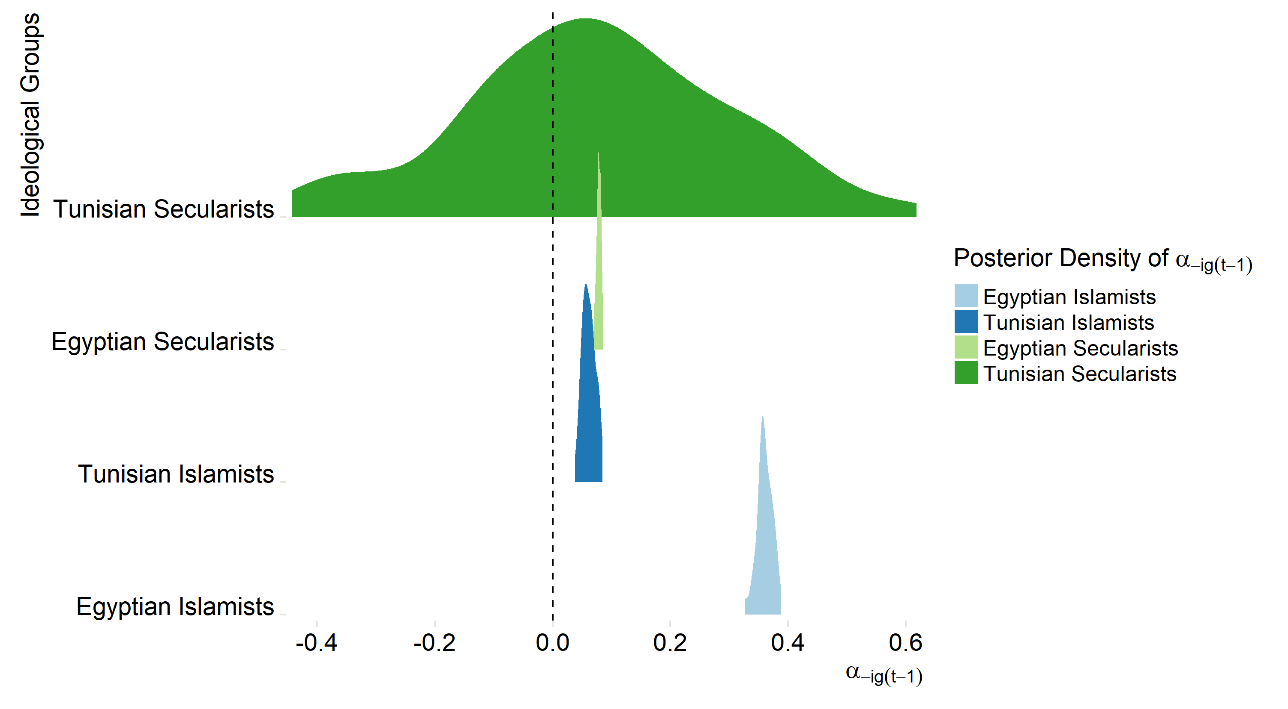
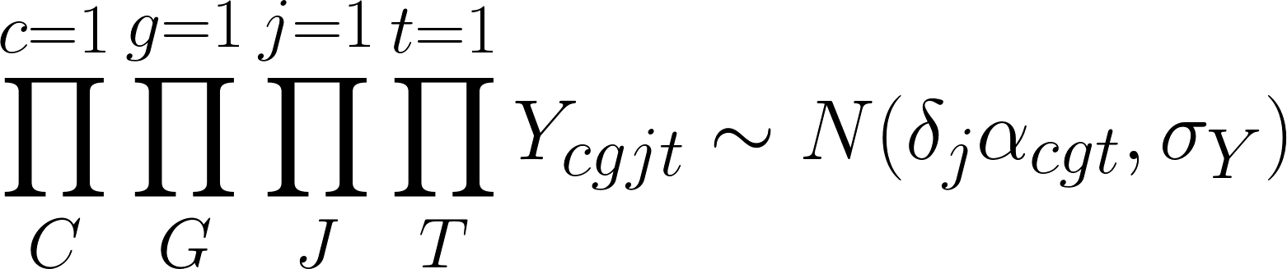
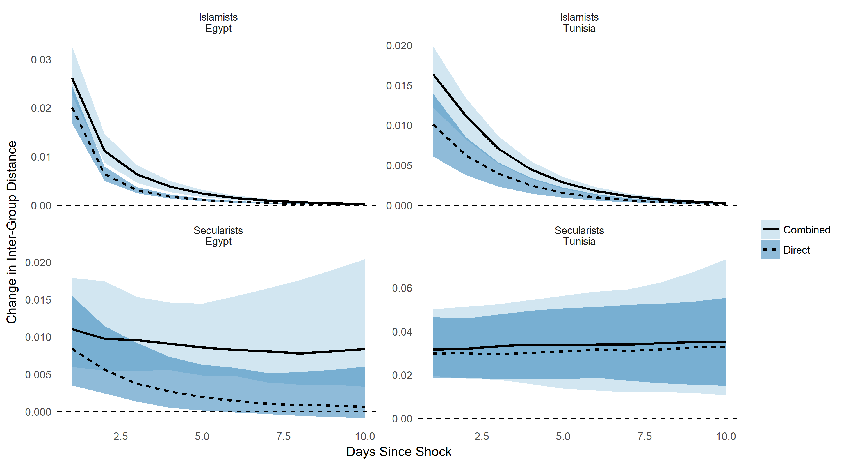
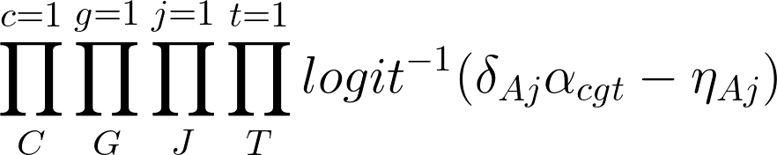
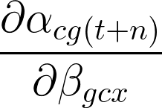
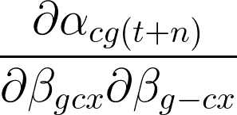
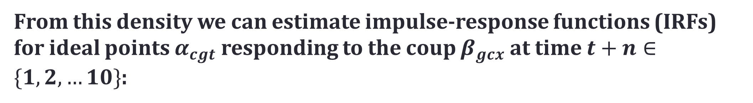
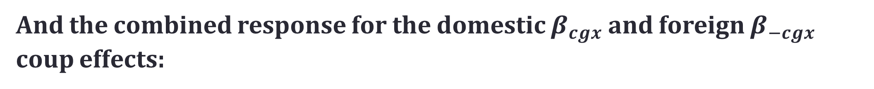
A Seismograph for Transnational Polarization: The Islamist-Secularist Divide During the Arab Uprising
Robert Kubinec and John Owen Department of Politics
Theory
Data: retweet counts
results
Latent Time Series
Over-Time Polarization
Coup Parameters
Adjustment Parameters
Item response theory-vector autoregression (irt-var)
Given $C$ countries, $G$ groups, $J$ citizens, $T$ time points and latent parameter set $θ$, define likelihood $L(Y_{cgjt}≠0|θ)$:
Hypotheses
Combined vs. Direct Impulse-Response Functions
H1 | As the latent ideological position of Islamists or secularists changes, the latent ideological position in the like-minded group in the other state will also change.
H2 | After the coup against Mohammed Morsi, the difference in latent ideological positions between Islamists and secularists will diverge in direct reaction to the coup (direct effect).
H3 | After the coup against Mohammed Morsi, the difference in latent ideological positions between Islamists and secularists will diverge from each group's reaction to their ideological allies' shift in latent ideological position (indirect effect).
H4 | After the coup against Mohammed Morsi, the difference in latent ideological positions between Islamists and secularists from the direct reaction to the coup and each group's reaction to their ideological allies' shift will be greater than the direct reaction to the coup alone (combined effect).
With priors on elite-level ideal point parameters $α_{cgt}$:
And separate likelihood for with latent parameter set $λ$ for missing data $L(Y_{cgjt}=0|λ)$:
We can define the joint posterior density for observed and missing tweet counts:
conclusions
Data: retweet counts
We can estimate and observe transnational polarization using Twitter data if we have an appropriate model (IRT-VAR).
Ideological groups with greater within-group structure, such as Islamists, tend to show greater transnational influence than groups without this structure.
Cross-cutting cleavages, such as concerns over violating democratic norms, can dampen the effects of transnational polarization.
From this density we can estimate impulse-response functions (IRFs) for ideal points $α_{cgt}$ responding to the coup $β_{gcx}$ at time $t+n∈\{1,2,…10\}$:
User | Egyptian Islamists | Egyptian Secularists | Tunisian Islamists
@user1 | 2 | 0 | 0
@user2 | 0 | 0 | 0
@user3 | 1 | 0 | 1
@user4 | 0 | 2 | 0
And the combined response for the domestic $β_{cgx}$ and foreign $β_{−cgx}$ coup effects:

