Slide 1
Getting Off the Gold Standard: A Holistic Approach to Causal Inference with Entropic Causal Graphs
Robert Kubinec
New York University Abu Dhabi

Slide 2

The Gold Standard
The causal inference revolution created a profound respect for randomized control trials as the “gold standard for causality” (Rubin 1974).
Research can only be considered causal if it is either randomized or considered “as-if” randomized (Imbens and Rubin 2015; Little and Rubin 2002).
This creates a hierarchy between research that is causally identified and not causally identified, i.e., descriptive (Imai, King and Stuart 2008).

Slide 3

But What About…
RCTs can fail. Low power, measurement error, and post-hoc analyses can all undermine theoretical causal identification (Gelman and Loken 2013; Nosek et al. 2018).
Scholars continue to perform observational analyses, sometimes arguing these are identified using “quasi-experimental methods.”
Fierce debate about the validity of assumptions in these methods (Kahn-Lang and Lang 2018; Caughey and Sekhon 2011; Rambachan and Roth 2020).

Slide 4
Silver Standards
Maybe causality can’t be reduced to any one particular approach, including potential outcomes.
Imagine instead we have three “silver” standards:
  Counterfactual/manipulationist inference
  Humean/correlational inference
  Mechanistic inference (qualitative)
All of these methods provide partial causal information and none exclusively provide all causal information except under ideal (unrealistic) conditions.

Slide 5
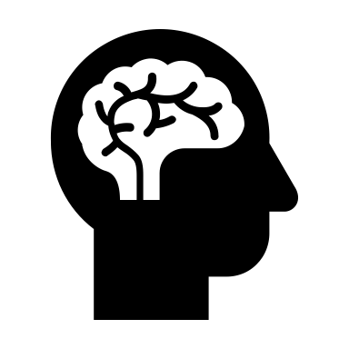
But What… Does It Mean?
I present entropy as a concept for determining the relative causal knowledge gained from a research design.
Entropy analysis shows any silver research design *can* increase causal knowledge.
Causal identification is sufficient but not necessary for causal learning.

Slide 6

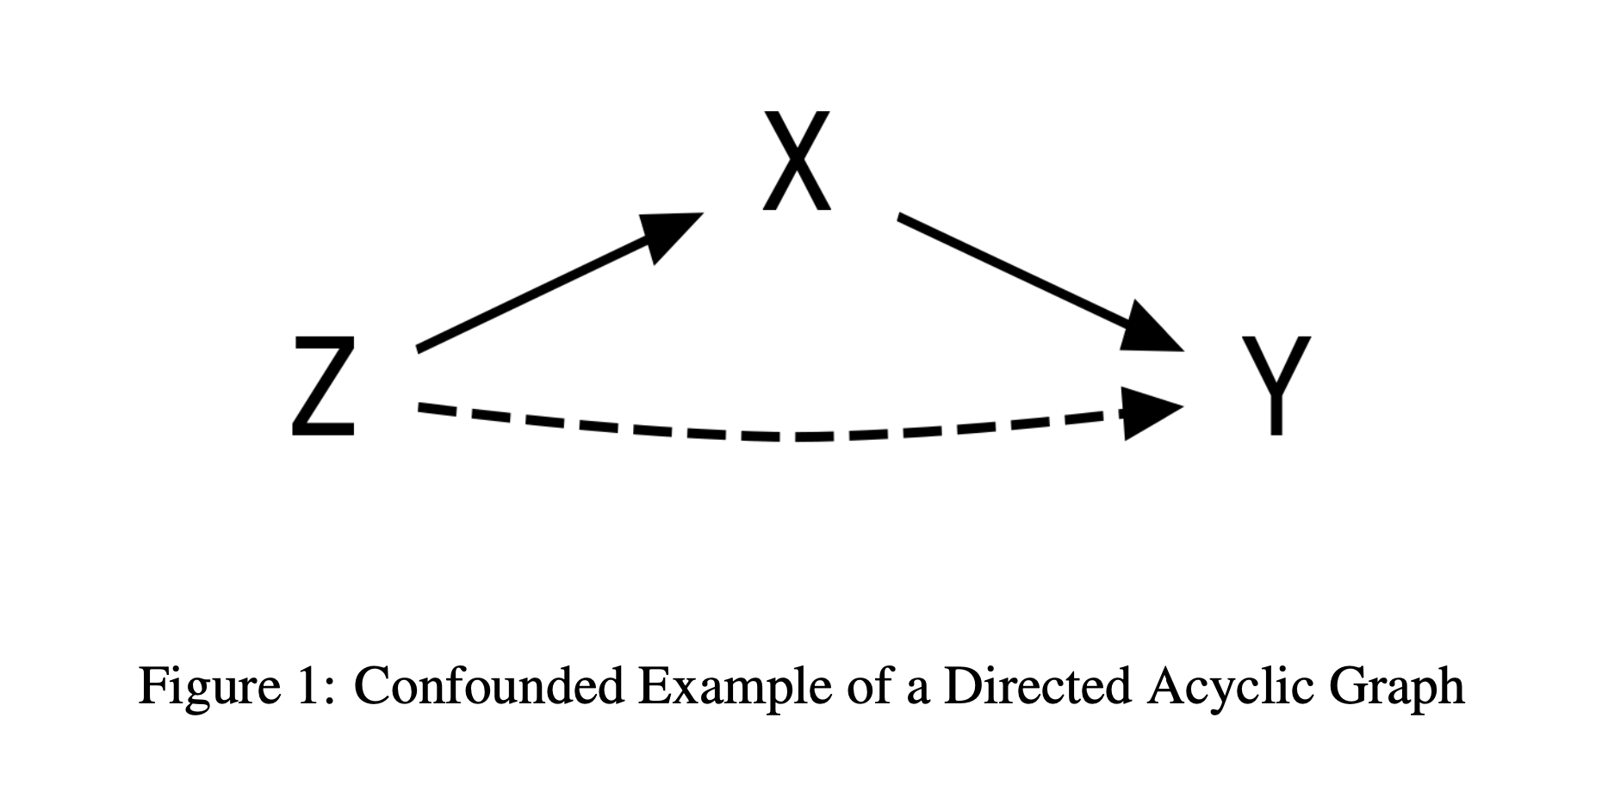


Simple Causal Graph with Confounding

Slide 7
Shannon Entropy
For a given set of N elements of a vector that sums to 1 (i.e., a discrete probability distribution).
Log of 1.01 ensures that each unit increase in entropy = 1% increase.

Slide 8
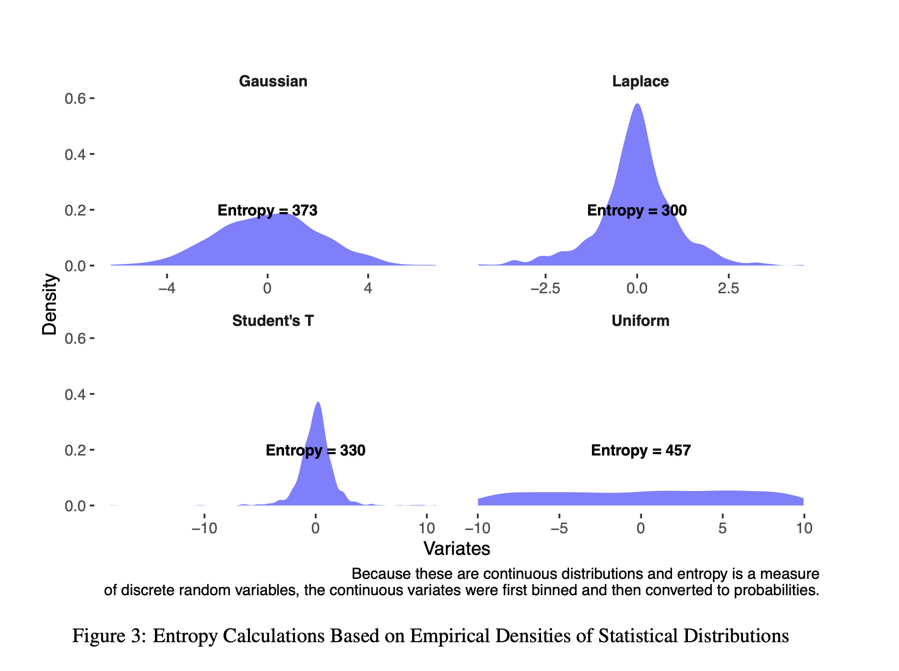
What Does Entropy Look Like?

Slide 9
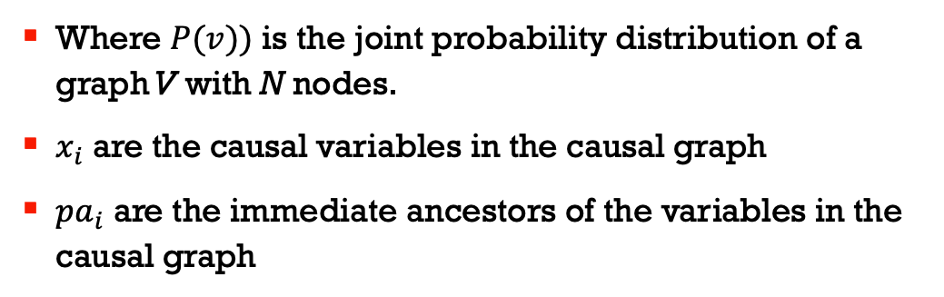
Entropic Measure of Causal Graphs
Where $P(v))$ is the joint probability distribution of a graph V with N nodes.
$x_{i}$ are the causal variables in the causal graph
$pa_{i}$ are the immediate ancestors of the variables in the causal graph

Slide 10
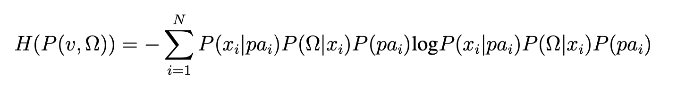
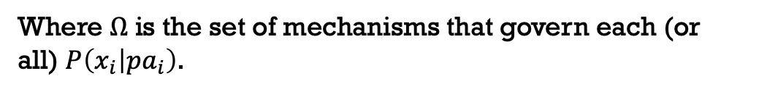
Entropy with Mechanisms
Where $Ω$ is the set of mechanisms that govern each (or all) $P\left(x_{i} | pa_{i}\right)$.

Slide 11
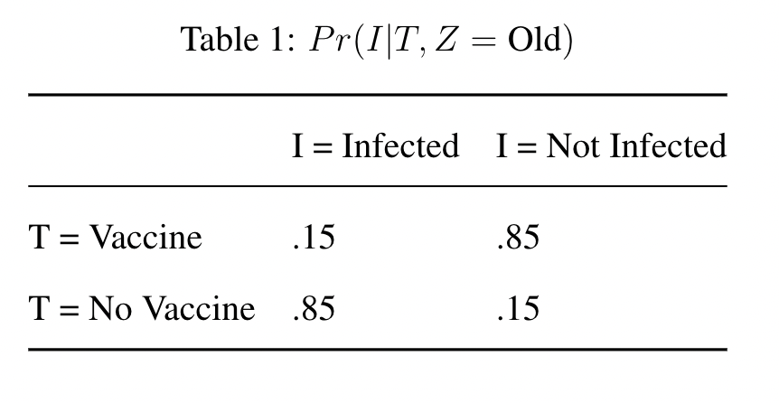
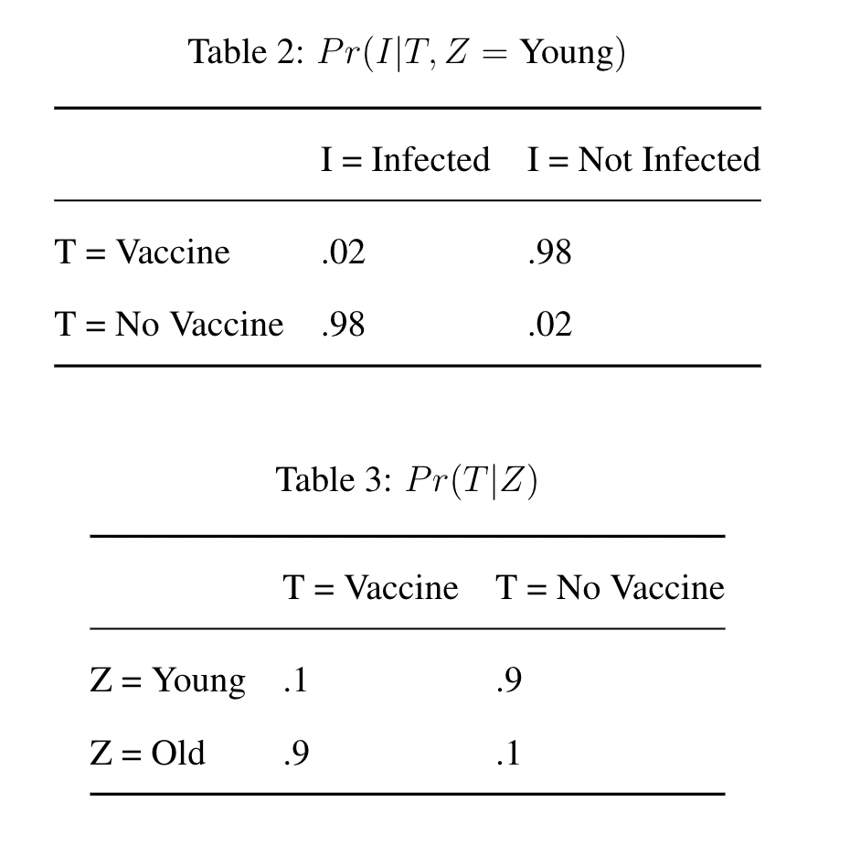
Case Study: Vaccines
Where I is for COVID-19 infection,
T is for vaccine,
Z is age, a confounder
  Young or
  Old

Slide 12
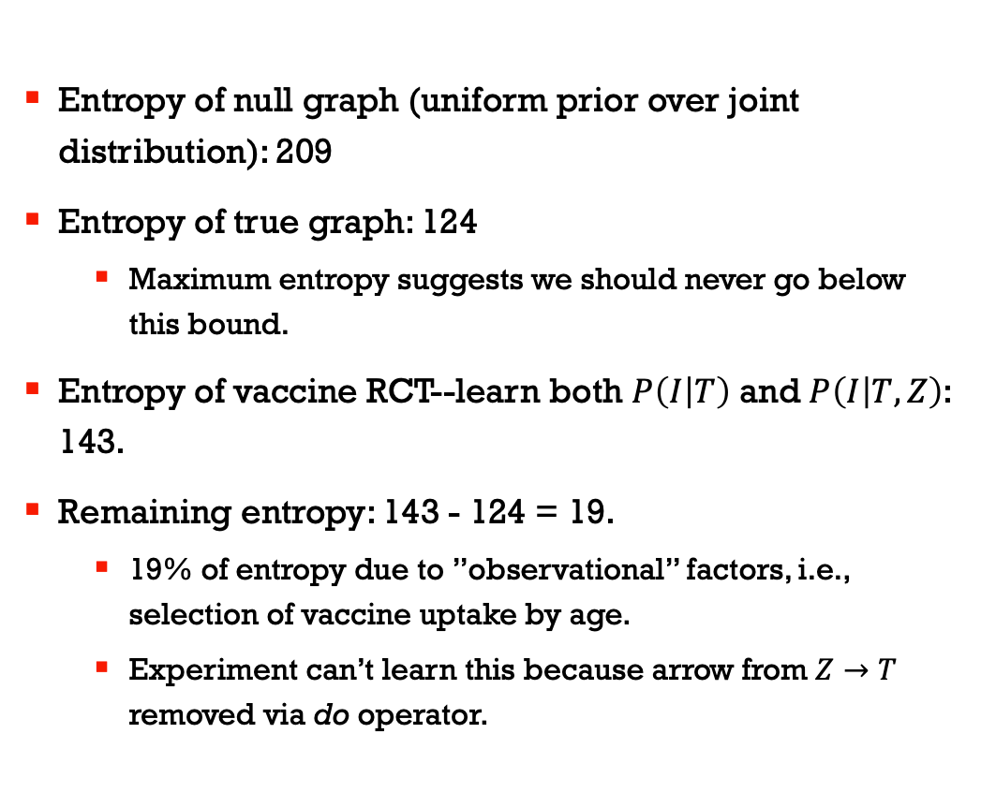
Entropy of Various Research Designs
Entropy of null graph (uniform prior over joint distribution): 209
Entropy of true graph: 124
  Maximum entropy suggests we should never go below this bound.
Entropy of vaccine RCT--learn both $P\left(I | T\right)$ and $P\left(I | T,Z\right)$: 143.
Remaining entropy: 143 - 124 = 19.
  19% of entropy due to ”observational” factors, i.e., selection of vaccine uptake by age.
  Experiment can’t learn this because arrow from $Z→T$ removed via do operator.

Slide 13
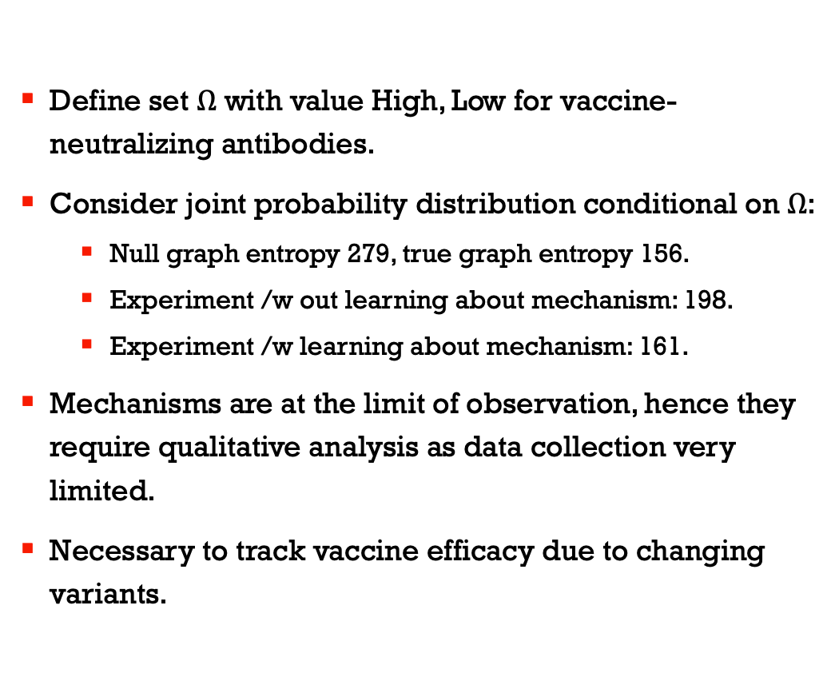
We Can Include Mechanisms
Define set $Ω$ with value High, Low for vaccine-neutralizing antibodies.
Consider joint probability distribution conditional on $Ω$:
  Null graph entropy 279, true graph entropy 156.
  Experiment /w out learning about mechanism: 198.
  Experiment /w learning about mechanism: 161.
Mechanisms are at the limit of observation, hence they require qualitative analysis as data collection very limited.
Necessary to track vaccine efficacy due to changing variants.

Slide 14
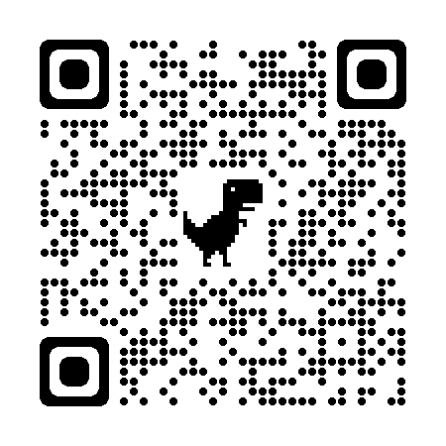
Conclusion
Case study about COVID-19 vaccines shows that:
  Scientists did not just rely on RCTs to track efficacy.
  Observational analysis not identified but still results in causal learning.
  Qualitative inference valuable but overlooked.
Suggestion:
  Replace “descriptive” with modifier about amount of causal knowledge (i.e., this study would produce small/medium/high amounts of causal knowledge).
  Causal knowledge/value of study requires appraisal of existing state of knowledge about the causal process (i.e., the null graph).
Paper Link:

