Slide 1

OOP PROJECT
Muhammad Saud Nasir Khan (22P-9227)

Slide 2

CAR RENTAL SYSTEM
Welcome to my object-oriented programming lab project on the Car Rental System. In this project, I have implemented a comprehensive and user-friendly system that enables customers to rent cars from a rental agency. The system is built using object-oriented programming principles, which allows for modular and reusable code.

Slide 3
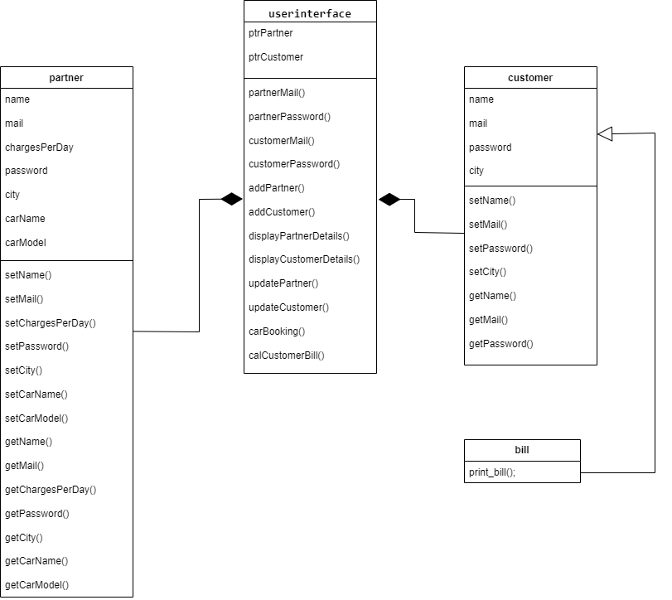
CLASS DIAGRAM

