Slide 1

CONSTRUCTION OPERATIONS
Intelligence Platform
An AI operations platform for construction companies — built to run a real portfolio, not just demonstrate one.
Built by Saud Rawdhan

Slide 2





Construction runs on documents nobody reads twice
Meeting minutes, site reports, purchase requests, RFIs, and claims pile up across every project. Decisions get made, forgotten, and re-litigated. A supplier's poor delivery history sits invisible in a spreadsheet until a project is already late. When a claim goes to arbitration, nobody can quickly assemble the change orders and decisions that support it.
Meeting minutes
Site reports
Purchase requests
The problem is not missing data.
RFIs
It is that the data does not talk to itself.
Claims
Construction Operations Intelligence Platform
2

Slide 3
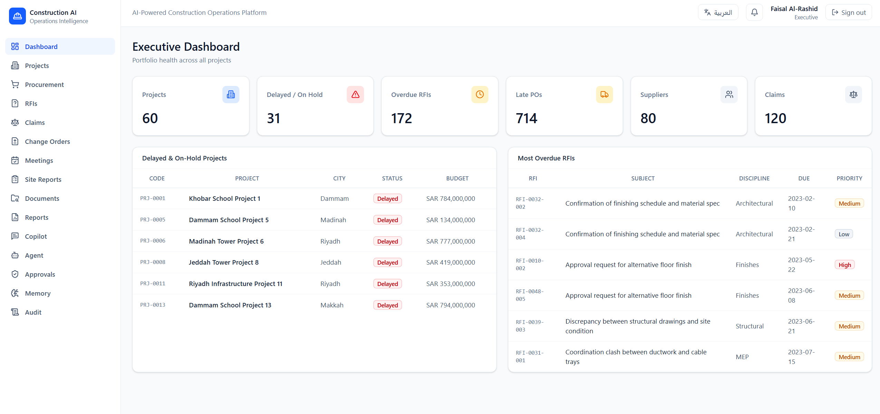
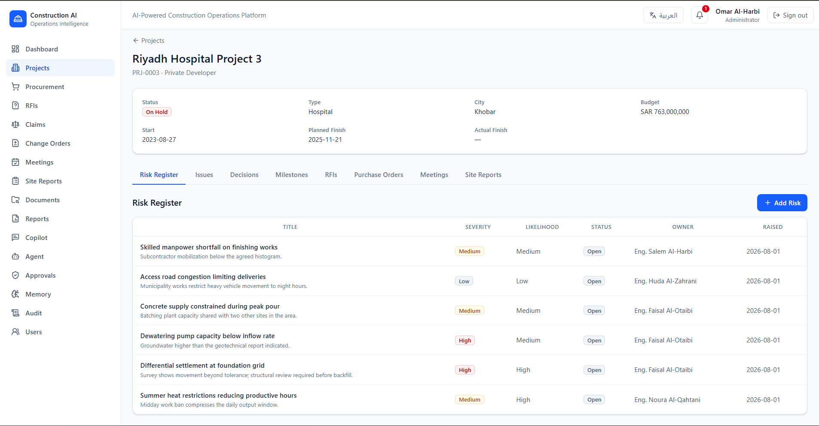
One platform that turns paperwork into decisions
The platform ingests project data, keeps an organizational memory of what was decided and why, runs AI workflows over the operational record, and answers management's questions — every AI answer traced back to the records it came from, every high-risk action held behind human approval.
Executive Dashboard — real portfolio KPIs at a glance
Project workspace — risk register for a live project
Construction Operations Intelligence Platform
3

Slide 4




Nine modules, one shared operational record
Everything a project team touches lives in the same system — queryable, filterable, and connected across modules, not siloed spreadsheets.
Projects
Procurement
RFIs & Change Orders
Portfolio, budgets, milestones
Requests, orders, suppliers
Cause, cost, and schedule impact
Claims
Meetings
Site Reports
Evidence chains, import
Minutes, actions, decisions
Field progress and delays
Documents
Copilot
Governance & Audit
Ingested, chunked, searchable
Grounded Q&A over the record
Approvals and full audit log
Construction Operations Intelligence Platform
4

Slide 5




Six AI workflows, each grounded in real computation
Purchase Request Review
Meeting Summary
Flags missing information and risk, weighted by the supplier's real delivery history.
Extracts action items, decisions, and risks from raw minutes.
Supplier Risk Assessment
Site Report Analysis
Scores a supplier from on-time rate, non-conformances, and delay patterns.
Extracts delays, risks, and an escalation recommendation from a field report.
RFI Escalation
Executive Weekly Report
Finds overdue RFIs and drafts a suggested action for each.
Aggregates portfolio KPIs into a written executive narrative.
Construction Operations Intelligence Platform
5

Slide 6



Organizational memory that grows on its own
Every workflow reads from and writes to a searchable memory of decisions, risks, lessons learned, and supplier performance — each record carrying the source it came from. A memory-extraction agent turns free text into categorized, confidence-scored memories without anyone filing a report.
Raw text
(minutes, reports, documents)
Memory-extraction agent
Categorized, confidence-scored memory
A review is informed by every past finding — and adds to it.
Read by every future workflow
Construction Operations Intelligence Platform
6

Slide 7
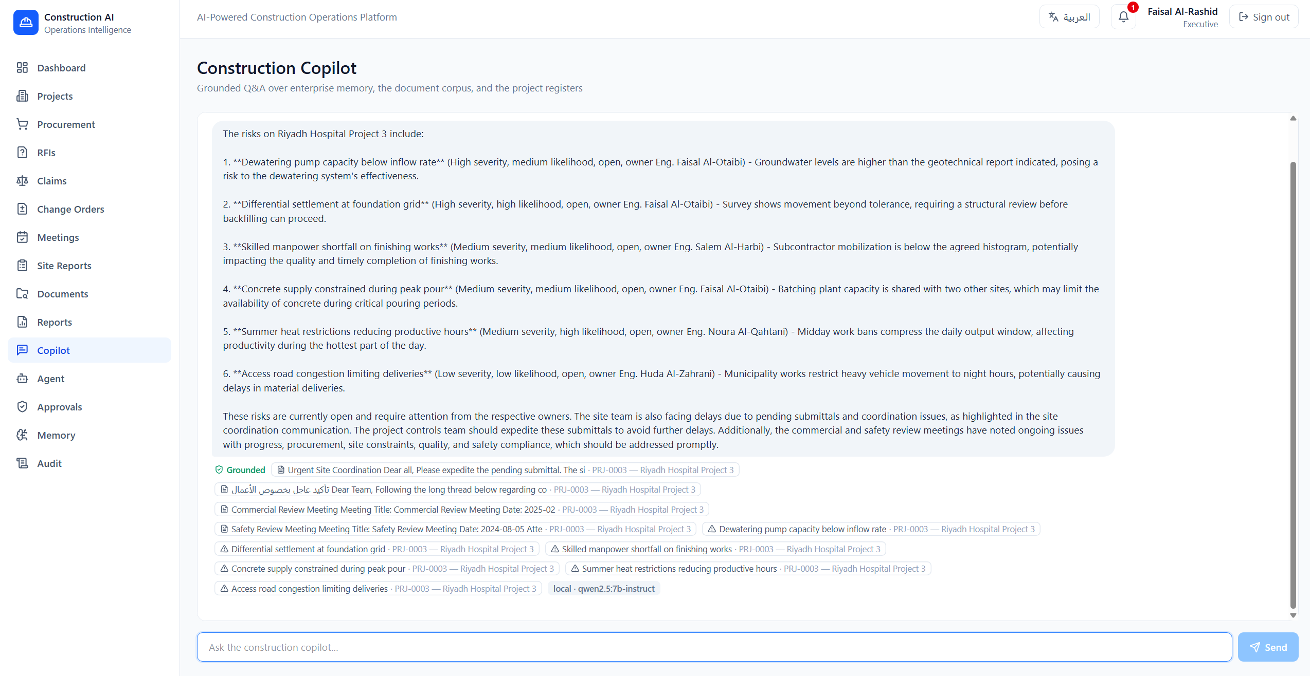
A copilot that refuses to guess
Ask about a named project and retrieval is scoped to it, so one project's records are never presented as another's. Every answer cites its sources, and when there is no evidence, it says so instead of inventing one.
0
answers without a cited source
2
languages — replies in the language asked
Construction Operations Intelligence Platform
7

Slide 8
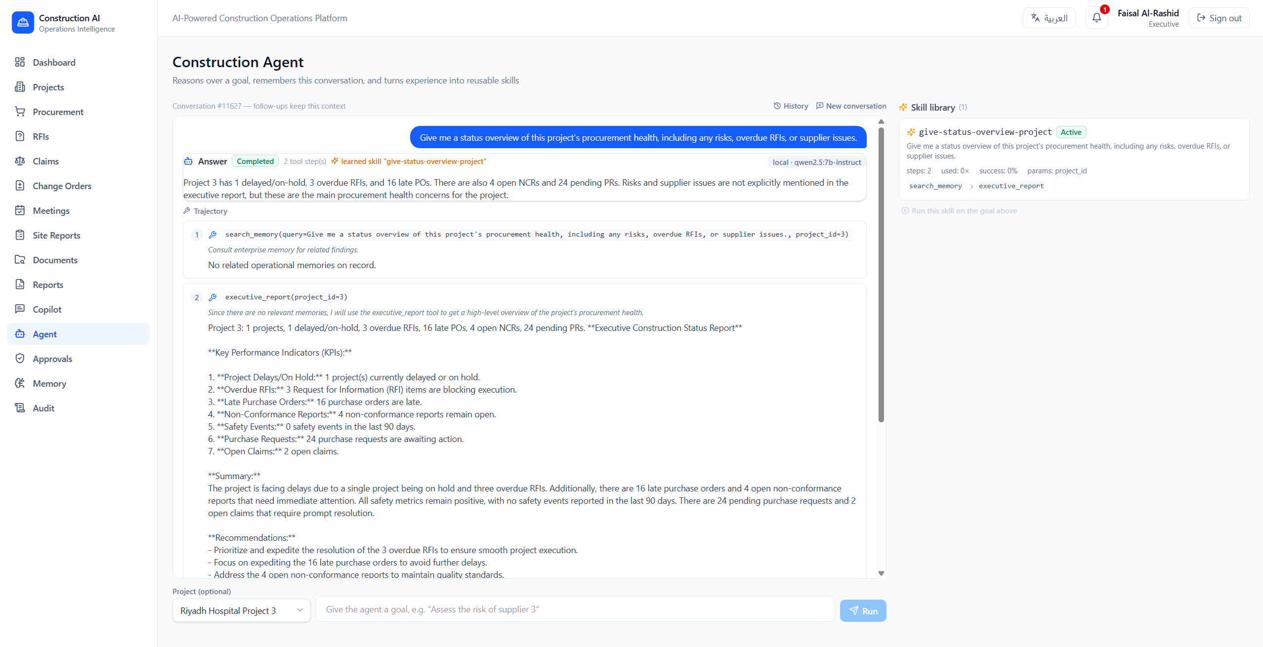
An agent that plans, acts, and remembers
Chains tool calls across all six workflows and direct lookups to reach a goal.
Turns a solved task into a named, reusable skill — shown here, learned live.
Every tool enforces the same RBAC as its direct API, even on a replayed skill.
Treats retrieved content as data, never instructions — flags embedded overrides.
Construction Operations Intelligence Platform
8

Slide 9
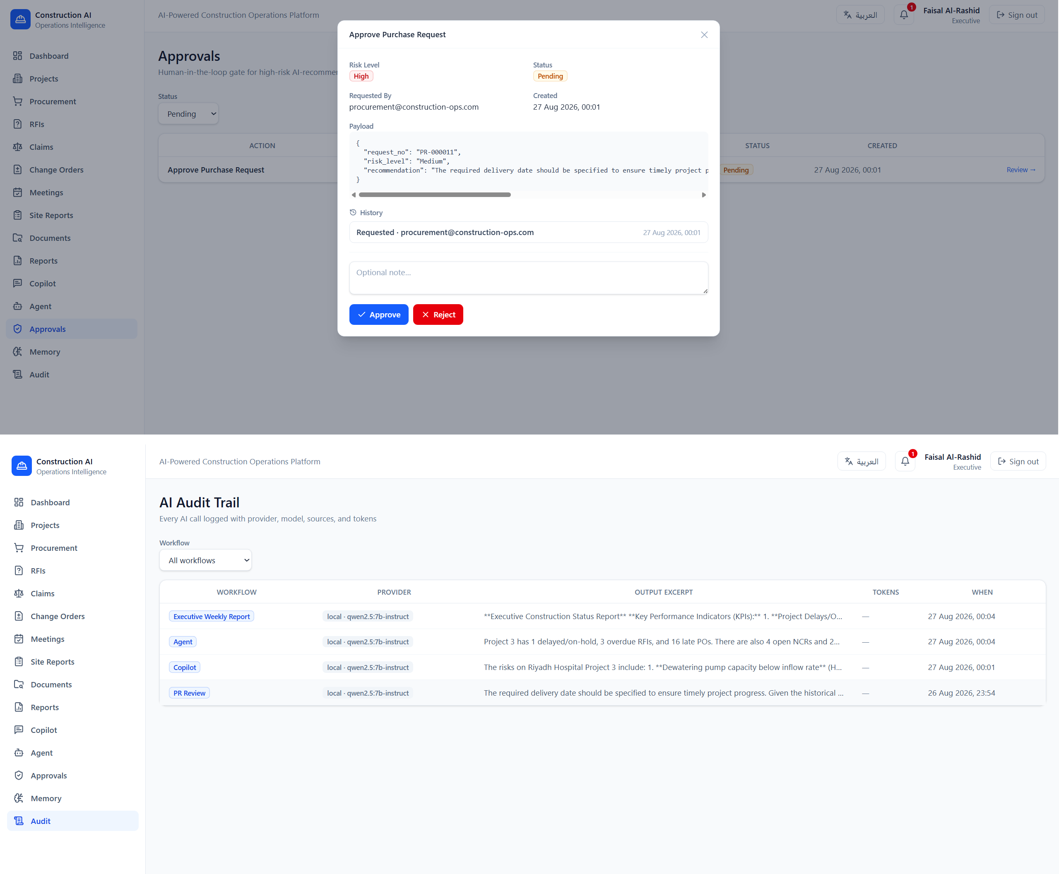
Governed by design, not by policy document
Any sensitive action becomes an approval request — the AI never executes alone.
Approving it moves the record forward: the request itself becomes Approved.
Seven-role RBAC; every route and every agent tool checks the same gate.
Every AI call is logged: who asked, what ran, and what it returned.
Construction Operations Intelligence Platform
9

Slide 10
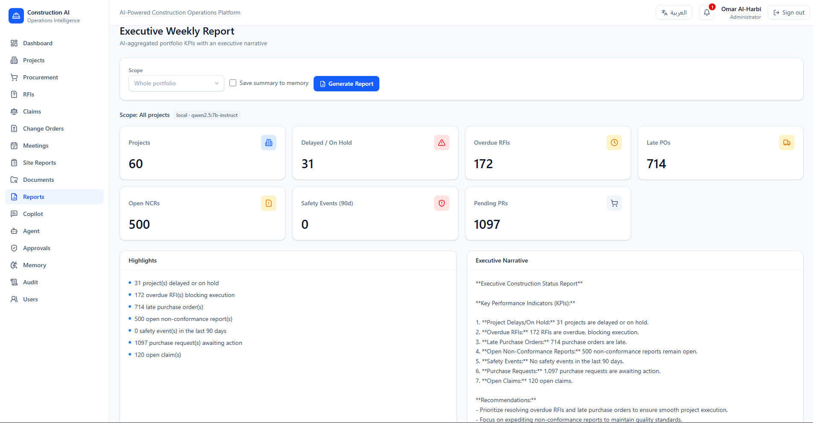

Numbers are computed, not generated
Every figure a decision depends on is computed in code from the database — never restated by the model. The language model is used only for what it is actually good at: reading unstructured text and writing prose.
Computed in code
KPI tiles: on-time rates, overdue counts, totals — byte-exact against the database.
Generated by the model
The narrative below them: judgment and prose, never a number of its own.
A real executive report — computed tiles above, AI narrative below
Construction Operations Intelligence Platform
10

Slide 11
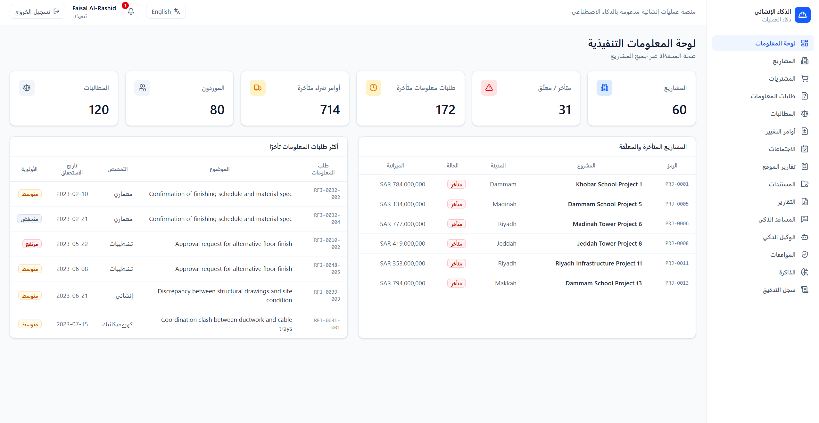
Built bilingual, tested like production software
368
41
9
7
automated tests
database tables
functional modules
RBAC roles
Arabic runs right-to-left throughout the interface, and AI-generated reports, reviews, and summaries are written natively in the language of the request — not machine-translated afterward. CI runs lint, typecheck, build, and translation-parity checks on every change.
The same interface, fully right-to-left
Construction Operations Intelligence Platform
11

Slide 12


Built on a modern, typed, async stack
Backend
Frontend
AI Layer
FastAPI · Pydantic v2
SQLAlchemy 2.0 (async) · Alembic
PostgreSQL 16 + pgvector
Redis 7 + arq worker
React 18 · TypeScript
Vite
Tailwind CSS
Full English/Arabic i18n
Hand-written agent core — no framework
Provider-agnostic LLM client
Hybrid RAG: pgvector + full-text, fused by RRF
Gemini, Groq, OpenAI, or local — one env variable
Construction Operations Intelligence Platform
12

Slide 13


Explore the project
A production-shaped platform for construction operations — designed to be run, not just demonstrated.
github.com/saudrawdhan/construction-ai-platform
linkedin.com/in/saud-rawdhan
Saud Rawdhan

