Slide 1
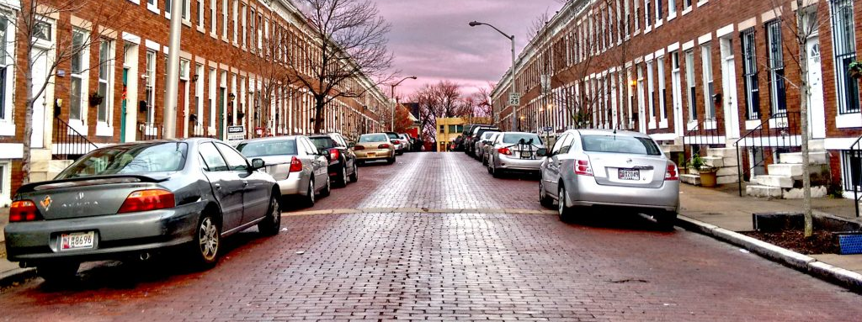
Predicting Housing Price Change with Yelp Data
Notes:
Hi I’m Stephanie and today I’m going to talk to you about predicting housing price change with yelp data.

Slide 2
Purpose
Prediction
Real estate investment
City planning and policy implementation
“Nowcasting”
Explanation
Insight into factors that contribute to neighborhood change
Notes:
- Predicting a turn toward higher prices neighborhoods can be advantageous for a range of parties, from real estate investors looking to cash in to city planners interested in mitigating the effects of gentrification.
- Yelp has the potential to tell us where neighborhood changes are occurring in real time, before public statistics become available (like the census). This is referred to as nowcasting and it is really
Explanation :
- Were interested in gaining insight into how neighborhoods change over time – what factors contribute to change

Slide 3
Methods
Methods
Data Collection
Linear Regression
Cross Validation
Results
Notes:
- Broad overview
- Data collection involved a combination of web scraping and downloading readily available datasets from Yelp and Zillow.
- I used an iterative process of Linear regression for modeling and cross validation to select which type of linear regression was best and to improve model performance.

Slide 4




Tools
Notes:
My main tools – scikit learn for linear regression and did all of my work with python and it is available on GitHub in Jupyter notebooks.

Slide 5

Target Variable
Percent change over a 10-year period (2009-2018)
Aggregated by zip code
659 unique zip codes
Notes:
371 cities and towns across the U.S.

Slide 6
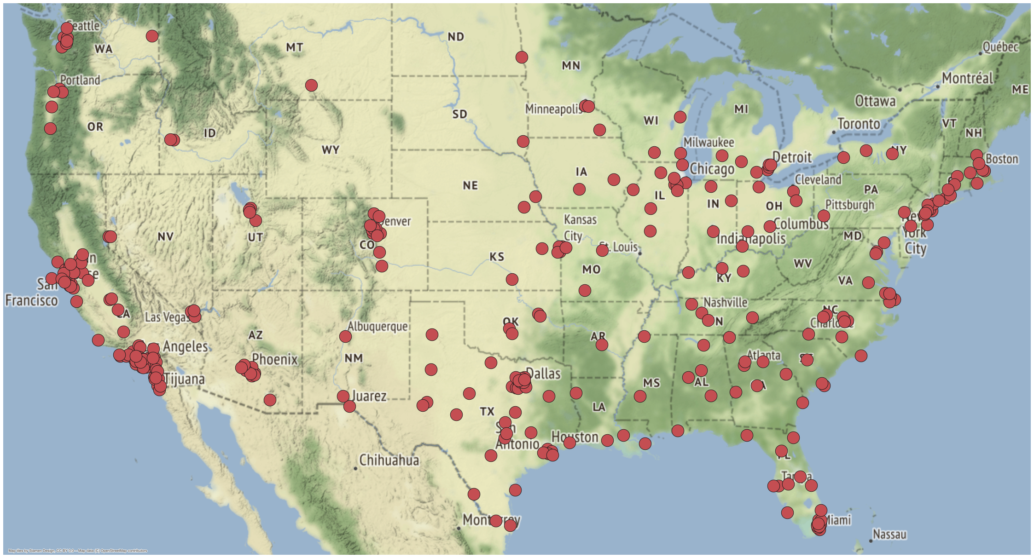
Cities Included in analysis

Slide 7

Feature Variables
Number of open businesses
Average number of Reviews
Average star rating
Business diversity
Trendy food
Total number of photos
Notes:
Business diversity = number of unique categories/total number of possible categories
Trendy food: Sushi, cocktail bars, breweries, coffee, avocado toast, etc.
- Total photos posted on yelp per zip

Slide 8
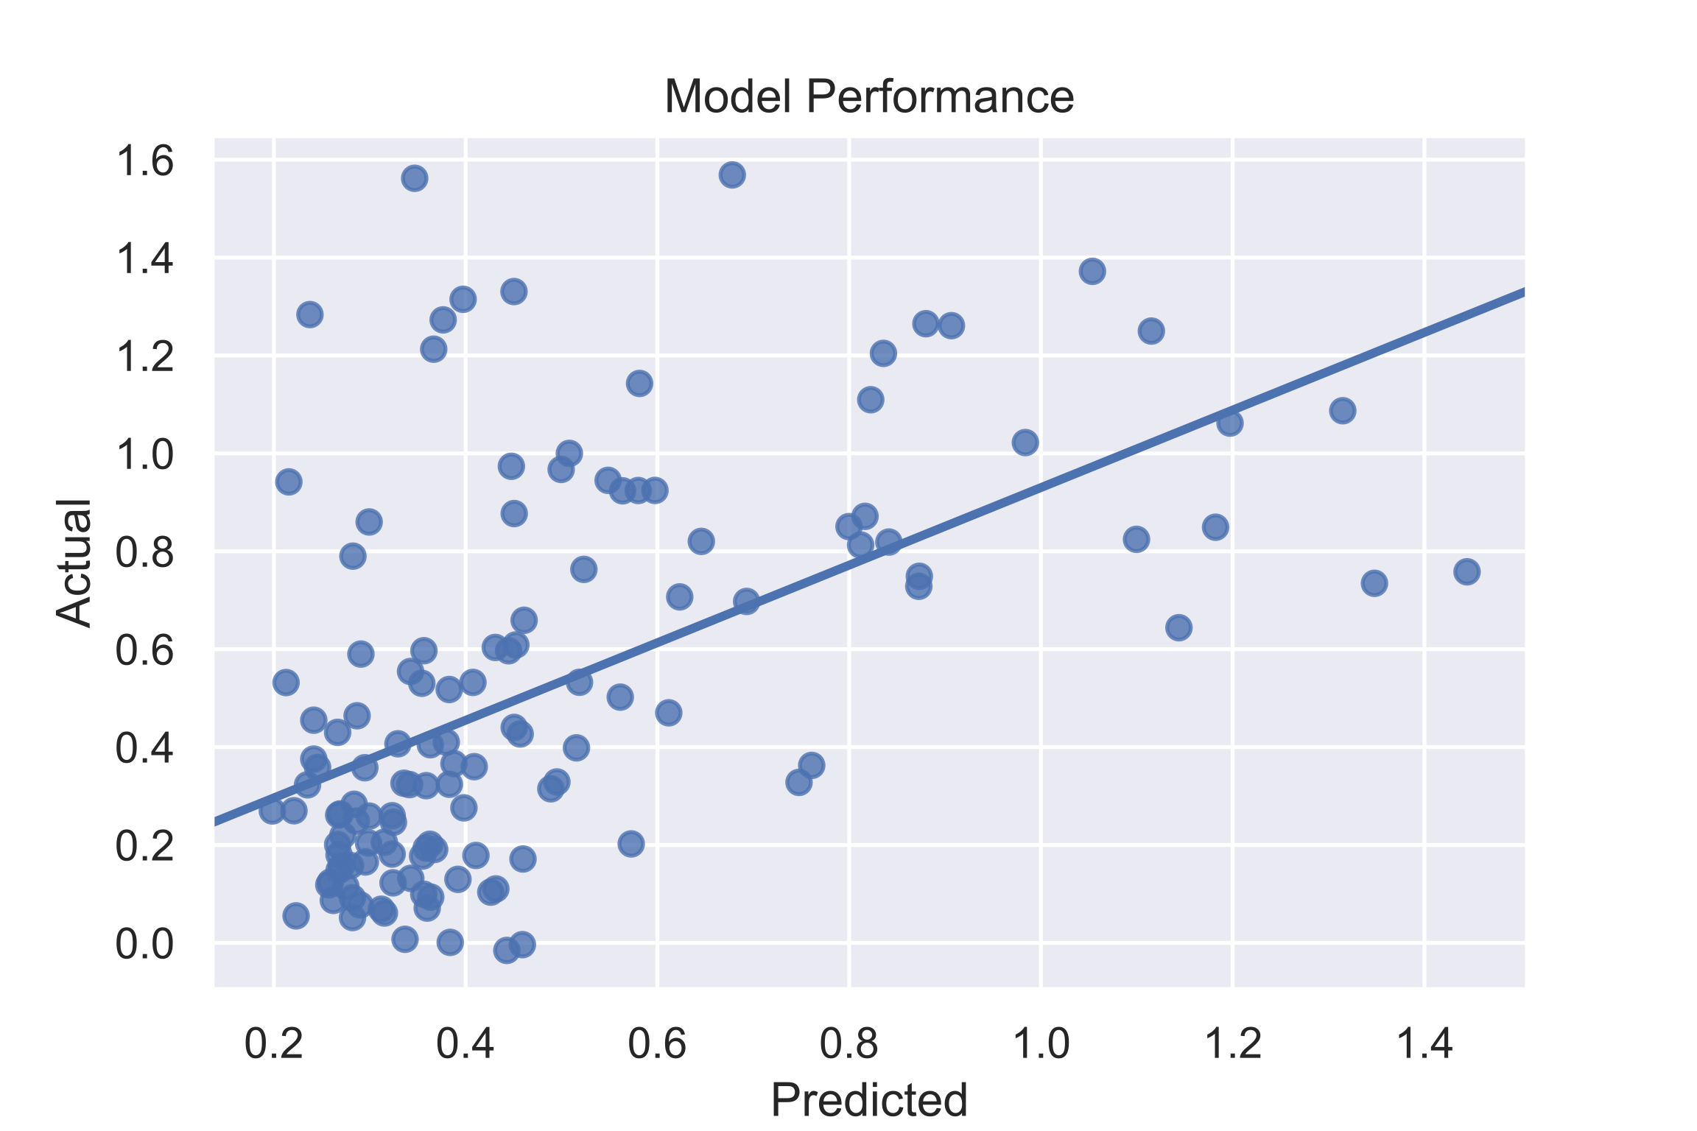
Results: Prediction
Final R² = 0.27
This is in line with previous research (Glaeser et al. 2018)
Notes:
R²: is the percentage of the target variable variation that is explained by a linear model. So, my model explains 27% of the data.
Any field that attempts to predict human behavior, typically has R-squared values lower than 50%. Humans are just harder to predict.
There aren’t a lot of studies involving yelp data like this but there was a recent study published by Harvard economists that attempted to predict economic indicators of gentrification and got similar prediction.
Linear regression calculates an equation that minimizes the distance between the fitted line and all of the data points.
R-squared is a statistical measure of how close the data are to the fitted regression line

Slide 9
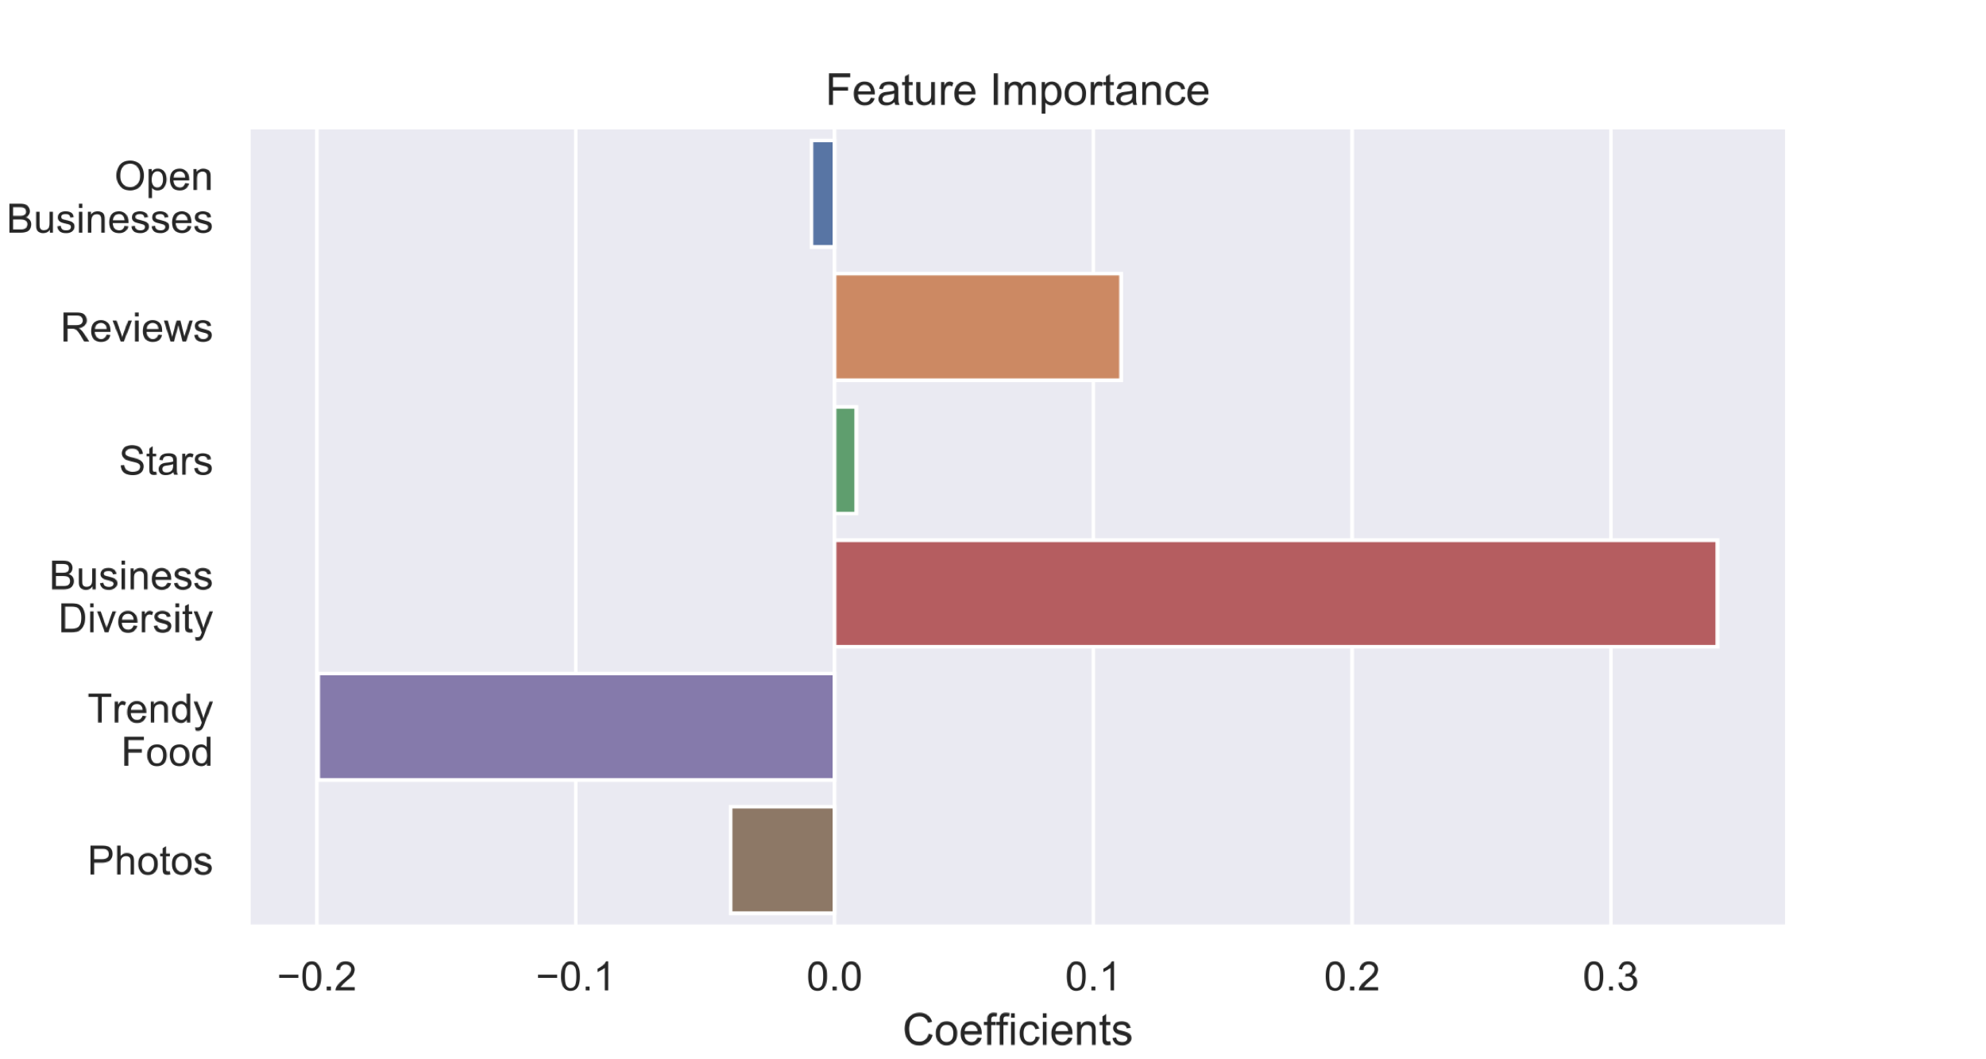
Results: Explanation
Business diversity had the greatest influence on the model.
Notes:
Trendy food was highly correlated with business diversity.
- Coefficients represent the change in the logit for each unit change in the predictor

Slide 10
Next Steps
Increase sample size
Compile more features from yelp data
Include time series
Include demographic data to get a better picture of neighborhood change
Notes:
My sample size affected model prediction - collecting more data was beyond the scope of this project but would be needed to make more robust predictions.
Similarly more features might have helped both prediction and explanation
This project would work better as a time series. This might give us more information about the timing of neighborhood change.
Would like to add complexity to my target variable with demographic data to get a better picture neighborhood change.

Slide 11

Questions

Slide 12

Appendix

Slide 13
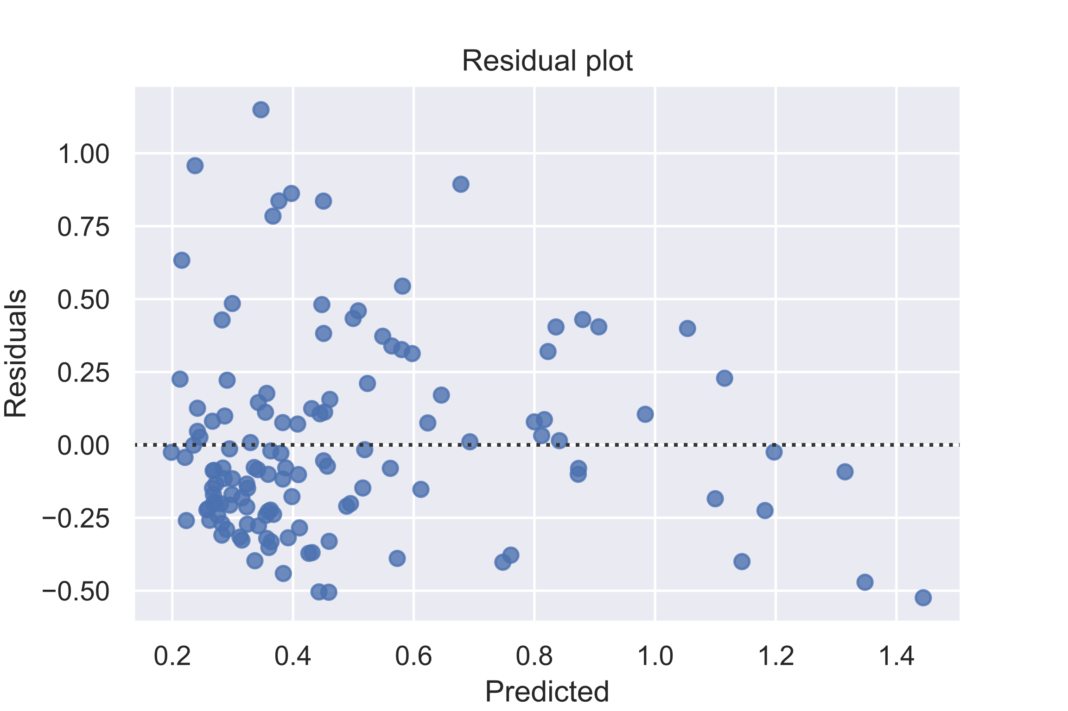
Errors are evenly distributed

