Slide 1
Helm Library Charts
F. Sauerborn
21/2/2024

Slide 2
Agenda
What is a Helm Library Chart?
Why is it important?
How to create it
Examples
Extracting a named template into a library chart
Templating whole Chart
Overwriting parts of the library
Q&A

Slide 3
What is a Helm Library Chart?
New type of Helm Chart introduced in Helm 3 which can be shared by Helm templates in other charts. Source: Helm Library Charts

Slide 4
Why is it important?
avoid duplication and keeping your charts DRY
clear distinction between library and application charts
library Charts are none installable charts
allow to use the importer’s context

Slide 5
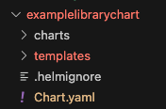
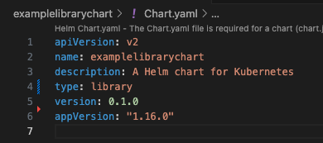
How to create it
Create a library Chart
Create a new Chart
$ helm create examplelibrarychart
Change the type in the Chart.yaml to library
type: library
Get rid of unnecessary files
$ rm -r examplelibrarychart/templates/*
$ rm examplelibrarychart/values.yaml
Finally the folder structure should be like the following:
Where charts and templates folders are empty.
And the Chart.yaml (without comments) looks like:

Slide 6
Examples
Extracting a named template into a library chart

Slide 7
Example: Extracting a named template into a library chart
Create a named template in the library Chart
Create a new template file In our example _helpers.tpl
Create the named template examplelibrarychart.chart in the template file
{{/*
Create chart name and version as used by the chart label.
*/}}
{{- define "examplelibrarychart.chart" -}}
{{- printf "%s-%s" .Chart.Name .Chart.Version | replace "+" "_" | trunc 63 | trimSuffix "-" }}
{{- end }}

Slide 8
Example: Extracting a named template into a library chart
Create a named template in the library Chart
Create the named template examplelibrarychart.labels in the template file
{{/*
Common labels
*/}}
{{- define "examplelibrarychart.labels" -}}
helm.sh/chart: {{ include "examplelibrarychart.chart" . }}
{{ include "examplelibrarychart.selectorLabels" . }}
{{- if .Chart.AppVersion }}
app.kubernetes.io/version: {{ .Chart.AppVersion | quote }}
{{- end }}
app.kubernetes.io/managed-by: {{ .Release.Service }}
{{- end }}

Slide 9
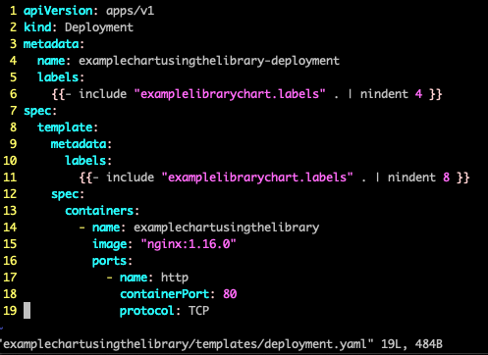
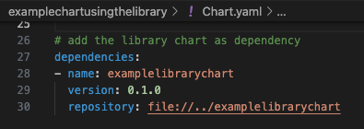
Example: Extracting a named template into a library chart
Use the library Chart from an application Chart
Create a new Chart
$ helm create examplechartusingthelibrary
Get rid of unnecessary files
$ rm -r examplelibrarychart/templates/*
Add the library Chart as dependency in Chart.yaml specify the version which we used during the creation and since the folder is next to our chart we can reference it locally
Finally we add a deployment template which uses our named template from the library:

Slide 10
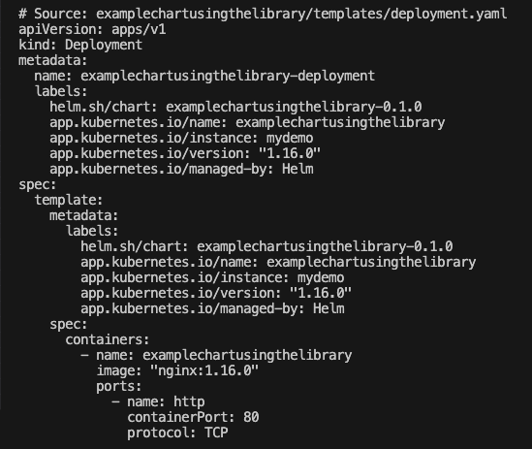
Example: Extracting a named template into a library chart
Use the library Chart from an application Chart
Retrieve the library $ helm dependency update
Verify it gets rendered as expected $ helm install mydemo \ examplechartusingthelibrary \ --dry-run --debug Should return the template filled as shown on the right

Slide 11
Examples
Templating whole Chart

Slide 12
Example: Templating whole Chart
Managing multiple charts (fully depend on the library, not having any own templates)
examplelibrarychart
dependent-chart 1 (UI)
UI (Templates for UI application Charts)
Deployment template
Service template
Ingress template
UI (Templates for UI application Charts)
Deployment template
Service template
Ingress template
API (Templates for API application Charts)
Deployment template
Service template
Ingress template
dependent-chart 2 (UI)
UI (Templates for UI application Charts)
Deployment template
Service template
Ingress template

Slide 13
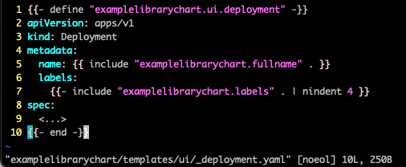
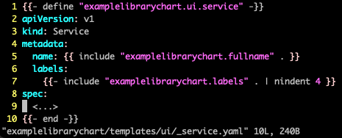
Example: Templating whole Chart
Create named templates as wrapper for each template you want to provide through the library.
For example for all UI related templates this could be
Deployment
Service

Slide 14
Example: Templating whole Chart
Use the named template in the dependent chart
In our example the dependenchart is for a UI. In the following you see their Deployment and Service
deployment.yaml
service.yaml
{{- include "examplelibrarychart.ui.deployment" . -}}
{{- include "examplelibrarychart.ui.service" . -}}

Slide 15
Examples
Overwriting parts of the library

Slide 16
Example: Overwriting parts of the library
Implement an overwritable configmap on the library side
Create a regular template containing your configmap
{{- define "examplelibrarychart.overwritable.configmap.tpl" -}}
apiVersion: v1
kind: ConfigMap
metadata:
name: {{ .Chart.Name }}-cm
data:
index.html: |-
<!DOCTYPE html>
<html>
<head>
<title>Welcome to Default ConfigMap nginx!</title>
<...>
</html>
{{- end -}}

Slide 17
Example: Overwriting parts of the library
Implement an overwritable configmap on the library side
Create function to merge the specifications
Create named template to provide overwritable configmap
{{- define "examplelibrarychart.util.merge" -}}
{{- $top := first . -}}
{{- $overrides := fromYaml (include (index . 1) $top) | default (dict ) -}}
{{- $tpl := fromYaml (include (index . 2) $top) | default (dict ) -}}
{{- toYaml (merge $overrides $tpl) -}}
{{- end -}}
{{- define "examplelibrarychart.overwritable.configmap" -}}
{{- include "examplelibrarychart.util.merge" (append . "examplelibrarychart.overwritable.configmap.tpl") -}}
{{- end -}}

Slide 18
Example: Overwriting parts of the library
Use the configmap of the library and append or overwrite values
Now on the application chart include the configmap and provide your template with values to overwrite:
{{- include "examplelibrarychart.overwritable.configmap" (list . "overwrite-dependent-chart.configmap.overwrite") -}}
{{- define "overwrite-dependent-chart.configmap.overwrite" -}}
metadata:
annotations:
overwritten: "true"
{{- end -}}

Slide 19
Example: Overwriting parts of the library
Use the configmap of the library and append or overwrite values
Then those values will be merged an in case overwritten:
{{- include "examplelibrarychart.overwritable.configmap" (list . "overwrite-dependent-chart.configmap.overwrite") -}}
{{- define "overwrite-dependent-chart.configmap.overwrite" -}}
metadata:
annotations:
overwritten: "true"
{{- end -}}
apiVersion: v1
data:
index.html: |-
<!DOCTYPE html>
<html>
<head>
<title><...>
kind: ConfigMap
metadata:
annotations:
overwritten: "true"
name: overwrite-dependent-chart-cm
{{- define "examplelibrarychart.overwritable.configmap.tpl" -}}
apiVersion: v1
kind: ConfigMap
metadata:
name: {{ .Chart.Name }}-cm
data:
index.html: |-
<!DOCTYPE html>
<html>
<head>
<title>Welcome to Default ConfigMap nginx!</title>
<...>
</html>
{{- end -}}

Slide 20
Q&A

