Slide 1
P2 / MODEL AND LAPTOP SOFTWARE
Traffic Sign CNN
Model and Software Approach
Basys3 FPGA project
Proposed model, preprocessing and hardware handoff
Planning draft 29 October 2026
01
Notes:
Based on the user-supplied lecturer guide and planning discussion. The teammate plan supplies context only. No trained checkpoint or measured accuracy exists.

Slide 2
P2 / MODEL AND LAPTOP SOFTWARE
P2 scope
Training
Prepare the data and train a small CNN on the laptop.
Integer reference
Quantize parameters and reproduce the agreed hardware arithmetic.
Hardware handoff
Export weights, memory files and expected outputs for every layer.
The FPGA classifies a supplied sign crop. Sign detection is outside this baseline.
Planning draft 29 October 2026
02
Notes:
Source: user-supplied lecturer guide. P2 supplies software evidence and parameters. RTL owners implement inference; UART requires agreement with P5.

Slide 3
P2 / MODEL AND LAPTOP SOFTWARE
GTSRB dataset inventory
Training images | Test images | Classes
39,209 | 12,630 | 43
Training class counts range from 210 to 2,250.
All CSV paths exist. Complete image readability checks remain pending.
The auxiliary GT-final_test.csv is empty. Use the populated Test.csv.
Planning draft 29 October 2026
03
Notes:
Sources: local dataset inventory on 29 October 2026; https://www.kaggle.com/datasets/meowmeowmeowmeowmeow/gtsrb-german-traffic-sign/data . All CSV paths exist with no duplicate paths or unlisted images. Decoding passed 10,000 images before stalling and was stopped. Full readability, ROI and exact image overlap checks remain pending.

Slide 4
P2 / MODEL AND LAPTOP SOFTWARE
Dataset choice and class subset
GTSRB first
Cropped images and labels support a direct classification baseline.
Eight classes proposed
Select meanings with sufficient examples and visible details at low resolution.
Korean data optional
Check AI Hub access and semantic labels before adding a Korean evaluation.
German test accuracy does not establish performance on Korean signs.
Planning draft 29 October 2026
04
Notes:
Sources: user-selected Kaggle distribution; https://aihub.or.kr/aihubdata/data/view.do?dataSetSn=187 ; https://docs.pytorch.org/vision/stable/generated/torchvision.datasets.GTSRB.html . AI Hub access and label suitability remain unconfirmed. Eight classes is a proposal.

Slide 5
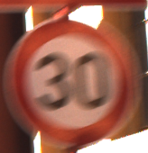
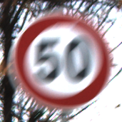
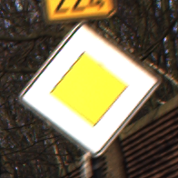
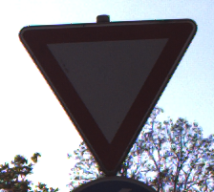
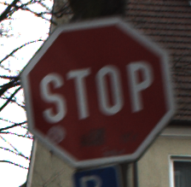
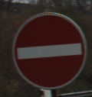
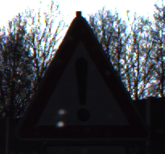
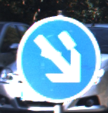
P2 / MODEL AND LAPTOP SOFTWARE
Examples from the training dataset
Original colour images with their GTSRB class IDs
Speed limit 30
ID 1
Speed limit 50
ID 2
Priority road
ID 12
Yield
ID 13
Stop
ID 14
No entry
ID 17
General caution
ID 18
Keep right
ID 38
Illustrative examples only. The final training class list remains open.
Planning draft 29 October 2026
05
Notes:
Source: local Tubes/dataset/Train from user-selected Kaggle GTSRB distribution. https://www.kaggle.com/datasets/meowmeowmeowmeowmeow/gtsrb-german-traffic-sign/data . Original source framing and colours retained. Largest annotated ROI per illustrated class selected for legibility. These examples are not the final class selection or an evaluation set.
GTSRB ID 1: Speed limit 30; Train/1/00001_00003_00029.png
GTSRB ID 2: Speed limit 50; Train/2/00002_00065_00029.png
GTSRB ID 12: Priority road; Train/12/00012_00062_00029.png
GTSRB ID 13: Yield; Train/13/00013_00003_00029.png
GTSRB ID 14: Stop; Train/14/00014_00020_00029.png
GTSRB ID 17: No entry; Train/17/00017_00024_00029.png
GTSRB ID 18: General caution; Train/18/00018_00033_00029.png
GTSRB ID 38: Keep right; Train/38/00038_00056_00029.png

Slide 6
P2 / MODEL AND LAPTOP SOFTWARE
Base preprocessing
Step | Starting approach
Crop | CSV sign ROI with explicit endpoint convention
Grayscale | One luminance channel
Resize | 16 x 16 or 32 x 32; fixed interpolation
Pixel representation | Deterministic unsigned bytes from 0 to 255
Float training input | float32 pixels divided by 255
One shared base function prepares training, validation and hardware inputs.
Planning draft 29 October 2026
06
Notes:
Proposed baseline. Confirm crop endpoint convention, grayscale method, interpolation, byte rounding and library versions. Histogram equalization remains an optional validation experiment.

Slide 7
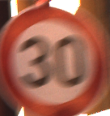

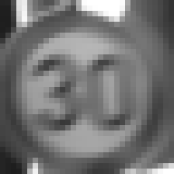
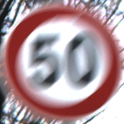


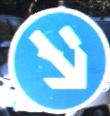


P2 / MODEL AND LAPTOP SOFTWARE
The same signs at two input resolutions
RGB ROI crop
16 x 16 grayscale
32 x 32 grayscale
Speed limit 30
ID 1
Speed limit 50
ID 2
Keep right
ID 38
Enlarged for pixel visibility. Model accuracy still requires validation.
Planning draft 29 October 2026
07
Notes:
Source: local GTSRB training images listed below. ROI crop uses inclusive CSV endpoints for this illustration. Pillow RGB-to-L conversion and bilinear resize to 16x16 or 32x32. Nearest-neighbor enlargement reveals pixels; no histogram equalization. No normalization effect is depicted, because division by 255 changes numerical scale rather than displayed contrast. These are illustrative proposed preprocessing settings, not a frozen contract or model accuracy evidence.
GTSRB ID 1: Speed limit 30; Train/1/00001_00003_00029.png
GTSRB ID 2: Speed limit 50; Train/2/00002_00065_00029.png
GTSRB ID 12: Priority road; Train/12/00012_00062_00029.png
GTSRB ID 13: Yield; Train/13/00013_00003_00029.png
GTSRB ID 14: Stop; Train/14/00014_00020_00029.png
GTSRB ID 17: No entry; Train/17/00017_00024_00029.png
GTSRB ID 18: General caution; Train/18/00018_00033_00029.png
GTSRB ID 38: Keep right; Train/38/00038_00056_00029.png

Slide 8
P2 / MODEL AND LAPTOP SOFTWARE
Normalization and FPGA input
Float training
Integer FPGA input
x = p / 255
q_x = p
p is a prepared pixel from 0 to 255.
x is a float from 0 to 1.
Input scale = 1/255
Zero point = 0
Quantized parameters account for the input scale. Simply removing division changes the model.
Planning draft 29 October 2026
08
Notes:
Quantization proposal. Input scale 1/255 and zero point 0 connect uint8 pixels to the float model. Derive weight and bias scales and requantization explicitly. Simply removing division changes computation.

Slide 9
P2 / MODEL AND LAPTOP SOFTWARE
Candidate A architecture
Stage | Configuration | Output
Input | Grayscale pixels | 1 x 16 x 16
Convolution | 8 filters, 3 x 3, stride 1, no padding | 8 x 14 x 14
ReLU and rescale | Nonnegative activation | 8 x 14 x 14
Max-pool | 2 x 2, stride 2 | 8 x 7 x 7
Flatten | Channel, row, column order proposed | 392
Fully connected | 392 inputs, 8 biased logits | 8
Argmax | Lowest index wins ties | Class 0 to 7
Planning draft 29 October 2026
09
Notes:
Proposed architecture. Sources for standard operators: https://docs.pytorch.org/docs/stable/generated/torch.nn.Conv2d.html and https://docs.pytorch.org/docs/stable/generated/torch.nn.MaxPool2d.html . Eight filters and classes are provisional. Agree flatten order with RTL.

Slide 10
P2 / MODEL AND LAPTOP SOFTWARE
Resolution comparison
Quantity | A: 16 x 16 | B: 32 x 32
Pooled features | 392 | 1,800
Weights excluding biases | 3,208 | 14,472
Weight storage at 8 bits | 3,208 bytes | 14,472 bytes
MACs per image | 17,248 | 79,200
Compare both on the same classes and split before freezing input dimensions.
Planning draft 29 October 2026
10
Notes:
Calculated for 8 filters and 8 classes. Conv MACs = 8*(N-2)^2*9. FC MACs = 8*8*floor((N-2)/2)^2. Weight totals exclude 16 biases and scales. Counts exclude bias additions, pooling, rescaling and memory/control overhead. They do not establish hardware latency.

Slide 11
P2 / MODEL AND LAPTOP SOFTWARE
Training and evaluation
Grouped validation
Keep each physical sign track in one split. Save the seed and manifest.
Training only
Try modest rotation, translation and brightness changes. Avoid horizontal flips.
Held-out test set
Use validation to choose the model. Evaluate the frozen model on Test.
Compare float and integer accuracy, per-class recall and confusion matrices.
Planning draft 29 October 2026
11
Notes:
Proposed protocol. Confirm track IDs survive Kaggle repackaging. Keep all views of one physical sign in one split. An approximate 80/20 train/validation group split is proposed. Test remains reserved for final evaluation.

Slide 12
P2 / MODEL AND LAPTOP SOFTWARE
Integer golden model
Numerical proposal
8-bit signed weights with layer scales and integer biases.
Exact arithmetic
Agree widths, rounding, overflow, saturation and rescale multiplier/shift.
Layer evidence
Save accumulators, activations, pooled features and final scores.
Include trained biases and rescale products in the bit-width analysis.
Planning draft 29 October 2026
12
Notes:
Initial proposal: signed 8-bit symmetric weights with per-layer scales, uint8 input and nonnegative activations. 0..127 activation range is a candidate. Analyze biases and multiplier product widths. Agree finite-width overflow, shift, rounding and saturation behavior.

Slide 13
P2 / MODEL AND LAPTOP SOFTWARE
Hardware handoff package
Artifact | Purpose
Model manifest | Shapes, class map, scales and checkpoint identity
Weights and biases | Agreed .mem / .coe files and RTL parameters
Input and layer dumps | Prepared pixels and expected intermediate results
Evaluation report | Accuracy, confusion and quantization differences
Batch checker | Exact FPGA score and class comparison over UART
Hardware match rate and classification accuracy are separate measurements.
Planning draft 29 October 2026
13
Notes:
Based on the lecturer guide and planning discussion. Agree file widths, two’s complement encoding, endianness, memory addresses and UART framing with hardware owners. Golden match and classification accuracy measure different things.

Slide 14
P2 / MODEL AND LAPTOP SOFTWARE
Next decisions
Inspect and select
Finish dataset checks and select classes using counts and thumbnails.
Compare and quantize
Train 16 x 16 and 32 x 32 baselines and measure integer degradation.
Freeze with the team
Agree acceptance criteria, then freeze tensor shapes and arithmetic.
Choose the smaller model if its validation results meet the agreed criteria.
Planning draft 29 October 2026
14
Notes:
No checkpoint, measured accuracy or hardware timing exists yet. No numerical accuracy threshold is adopted. The teammate plan supplies context only. Freeze dimensions and arithmetic after validation and hardware agreement.

