Slide 1
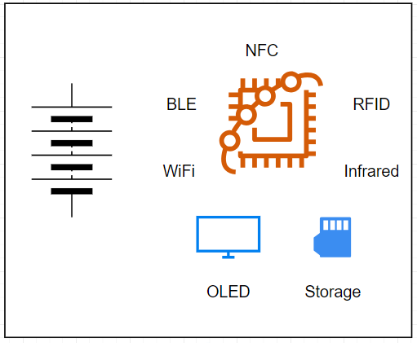
SignalForge
(Swiss Army for Hackers)
BACKGROUND
Need to test device on the field
Portable Device to Carry around
Constraint
Light weight
Low power
No cable
Features :
Reading, Cloning NFC/RFID card information
Saving Infrared Signal for Consumer Devices (TV, AC)
WiFi + Bluetooth analyzer
Signal Generator
Display + Buttons

Slide 2
Hardware Password Manager
Background:
- Password is hard to remember
- Software password manager is immobile
Constraint:
- Lightweight
Low power
Support calculating encryption
Solution
Wearable Password manager
Interfacing with device as Bluetooth keyboard

Slide 3
Wireless Mixer
Background:
- For live concert settings, having long cable can hinder performers
- For live monitoring settings, usually several people need to listen to the same source
Constraint:
- No cable
On battery
Good audio quality
Good latency
Solution
Audio mixer with wireless input and output using custom wireless module

