Slide 1
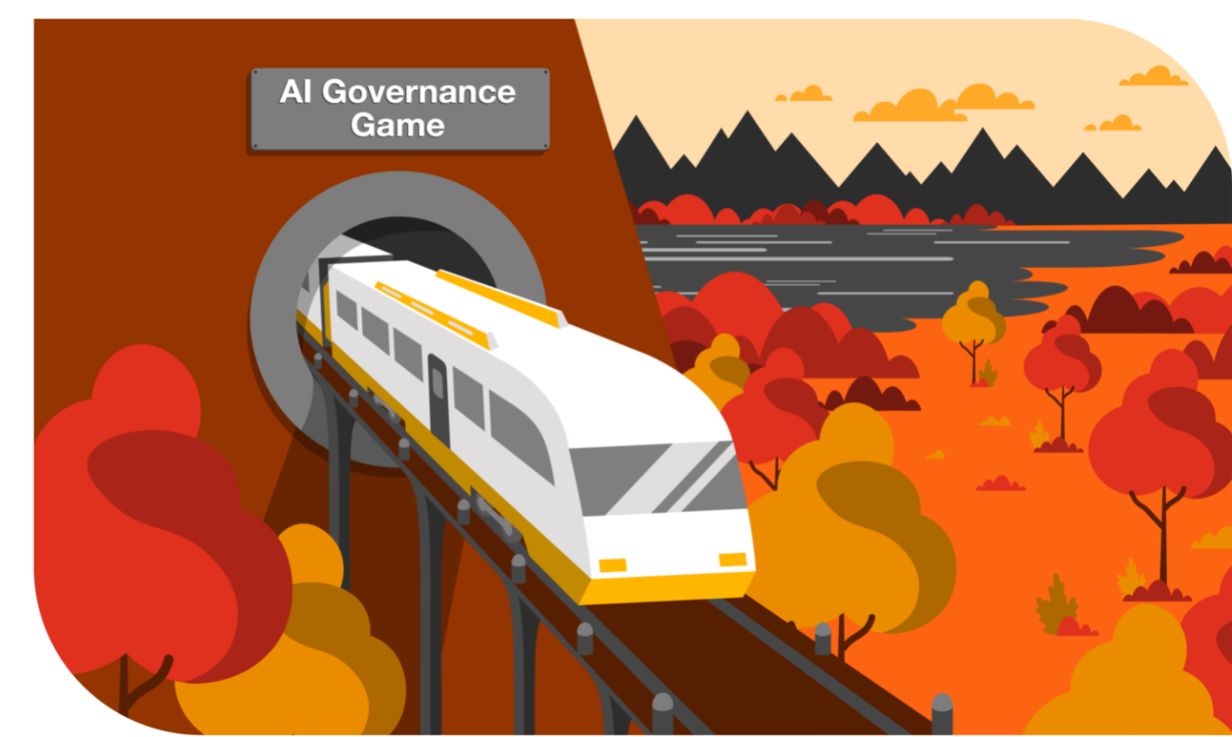
PwC

Slide 2

The Problem
The Opportunity
As the use of AI increases, so does the demand for implementing robust AI governance strategies. The Responsible AI team at PwC has been advocating for organizations to adopt newer and more common sets of practices and procedures around how they build, deploy, and sustain AI systems within their business while complying with regulations and ethical standards. The challenge we find is that business leaders are struggling to progress in this area, presenting a unique opportunity.
AI governance typically lacks a strategic and repeatable framework, and is perceived as tedious and a reactive compliance chore. It can also be unclear who in the organization is responsible for instantiating and overseeing AI governance.
In turn, leaders have slowly progressed AI governance, without understanding its true downstream impact on their overall business outcomes.
If we change the perception of AI governance from being a “check the box” activity to an end-to-end strategy, then organizations will be able to confidently minimize risk and maximize ROI.

Slide 3
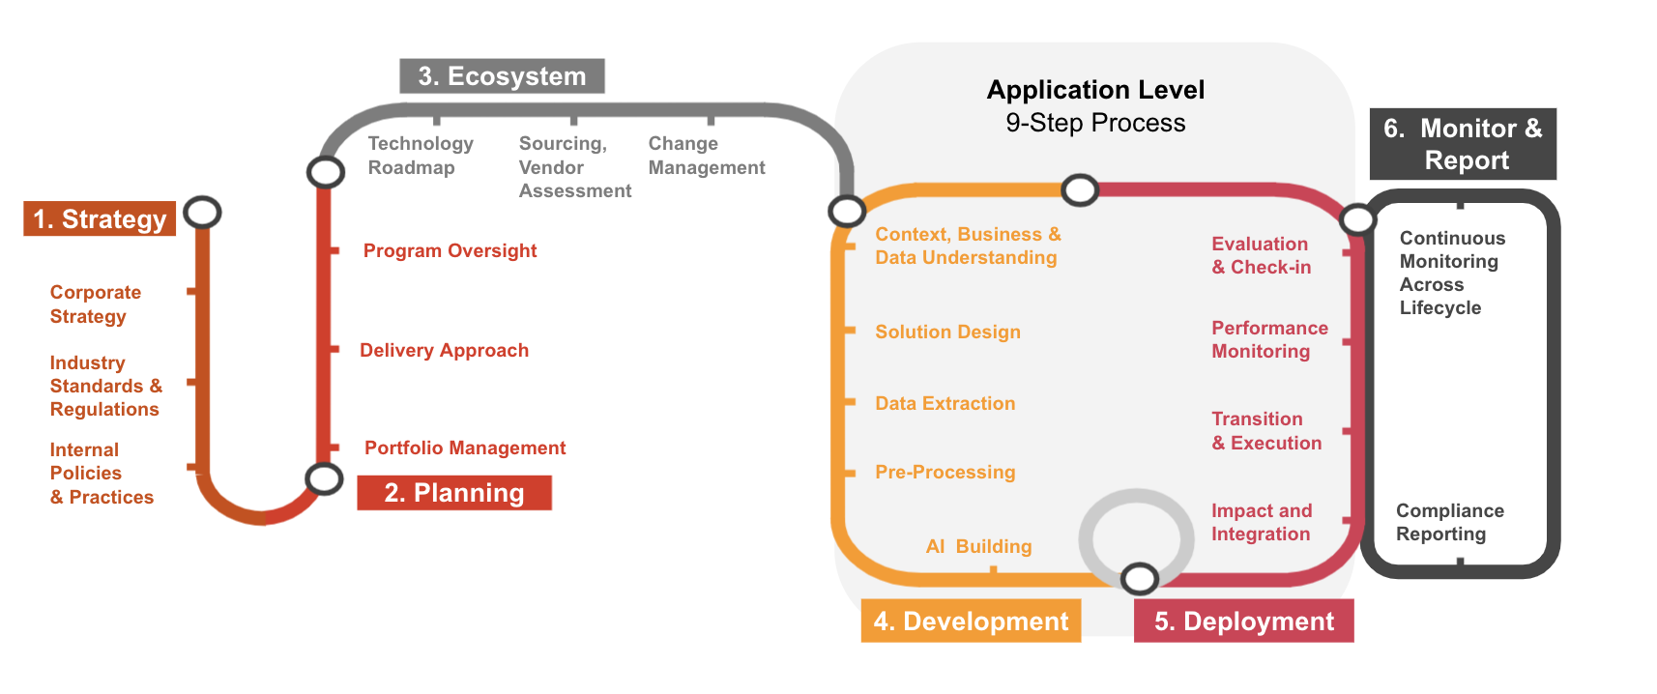
Responsible AI is not
just a point in time.
Many leaders view responsible AI as an afterthought, addressing governance issues after it is already too late. In reality, the foundation for responsible AI is an end-to-end enterprise governance framework, focusing on the risks and controls along an organization’s AI journey—from top to bottom.
We used this framework as inspiration for a journey style game, intending to help players better understand the steps of the AI governance process, and understand why early, focused investment is key.

Slide 4
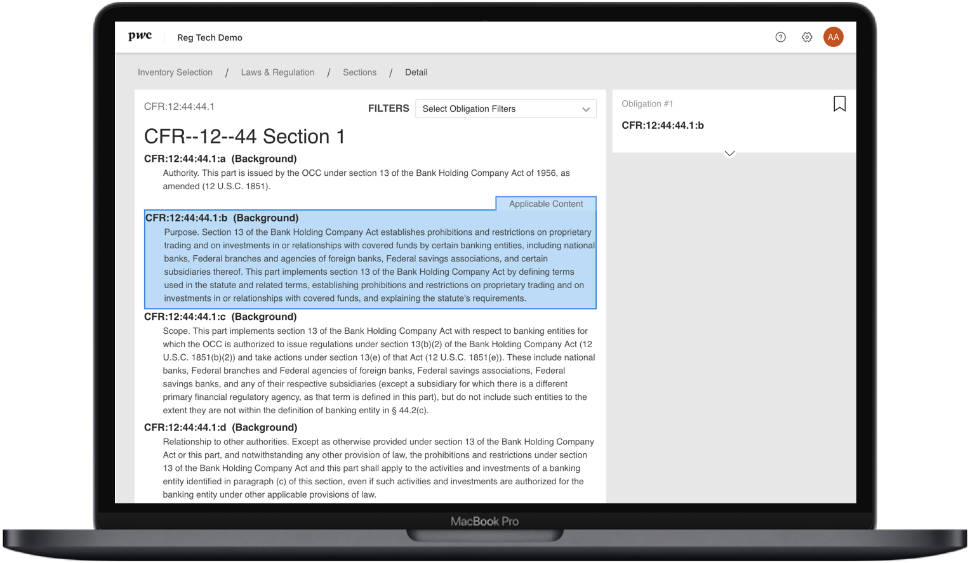
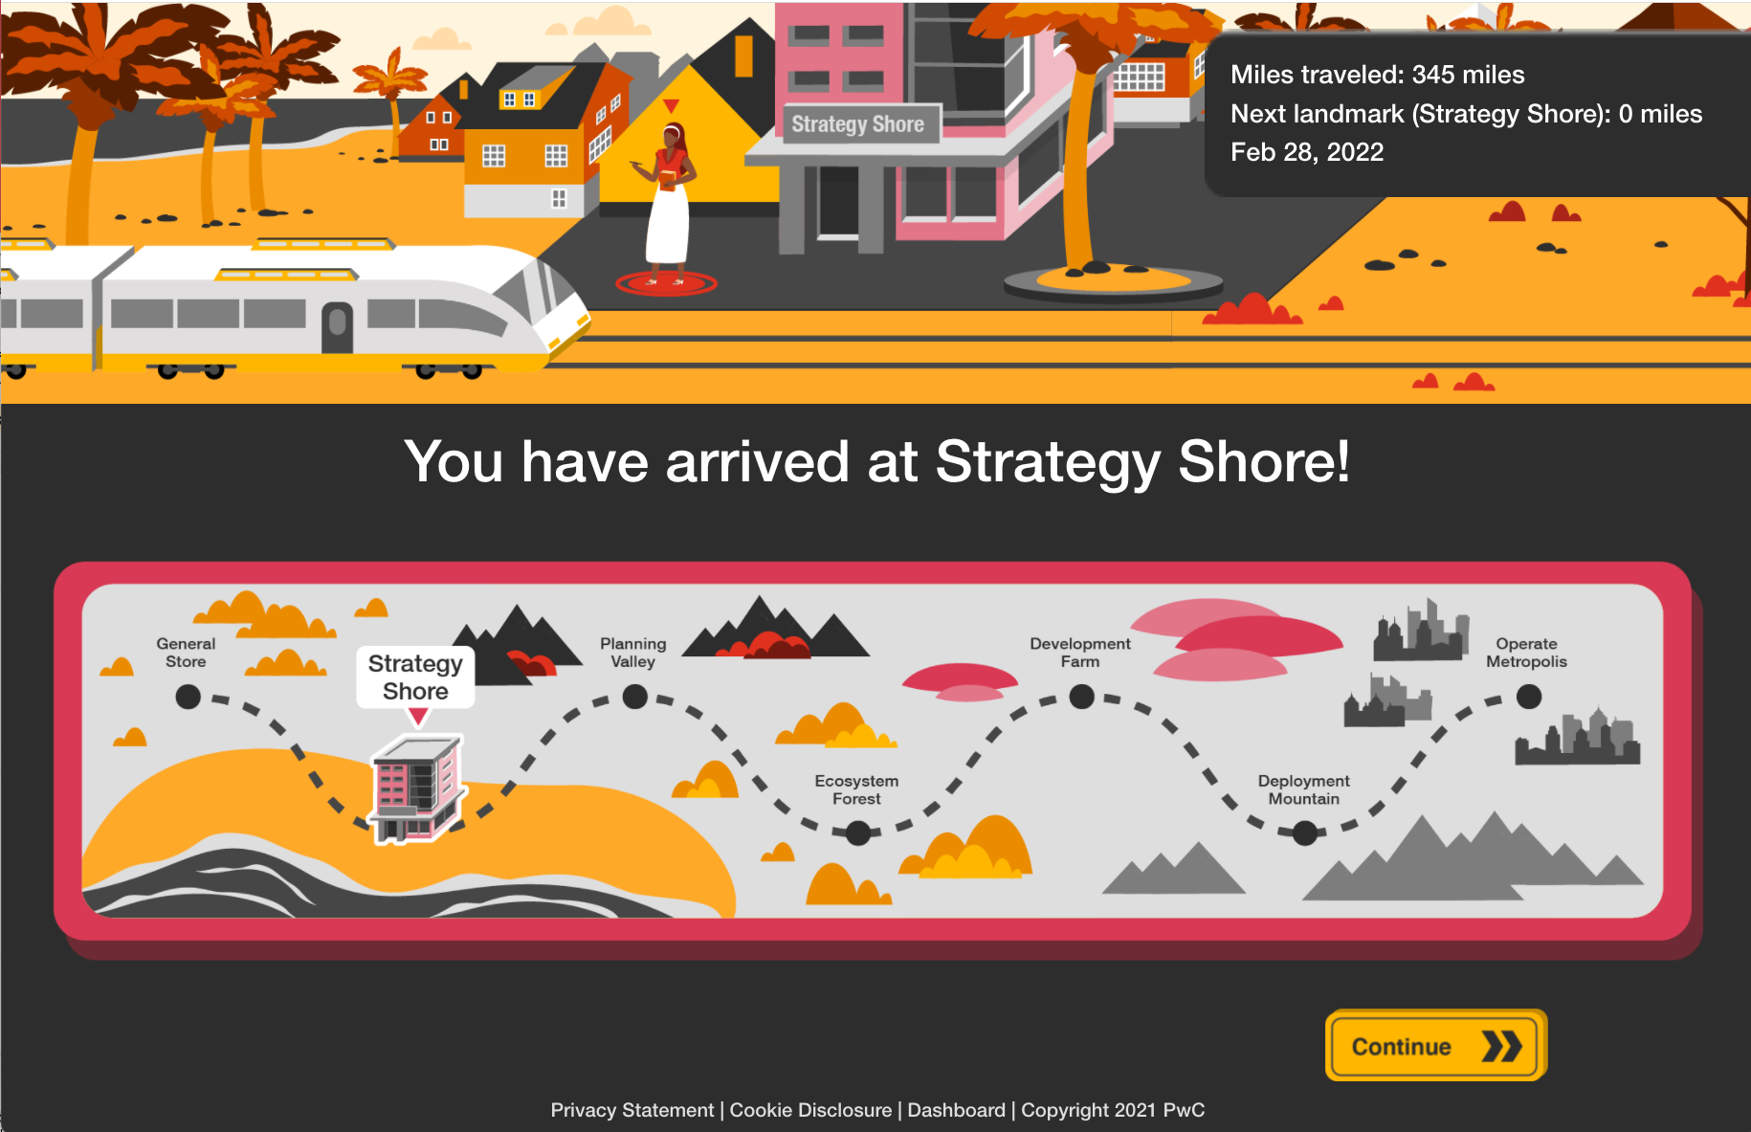
Introducing, PwC’s AI Governance Game. Load up your train with staff/supplies and hop on the Governance Railway to embark on a journey of AI governance!
At each station, players face different scenarios and must make challenging decisions for their company while considering trade-offs such as cost, time, ROI, team morale, customer sentiment, and a measurement of governance readiness. Players will see the immediate and potentially long term consequences of their decisions - both good and bad.

Slide 5
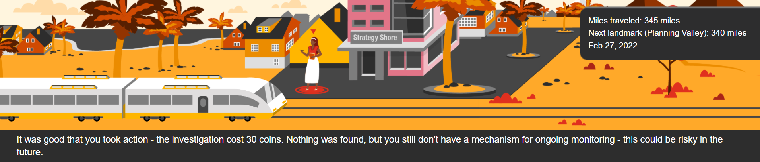
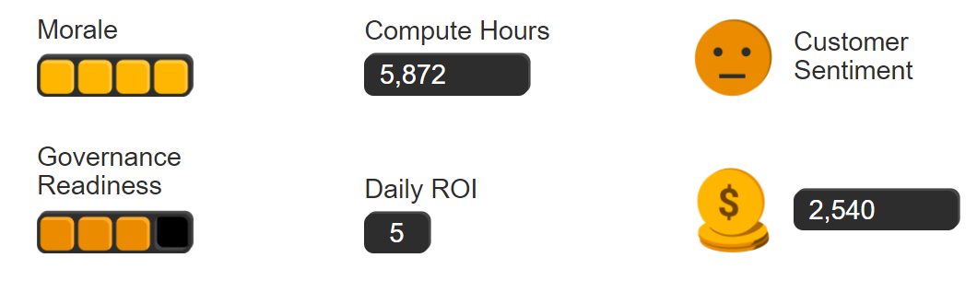
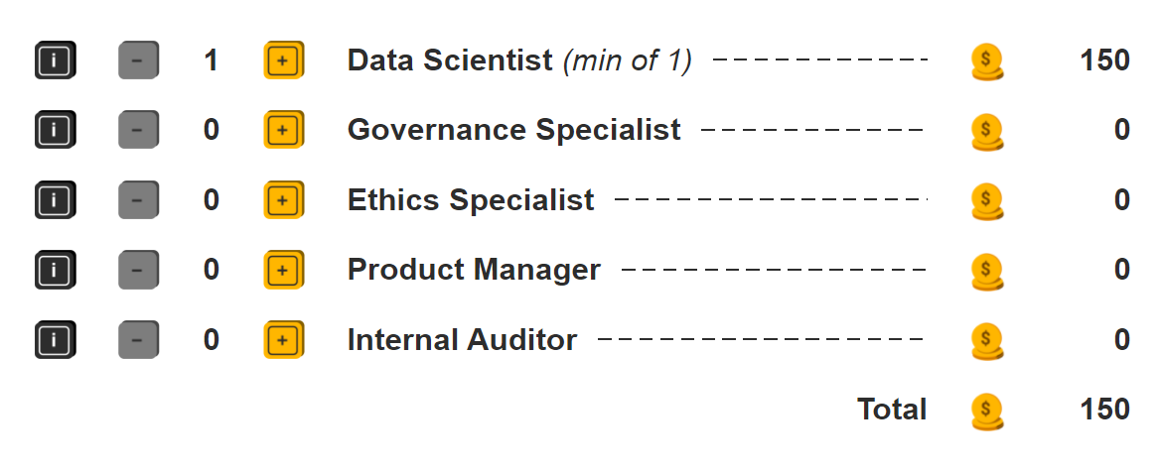
Decisions, Decisions
The game simulates real world constraints and trade-offs such as:
Monetary and time constraints (tracking ROI, customer satisfaction, governance readiness, morale, coins)
Resource expertise and team capacity
Time to market ROI vs Risk and Compliance
Data analytics vs Privacy
Unplanned random events

Slide 6
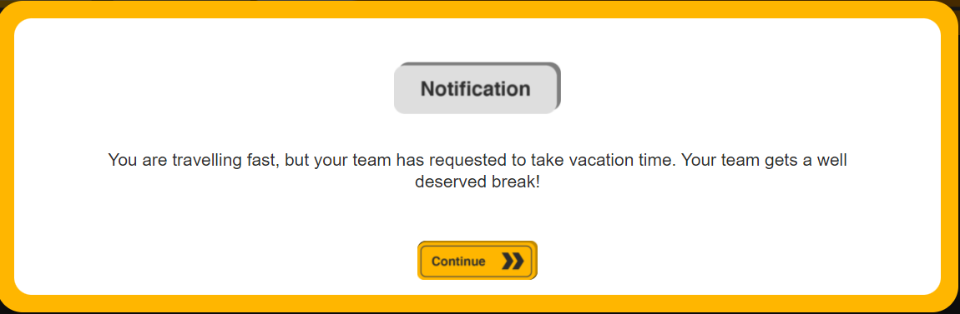
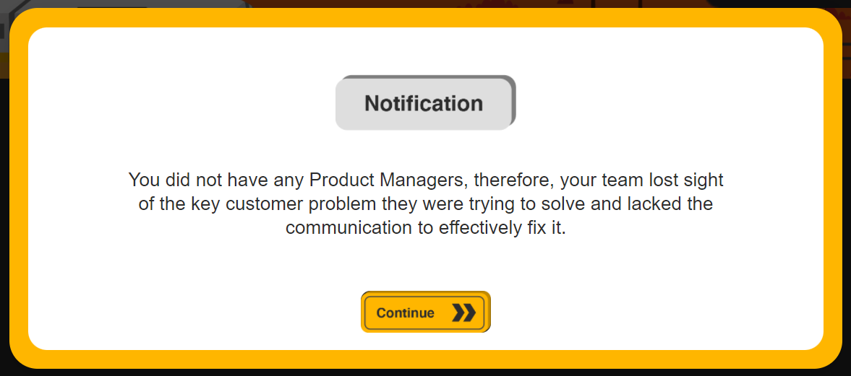
Life Events_
User decisions can trigger the possibility of a life event to occur randomly throughout the game. These life events may have positive or negative impacts.
Benefit: More real life scenarios and larger impact of a user’s upfront selection decisions, and their choices throughout the game.
Example: If a player sets a grueling pace for their innovation speed, their staff may feel burnt out, ultimately delaying the journey (and therefore any future product releases) by 5 days.
Example: When staffing their team, if a player does not select any project managers, their coin balance may decrease due to unforeseen issues.

Slide 7
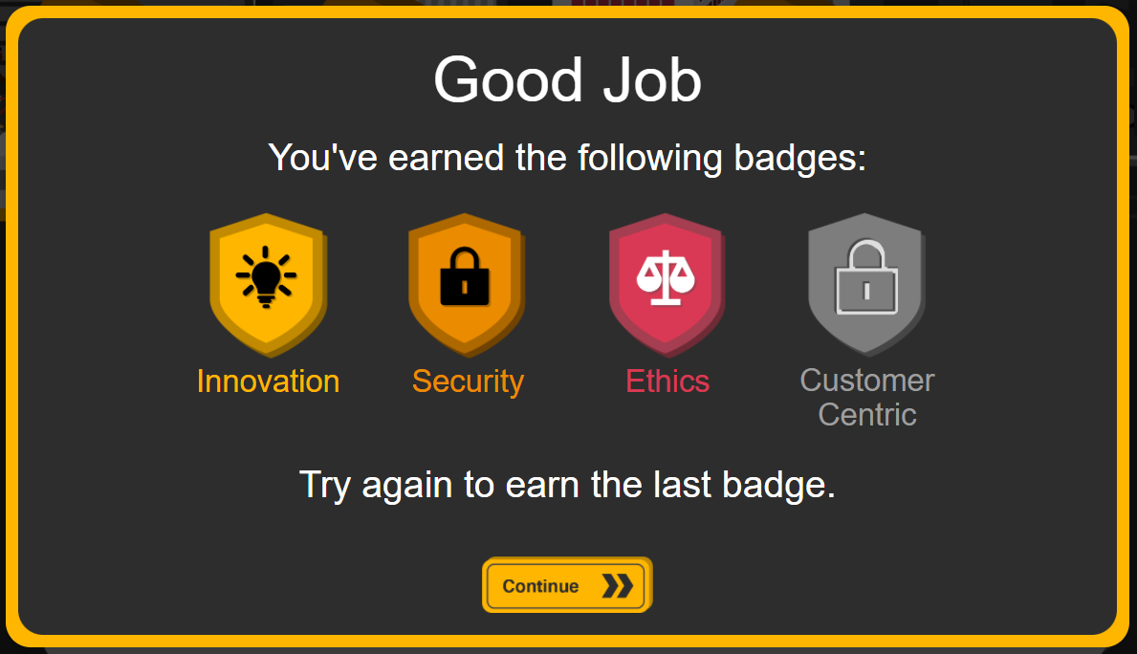
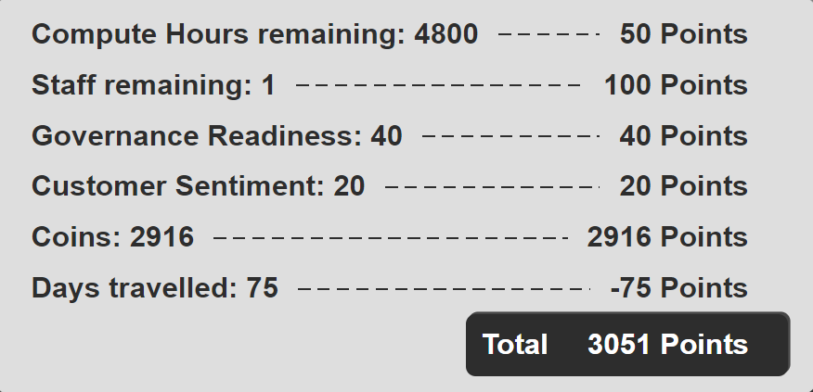
Badges & Outcomes_
At the end of the game, badges are awarded to the player to recognize the positive impact their decisions had on various business imperatives throughout the game.
Scores based on the metrics throughout the game are totalled to give an overall score.

Slide 8
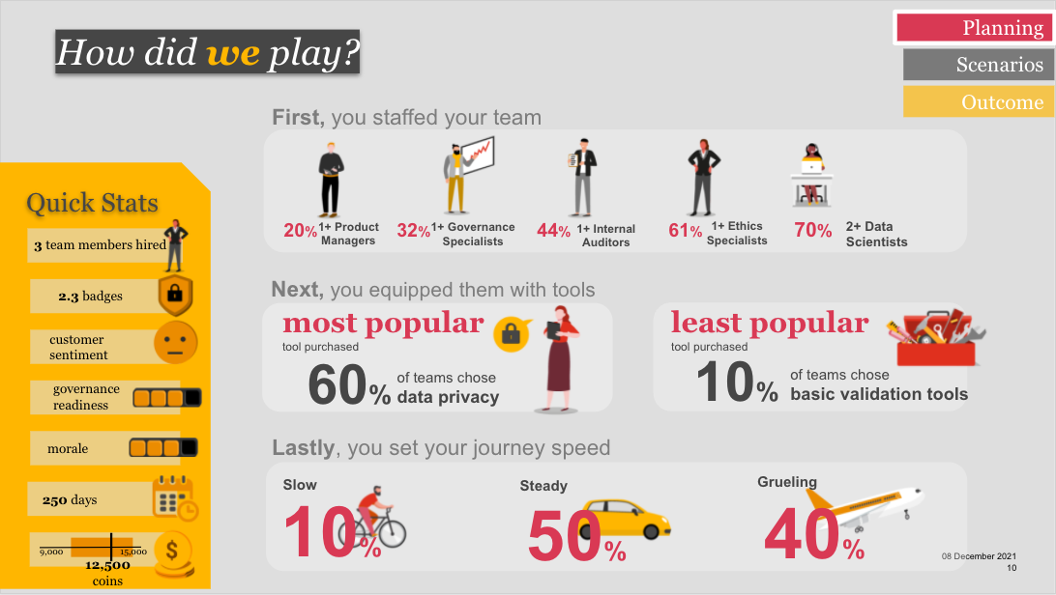
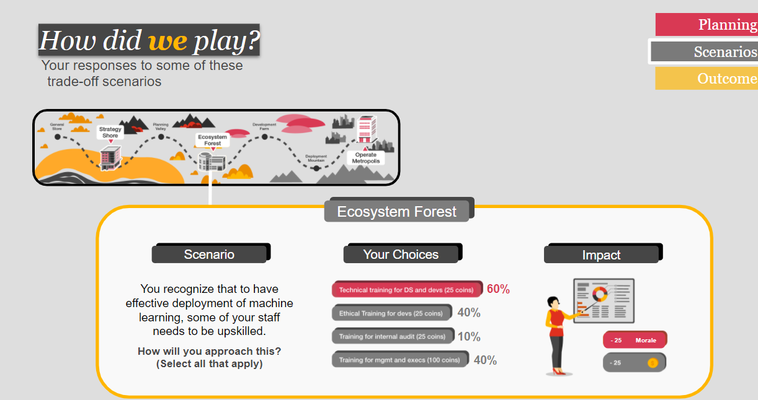
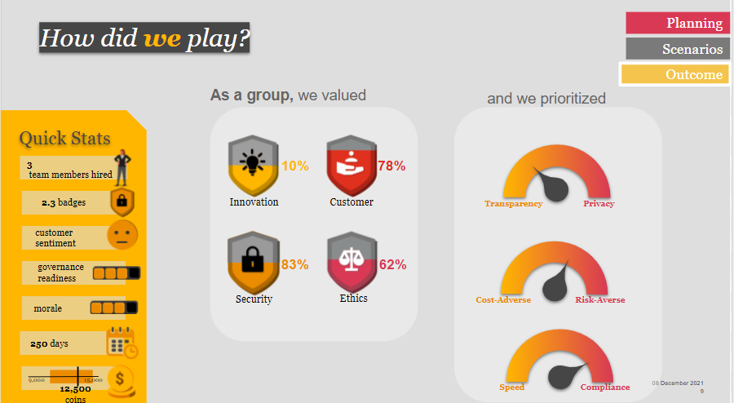
Dashboard_
A dashboard shows the historical overall data across all participants. This paints a picture of what decisions other players have made throughout the game. This enables us to identify where similar decisions are being made, and what metrics players are placing emphasis on when making decisions throughout the game.
We use these outcomes to have more targeted conversations with our clients on how they currently prioritize governance, and where they can be improving their strategies.

Slide 9
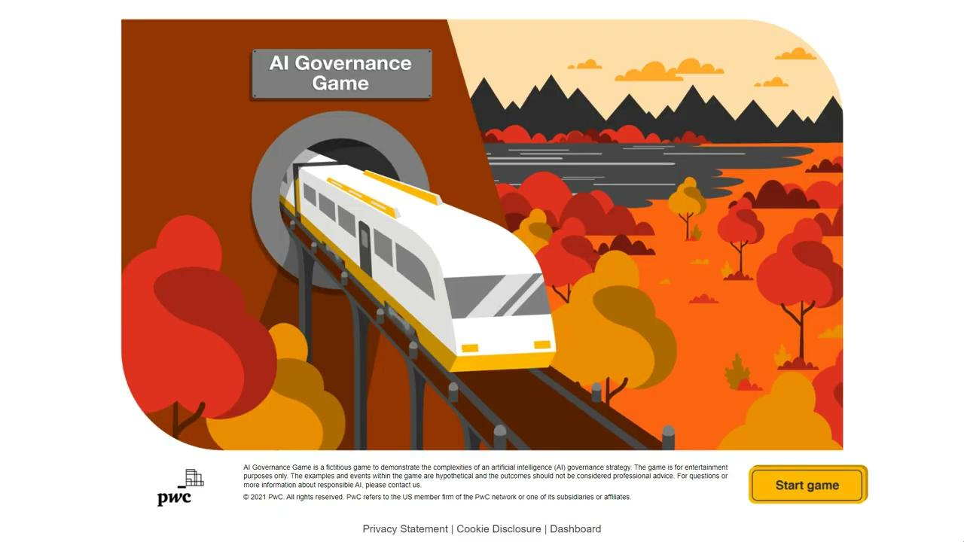
Demo
Play the game yourself! Click here.

Slide 10

The Bigger Impact__
Our AI Governance Game has been featured as a part of curriculum for many large scale events, including the PwC Trust Leadership Institute (TLI). The game provides value in learning experiences by gamifying the concepts of AI governance in an approachable way. Attendees play our game to gain a better understanding of trade-offs they must face when implementing AI in their businesses. Read below to learn more about the PwC Trust Leadership Institute.
Trust is the future of business. The business landscape is changing, fast. The skills needed to effectively lead are fundamentally different from even five years ago. Now is the time for all of us to lean into the responsibility—and embrace the opportunity—to lead with trust and deliver meaningful and lasting impact.
The PwC TLI provides an immersive learning experience to equip 10,000 of today and tomorrow’s C-suite leaders, business executives and corporate director leaders with the skills to develop trust and create a connected center of excellence in leadership and community.
https://www.pwc.com/us/en/about-us/tomorrow-takes-trust/trust-leadership-institute-overview.html

Slide 11
Thank you!

