Slide 1

A Semi-Autonomous SIEM–SOAR Framework for Anomaly-Based Security Operations with Human-in-the-Loop Learning
Presented by
Venkateswara rao (221FA19020)
Niteesh Babu (221FA19030)
Tarun Kumar Reddy (221FA19057)
Saugat Chaudhary (221FA19066)
Under the Supervision of
Dr. P.M Benson Mansingh
Professor, ACSE
Department of Advanced Computer Science and Engineering
School of Computing and Informatics
Vignan’s Foundation for Science, Technology & Research
(Deemed to be University)

Slide 2
Index
Introduction
• Literature Review
• Problem Statement
• Motivation
• Methodology
• Algorithm / Workflow
• Architecture Diagram
• Results and Analysis
• Conclusion
• References

Slide 3
Introduction
Modern enterprise environments generate massive volumes of security telemetry from networks, cloud systems, authentication services, and endpoints.
Traditional SIEM systems rely on static rules and signature-based detection, making them ineffective against zero-day attacks, insider threats, and evolving attack patterns.
SOC analysts face challenges such as alert fatigue, high false positives, and delayed incident response.
Machine learning–based anomaly detection helps identify unknown threats by learning normal behavioral patterns.
This project proposes a semi-autonomous SIEM–SOAR framework integrating:
Isolation Forest anomaly detection
ELK Stack SIEM monitoring
Shuffle SOAR automation
Human-in-the-loop validation
Objectives
Detect abnormal behavior using anomaly-based machine learning
Reduce alert overload using intelligent prioritization
Provide centralized monitoring and visualization
Maintain analyst supervision over critical response actions

Slide 4
Literature Review
Dorothy E. Denning (1987)
Proposed one of the earliest anomaly-based intrusion detection models.
Established the foundation for behavioural cybersecurity monitoring.
Martin Roesch (1999)
Developed Snort IDS for real-time signature-based traffic analysis.
Effective for known threats but weak against zero-day attacks.
Fei Tony Liu et al. (2008)
Introduced Isolation Forest algorithm.
Efficient anomaly detection for high-dimensional unlabelled datasets.
Robin Sommer & Vern Paxson (2010)
Discussed challenges of machine learning in network intrusion detection.
Highlighted operational limitations and false positives.
Mauro Conti et al. (2021)
Surveyed Human-in-the-Loop cybersecurity systems.
Emphasized analyst-guided validation for operational safety.

Slide 5
Literature Review
Year | Paper/Authors | Method used | Key Findings/Limitations
1987 | Dorothy E. Denning | Behavioral Intrusion Detection Model | Introduced anomaly-based intrusion detection, but limited by high false positives
1999 | Martin Roesch | Rule-Based IDS (Snort) | Efficient real-time traffic monitoring, but ineffective against unknown attacks
2008 | Fei Tony Liu, Kai Ming Ting, and Zhi-Hua Zhou | Isolation Forest Algorithm | Fast and efficient anomaly detection, but requires proper threshold tuning

Slide 6
Problem Statement
With the rapid growth of enterprise networks, cloud services, and digital infrastructures, protecting organizational systems from cyber threats has become a major challenge. Traditional rule-based security monitoring methods are effective for detecting known attacks, but they often fail to identify unknown, stealthy, or evolving threats, making enterprise environments vulnerable to advanced cyber attacks and security breaches. There is a need for a system that not only detects suspicious activities but also adapts to changing attack patterns while supporting secure and efficient incident response.
Existing intrusion detection and security monitoring systems provide threat detection capabilities, but many face limitations such as high false-positive rates, excessive alert generation, limited adaptability, and lack of intelligent response coordination. Therefore, an efficient system is required that integrates anomaly-based detection, centralized SIEM monitoring, SOAR-assisted alert handling, and human-in-the-loop learning, while maintaining operational reliability and ensuring accurate identification of malicious activities.

Slide 7

Motivation
• Growing need for secure cybersecurity monitoring to protect enterprise systems from unauthorized access and cyber threats.
• Interest in exploring anomaly detection, SIEM, and SOAR as advanced technologies for cybersecurity operations.
• To develop a method that identifies hidden malicious activities, not just detects known cyber attacks.
• To ensure accurate threat detection and reliable alert handling after identifying suspicious network behavior.
• Contributes to society by improving cybersecurity, data protection, and secure digital infrastructure in modern systems.

Slide 8
Methodology
The proposed system uses anomaly-based detection and SIEM–SOAR integration to monitor and identify suspicious activities in enterprise environments. Security events are collected from network flow records and authentication logs, then processed using temporal aggregation and behavioral feature extraction. An Isolation Forest model detects deviations from normal behavior. Detected anomalies are indexed into the ELK Stack for monitoring and visualization, while high-severity alerts are forwarded to the Shuffle SOAR platform for notification and analyst-guided response actions.
Technologies Used :
Python
Isolation Forest Algorithm
ELK Stack (Elasticsearch, Logstash, Kibana)
Shuffle SOAR
Docker
CICIDS2017 Dataset
Machine Learning and Security Monitoring Techniques

Slide 9
Algorithm / Pseudocode
Collect network flow logs and authentication events from data sources.
Preprocess and normalize the collected security logs into a unified schema.
Apply sliding-window aggregation to extract behavioral features from events.
Train the Isolation Forest model using baseline normal activity data.
Input aggregated feature vectors into the trained anomaly detection model.
Compute anomaly scores and identify suspicious activities based on threshold values.
Store detected anomalies in Elasticsearch for SIEM monitoring and visualization.
Visualize alerts and anomaly trends using Kibana dashboards.
Forward high-severity alerts to Shuffle SOAR through webhook-based workflows.
Perform notification and case-tracking actions with analyst supervision.
Collect simulated analyst feedback for offline retraining and model improvement.

Slide 10
Architecture / System Diagram
The proposed system is designed with multiple functional modules that work together to provide intelligent security monitoring, anomaly detection, alert management, and analyst-guided response operations. The User Interface and Monitoring module allows analysts to monitor alerts, visualize suspicious activities, and investigate security events through centralized dashboards. The Data Ingestion module collects CICIDS-style network flow records and synthetically generated authentication logs, while the Preprocessing module normalizes and aggregates security events for analysis. A Human-in-the-Loop Validation module is used during alert handling and retraining to ensure analyst supervision and operational safety.
The core processing includes the Sliding Window Feature Aggregation module for extracting behavioral features from security telemetry and the Isolation Forest Anomaly Detection module for identifying deviations from normal behavior. The SIEM Integration module stores detected anomalies in Elasticsearch and visualizes alerts using Kibana dashboards. The SOAR Integration module forwards high-severity alerts to Shuffle through webhook-based workflows for notification and case-tracking actions. Finally, the Feedback and Retraining module incorporates simulated analyst feedback for offline model refinement and improved future detection performance.

Slide 11
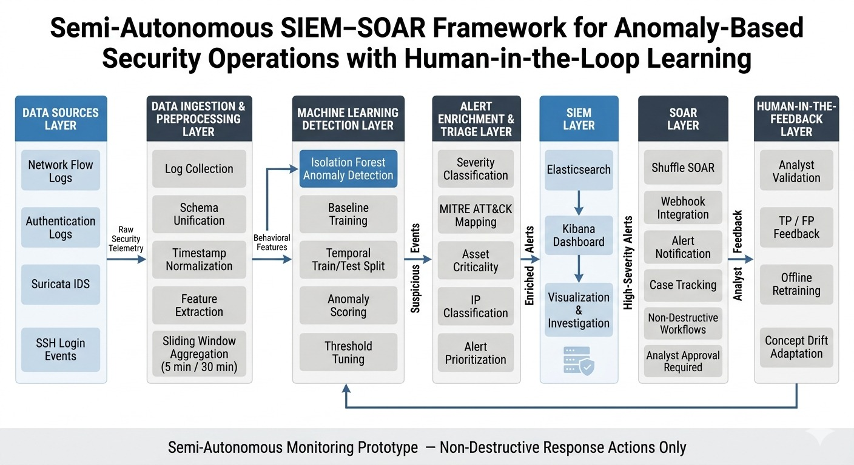

Architecture / System Diagram

Slide 12
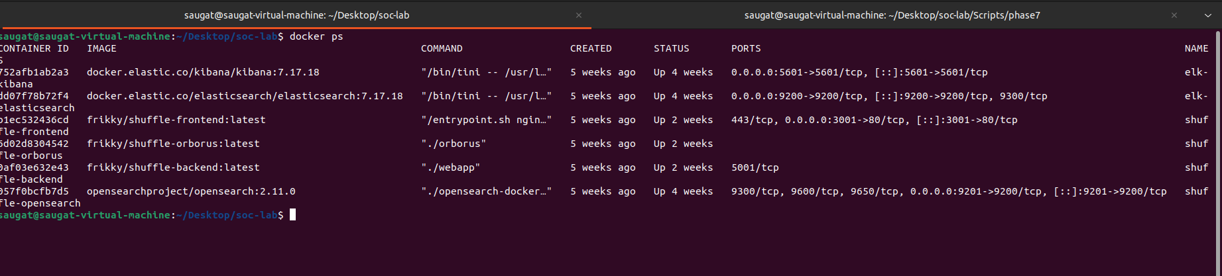
Results and Analysis(Docker)
Docker is used to deploy and manage ELK Stack and Shuffle SOAR services in isolated containers, ensuring scalable, portable, and efficient security monitoring operations.

Slide 13
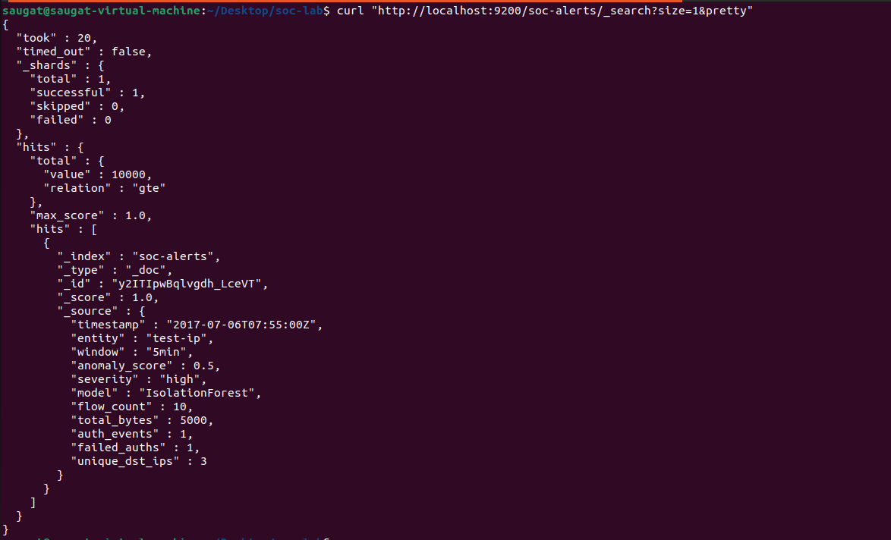
Results and Analysis(Elasticsearch)
Elasticsearch stores detected anomaly alerts as structured records, enabling fast indexing, centralized security monitoring, and efficient analysis of suspicious activities.

Slide 14
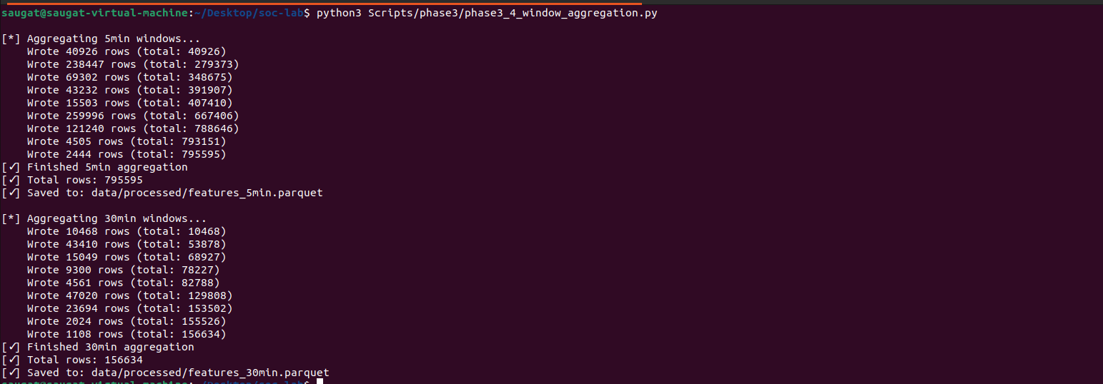
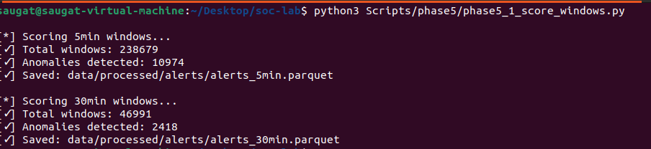
Results and Analysis (Windows Aggregation Python File )
The module performs sliding-window feature aggregation by grouping network and authentication events over fixed time intervals to generate behavioral features for anomaly detection.

Slide 15
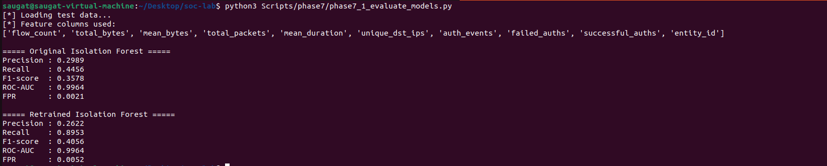
Results and Analysis
The proposed system securely performs anomaly detection, alert management, and suspicious activity monitoring in enterprise environments using Isolation Forest–based machine learning and SIEM–SOAR integration. Security events are analyzed to identify abnormal behavior and high-severity threats can be accurately monitored and investigated when needed. The alert handling mechanism identifies suspicious activities from network and authentication logs. SIEM visualization through Kibana shows centralized monitoring with minimal operational overhead, while performance metrics such as Precision, Recall, F1-Score, ROC-AUC, and False Positive Rate confirm that the system maintains reliable detection performance and operational stability after anomaly analysis.

Slide 16
Conclusion
Successfully developed a Semi-Autonomous SIEM–SOAR Framework for anomaly-based security monitoring and threat detection in enterprise environments.
Achieved project objectives by implementing anomaly detection using Isolation Forest, SIEM-based monitoring with the ELK Stack, SOAR-assisted alert handling, and human-in-the-loop validation while maintaining operational safety.
The system provides improved threat detection, centralized security monitoring, and reliable alert investigation, making it suitable for modern Security Operations Center (SOC) environments.
A key contribution of this work is the integration of anomaly detection, SIEM monitoring, SOAR workflows, and analyst-guided feedback in a single operational framework for enhanced cybersecurity monitoring.
Future enhancements can include deep learning–based threat detection, real-time threat intelligence integration, automated response orchestration, cloud security monitoring, and deployment in live enterprise environments for wider operational usability.

Slide 17
Publication
IEEE Conference
A Semi-Autonomous SIEM–SOAR Framework for Anomaly-Based Security Operations with Human-in-the-Loop Learning
Status:
Presented / Communicated

Slide 18
References
[1] F. T. Liu, K. M. Ting, and Z.-H. Zhou, “Isolation Forest,” in Proc. IEEE International Conference on Data Mining (ICDM), 2008, pp. 413–422.
[2] R. Sommer and V. Paxson, “Outside the Closed World: On Using Machine Learning for Network Intrusion Detection,” in Proc. IEEE Symposium on Security and Privacy, 2010, pp. 305–316.
[3] Elastic, “Elastic Stack Overview,” 2023. [Online]. Available: https://www.elastic.co/elastic-stack
[4] MITRE Corporation, “MITRE ATT&CK Framework,” 2023. [Online]. Available: https://attack.mitre.org/
[5] J. Brown and S. Gommers, “Security Orchestration, Automation, and Response (SOAR): Current Trends,” IEEE Security & Privacy, vol. 18, no. 5, pp. 72–77, 2020.
[6] M. Conti, T. Dargahi, and A. Dehghantanha, “Human-in-the-Loop Security Systems: A Survey,” ACM Computing Surveys, vol. 54, no. 1, 2021.

Slide 19
References
[7] D. E. Denning, “An Intrusion-Detection Model,” IEEE Transactions on Software Engineering, vol. SE-13, no. 2, pp. 222–232, 1987.
[8] S. Axelsson, “The Base-Rate Fallacy and Its Implications for the Dif ficulty of Intrusion Detection,” in Proc. ACM Conference on Computer and Communications Security (CCS), 1999, pp. 1–7.
[9] W. Lee and S. J. Stolfo, “Data Mining Approaches for Intrusion Detection,” in Proc. USENIX Security Symposium, 1998, pp. 79–93.
[10] M. Roesch, “Snort: Lightweight Intrusion Detection for Networks,” in Proc. USENIX LISA, 1999, pp. 229–238.

Slide 20
THANK YOU

