Slide 1

Bench Buddy
CS 375- Web and Mobile Application Development
Ben Arinze, Saugat Dawadi, Mohammad Adib, Ridwan Olawin

Slide 2

Purpose of Application
Make going to the gym fun
Bring out the competitive nature of our users
Encourage a healthy lifestyle
Join a community of like minded individuals

Slide 3
Log-in/Sign-up Functionality
Added sign-up page which allows users to sign up for the program
Render clock-in page inaccessible if not signed in
Renders login/sign-up page inaccessible when signed in.
Hashed the password for each user making them inaccessible to other users or the admin

Slide 4
Changes since Proposal
User Schedule Visibility
Exercise Rewards System
Global Community Leaderboard

Slide 5
User Schedule Visibility
Originally we had planned to enable users to see their friends workout schedules
This would enable users to get ideas regarding their own schedules, as well as possibly coordinate workouts with their friends
However, we decided that this would be a massive safety issue
We don’t want users knowing where others will be at certain times

Slide 6
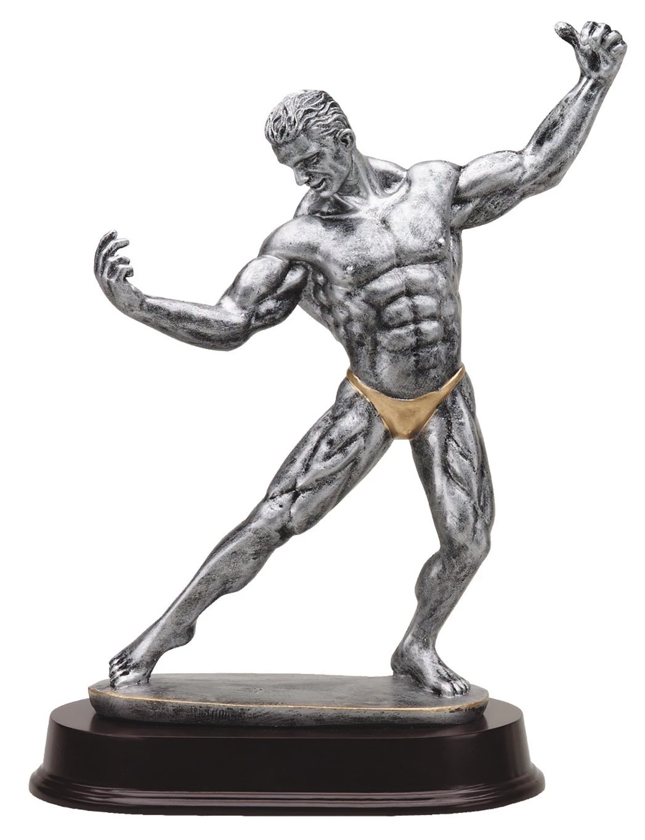
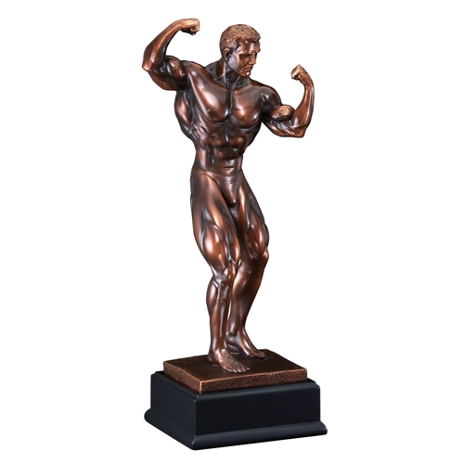

Rewards System

Slide 7
Updates to Reward System
Originally we had decided to reward the user whenever they clocked in during their weekly scheduled workouts
However, this would lock the users in for a week, and if users decided to workout at random times during the week they would not be rewarded
Now, a user receives a point whenever they workout for at least an hour, regardless of schedule

Slide 8

Leaderboard Changes

Slide 9
Leaderboard System
Originally we had decided to have the leaderboard set up by friend group
The leaderboard is now global, so that you can compete with people all over the world
Your friends will also be on the global leaderboard!

Slide 10
calculateDistance()
When user signs up, they pick a gym from our dropdown
The latitude and longitude of the gym is stored in our database
When they attempt to clock in, our application calculates their distance from their gym
If they are outside the gym, it lets them know that they are not in the gym and they can’t clock in
If they are inside the gym, it starts the one hour timer and hides the clock in button so that they can’t press it multiple times
After an hour, it calculates their distance again, and if they are still in the gym, they recieve one point

Slide 11
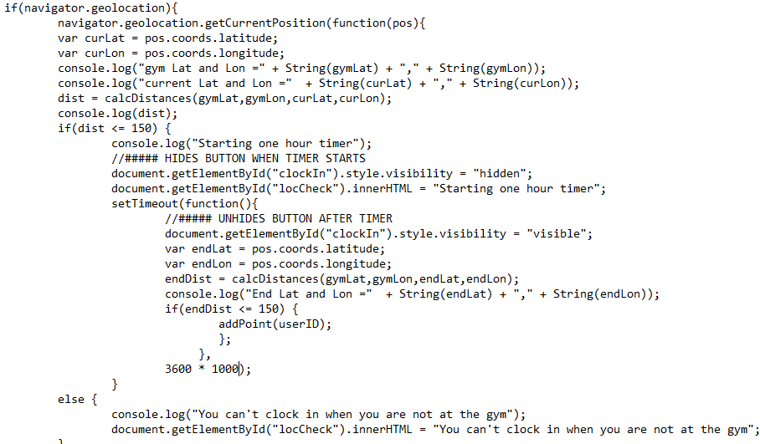
calculateDistance() cont...

Slide 12
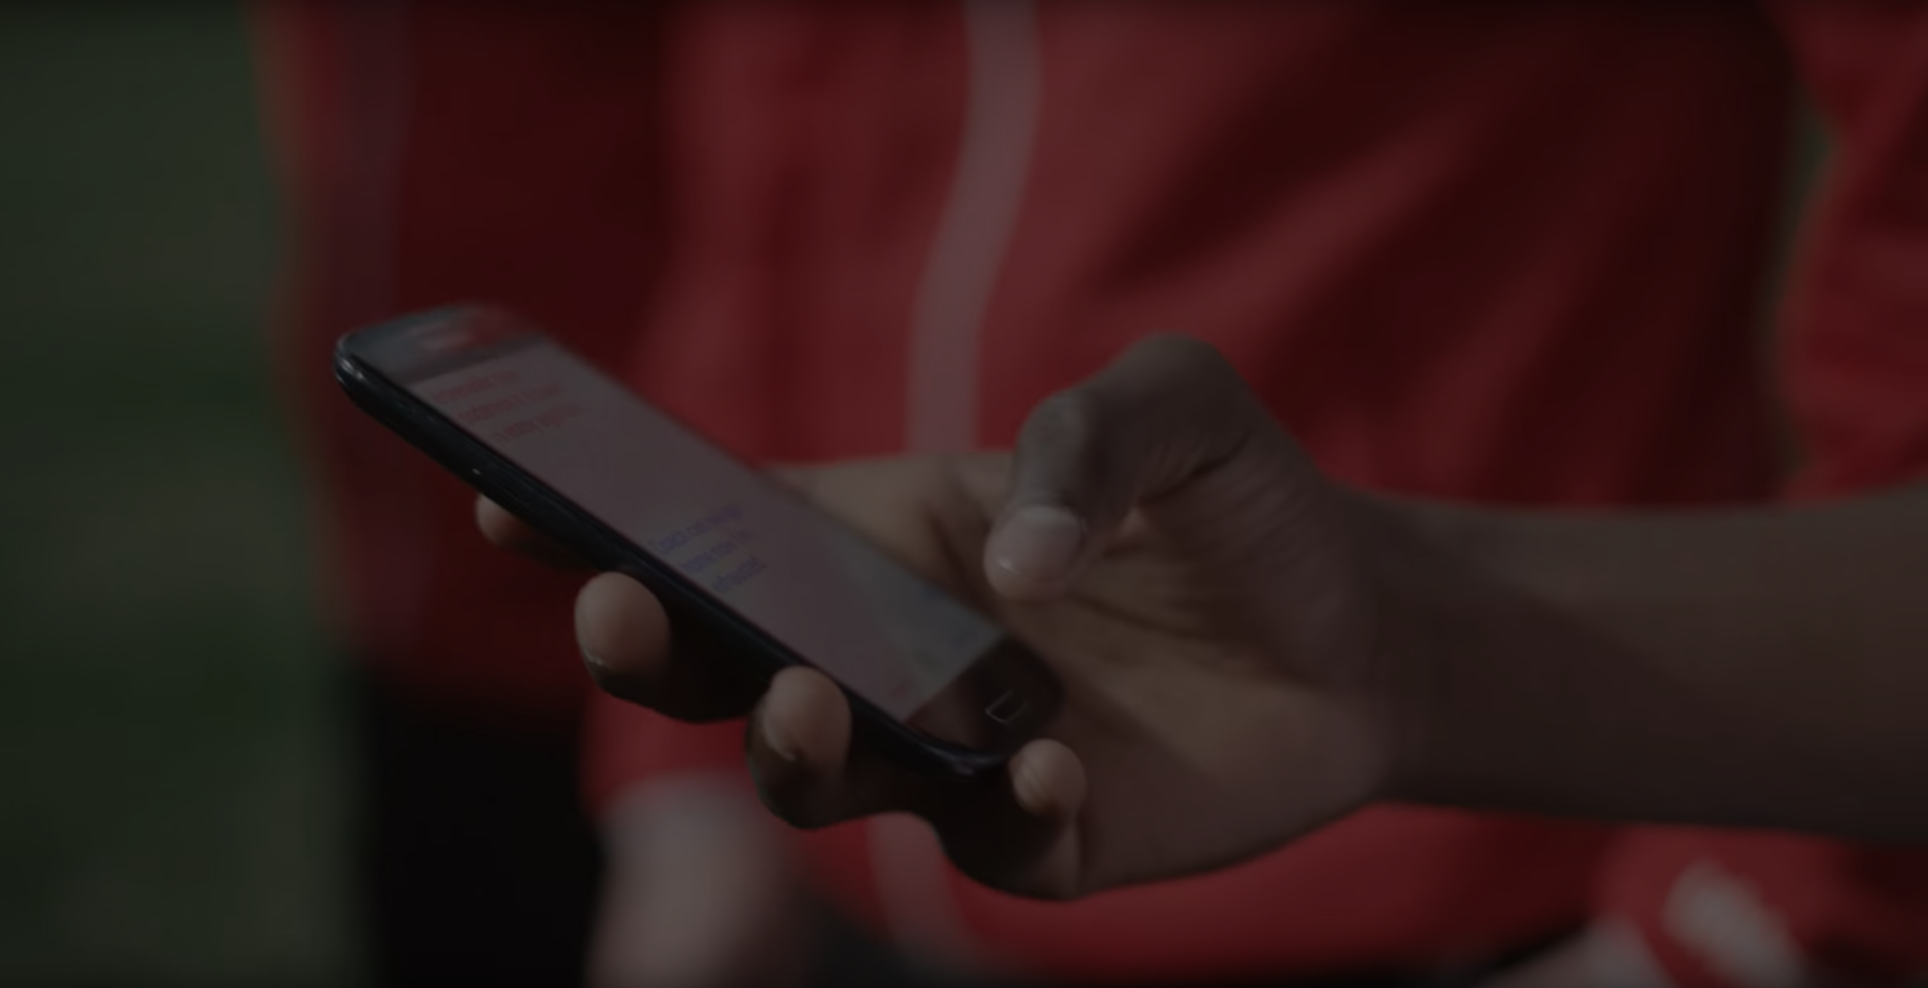
Let’s Make Fitness Fun Together!

Slide 13
Any Questions?

