Slide 1
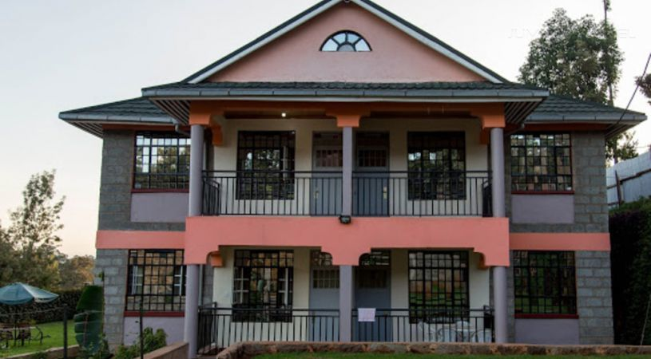
Guest House Management System
Submitted By: Saugat K.C.
NCC ID: 00172898
Submitted to: Kiran Rana

Slide 2
Introduction
Guest house management system is a web based application designed for the guest house to manage their transactions as well as to provide information about the guest house and available rooms and facility to book those rooms to user.

Slide 3
Problem Statement
Giving information about the guest house to customers is not so smoot as well as the proper details of the facilities provided by the guest house to the customers. People often have to visit the guest house to book or view the room and know the prices of rooms, packages provided by the guest house. Some customers have to return with dissatisfaction if the facilities are not as they except. Customers sometime have to return due to all available rooms pack and the details of the rooms occupied or empty have to be saved in paper which gives employee little bit of hard time.

Slide 4
Background
People trying to minimize their expenses when they are going to places far from home so likely than hotels they prefer guest houses. Using the website of the guest house customers and view the room picture and their prices and if like the room can book it online. Customers can see if the room is empty, booked or occupied. Customer can get other information of the guest house through the website like location , facilitys and other.

Slide 5
Aims And Objective
Aim:
Provide upto date information to the customer
Develop user friendly and helpful application
Proper data management
Give more facilities to the customer
Objectives:
All information about the room their facilities provided to the guest house including their price is shown.
Information of in use rooms or no in use rooms are updated
Information of the customer as well as the information of the guest house is properly saved as well as their expenses.
reviews from customer are seen for further development of the guest house
Rooms can be booked online if empty for their date required and select the room they prefer

Slide 6
Features
Room
Booking
Review
Bill
Order

Slide 7
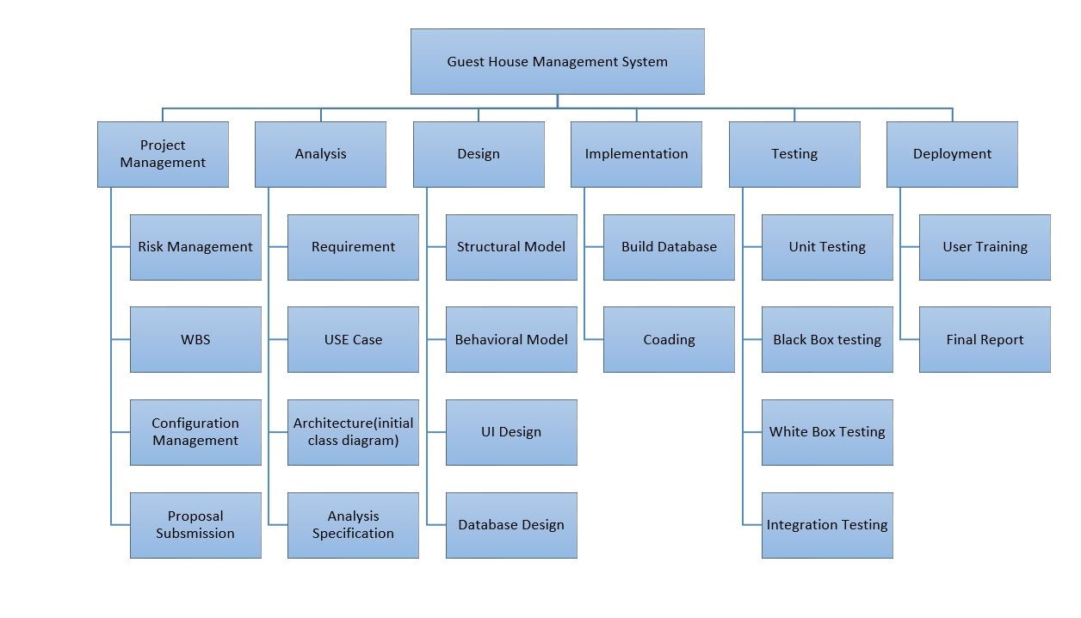
WBS

Slide 8
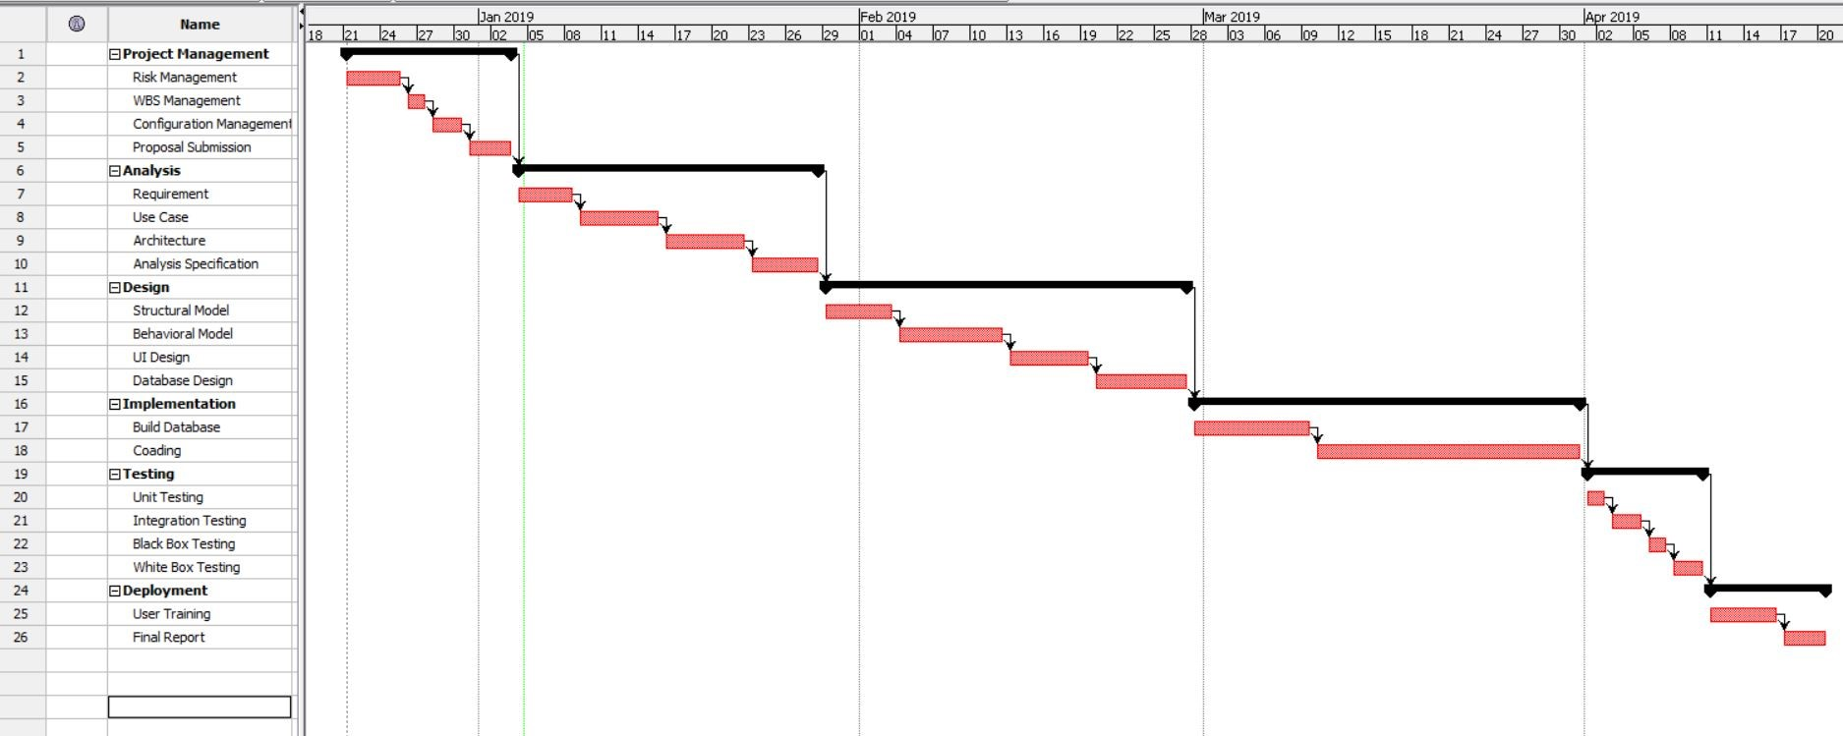
Gantt Chart

Slide 9
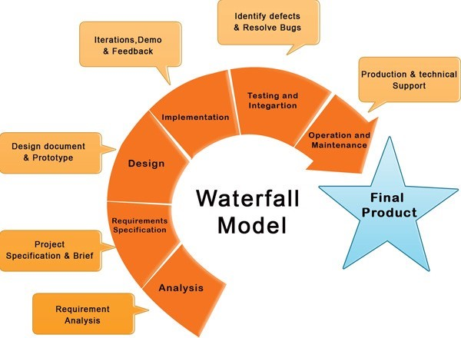
Methodology Used
Waterfall methodology is used in the project. Waterfall model is very simple methodology of software development. There are sequential steps which are proceeded after the completion of one due to which there is no overlapping during the process

Slide 10
Steps
Requirement gathering and analysis
System Design
Implementation
Testing
Deployment of System
Maintenance

Slide 11
Architecture
I have decided to use three tire architecture. Three-tier architecture is a client-server architecture in which the functional process logic, data access, computer data storage and user interface are developed and maintain independent modules on separate platform

Slide 12
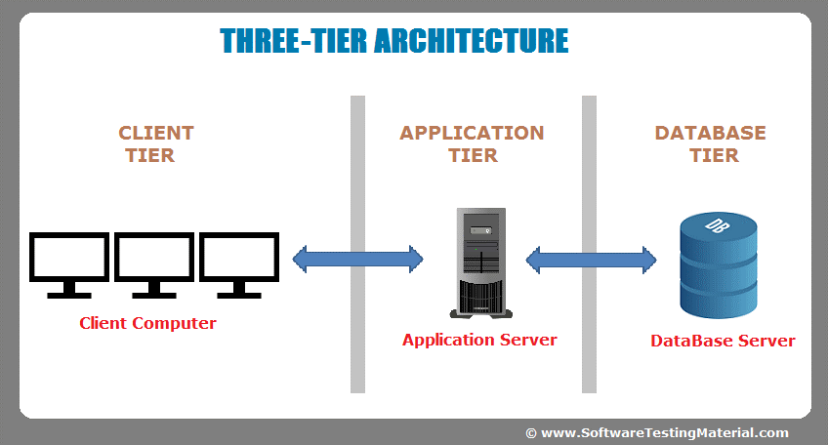
The Three Tier

Slide 13
Risk Management
To identify and avoid the possible risk that may occur during the development of our project is risk management. It helps us to tackle the problem in real time when project should be implemented.
Impact = Likelihood * Consequence Risk Likelihood values are shown as follows
Risk Consequence values are shown below
Likelihood | Value
Low | 1
Medium | 2
High | 3
Consequence | Value
Very low | 1
Low | 2
Medium | 3
High | 4
Very High | 5

Slide 14
Risk Management-2
S. No | Risks | Likelihood | Consequences | Impact | Solution
1 | Server failure | 1 | 5 | 5 | Suitable environment and equipment for server
2 | DDoS attack | 2 | 2 | 4 | Use of proper firewall
3 | Phishing | 2 | 3 | 6 | Proper planning is to be done in every phase.
4 | Identity theft | 3 | 3 | 9 | Proper study of customer
5 | Information leakage | 2 | 4 | 8 | Proper security
6 | Hard disk crash | 2 | 5 | 10 | Data must be backed up in external drive or in clouds.
7 | User error | 2 | 2 | 4 | User training

Slide 15
Configuration Management
The process of keeping and tracking the detail data, so the updates can flow with the existing project. Files and folder should be safely stored in a systematic order, so that it can be easily excessed whenever we need to. When configuration management is done, the consistency of the projects becomes better.

Slide 16
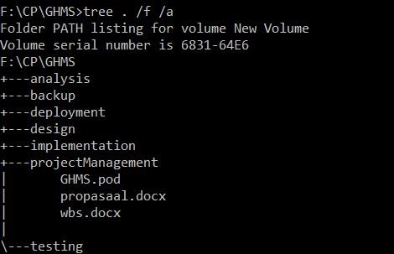
Configuration Management-2
Directory Structure

Slide 17
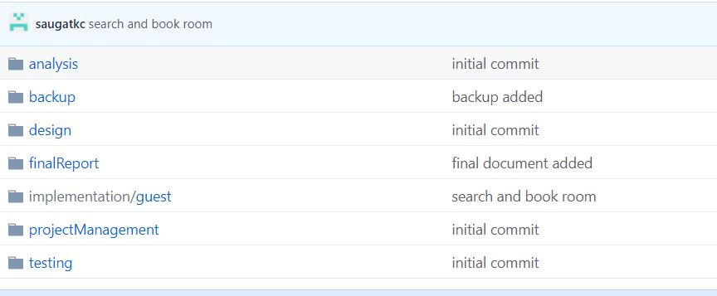
Configuration Management-3
Configuration folder

Slide 18
Diagrams

Slide 19
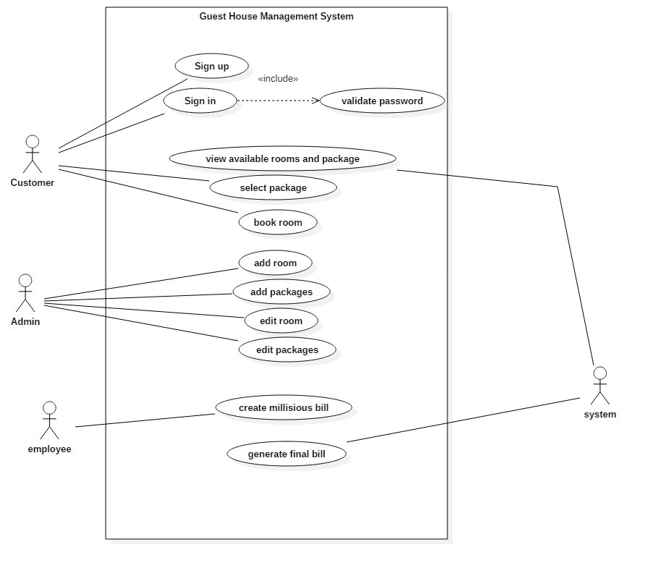
Use Case Diagram

Slide 20
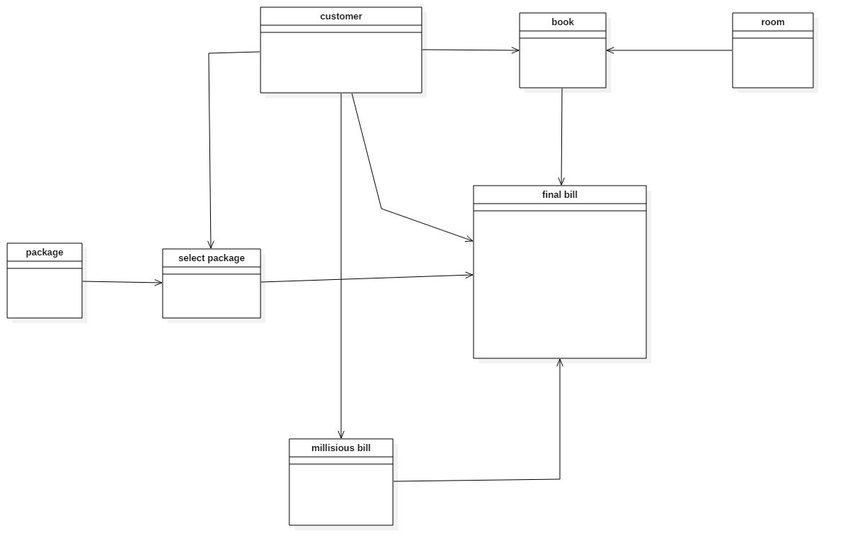
Initial class diagram

Slide 21
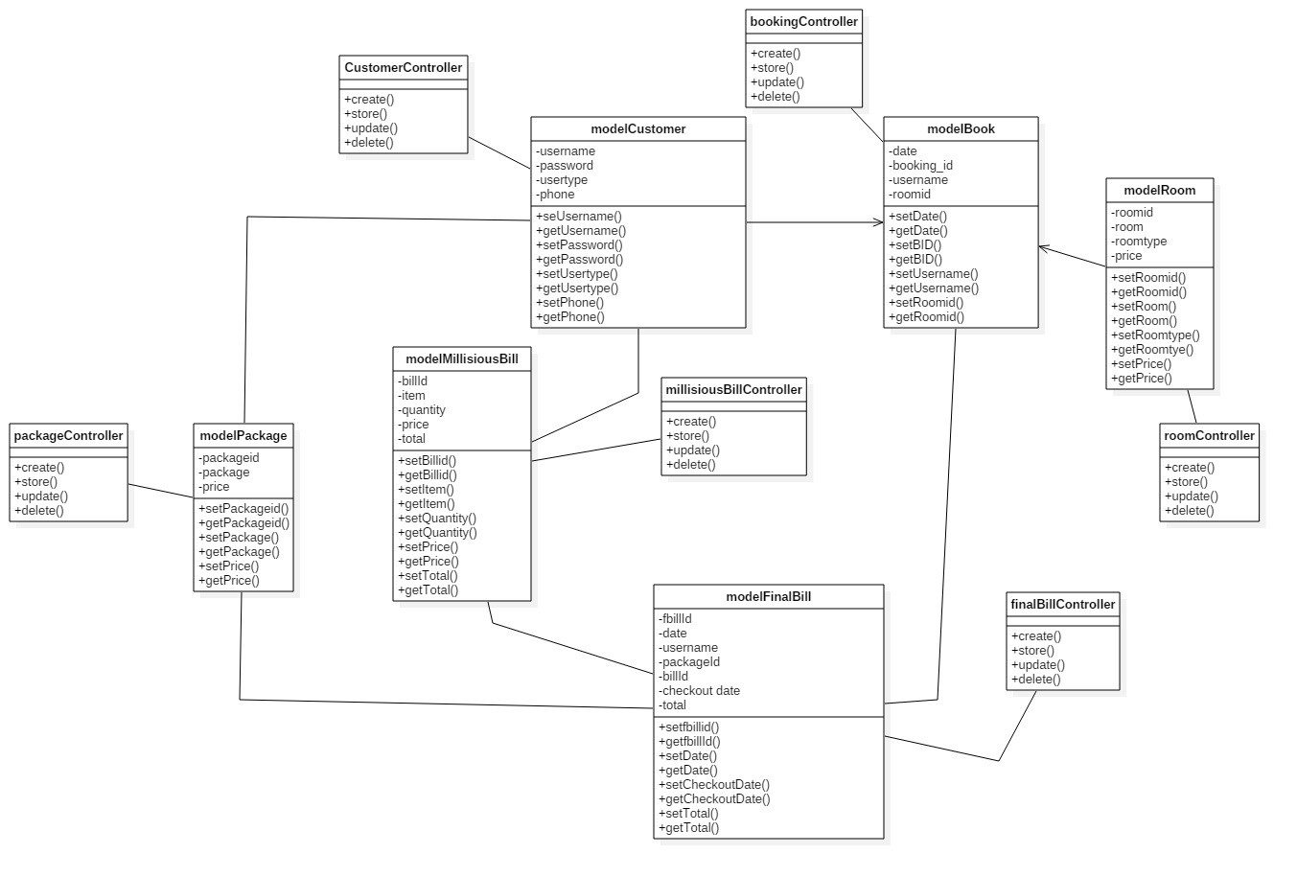
Final class diagram

Slide 22
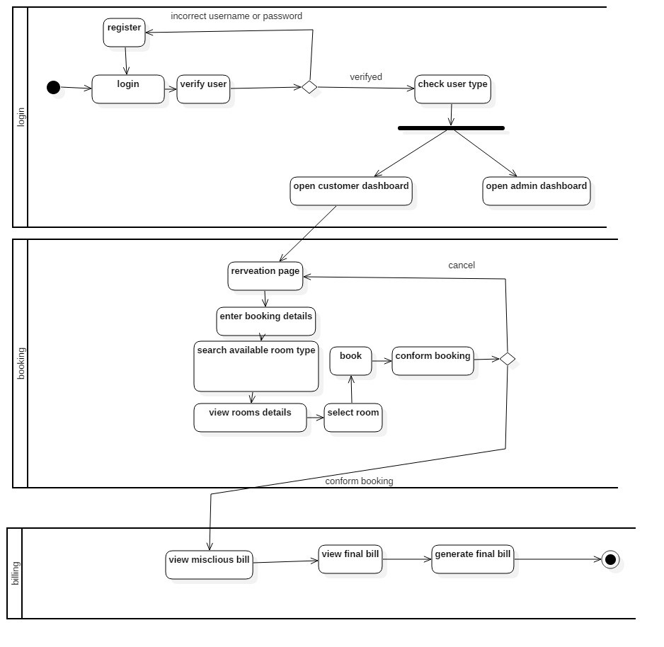
Activity diagram

Slide 23
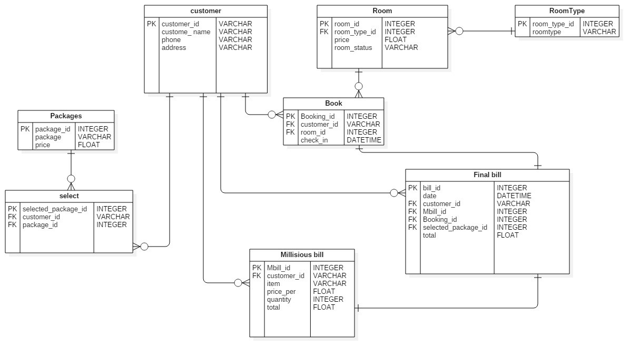
ER diagram

Slide 24
Coading And UI

Slide 25
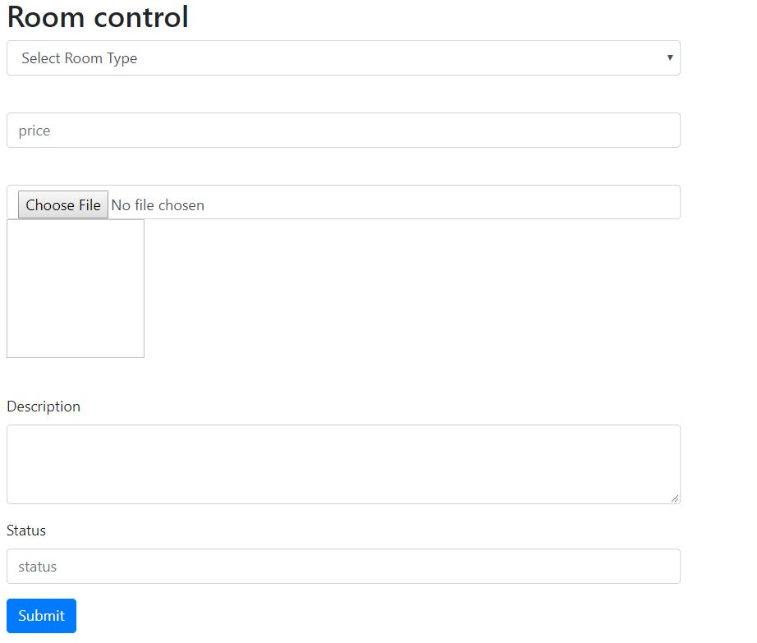
Add new room form UI

Slide 26
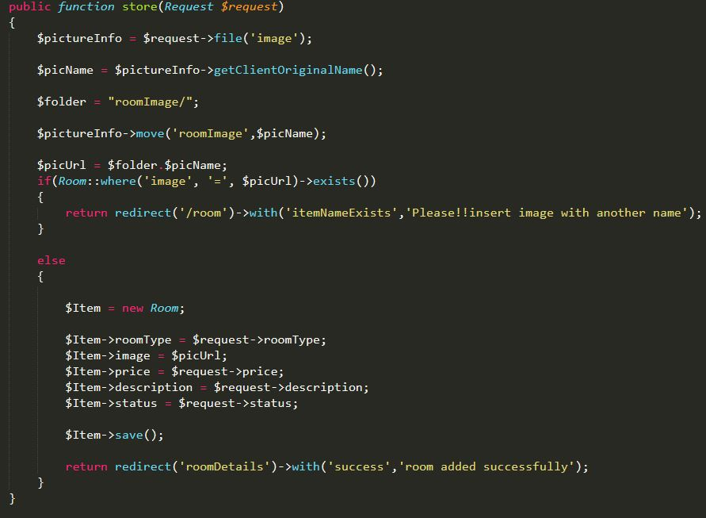
Add new room controller code

Slide 27
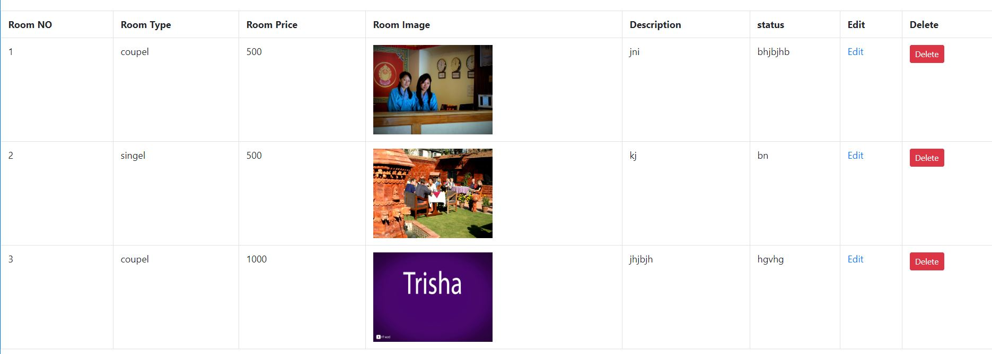
View All Rooms UI

Slide 28
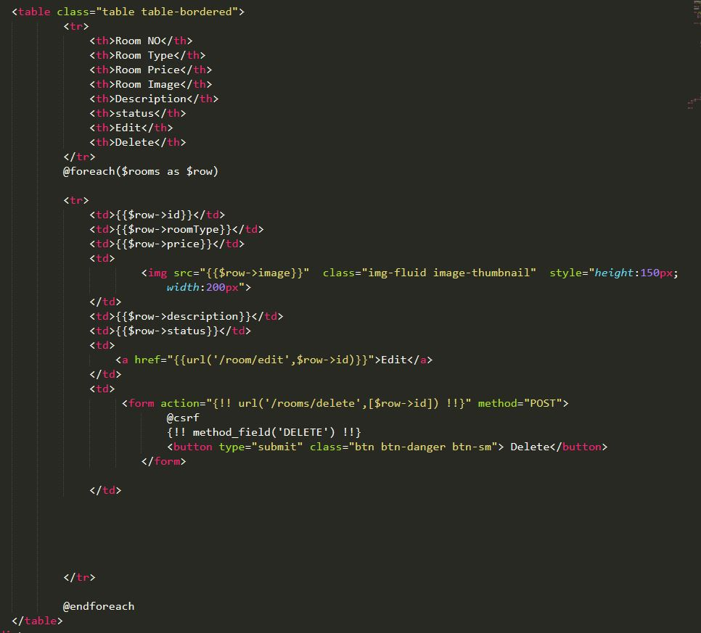
Showing all rooms Code

Slide 29
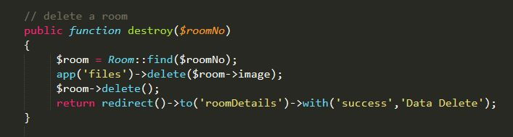
Delete room code

Slide 30
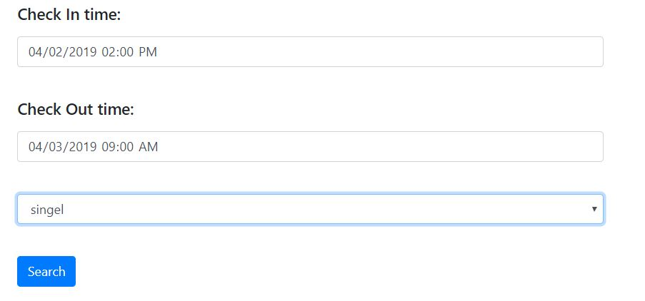
Search for unbooked room UI

Slide 31
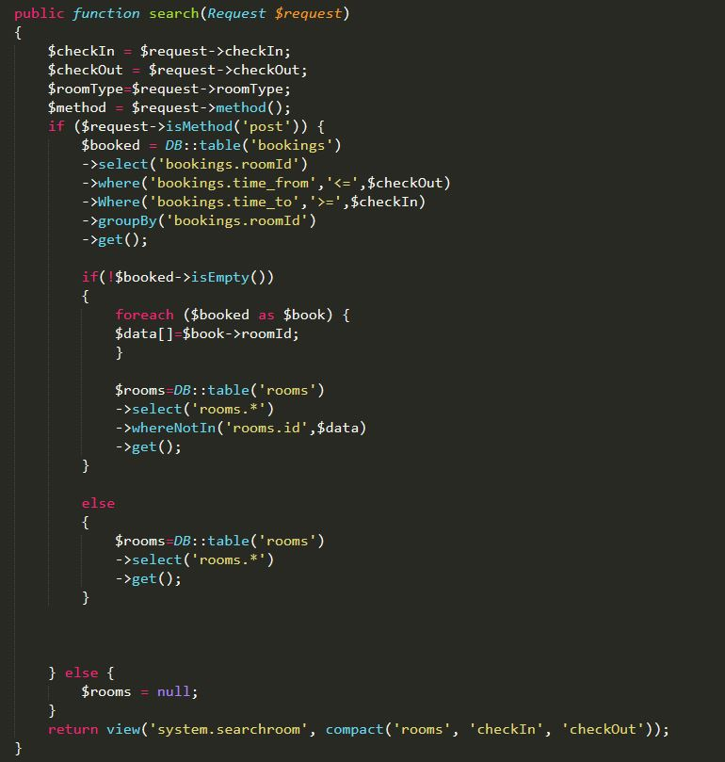
Search unbooked room code

Slide 32
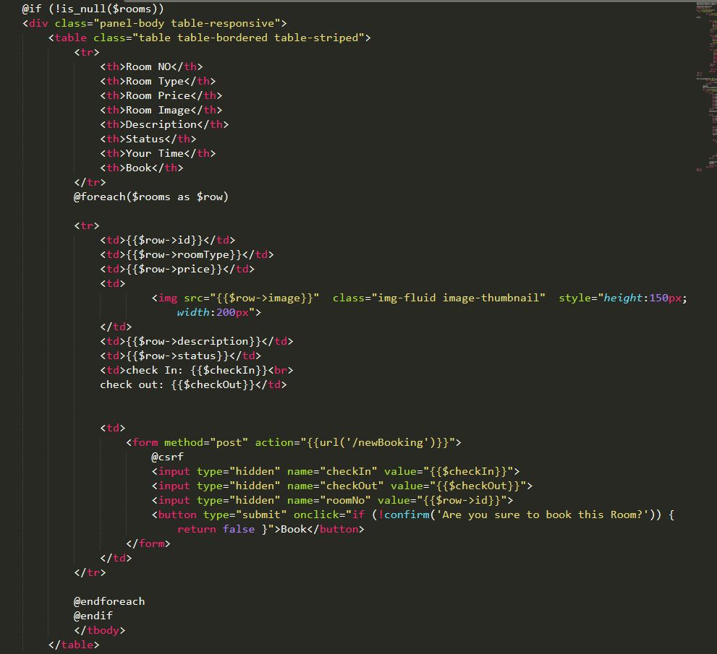
Show Unbooked rooms code

Slide 33
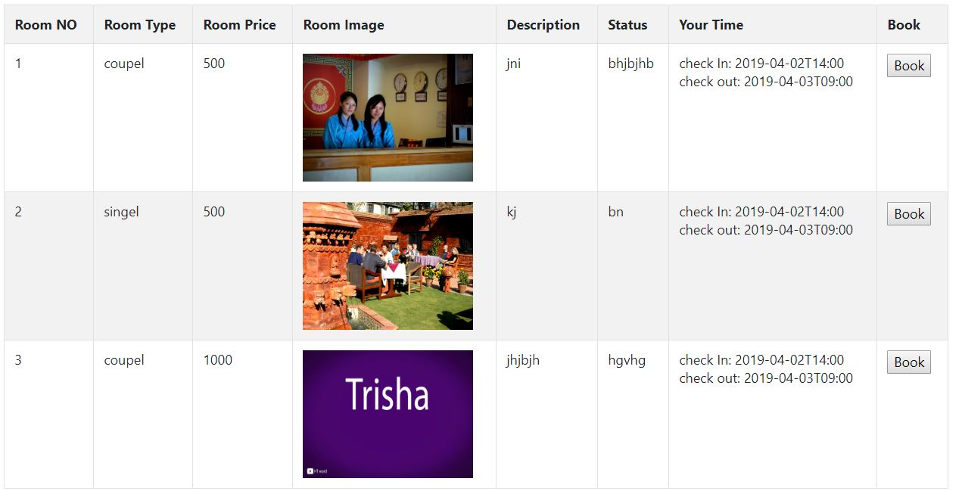
Unbooked rooms shown UI

Slide 34
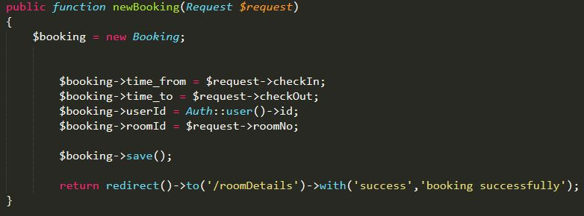
Create new booking code

Slide 35
Future Work
Online Payment System
Count visit of user and provide free stay after certain
Add packages
Booking cancelation
User to view all their stays till date
Online order

Slide 36
Limitation
Users cannot get access to the database to see background information.
User do not have access to manipulate their booking details afterwards
User cannot order items online.
User cannot see details of other people in the guest house.
Site cannot be executed in absence of internet.
Online payment cannot be done.
Rating and sorting is not available.

Slide 37
Conclusion
The project is developed to make easier for the user to get information of the guest house and their facilities as well as customer for checking the information and to book the rooms online. The application will be reliable, efficient and easier for a user to work on it. The application will be user friendly for the user. Hence, this proposal will be used as the guideline for the final project.

Slide 38
---THANK YOU---

