Slide 1
Workshop on XFAB XH018
Saul Rodriguez

Slide 2
OUTLINE
Day 1 - Technology Overview and Analog Flow
XFAB 0.18um CMOS process and module configuration for Europractice
  Installation and documentation
  Available devices and standard cell libraries
Analog Flow
  Schematic Entry, Corners and Montecarlo
  Rapid Prototyping with Modgens
  Physical implementation and verification
  Post-layout simulation

Slide 3
OUTLINE
Day 2 - Digital Flow
Digital Project setup
RTL Simulation
RTL Synthesis
Gate level simulation
Place and Route
Post Layout simulation
Export cell for Analog-on-Top integration

Slide 4
OUTLINE
Day 3 - AMS flow and Chip assembly
Overriding global nets and substrate separation
Advanced Test Bench creation
AMS Simulation Setup
  AMS Simulation views
  VerilogA (behavioral analog) + functional (digital)
  Schematic (transistor level analog) + gate level (digital)
Post-layout (parasitic extracted view analog) + Post layour digital (gate level + back annotated delays)
Chip Assembly (TOP assembly)
  Analog and digital IOs and ESD protection circuits
  AMS TOP SimulationDigital Flow

Slide 5
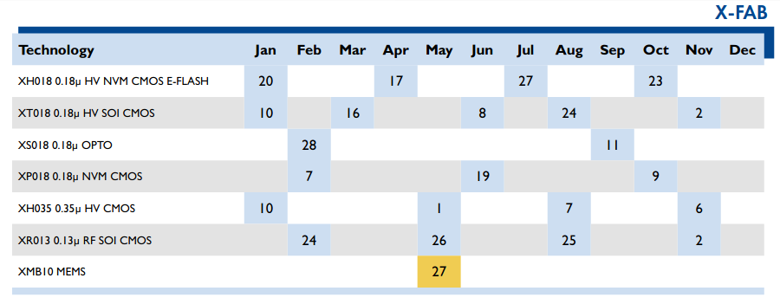
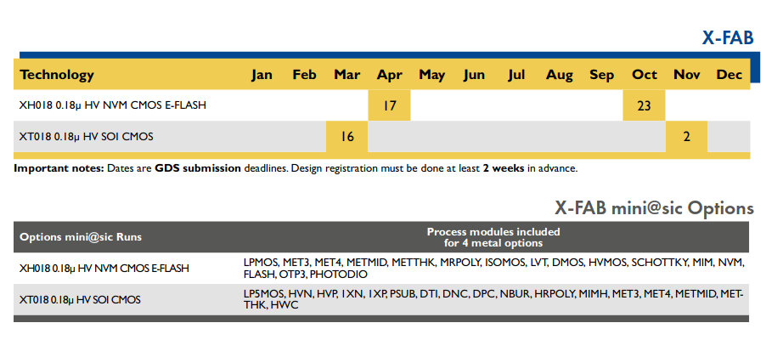
XFAB 0.18um CMOS Process and Configuration for Europractice
Europractice website: https://europractice-ic.com
MPW and miniasic: https://europractice-ic.com/schedules-prices/

Slide 6
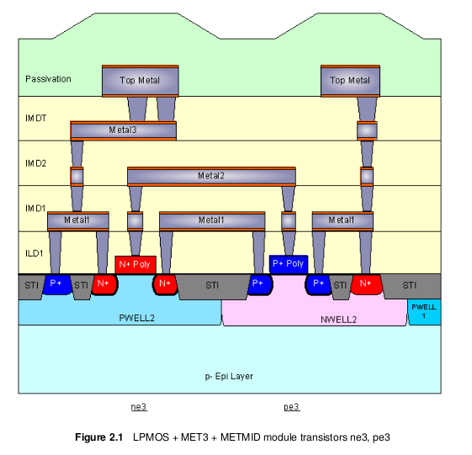
XFAB 0.18um CMOS Process and Configuration for Europractice
Basic Modules: LPMOS + MET3 + METMID

Slide 7
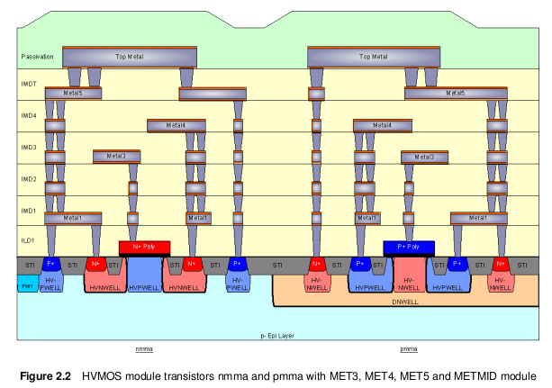
XFAB 0.18um CMOS Process and Configuration for Europractice
Basic Modules + MET4 + MET5 + HVMOS + METMID

Slide 8
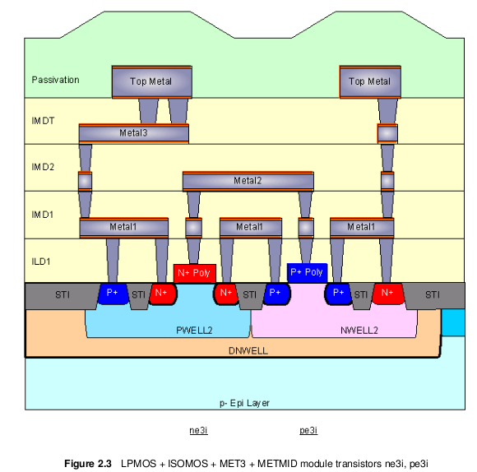
XFAB 0.18um CMOS Process and Configuration for Europractice
Basic Modules + ISOMOS + MET3 + METMID

Slide 9
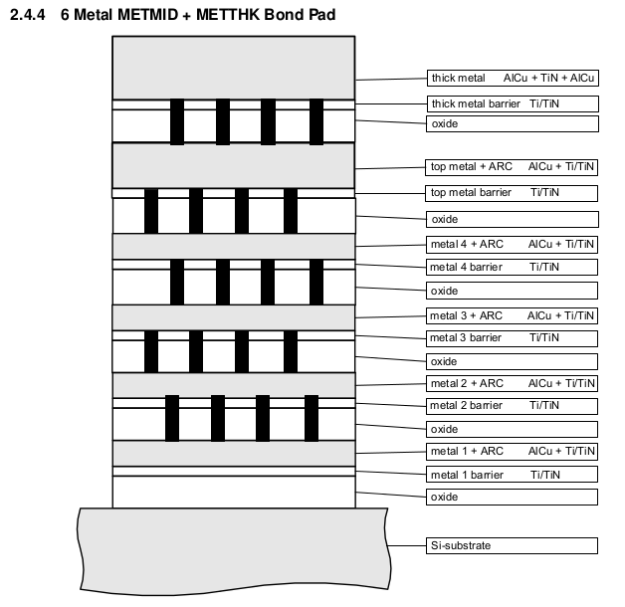
XFAB 0.18um CMOS Process and Configuration for Europractice
Currently metal stack for Europractice MPW/Miniasic (year 2020)
METTHK,
METMID,
MET4,
MET3
Run xenv -t xh018 and select the option:
xh018: 1143
INPUT_CORE = "1" LP (Low Power 1.8V)
INPUT_MOS35 = "1" MOS3 (3.3 Volt MOS)
INPUT_METALS = "4" 4 Thin Metals
INPUT_TOPMTLS = "3" Top and Thick Metal: METTP & METTPL

Slide 10
XFAB 0.18um CMOS Process and Configuration for Europractice
PDK’s documentation available at: /pkg/xfab/docs
Process and device specs: xh018-PDS-vX.pdf
Design rules: xh018-DR-vX.pdf
Device status: xh018-ApplicationNote-Primitive_Device_Status-vX.pdf
MIM caps: 0.18um-ApplicationNote-MIM_Capacitors_Check_vX.pdf
….
….
….
Zim notebook with guidelines for analog, digital and AMS flows (github)

Slide 11
XFAB 0.18um CMOS Process and Configuration for Europractice
Available devices and standard cell libraries
Devices available in LPMOS module
Devices available in ISOMOS (tripple-well, etc)
Devices available in other modules included in MPW config.
All devices in HV module (check status)
High poly resistor from MRPOLY module: rpp1k and rpp1k1_3
MIM Capacitor between metal top METTP and MET4: cmm5t (xh018-DR-v8_0_1.pdf, section 3.26)
MOS Varactor: mosv from LPMOS

Slide 12
XH018 CADENCE ANALOG FLOW

