Slide 1
Python data analysis
Iris

Slide 2
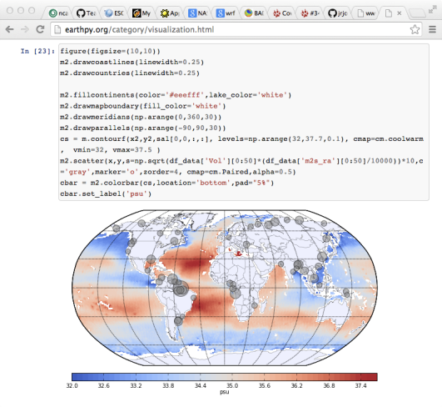
There are lots of tools
Many (Atmospheric) Science libraries are available for Python:
netCDF4-python
cdat
cf-python
Iris
pyNGL
Many others
OpenClimateGIS
pyTroll
…

Slide 3
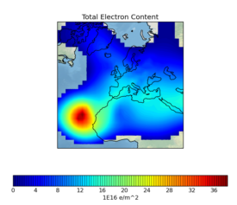
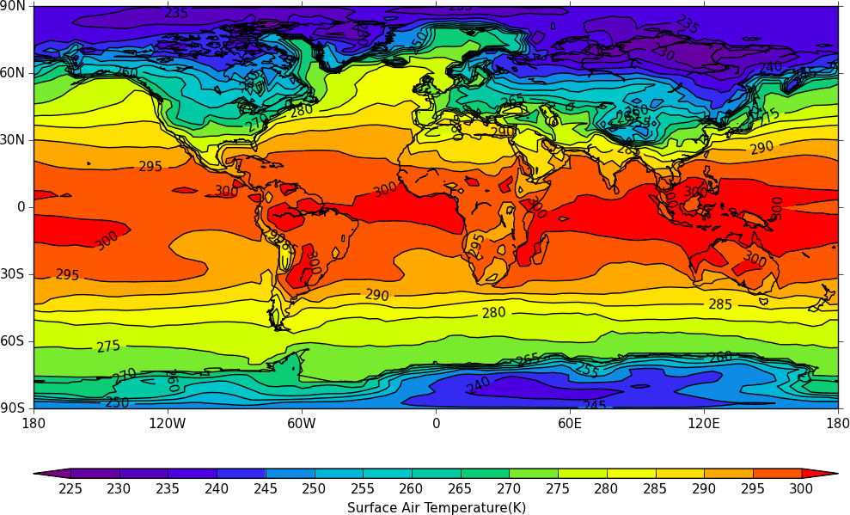
Higher-level data tools
Iris
Developed by the Met Office
Reads NetCDF, PP and Grib
Supports CF-conventions via the "Cube"
Plotting via cartopy or matplotlib + basemap
cf-python
Developed by Uni. Reading
Reads NetCDF and PP
Strict interpretation of the CF-conventions
Plotting via cfplot or matplotlib + basemap

Slide 4
What makes these tools useful?
The biggest gain from using these tools is that you can work with higher-level objects that know about real-world coordinate systems.
Hence you can subset a variable based on temporal, spatial and other constraints rather than using slicing in index space.

Slide 5

Introducing Iris
A Python package for data analysis and visualisation
Iris

Slide 6
What is Iris?
Iris is publicised as:
"A Python library for Meteorology and Climatology"
Implements the CF-netCDF Data Model in its "cube" design.
Supports read/write access to a range of data formats (including CF-netCDF, GRIB, and PP).
Fundamental data manipulation operations, such as arithmetic, interpolation, and statistics;
A range of integrated plotting options.

Slide 7
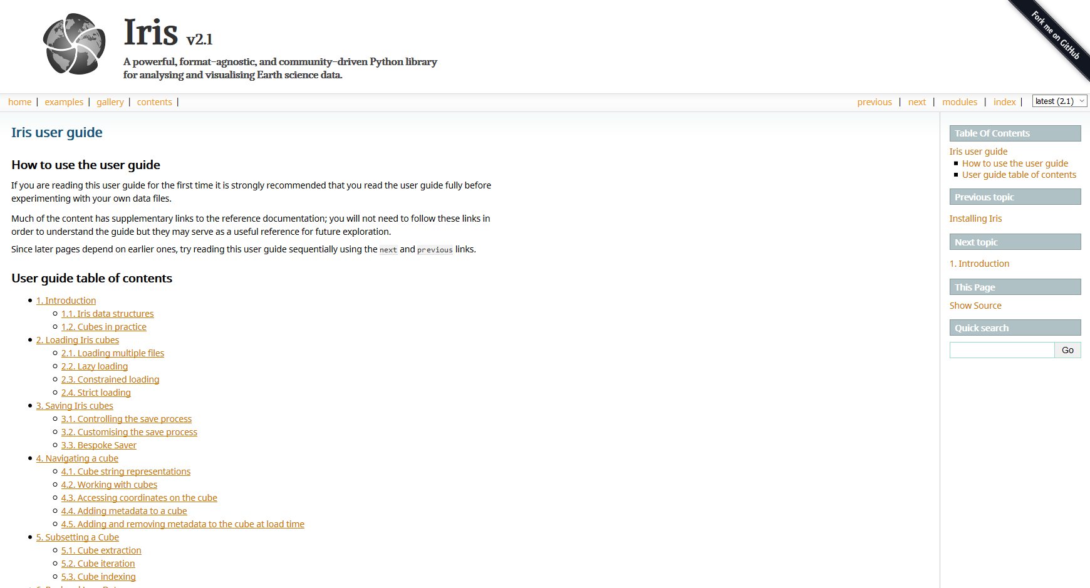
Documentation
https://scitools.org.uk/iris/docs/latest/userguide/

Slide 8
Main concept - the "cube"
A cube consists of:
a standard name and/or a long name and unit;
a data array;
a collection of coordinates and associated data dimensions on the cube's data array;
an attributes dictionary for metadata;
a list of cell methods (e.g. "mean over time")
a list of coordinate "factories" used to derive coordinates from the values of other coordinates in the cube;

Slide 9
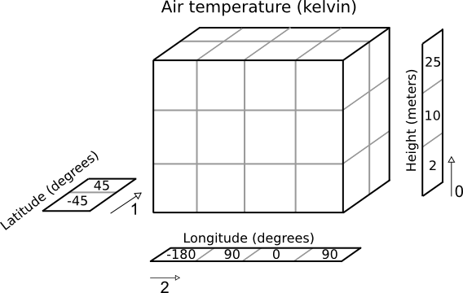
The "cube" - in a picture

Slide 10
So what can Iris do?
There are too many features to describe in detail. Here are some things that extend functionality we have seen in lower level libraries:
Loading data from multiple files:
import iris
filename = iris.sample_data_path('GloSea4', '*.nc')
cubes = iris.load(filename)

Slide 11
Constrained loading
Constrained by CF standard name:
filename = iris.sample_data_path('uk_hires.nc')
cubes = iris.load(filename,
['air_potential_temperature', 'specific_humidity'])
Constrained by coordinate selection:
filename = iris.sample_data_path('uk_hires.nc')
level_10_or_12_fp_6 = iris.Constraint(
model_level_number=[10, 16], forecast_period=6)
cubes = iris.load(filename, level_10_or_16_fp_6)

Slide 12
Cube slicing/indexing - like numpy
Cubes can be sliced and indexed like numpy arrays:
# get the first element of the first dimension # (+ every other dimension)
print(cube[0])
# get the first 4 elements of the first dimension
# (+ every other dimension)
print(cube[0:4])
# Get the first element of the first and third dimension (+ every other dimension)
print(cube[0, :, 0])

Slide 13
Plotting a cube
import matplotlib.pyplot as plt
import iris
import iris.quickplot as qplt
# Load the data
fname = iris.sample_data_path('air_temp.pp')
temperature_cube = iris.load_cube(fname)
# Draw the contour with 25 levels.
qplt.contourf(temperature_cube, 25)
# Add coastlines to the map created by contourf.
plt.gca().coastlines()
plt.show()

Slide 14
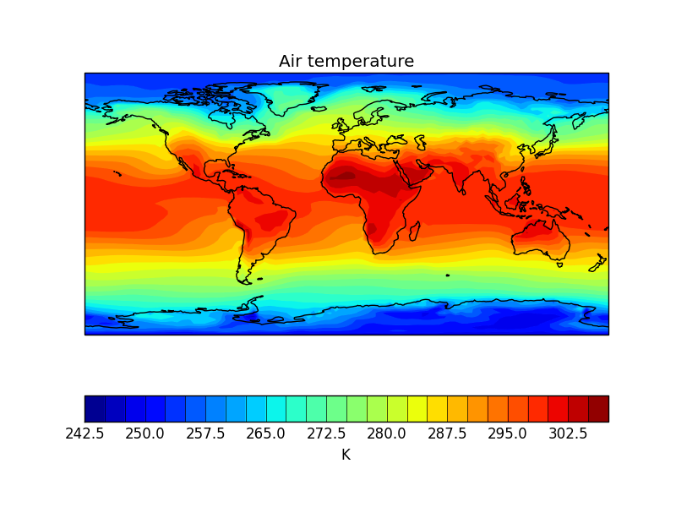
Plotting a cube
import matplotlib.pyplot as plt
import iris
import iris.quickplot as qplt
# Load the data
fname = iris.sample_data_path('air_temp.pp')
temperature_cube = iris.load_cube(fname)
# Draw the contour with 25 levels.
qplt.contourf(temperature_cube, 25)
# Add coastlines to the map created by contourf.
plt.gca().coastlines()
plt.show()

Slide 15
Collapsing cubes
Cubes can be collapsed using various statistical/mathematical operations.
Calculate a time-series mean:
air_temp_mean = air_temp.collapsed('time', iris.analysis.MEAN)

Slide 16
Merging cubes
>>> print(cubes)
0: air_temperature / (kelvin) (y: 4; x: 5)
1: air_temperature / (kelvin) (y: 4; x: 5)
2: air_temperature / (kelvin) (y: 4; x: 5)
>>> print(cubes[0])
air_temperature / (kelvin) (y: 4; x: 5)
... z: 1 meters
>>> print(cubes[1])
air_temperature / (kelvin) (y: 4; x: 5)
... z: 2 meters
>>> print(cubes[2])
air_temperature / (kelvin) (y: 4; x: 5)
... z: 3 meters
>>> print(cubes.merge())
0: air_temperature / (kelvin) (z: 3; y: 4; x: 5)

Slide 17
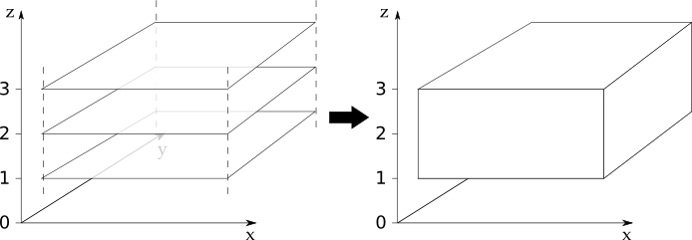
Merging cubes

Slide 18
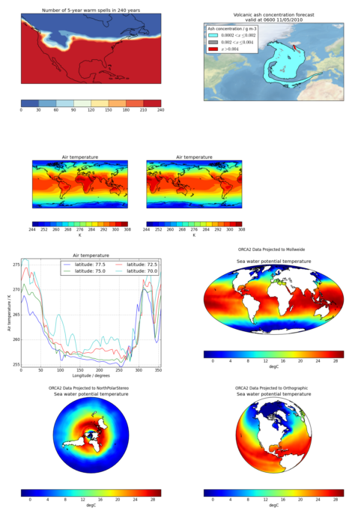
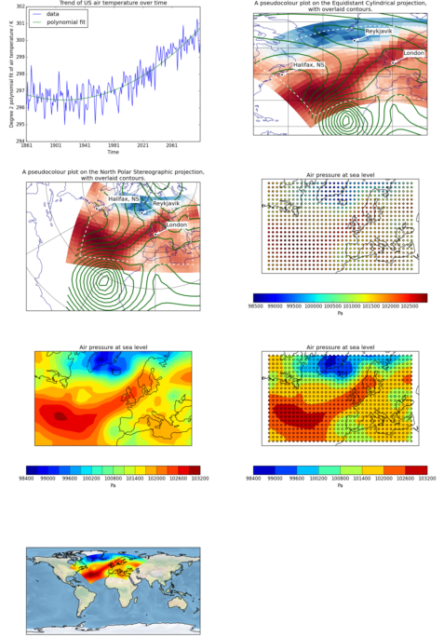
And plotting
See: https://scitools.org.uk/iris/docs/latest/gallery

Slide 19
Further reading
Iris documentation:
https://scitools.org.uk/iris/docs/latest
Iris image gallery:
https://scitools.org.uk/iris/docs/latest/gallery

