Slide 1
Python data analysis
cf-python and cf-plot

Slide 2
What is cf-python?
cf-python is an implementation of the CF data model that:
Reads CF-netCDF and PP format files, aggregating contents into as few multi-dimensional fields as possible.
Writes fields to CF-netCDF files on disk.
Creates, deletes and modifies field data and metadata.
Subsets fields by conditions on their metadata.
Subspaces a field to create a new field.
Enables arithmetic/comparison operations with fields.
Calculates statistics on field data.

Slide 3
A foreword
At the moment cf-python and cf-plot only work with Python 2 and are hopefully getting Python 3 support at some point in 2019.
For the sake of completeness we will show you how to use them regardless.
If you want to use them yourself you can do so if you install Python 2 or just wait until they are updated with Python 3 compatibility.

Slide 4
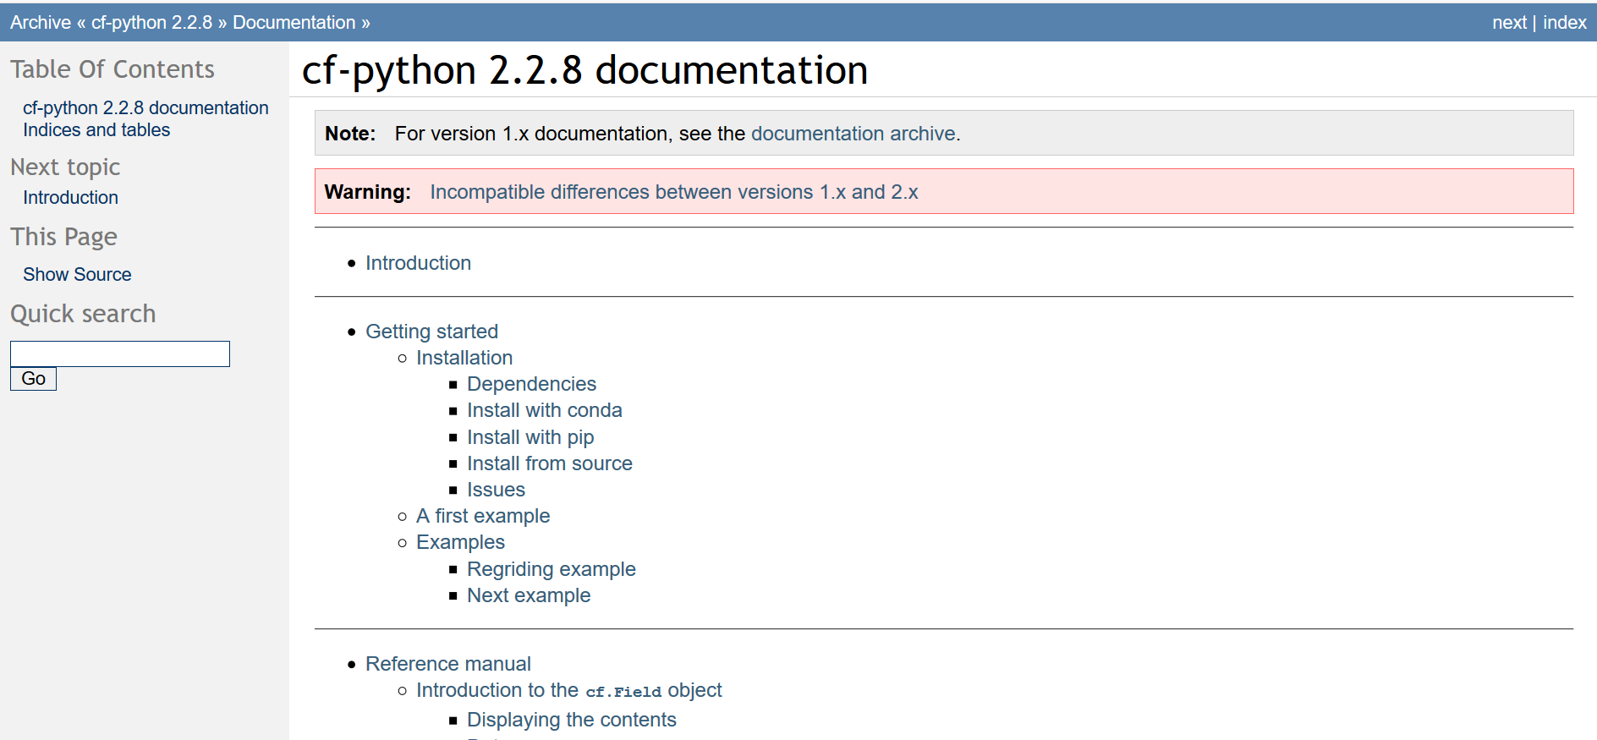
Documentation
https://cfpython.bitbucket.io/docs/latest/index.html

Slide 5
Main concept - the "field"
The cf package allows a data array and its associated metadata to be contained and manipulated as a single entity called a field, which is stored in a cf.Field object.

Slide 6
Some example functionality
Here we will highlight some example cf-python functionality that goes beyond that provided by lower level packages:
Reading data from multiple files:
>>> import cf >>> f = cf.read('~/file.nc')
>>> f = cf.read('file[1-9a-c].nc')
>>> f = cf.read('dir*/*.pp')
>>> f = cf.read(['file1.nc', 'file2.nc', 'file3*.nc'])

Slide 7
Selecting from a field
Fields may be selected with the match and select methods. These methods take conditions on field CF properties, attributes and coordinates as inputs:
>>> f
[<CF Field: x_wind(grid_latitude(110), grid_longitude(106)) m s-1>,
<CF Field: air_temperature(time(12), grid_latitude(73), grid_longitude(96)) K>]
>>> f.match('temperature', regex=True)
[False, True]
>>> g = f.select('air_temperature', cvalue={'longitude': 0})
>>> g
[<CF Field: air_temperature(time(12), grid_latitude(73), grid_longitude(96)) K>]

Slide 8
Functions of the cf module
The cf module provides a variety of functions, including:
I/O: read, write, open_files
Aggregation: aggregate
Statistics: collapse
Comparison: eq, gt, lt, ...
For climatologies: djf, mam, jja, son
Date-time: dt, Y, M, D

Slide 9
Command-line tools
cfplot provides some useful command-line utilities:
The cfdump tool generates text representations on standard output of the CF fields contained in the input files.
The cfa tool creates aggregated CF datasets - it creates and writes to disk the CF fields contained in the input files.
For usage instructions, use the -h option to display the manual pages:

Slide 10
cfa example
cfa can read multiple files and aggregate the contents into a single output file, e.g.:
$ cfa -o out.nc file1.nc file2.nc
$ cfa -o out.nc file[1-9].nc
$ cfa -f NETCDF3_CLASSIC -o out.nc data1/*.nc data2/*.nc
$ cfa -o out.nc http://test.opendap.org/dap/coads_climat ology.nc file*.nc # remote file(s)

Slide 11
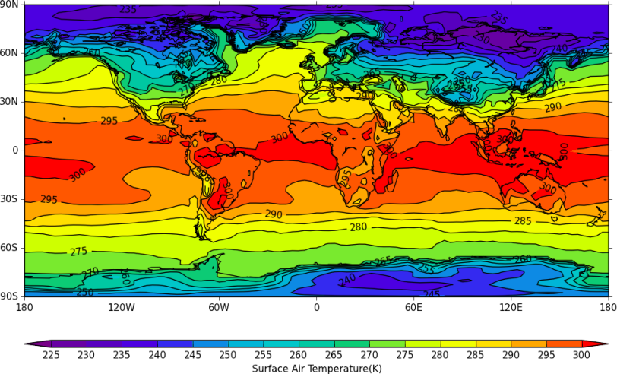
Plotting with cfplot
cfplot is a set of Python routines for making the common contour and vector plots that climate researchers use. The data to make a contour plot can be passed to cfplot using cf-python as per the following example.
import cf, cfplot as cfp
f = cf.read('/opt/graphics/cfplot_data/tas_A1.nc')[0]
cfp.con(f.subspace(time=15))

Slide 12
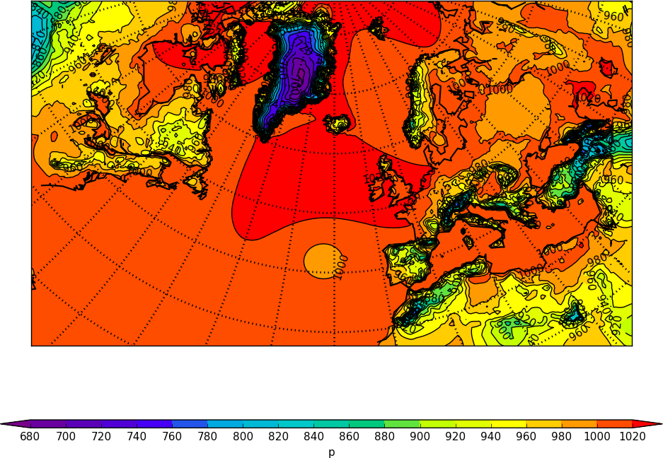
Plotting with cfplot
Plotting rotated pole data.
import cf, cfplot as cfp
f = cf.read('/opt/graphics/cfplot_data/rgp.nc')[0]
cfp.con(f)

Slide 13
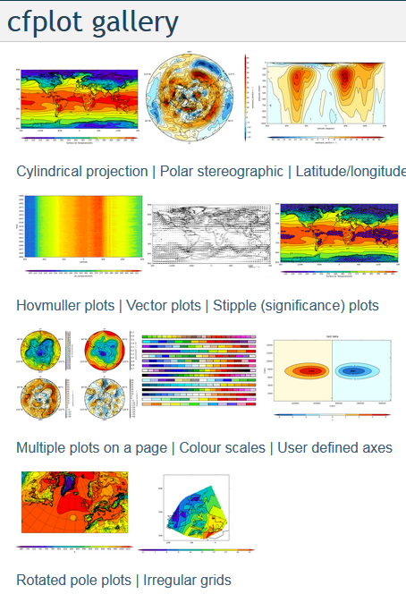
And more
See: http://ajheaps.github.io/cf-plot/gallery.html

Slide 14
Further reading
cf-python documentation (current version):
https://cfpython.bitbucket.io/docs/latest/index.html
cf tools:
http://cms.ncas.ac.uk/wiki/ToolsAndUtilities
cfplot:
http://ajheaps.github.io/cf-plot/

