Slide 1
Read and Write Data
Some common text formats (at CEDA)

Slide 2
What is a good text format?
A good text format should:
be well-described following a clear format specification
contain appropriate metadata to enable:
scientific understanding
Interpretation and usage

Slide 3
Text formats at CEDA
At CEDA we have adopted two such formats over the years:
NASA Ames
A set of well-described sub-formats to handle 1-dimensional to 4-dimensional data
BADC-CSV
A simple comma-separated format aimed at facilitating data preparation, submission and usage.

Slide 4
NASA Ames format: Overview
An ASCII (text) format developed in late 1980s to facilitate the data exchange between the participants and allow shared use of a minimised amount of software to analyse and display different datasets.
Developed with the requirements:
portable - readable on any machine by any language;
self-describing - the data had to include a header containing all the information needed to read, understand and interpret;
readable by humans - to retain the benefit of its self-description.
NASA Ames is well suited to field campaigns involving several teams that need to share their observations.

Slide 5
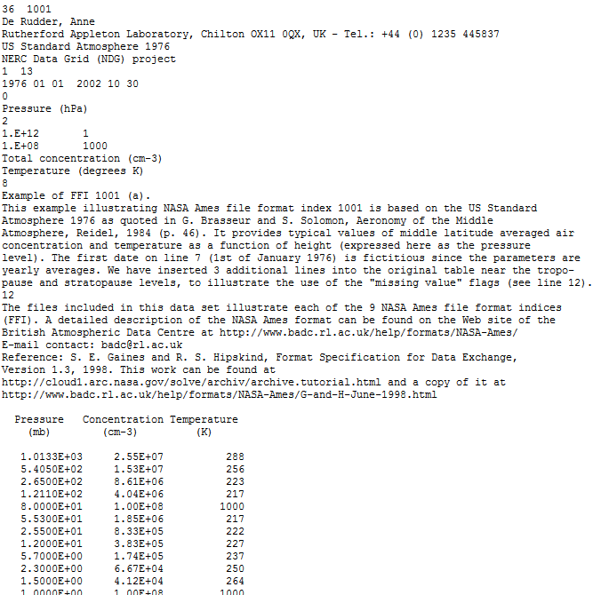
Example NASA Ames file
Header section
Data section

Slide 6
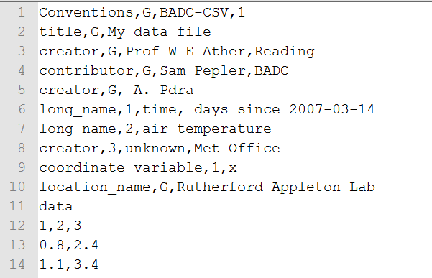
BADC-CSV format: Overview
Developed as a simplified alternative to NASA-Ames.
A record-based format (multiple records allowed).
Each record has a short simple header and a data section.
Format is very simple to read/write/interpret.

Slide 7
More info
NASA Ames Specification:
http://cedadocs.badc.rl.ac.uk/73/3/G-and-H-June-1998.html
NASA Ames Overview:
http://badc.nerc.ac.uk/help/formats/NASA-Ames/
BADC-CSV Format:
http://www.ceda.ac.uk/help/users-guide/file-formats/badc-csv/

