Slide 1
Read and Write Data
The structure of "Classic" NetCDF files
Thanks to all contributors:
Alison Pamment, the Unidata team.

Slide 2
The "Classic" NetCDF Data Model
The netCDF classic data model associated with netCDF-3 is now (and will continue to be) widely used.
Understanding this simple and effective "classic" data model will be very beneficial in your use of NetCDF.

Slide 3
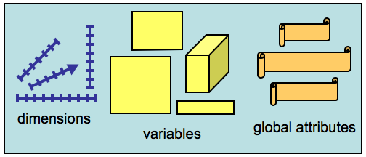
What's in a NetCDF file?
NetCDF files are containers for Dimensions, Variables, and Global Attributes.
A netCDF file has a path name and possibly some dimensions, variables, global (file-level) attributes, and data values associated with the variables. Sometimes we refer to netCDF files more abstractly as datasets.

Slide 4
Operating on a NetCDF file
When working with a netCDF file you can:
Create a new file, given its path name and whether to overwrite or not.
Open an existing file for access, given dataset name and read or write intent.
Add dimensions, variables, or attributes.
Close a file, writing to disk if required.
Get the number of dimensions, variables or global attributes.
Get the unlimited dimension, if present.

Slide 5
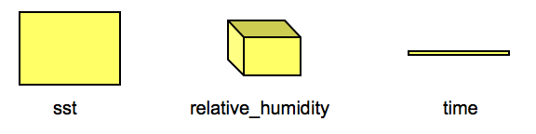
Variables
Variables hold data values. In the classic netCDF data model, a variable can hold a multidimensional array of values of the same type.

Slide 6
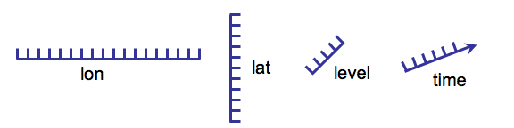
Dimensions
Dimensions are used to specify variable shapes, common grids, and coordinate systems.
A dimension has a name and a length. Dimensions are used to define the shape of one or more variables in a netCDF file.
In the classic netCDF data model, at most one dimension can have the unlimited length, which means variables can grow along that dimension.
Record dimension is another term for an unlimited dimension.

Slide 7
NetCDF Variables
NetCDF Variables have:
A type, e.g. char (text character), byte (8 bits) or float (32 bits)
A shape, specified by a list of dimensions, e.g.:
1 dimension: a 1-D (vector) variable, such as time
2 dimensions: a 2-D (grid or matrix) variable, such as surface_pressure
Attributes (optionally) – specifying properties such as long name and units.
Values – the actual data values.

Slide 8
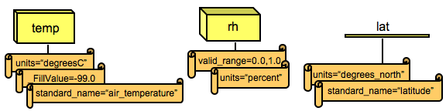
Attributes
Attributes hold metadata (data about data). An attribute contains information about properties of a variable or dataset.
Attributes can be "global" (applying to the whole file) or "variable attributes" (applying only to a specified variable).

Slide 9
An easier way to view NetCDF: CDL
CDL (network Common Data form Language) is a human-readable notation for netCDF objects and data.
netcdf example { // example of CDL notation
dimensions:
lon = 3 ;
lat = 8 ;
variables:
float rh(lon, lat) ;
rh:units = "percent" ;
rh:long_name = "Relative humidity" ;
// global attributes
:title = "Simple example, lacks some conventions" ;
data:
rh =
2, 3, 5, 7, 11, 13, 17, 19,
23, 29, 31, 37, 41, 43, 47,
53, 59, 61, 67, 71, 73, 79, 83, 89 ;
}

Slide 10
netcdf example { // example of CDL notation
dimensions:
lon = 3 ;
lat = 8 ;
variables:
float rh(lon, lat) ;
rh:units = "percent" ;
rh:long_name = "Relative humidity" ;
// global attributes
:title = "Simple example, lacks some conventions" ;
data:
rh =
2, 3, 5, 7, 11, 13, 17, 19,
23, 29, 31, 37, 41, 43, 47,
53, 59, 61, 67, 71, 73, 79, 83, 89 ;
}
This example specifies a netCDF dataset with two dimensions (lon and lat), one variable (rh), two variable attributes (units and long_name), one global attribute (title), and some data values for the variable.

Slide 11
Acknowledgement
The material presented here was primarily taken from the Unidata NetCDF workshop notes at:
https://www.unidata.ucar.edu/software/netcdf/workshops/2012

Slide 12
The "Classic" Data Model
The classic netCDF data model uses dimensions, variables, and attributes, to capture the meaning of array-oriented scientific data.
The following diagram represents the "classic" data model visually. Each box contains:
the name of a class of objects
characteristics of object in the class
operations (methods) for that class of objects

Slide 13
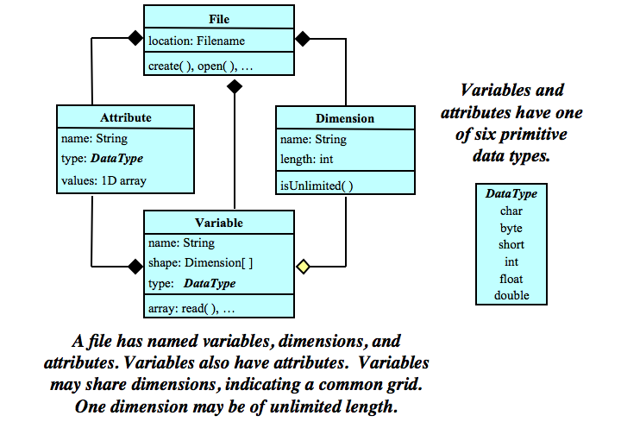
The "Classic" Data Model

