Slide 1
Read and Write Data
Viewing NetCDF: Ncview and ncBrowse

Slide 2
Tools, tools, tools
NetCDF is such a popular format that there are thousands of tools that can read it.
Here are a couple that allow you to quickly plot and view the contents of a NetCDF file.
They both allow selection and quick view/plotting functionality that can be useful when working with data.

Slide 3
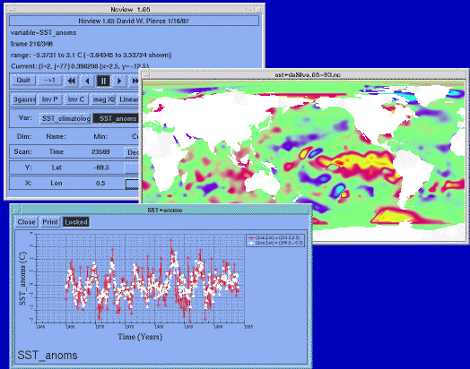
ncview
ncview:
Visual browser for netCDF
View simple animations along various dimensions
Change look of graphs/maps

Slide 4
ncview – getting started
To run ncview type:
$ ncview <data_file>
E.g.:
$ ncview example_data/ggas2014121200_00-18.nc &

Slide 5
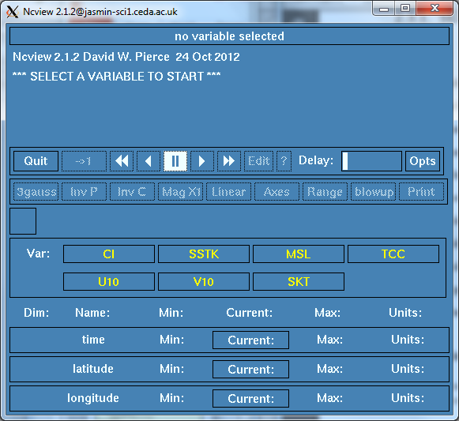
ncview – getting started
You are presented with:
An information panel
A control panel for visualization
A variable selection panel
Details of dimensions for the selected variable

Slide 6
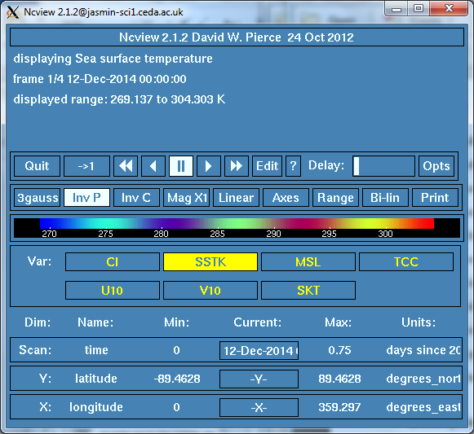
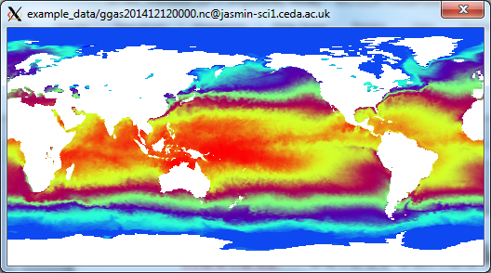
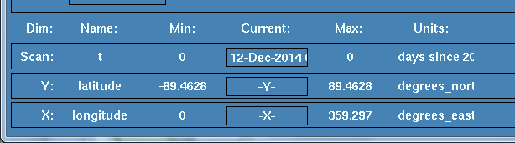
ncview – select variable
Select variable: in this case we have selected Sea Surface Temperature ("SSTK").
ncview:
displays information in the top panel
Populates the colour bar
Plots the first time step of the variable
Displays information about dimensions

Slide 7
ncview – animate
Use the animation panel to click through time steps or animate the plot.
Press the button to run the animation. Adjust the "Delay" to slow it down.

Slide 8
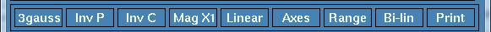
ncview – other options
The plotting panel has a range of useful functions that are best investigated by manually testing each.
E.g.: 3gauss: click to select a different colour scale
Inv P: Invert the plot.
Inv C: Invert the colour scale
Mag X1: right/left click to zoom in/out
Axes: modify axes of plot
Print: print to a file or printer

Slide 9
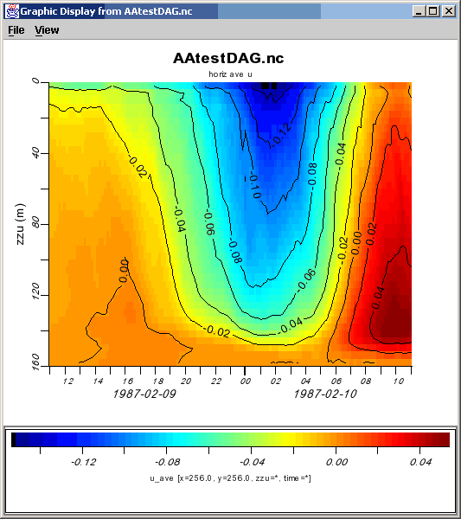
ncBrowse
ncBrowse:
Visual browser for netCDF
View/select contents of files
Tree View of file contents
Various plotting options

Slide 10
ncBrowse – getting started
To run ncBrowse type:
$ ncBrowse <data_file>
E.g.:
$ ncBrowse example_data/ggas2014121200_00-18.nc &

Slide 11
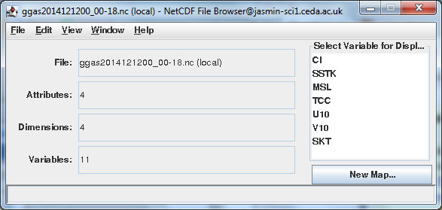
ncBrowse – getting started
You are presented with:
Basic file information
A variable selection panel

Slide 12
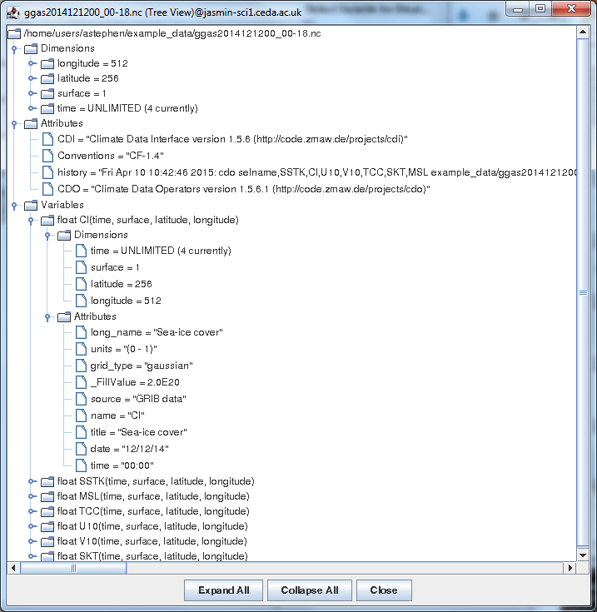
ncBrowse – view file as Tree
Click View →As Tree:

Slide 13
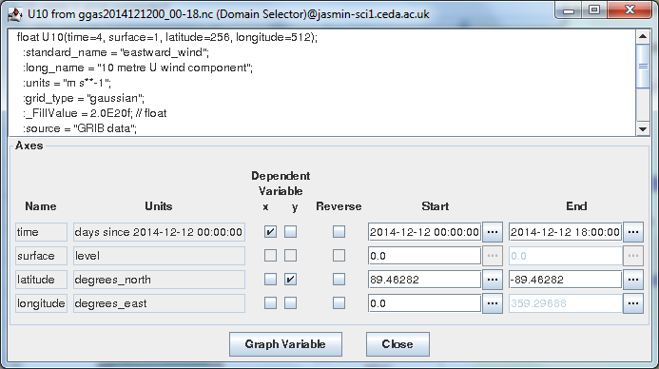
ncBrowse – examine a variable
Double click a variable to open the Domain Selector.

Slide 14
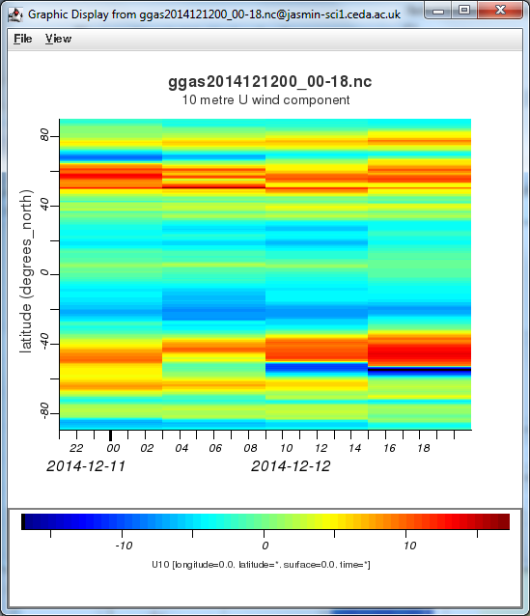
ncBrowse – plot a variable
Click "Graph Variable" to plot

Slide 15
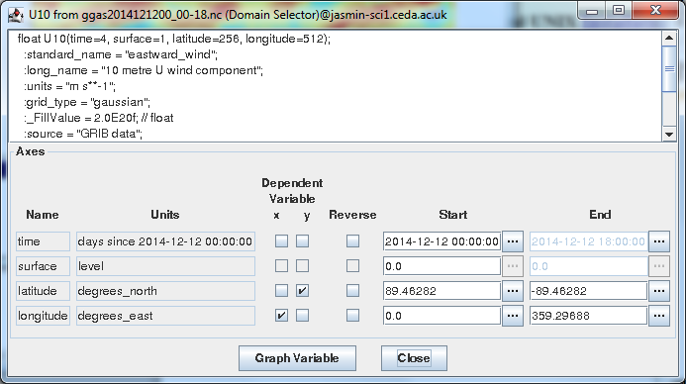
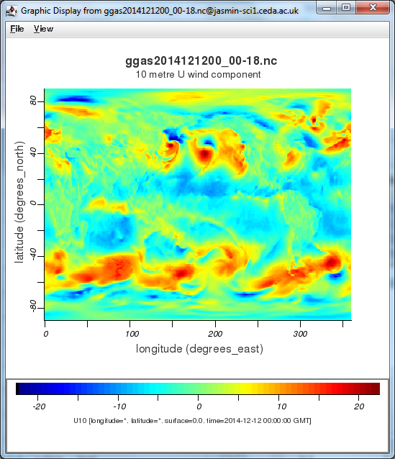
ncBrowse – plot a variable (2)
Modify the axes selected and click "Graph Variable"

Slide 16
Further reading
ncview:
http://meteora.ucsd.edu/~pierce/ncview_home_page.html
ncBrowse:
https://www.nodc.noaa.gov/woce/woce_v3/wocedata_1/utils/netcdf/ncbrowse/index.htm

