Slide 1
Visualisation in Python
Matplotlib
Thanks to all contributors:
Ag Stephens, Stephen Pascoe, Tommy Godfrey and Andy Heaps

Slide 2
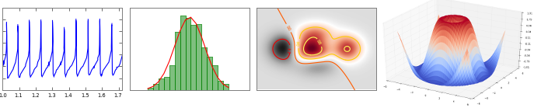
Introducing Matplotlib
Matplotlib is a python 2D plotting library which produces publication quality figures in a variety of hardcopy formats and interactive environments across platforms. Matplotlib can be used in python scripts, the python shell, web application servers, and graphical user interface toolkits.
Notes:
1

Slide 3
Introducing Matplotlib
Matplotlib enables you to generate plots, histograms, power spectra, bar charts, error charts, scatterplots, etc, with just a few lines of code.
For simple plotting the "pyplot" interface provides a MATLAB-like interface.
You also have full control of line styles, font properties, axes properties, etc, via an object oriented interface or via a set of functions familiar to MATLAB users.
Notes:
1

Slide 4
Recommending Matplotlib
As with all open source Python tools there are other options and approaches available.
However, Matplotlib, like NumPy, has become the clear leader in its particular niche.
If you want to do (high quality) visualisation in Python – use Matplotlib!
Notes:
1

Slide 5
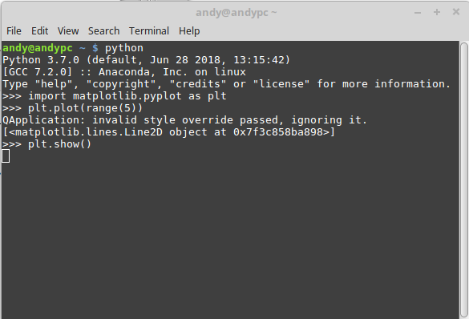
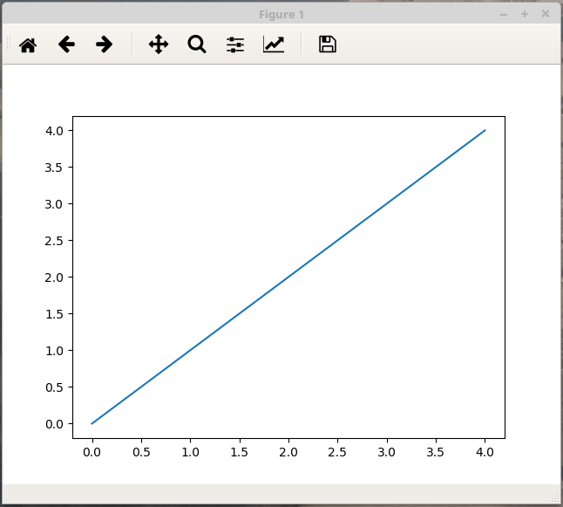
Using Matplotlib Interactively
Matplotlib has its own interactive plotting window:
Notes:
1

Slide 6

Using Matplotlib Interactively
The buttons allow you to:
Re-set the image
Move between different plots in this session
Scroll around the current plot
Zoom in to specified region
View whole plot
Save the plot
Notes:
1

Slide 7
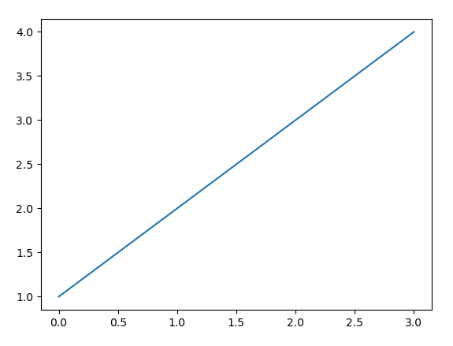
The first plot: A simple line graph
import matplotlib.pyplot as plt
plt.plot([1,2,3,4])
plt.show()
Defaults are used for things you do not specify (such as the x-axis values).
Notes:
1

Slide 8
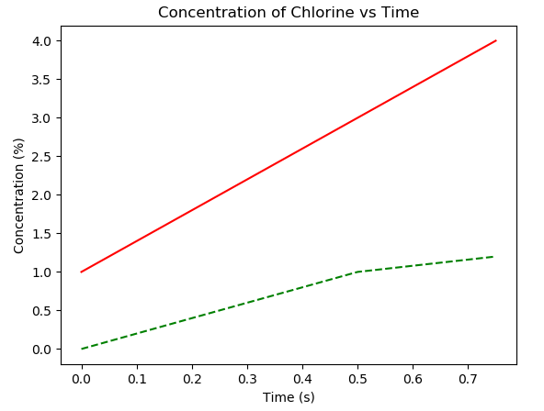
Two lines with axes and a title
times = [0, 0.25, 0.5, 0.75]
plt.plot(times, [0,0.5,1,1.2], 'g--')
Plt.plot(times, [1, 2, 3, 4], 'r')
plt.title('Concentration of Chlorine vs Time')
plt.ylabel('Concentration (%)')
plt.xlabel('Time (s)')
plt.show()
Assume we have always run:
import matplotlib.pyplot as plt
Notes:
1

Slide 9
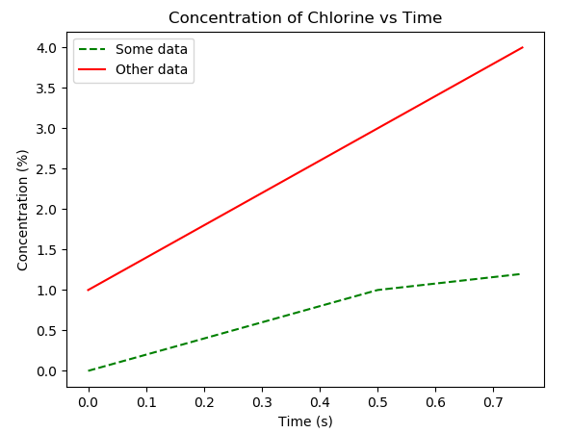
Add a legend
times = [0, 0.25, 0.5, 0.75]
plt.plot(times, [0,0.5,1,1.2], 'g--', label = "Some data")
plt.plot(times, [1, 2, 3, 4], 'r', label = "Other data")
plt.title('Concentration of Chlorine vs Time')
plt.ylabel('Concentration (%)')
plt.xlabel('Time (s)')
plt.legend()
plt.show()
Notes:
1

Slide 10
Saving an image: savefig
To save an image use:
plt.savefig("myplot.png")
Optional arguments include:
dpi: resolution
orientation: "portrait" or "landscape"
format: "png", "pdf", "ps", "eps"
Notes:
1

Slide 11
plt.figure – To plot multiple figures and change size
To draw multiple plots from the same session:
plt.figure()
plt.plot(range(5))
plt.figure(figsize = (10, 10)) # size in inches
plt.plot(range(100))
plt.show() # shows both figures
plt.figure: returns a new figure so you can interact with them independently, e.g.:
f1 = plt.figure()
f2 = plt.figure()
Notes:
1

Slide 12
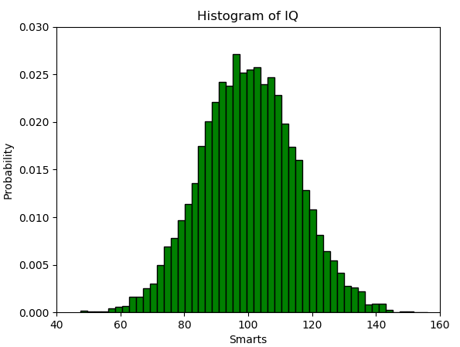
Histogram plot
import numpy as np
import matplotlib.pyplot as plt
mu, sigma = 100, 15
x = mu + sigma * np.random.randn(10000)
n, bins, patches = plt.hist(x,50,density=1,color='g',
edgecolor='k')
plt.axis([40, 160, 0, 0.03])
plt.xlabel('Smarts')
plt.ylabel('Probability')
plt.title('Histogram of IQ')
plt.show()
Notes:
1

Slide 13
Multiple plots – data and subplot function (1)
import numpy as np
import matplotlib.pyplot as plt
x1 = np.linspace(0.0, 5.0)
x2 = np.linspace(0.0, 2.0)
y1 = np.cos(2 * np.pi * x1) * np.exp(-x1)
y2 = np.cos(2 * np.pi * x2)
The "subplot" function is defined as:
subplot(nrows, ncols, plot_number)
Here we define: 2 rows, 1 column.
Notes:
1

Slide 14
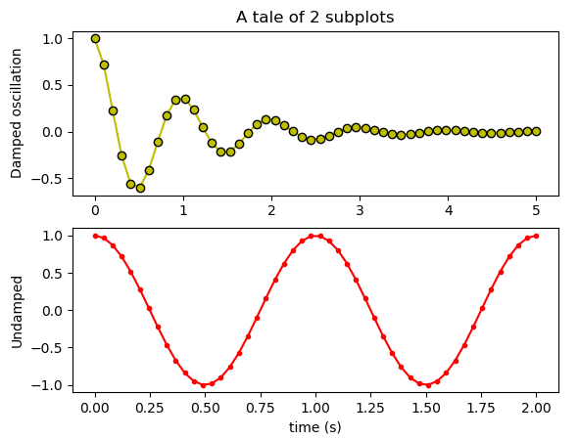
Multiple plots using subplot (2)
plt.subplot(2, 1, 1)
plt.plot(x1, y1, 'yo-', markeredgecolor='k')
plt.title('A tale of 2 subplots')
plt.ylabel('Damped oscillation')
plt.subplot(2, 1, 2)
plt.plot(x2, y2, 'r.-')
plt.xlabel('time (s)')
plt.ylabel('Undamped')
plt.show()
Notes:
1

Slide 15
Multiple axes on one plot (1)
import numpy as np
import matplotlib.pyplot as plt
fig, ax1 = plt.subplots()
t = np.arange(0.01, 10.0, 0.01)
s1 = np.exp(t)
ax1.plot(t, s1, 'b-')
ax1.set_xlabel('time (s)')
# Make the y-axis label and tick labels match the line color.
ax1.set_ylabel('exp', color='b')
for tl in ax1.get_yticklabels():
tl.set_color('b')
Notes:
1

Slide 16
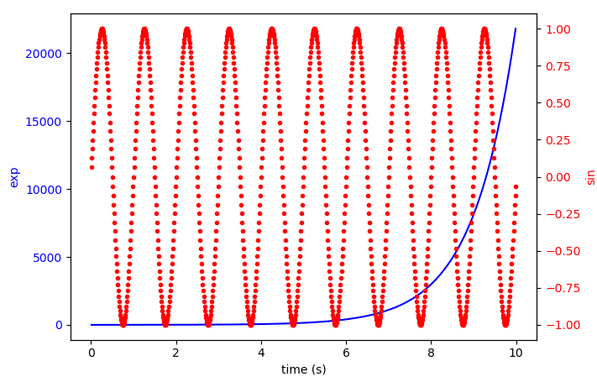
Multiple axes on one plot (2)
ax2 = ax1.twinx()
s2 = np.sin(2*np.pi*t)
ax2.plot(t, s2, 'r.')
ax2.set_ylabel('sin', color='r')
for tl in ax2.get_yticklabels():
tl.set_color('r')
plt.show()
Notes:
1

Slide 17
Contour plot – prepare data
import matplotlib
import numpy as np
import matplotlib.cm as cm
import matplotlib.pyplot as plt
delta = 0.025
x = np.arange(-3.0, 3.0, delta)
y = np.arange(-2.0, 2.0, delta)
X, Y = np.meshgrid(x, y)
# Make field to contour
Z1 = np.exp(-X**2 - Y**2)
Z2 = np.exp(-(X - 1)**2 - (Y - 1)**2)
Z = (Z1 - Z2) * 2
Assume this code applies to all contour examples.
Notes:
1

Slide 18
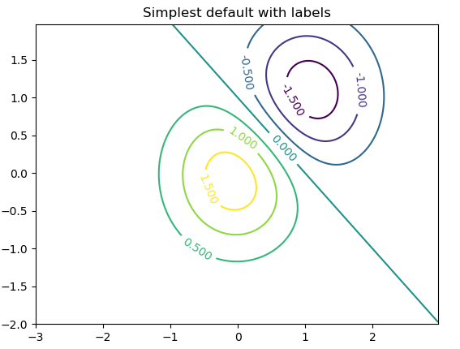
Contour plot – default colours
CS = plt.contour(X, Y, Z)
plt.clabel(CS, inline=1, fontsize=10)
plt.title('Simplest default with labels')
plt.show()
Notes:
1

Slide 19
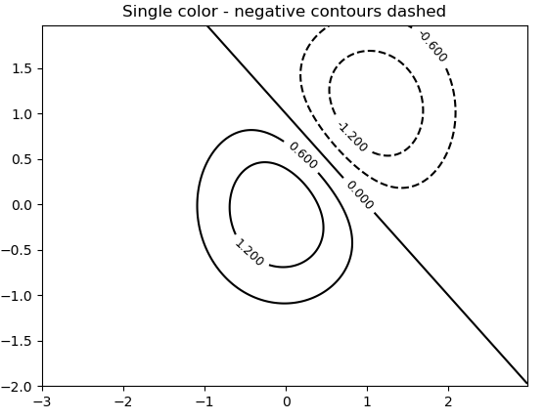
Contour plot – with negative values
# This time negative contours will be dashed by default
CS = plt.contour(X, Y, Z, 6, colors='k')
plt.clabel(CS, fontsize=9, inline=1)
plt.title('Single color - negative contours dashed')
plt.show()
Notes:
1

Slide 20
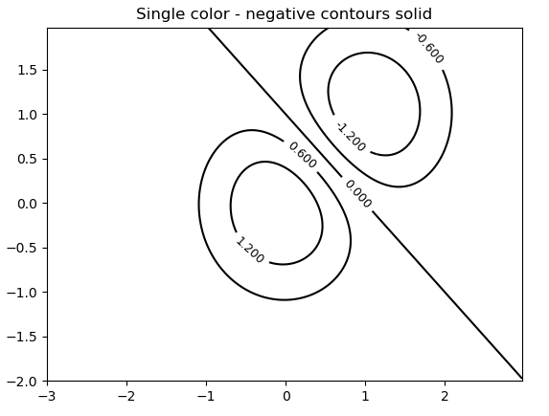
Contour plot - set negative line style
# Override negative contours – use solid lines
matplotlib.rcParams['contour.negative_linestyle'] = 'solid'
CS = plt.contour(X, Y, Z, 6, colors='k')
plt.clabel(CS, fontsize=9, inline=1)
plt.title('Single color - negative contours solid')
plt.show()
Notes:
1

Slide 21
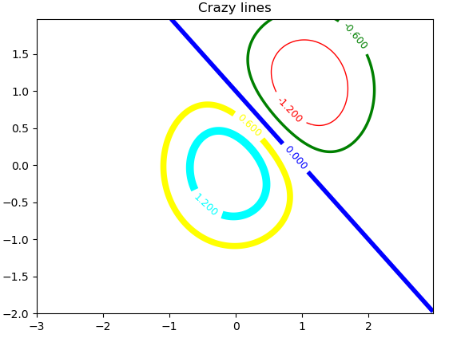
Contour plot – specify colours
CS = plt.contour(X, Y, Z, 6, linewidths=np.arange(1, 8, 1.5), colors=('r', 'green', 'blue', 'yellow', 'cyan', 'wheat'))
plt.clabel(CS, fontsize=9, inline=1)
plt.title('Crazy lines')
plt.show()
Notes:
1

Slide 22
Introducing cartopy
cartopy is a Python package designed for geospatial data processing in order to produce maps and other geospatial data analyses.
cartopy does not do any plotting on its own, but provides the facilities to transform coordinates to one of 33 different map projections.
matplotlib is then used to plot contours, images, vectors, lines or points in the transformed coordinates. Shoreline, river and political boundary datasets are provided within cartopy, along with methods for plotting them.
Notes:
1

Slide 23
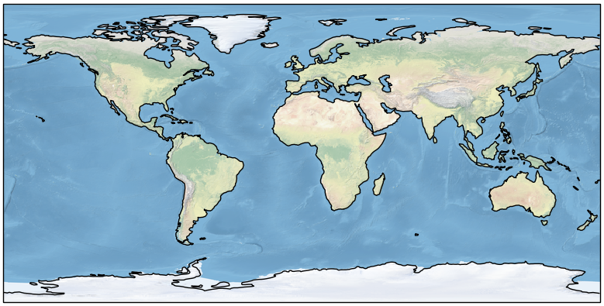
Plotting maps using cartopy
import matplotlib.pyplot as plt
import cartopy.crs as ccrs
fig = plt.figure(figsize=(10, 5))
ax = fig.add_subplot(1, 1, 1, projection=ccrs.PlateCarree())
ax.set_global()
ax.stock_img()
ax.coastlines()
fig.show()
https://scitools.org.uk/cartopy/docs/latest/gallery/index.html
Notes:
1

Slide 24
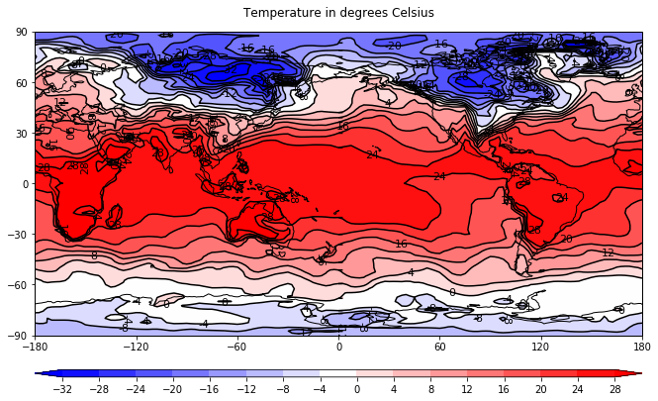
Plotting data on maps
With 31 lines of code you can extract the Air Temperature from a netCDF file and plot on a required projection:
Notes:
1

Slide 25
Plotting data on maps – code 1/2
# import libraries
import matplotlib.pyplot as plt
import cartopy
import cartopy.crs as ccrs
import cartopy.util as cartopy_util
import numpy as np
from netCDF4 import Dataset as ncfile
# read in data
nc = ncfile('/home/andy/gdata.nc')
lons=nc.variables['lon'][:]
lats=nc.variables['lat'][:]
field=nc.variables['temp'][0,:,:]
# add cyclic point
lonrange = np.max(lons)-np.min(lons)
if lonrange <= 360:
field, lons = cartopy_util.add_cyclic_point(field, lons)
# open a figure
plot=plt.figure(figsize=(11, 8))
# set plot limits
lonmin=0
lonmax=360
latmin=-90
latmax=90
lon_0=(lonmax-lonmin)/2.0+lonmin
Notes:
1

Slide 26
Plotting data on maps – code 2/2
# set the map
proj=ccrs.PlateCarree(central_longitude=lon_0)
mymap = plot.add_subplot(1,1,1, projection=proj)
mymap.set_extent((lonmin, lonmax, latmin, latmax), crs=proj)
# contour the data
clevs=np.arange(-32, 32, 4) # levels
cs = mymap.contourf(lons, lats, field, clevs,extend='both', transform=ccrs.PlateCarree(), cmap='bwr')
cb = plot.colorbar(cs, orientation='horizontal', aspect=75, pad=0.08, ticks=clevs)
cs = mymap.contour(lons, lats, field, clevs, colors='k', linestyles='solid', transform=ccrs.PlateCarree())
plt.clabel(cs, fmt = '%d', colors = 'k', fontsize=11)
# axes
mymap.set_xticks(np.arange(-180, 181, 60), crs=proj)
mymap.set_yticks(np.arange(-90, 91, 30))
# coastlines
mymap.coastlines(resolution='110m')
# plot title
title = plt.title('Temperature in degrees Celsius', y=1.03)
Notes:
1

Slide 27
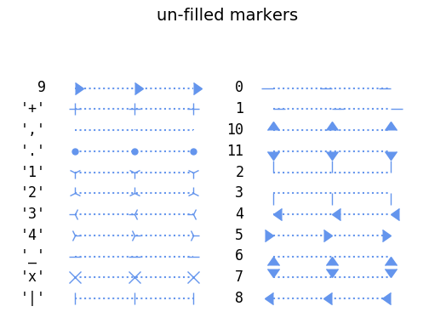
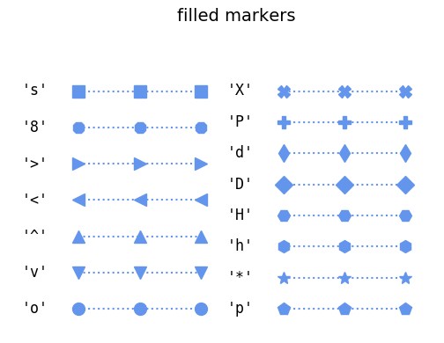
Useful features: Markers
https://matplotlib.org/examples/lines_bars_and_markers/marker_reference.html
Notes:
1

Slide 28
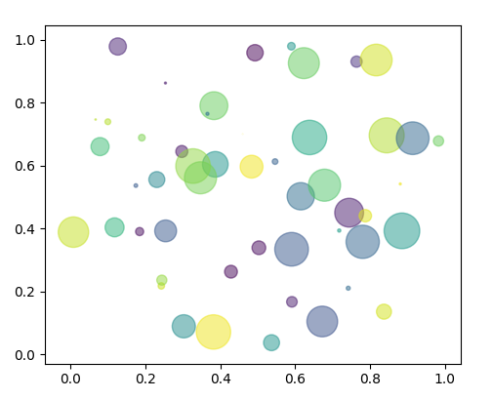
Useful features: Scatter plots
https://matplotlib.org/examples/shapes_and_collections/scatter_demo.html
Notes:
1

Slide 29
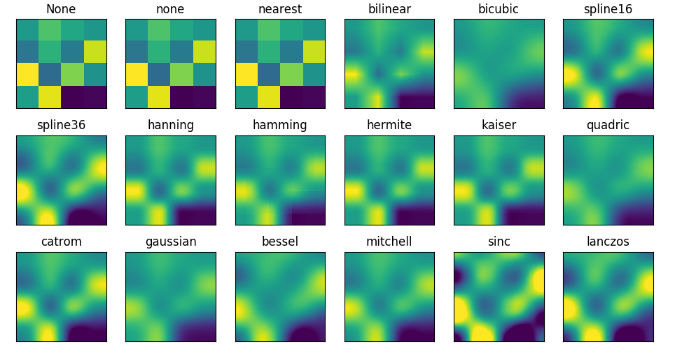
Useful features: Interpolation
https://matplotlib.org/examples/images_contours_and_fields/interpolation_methods.html
Notes:
1

Slide 30
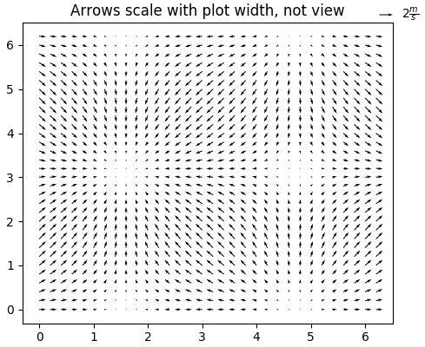
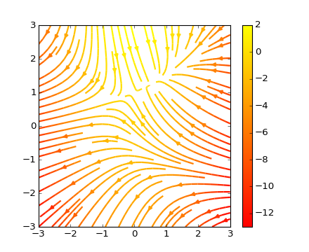
Useful features: quiver and stream plot
https://matplotlib.org/examples/pylab_examples/quiver_demo.html
https://matplotlib.org/examples/images_contours_and_fields/streamplot_demo_features.html
Notes:
1

Slide 31
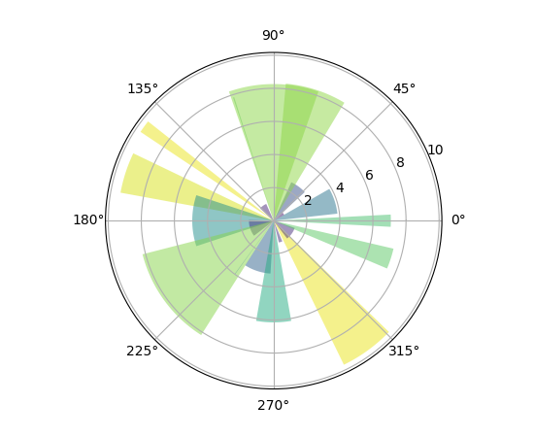
Useful features: Polar bar
https://matplotlib.org/examples/pie_and_polar_charts/polar_bar_demo.html
Notes:
<number>

Slide 32
One last word: the OOP interface
We have demonstrated Matplotlib using the "pylab" interface (which aims to mimic that of MATLAB).
You can interact with Matplotlib using its OOP interface (known as the Matplotlib API). This is a different interface to the same functionality.
Over time you may wish to use the OOP interface for complex plotting applications.
Notes:
<number>

Slide 33
More info
Matplotlib: https://matplotlib.org
Matplotlib gallery: https://matplotlib.org/gallery
Pyplot reference: https://matplotlib.org/api/pyplot_summary.html
Cartopy: https://scitools.org.uk/cartopy/docs/latest/index.html
Books, videos and tutorials: https://matplotlib.org/resources/index.html

