Slide 1
Introduction to Computer Vision - Assignment #05
Dossymbekova Saule

Slide 2
Machine Learning (ml module)
Please, describe Support Vector Machine (SVM) and Principal Component Analysis (PCA) and describe where we use those methods in Computer Vision
A Support Vector Machine (SVM) is a discriminative classifier formally defined by a separating hyperplane. In other words, given labeled training data (supervised learning), the algorithm outputs an optimal hyperplane which categorizes new examples.
SVM is supervised learning models with associated learning algorithms that analyze data used for classification and regression analysis. Given a set of training examples, each marked as belonging to one or the other of two categories, an SVM training algorithm builds a model that assigns new examples to one category or the other, making it a non-probabilistic binary linear classifier (although methods such as Platt scaling exist to use SVM in a probabilistic classification setting). An SVM model is a representation of the examples as points in space, mapped so that the examples of the separate categories are divided by a clear gap that is as wide as possible. New examples are then mapped into that same space and predicted to belong to a category based on the side of the gap on which they fall.

Slide 3
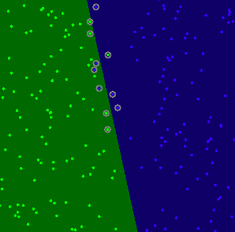
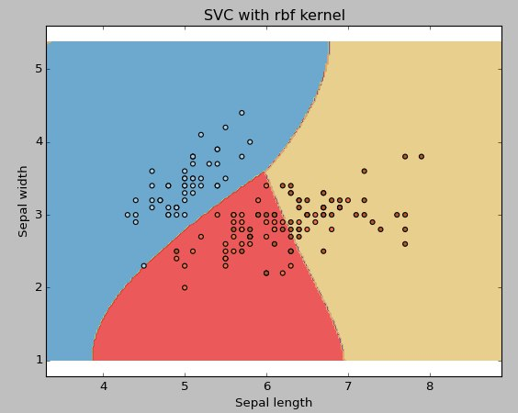
The code opens an image and shows the training examples of both classes. The points of one class are represented with light green and light blue ones are used for the other class.
The SVM is trained and used to classify all the pixels of the image. This results in a division of the image in a blue region and a green region. The boundary between both regions is the separating hyperplane. Since the training data is non-linearly separable, it can be seen that some of the examples of both classes are misclassified; some green points lay on the blue region and some blue points lay on the green one.
Finally the support vectors are shown using gray rings around the training examples.

Slide 4
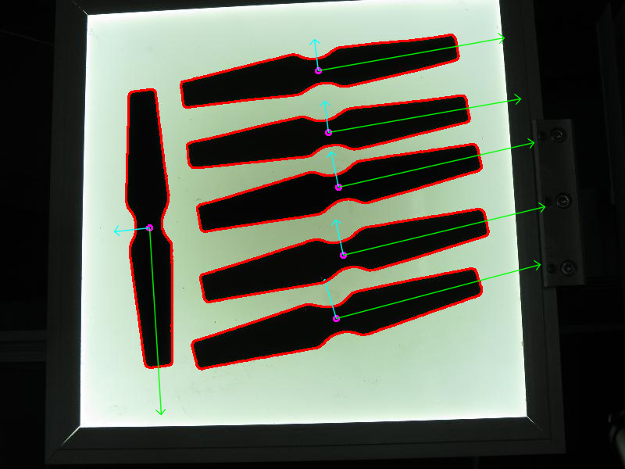
Principal Component Analysis (PCA) is a statistical procedure that extracts the most important features of a dataset. Given a collection of points in two, three, or higher dimensional space, a "best fitting" line can be defined as one that minimizes the average squared distance from a point to the line. The next best-fitting line can be similarly chosen from directions perpendicular to the first. Repeating this process yields an orthogonal basis in which different individual dimensions of the data are uncorrelated. These basis vectors are called principal components, and several related procedures principal component analysis (PCA).
PCA is predominantly used as a dimensionality reduction technique in domains like facial recognition, computer vision and image compression. It is also used for finding patterns in data of high dimension.

Slide 5
Thank you!

