Slide 1


Адаптивная Верстка
Sapsan-Code

Slide 2
Что будем проходить?
CSS Layout
Float
Position
Flex box
Адаптивный и Респонсив верстка
nth child pseudo selector
@media

Slide 3
CSS Layout
Display

Slide 4
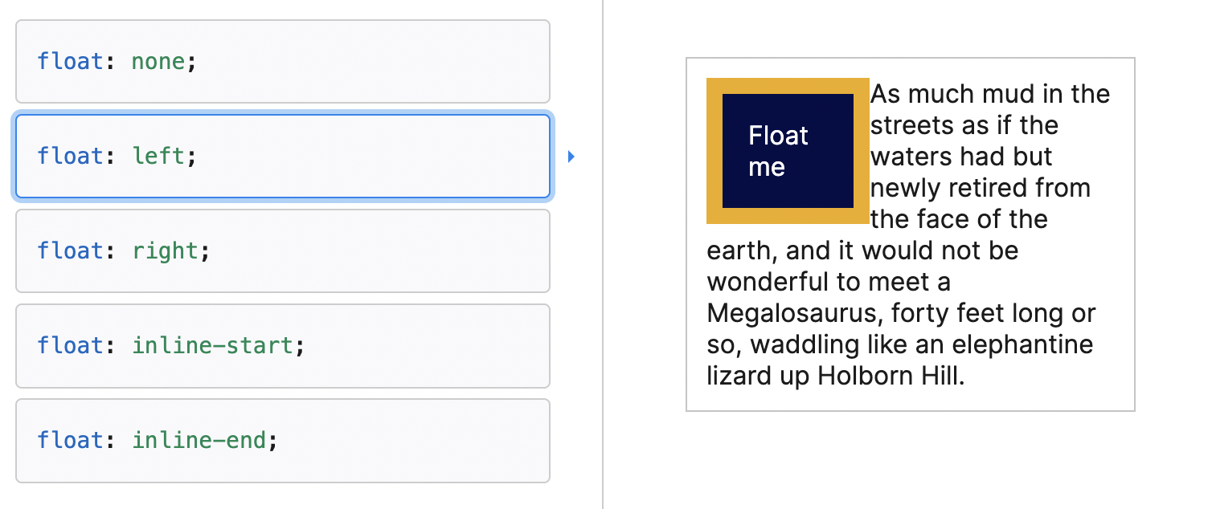
CSS Layout
Float

Slide 5
CSS Layout
Position - https://developer.mozilla.org/en-US/docs/Web/CSS/position
Static
Relative
Absolute
Fixed
Sticky
*Частые вопросы на собеседованиях

Slide 6
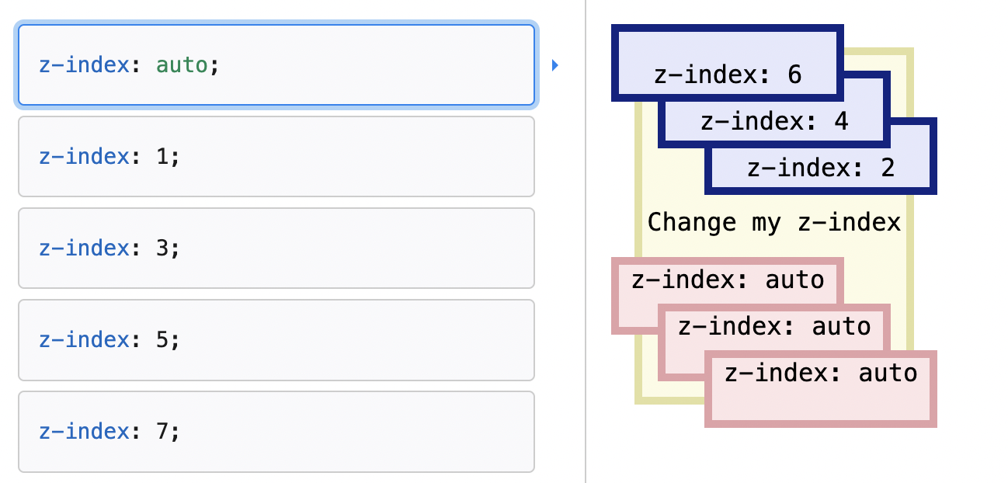
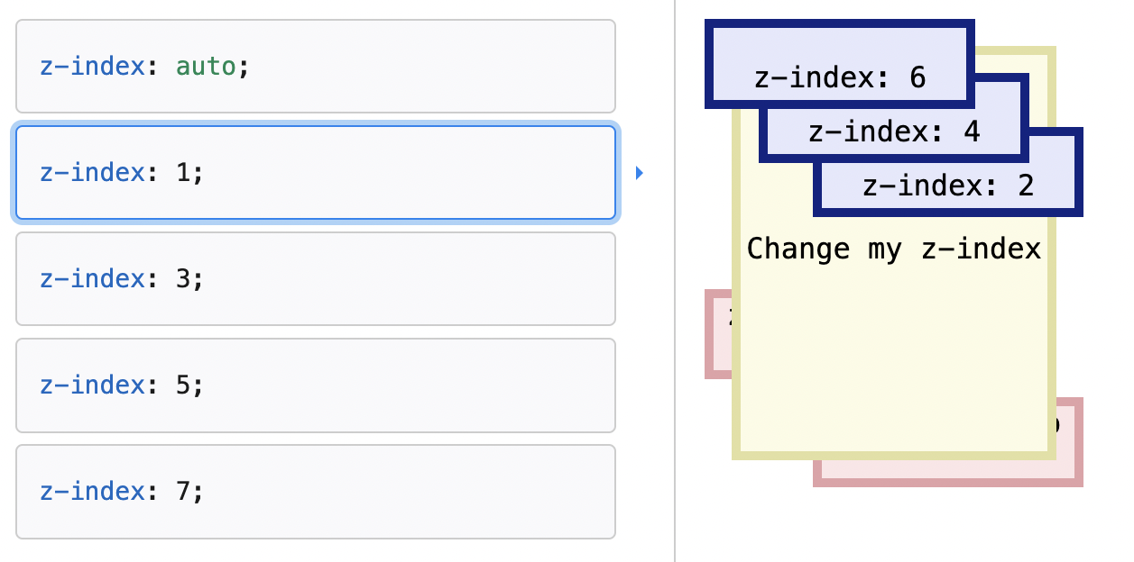
CSS Layout
Z-index
https://developer.mozilla.org/en-US/docs/Web/CSS/z-index
https://developer.mozilla.org/en-US/docs/Web/CSS/CSS_positioned_layout/Understanding_z-index

Slide 7
Z-Index
.container {
position: relative;
}
.black-box {
position: relative;
z-index: 1;
border: 2px solid black;
height: 100px;
margin: 30px;
}
.gray-box {
position: absolute;
z-index: 3;
background: lightgray;
height: 60px;
width: 70%;
left: 50px;
top: 50px;
}
.green-box {
position: absolute;
z-index: 2;
background: lightgreen;
width: 35%;
left: 270px;
top: -15px;
height: 100px;
}
<div class="container">
<div class="black-box">Black box</div>
<div class="gray-box">Gray box</div>
<div class="green-box">Green box</div>
</div>

Slide 8
CSS Layout
Flexbox container:
flex-direction
flex-wrap
flex-flow
justify-content
align-items
align-content
gap, row-gap, column-gap
Flexbox items:
order
flex-grow
flex-shrink
flex-basis
flex
align-self
gap, row-gap, column-gap
*Частые вопросы на собеседованиях

Slide 9
Flexbox
https://css-tricks.com/snippets/css/a-guide-to-flexbox/
https://developer.mozilla.org/en-US/docs/Learn/CSS/CSS_layout/Flexbox

Slide 10
Псевдо-классы нужные
относительно родителя
:nth-child()
:nth-last-child()
:nth-last-of-type()
:nth-of-type()
:first-child
:first-of-type
:last-child
:last-of-type

Slide 11
Псевдо-класс: the n-th child
p:nth-child(1) {
color: blue;
}
p:nth-child(2) {
color: red;
}
p:nth-child(3) {
color: green;
}

Slide 12
Псевдо-класс: the n-th child
p:nth-child(1) {
color: blue;
}
p:nth-child(2) {
color: red;
}
p:nth-child(3) {
color: green;
}

Slide 13
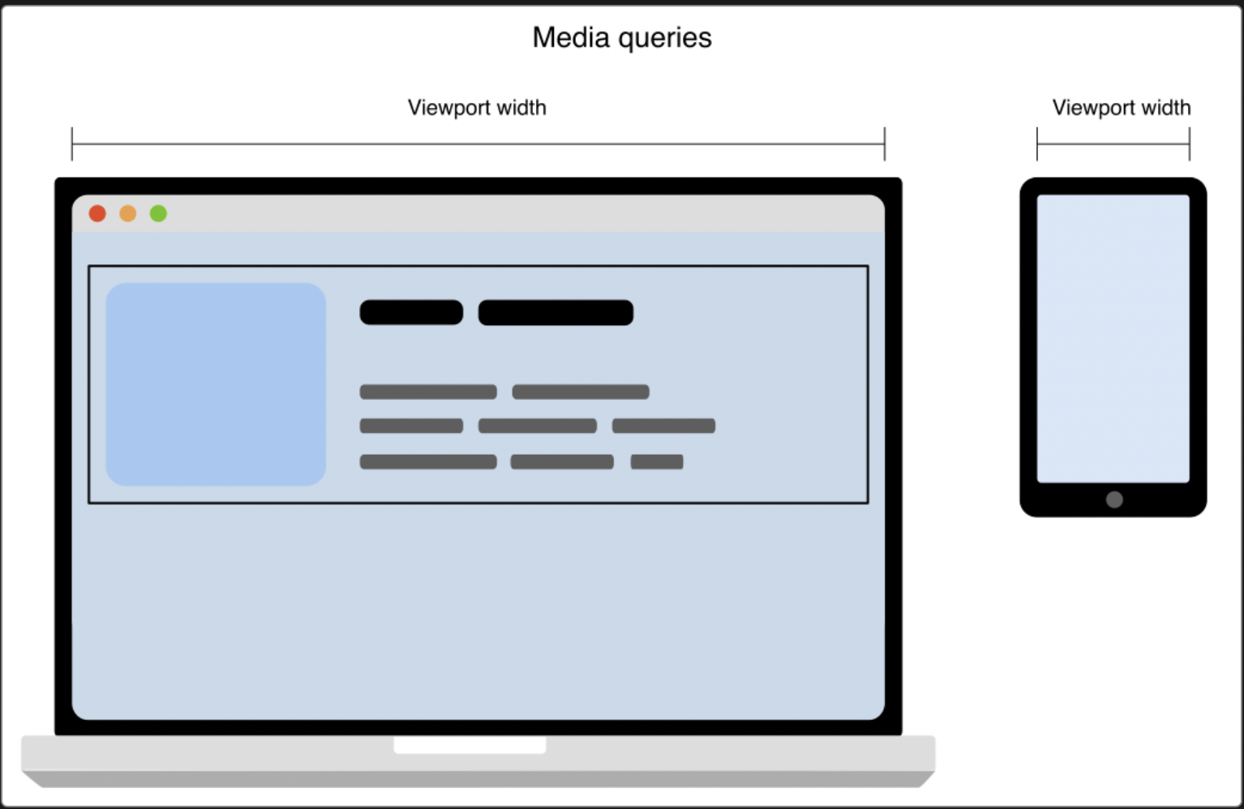
Responsive
<meta name="viewport" content="width=device-width, initial-scale=1"> Meta-тег viewport сообщает браузеру о том, как именно обрабатывать размеры страницы, и изменять её масштаб. Этот тег необходимо добавлять в секцию HEAD. константа device-width, которая задаёт ширину страницы в соответствии с размером экрана
https://developer.mozilla.org/ru/docs/Glossary/Viewport
https://www.w3schools.com/html/html_head.asp

Slide 14
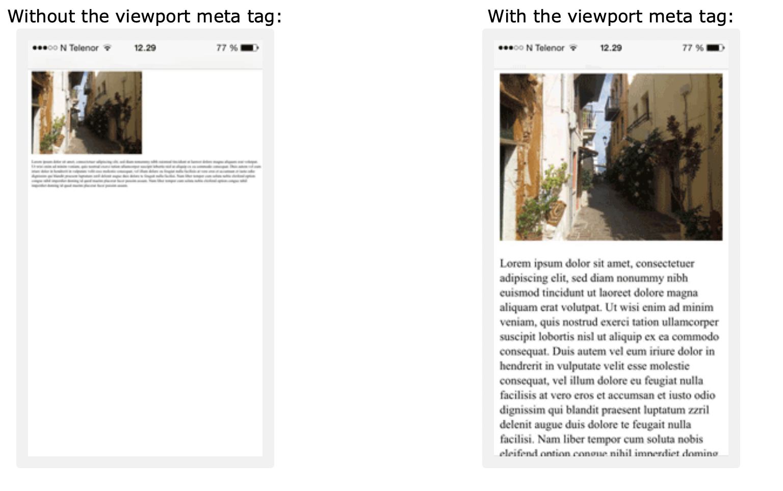
Responsive

Slide 15
Media CSS
/* Extra small devices (phones, 600px and down) */
@media only screen and (max-width: 600px) {...}
/* Small devices (portrait tablets and large phones, 600px and up) */
@media only screen and (min-width: 600px) {...}
/* Medium devices (landscape tablets, 768px and up) */
@media only screen and (min-width: 768px) {...}
/* Large devices (laptops/desktops, 992px and up) */
@media only screen and (min-width: 992px) {...}
/* Extra large devices (large laptops and desktops, 1200px and up) */
@media only screen and (min-width: 1200px) {...}

Slide 16
Media CSS. Example
<style>
/* Extra small devices (phones, 600px and down) */
@media only screen and (max-width: 600px) {
.example {background: red;}
}
/* Small devices (portrait tablets and large phones, 600px and up) */
@media only screen and (min-width: 600px) {
.example {background: green;}
}
/* Medium devices (landscape tablets, 768px and up) */
@media only screen and (min-width: 768px) {
.example {background: blue;}
}
/* Large devices (laptops/desktops, 992px and up) */
@media only screen and (min-width: 992px) {
.example {background: orange;}
}
/* Extra large devices (large laptops and desktops, 1200px and up) */
@media only screen and (min-width: 1200px) {
.example {background: pink;}
}
</style>
<body>
<h2>Typical Media Query Breakpoints</h2>
<p class="example">Resize the browser window to see how the background color of this paragraph changes on different screen sizes.</p>
</body>

Slide 17

КАК адаптировать сайт под разные устройства?
Для чего это нужно?

Slide 18
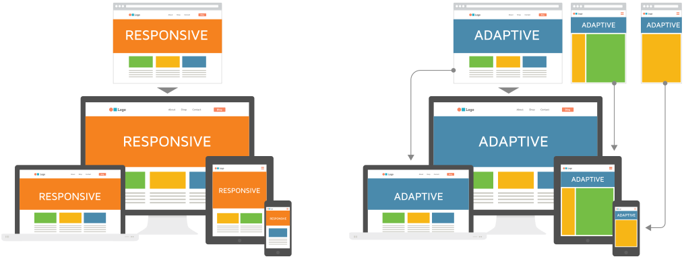
responsive VS adaptive web design
https://www.geeksforgeeks.org/difference-between-responsive-design-and-adaptive-design/

Slide 19
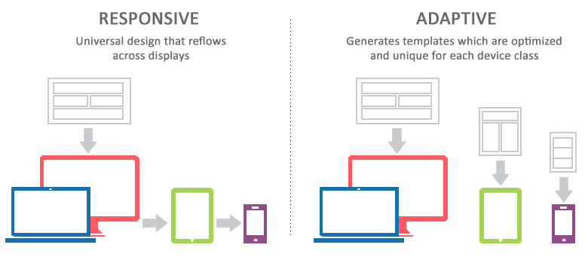
responsive VS adaptive web design
https://www.geeksforgeeks.org/difference-between-responsive-design-and-adaptive-design/

Slide 20
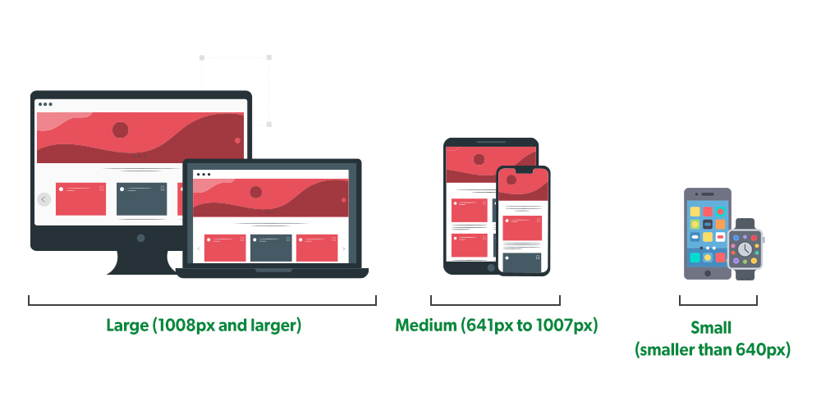
Responsive

Slide 21
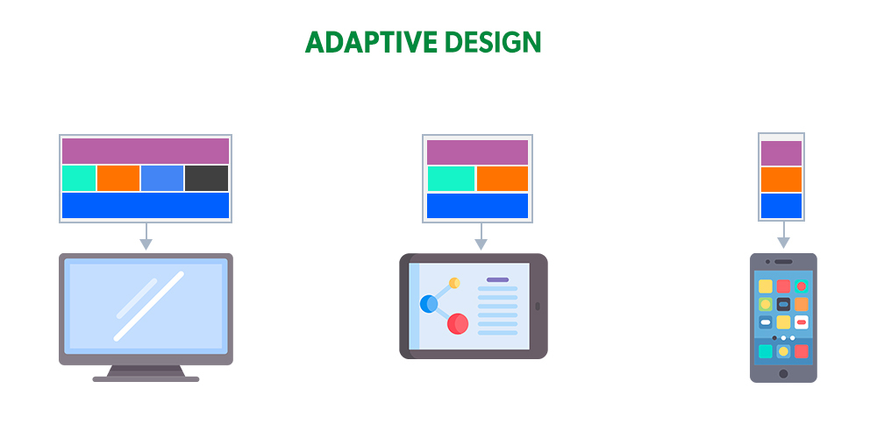
Adaptive

Slide 22
Responsive
Responsive web design is about creating web pages that look good on all devices! A responsive web design will automatically adjust for different screen sizes and viewports. Responsive Web Design is about using HTML and CSS to automatically resize, hide, shrink, or enlarge, a website, to make it look good on all devices (desktops, tablets, and phones):
https://www.w3schools.com/html/tryit.asp?filename=tryhtml_responsive_page

Slide 23
Псевдо-классы. Синтаксис
selector:pseudo-class { property: value; }

Slide 24
Псевдо-классы. Синтаксис
a:link {
color: red;
}
/* visited link */
a:visited {
color: green;
}
/* mouse over link */
a:hover {
color: hotpink;
}
/* selected link */
a:active {
color: blue;
}
<p>
<b>
<a href="default.asp" target="_blank">This is a link</a>
</b>
</p>
<p>
<b>Note:</b> a:hover MUST come after a:link and a:visited in the CSS definition in order to be effective.
</p>
<p>
<b>Note:</b> a:active MUST come after a:hover in the CSS definition in order to be effective.
</p>

Slide 25
Псевдо-классы и HTML Classes
<h2>Pseudo-classes and HTML Classes</h2>
<p>When you hover over the first link below, it will change color and font size:</p>
<p><a class="highlight" href="css_syntax.asp">CSS Syntax</a></p>
<p><a href="default.asp">CSS Tutorial</a></p>
a.highlight:hover {
color: #ff0000;
font-size: 22px;
}

Slide 26
Псевдо-класс: Hover
p {
display: none;
background-color: yellow;
padding: 20px;
}
div:hover p {
display: block;
}

Slide 27
Advanced CSS. Grid
<!DOCTYPE html>
<html>
<head>
</head>
<body>
<h1>display: grid</h1>
<p>Use display: grid; to make a block-level grid container:</p>
<div class="grid-container">
<div class="grid-item">1</div>
<div class="grid-item">2</div>
<div class="grid-item">3</div>
<div class="grid-item">4</div>
<div class="grid-item">5</div>
<div class="grid-item">6</div>
<div class="grid-item">7</div>
<div class="grid-item">8</div>
<div class="grid-item">9</div>
</div>
</body>
</html>
.grid-container {
display: grid;
grid-template-columns: auto auto auto;
background-color: #2196F3;
padding: 10px;
}
.grid-item {
background-color: rgba(255, 255, 255, 0.8);
border: 1px solid rgba(0, 0, 0, 0.8);
padding: 20px;
font-size: 30px;
text-align: center;
}

Slide 28

SASS
https://sass-lang.com/

Slide 29
Вложенности
SASS
nav {
ul {
margin: 0;
padding: 0;
list-style: none;
}
li { display: inline-block; }
a {
display: block;
padding: 6px 12px;
text-decoration: none;
}
}
CSS:
nav ul {
margin: 0;
padding: 0;
list-style: none;
}
nav li {
display: inline-block;
}
nav a {
display: block;
padding: 6px 12px;
text-decoration: none;
}

Slide 30
Импорт
// _reset.scss
html,
body,
ul,
ol {
margin: 0;
padding: 0;
}
@import 'reset';
body {
font: 100% Helvetica, sans-serif;
background-color: #efefef;
}

Slide 31
Математические Операторы
.container {
width: 100%;
}
article[role="main"] {
float: left;
width: 600px / 960px * 100%;
}
aside[role="complementary"] {
float: right;
width: 300px / 960px * 100%;
}

Slide 32
Advanced CSS. Grid
<!DOCTYPE html>
<html>
<head>
</head>
<body>
<h1>display: grid</h1>
<p>Use display: grid; to make a block-level grid container:</p>
<div class="grid-container">
<div class="grid-item">1</div>
<div class="grid-item">2</div>
<div class="grid-item">3</div>
<div class="grid-item">4</div>
<div class="grid-item">5</div>
<div class="grid-item">6</div>
<div class="grid-item">7</div>
<div class="grid-item">8</div>
<div class="grid-item">9</div>
</div>
</body>
</html>
.grid-container {
display: grid;
grid-template-columns: auto auto auto;
background-color: #2196F3;
padding: 10px;
}
.grid-item {
background-color: rgba(255, 255, 255, 0.8);
border: 1px solid rgba(0, 0, 0, 0.8);
padding: 20px;
font-size: 30px;
text-align: center;
}

Slide 33
Advanced CSS. Inline-Grid
<!DOCTYPE html>
<html>
<head>
</head>
<body>
<h1>display: inline-grid</h1>
<p>Use display: inline-grid; to make an inline grid container:</p>
<div class="grid-container">
<div class="grid-item">1</div>
<div class="grid-item">2</div>
<div class="grid-item">3</div>
<div class="grid-item">4</div>
<div class="grid-item">5</div>
<div class="grid-item">6</div>
<div class="grid-item">7</div>
<div class="grid-item">8</div>
<div class="grid-item">9</div>
</div>
</body>
</html>
.grid-container {
display: inline-grid;
grid-template-columns: auto auto auto;
background-color: #2196F3;
padding: 10px;
}
.grid-item {
background-color: rgba(255, 255, 255, 0.8);
border: 1px solid rgba(0, 0, 0, 0.8);
padding: 20px;
font-size: 30px;
text-align: center;
}

Slide 34
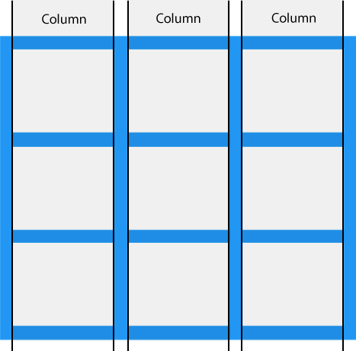
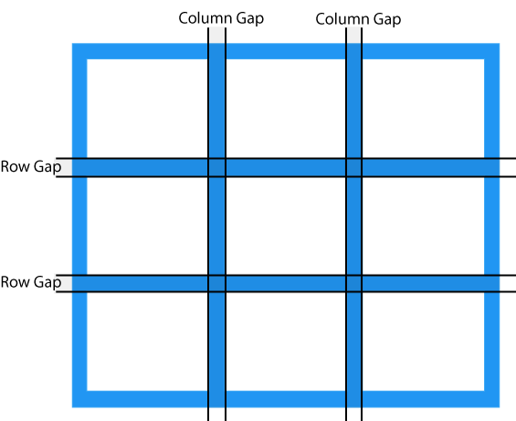
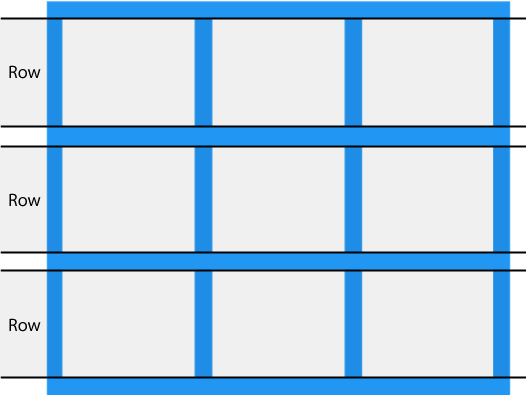
Advanced CSS. Grid Rows,Columns and Gaps

Slide 35
Homework
Сделайте ваше онлайн CV адаптивным
Перепишите ваше онлайн CV на SASS

