Slide 1
QA – Blue-Tomato.com
Final Project

Slide 2

Website description
Biggest European e-commerce website specialized on snowboard/ski equipment
Selling skate/ surf products and several products related to the available brands
Rental snowboard feature
Buyers guide – ski /snowboard/ skate
Blue world – news/ events and articles

Slide 3
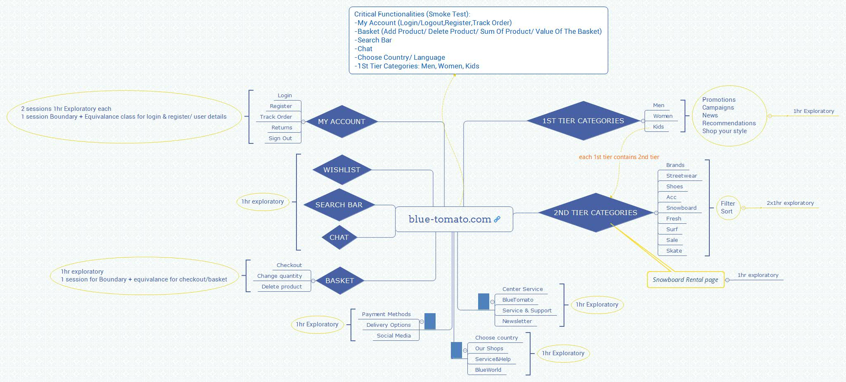
Testing approach

Slide 4

Tools used:
Xmind - website map and define testing strategy
TestLink – test management tool
Mantis – bug reporting tool
Microsoft Office Suite
Snipping tool

Slide 5

Testing types
What can be tested:
Functional:
Regression
Non-Functional:
Load
Stress
Vulnerability
Security
Usability
What was tested:
Functional:
Ad-Hoc Testing
Smoke testing
Exploratory testing with Positive/Negative scenarios
GUI Testing
UX
Non-Functional:
Compatibility testing
Localization testing

Slide 6
Test Case overview
Test cases were created for Smoke test
Critical functionalities were covered:
Main Page functionalities, e.g.: Webpage running, Home Page, Choose country, etc.
Register
Login/logout
My Account – change user details
Product page, e.g.: Change size/color
Basket: Add/ Remove product, change quantity
Checkout

Slide 7
Bugs Overview
30 bugs found. Majority of them were found during Exploratory Testing

Slide 8
Test Case results
Functionality | Total | Pass | Failed | Blocked | Not Run | Defects
Main Page | 6 | 6 | 0 | 0 | 0
Register | 1 | 1 | 0 | 0 | 0
Login/ Logout | 2 | 2 | 0 | 0 | 0
My Account | 1 | 0 | 1 | 0 | 0 | 0043003
Product Page | 3 | 3 | 0 | 0 | 0
Basket | 3 | 3 | 0 | 0 | 0
Checkout | 1 | 1 | 0 | 0 | 0
Overall Results | 17 | 16 | 1 | 0 | 0 | 1

Slide 9

Conclusions
The main website has a lot of functionalities, the UX is very good and all the main functionalities are working well.
The rental page has very low UX, very bad English and fatal crashes (500, 502 Server issues). This page needs urgent focus on fixing the bugs.
Overall the bugs are not impacting end-to-end main functionality of the website but to have a better user experience the bugs should be fixed with normal to lower priority

Slide 10

Lessons learned
Writing all those bugs in one session helped me to report them better
Organizing the testing sessions from the beginning help me to not over test and to have a clear view with what will be tested
I started testing with secondary functionalities and when the time came to test the main functionalities only a few days left until due date

Slide 11
Thanks for your attention!

