Slide 1

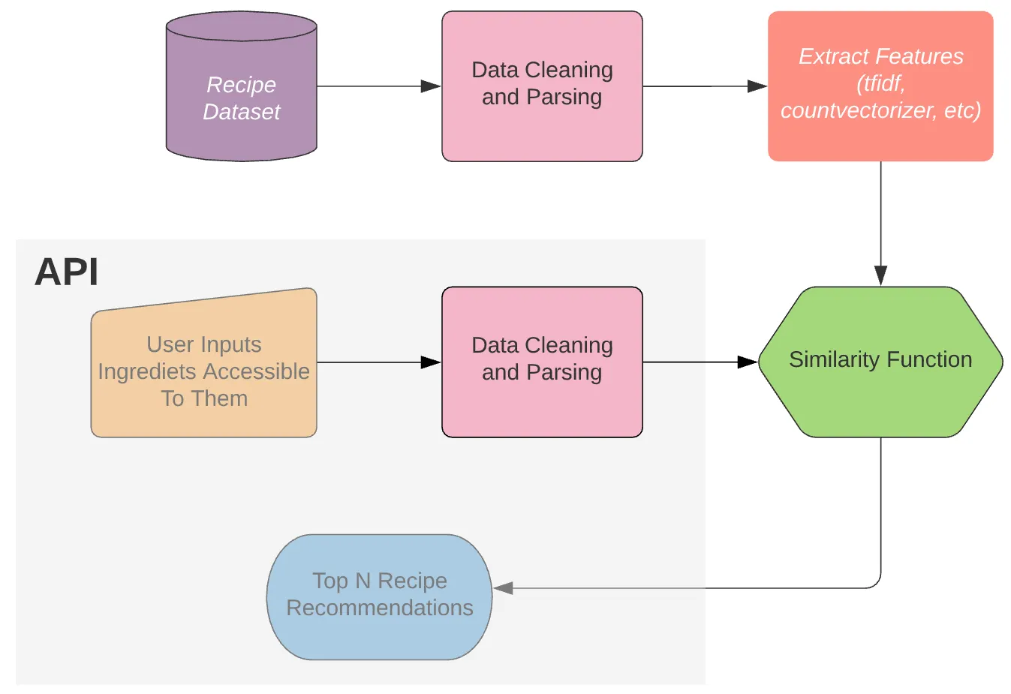
What’s the Deal for Your Meal Jack Valian, Andrew Masur, Saul Hernandez
Business Intelligence & Analytics
Introduction
Food.com and various other recipe websites give no ability to filter for multiple dietary restrictions, making dinner parties a nightmare.
This results in endless scrolling to find recipes that fit
Feel Free to change box headings and sizes
Results
Box 3
Experiment (?)
Using a dataset of ~230,000 recipes, to create a bot that would take in the meal preferences and restrictions of a user and output recipe suggestions for the user.
Conclusion
Box 4
http://www.stevens.edu/school-business/masters-programs/business-intelligence-analytics

