Slide 1
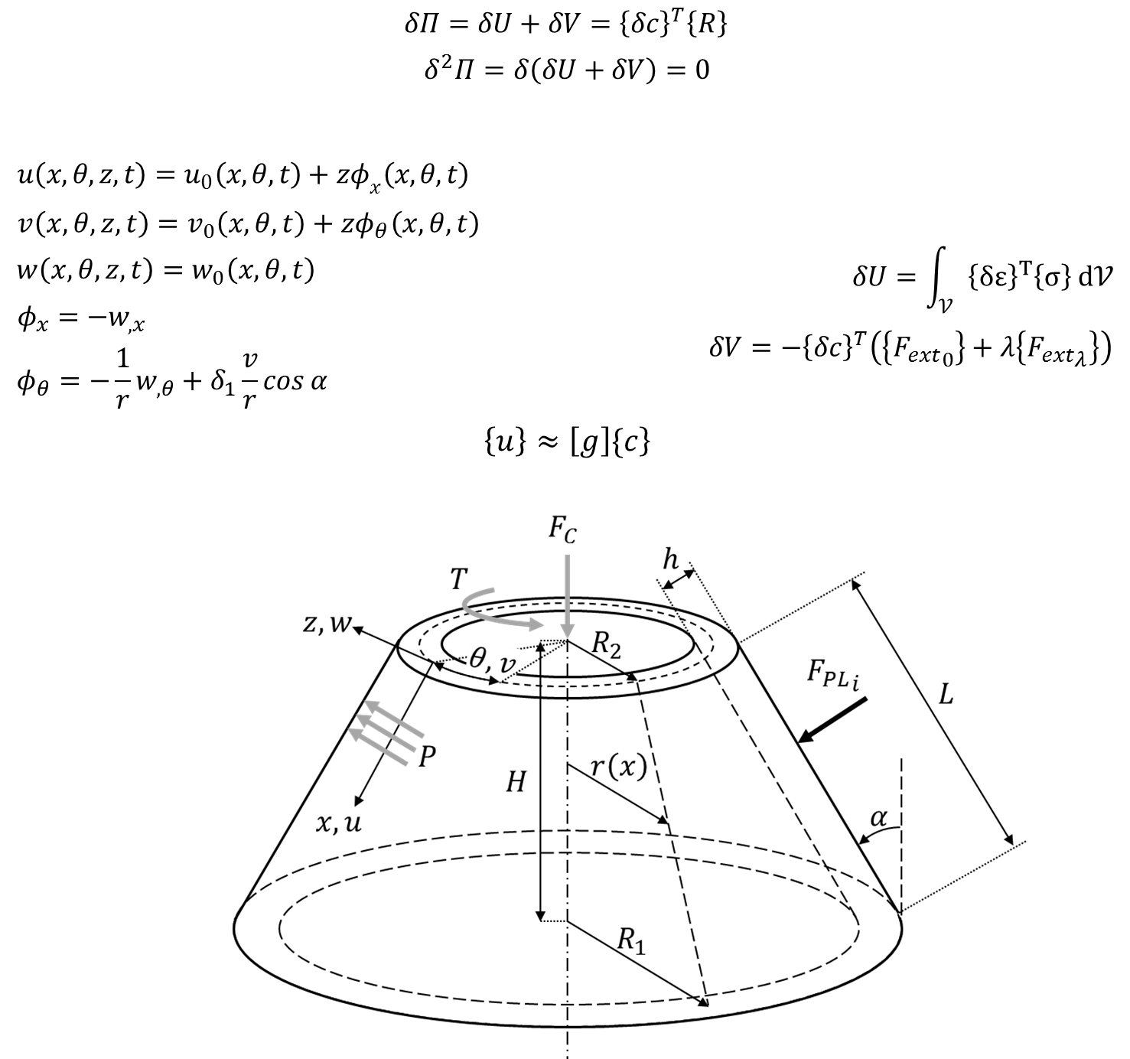
Semi-Analytical Modelling of Thin-Walled Structures: Theory and Practice
2026 Edition
Saullo G. P. Castro

