Slide 1
Capstone III presentation
Project: Analysis of how height and weight impact who gets drafted in the NBA draft
Presented by: Saulo Sanchez

Slide 2
The Dataset
The data set being used contains over two decades of data of all players that have played in the NBA.
There are 12306 records across 22 fields, but I will only used 4 for the analysis:
Player_height
Player_weight
Draft_number
Draft_round

Slide 3
Hypothesis
Hypothesis #1: Undrafted players are smaller than drafted players.
Hypothesis #2: Top 5 drafted players are heavier than the rest drafted and undrafted players.

Slide 4
The research questions
Two questions are being analyzed with the data.
Is there a significant difference in height between players undrafted and drafted players?
Is there a significant difference in weight between the top 5 players drafted and the rest?

Slide 5
How will the data test the hypotheses?
Visualization and t-test will show the difference in height between players
T- test will show the difference in weight between players

Slide 6
How findings will be useful
NBA teams will know what weight and height need to keep in mind, when scouting young players.

Slide 7
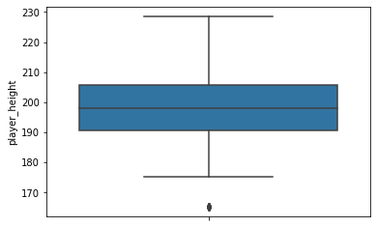
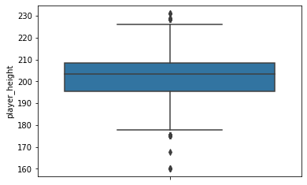
Analysis – Hypothesis #1
Visualizations and t-test were used to show difference in height
undrafted players drafted players
the result of the t-test is a pvalue=1.248764127086546e-66
The T-test is rejected. There is a significant difference in height between undrafted and drafted players.

Slide 8
Analysis- Hypothesis #2
Independent sample t-test was used to support the hypothesis
top drafted weight avg rest of the players weight avg
count 1670.000000 count 12305.000000
mean 103.903151 mean 100.369926
The result of the analysis is a pvalue=2.043954818820574e-27
The t-test is rejected. There is a difference between top drafted and the rest.

Slide 9
Summary
Hypothesis #1 has been rejected. There is significant difference in height between undrafted players and drafted players
Hypothesis #2 has been rejected. Top 5 drafted players are heavier than the rest drafted and undrafted players.

