Slide 1
Genesis
⚡
INTELLIGENT BRAND DESIGN
The world's first AI creative director for growing businesses.
Brand creation · Ongoing strategy · Assets on demand · Physical products
Darrell Irwin & Saulo Oliveira · genesisbrands.ai

Slide 2
Problem
Brand is the most important part of any start-up's journey.
Yet it remains the hardest to execute — constrained by budget, time, and confidence.
5.5M
<10%
new US businesses registered every year
can afford professional branding in year one
$15K–$75K+
Weeks–months
what a traditional agency charges for a brand
how long agencies take to deliver

Slide 3
Solution
A trained AI creative director — not a template generator.
Founders answer a structured discovery questionnaire. Genesis AI — the Brain Engine — conducts intelligent discovery, derives brand strategy, and orchestrates specialist agents to produce a complete brand in minutes.
Brand Creation
Ongoing Strategy
Assets on Demand
Physical Products
Complete brand identity in minutes: logo, copy, colour, typography, brand book — three directions.
Subscription access to the AI creative director that knows your brand inside out.
Generate social media posts, carousels, graphics and more whenever you need them.
Order branded business cards, banners, merch — printed and delivered via our partners.

Slide 4
The Differential
The Brain Engine — a trained second brain, not a prompt wrapper.
What everyone else does
Genesis Brain Engine
✗ Ask a few style questions
✓ Conducts structured brand discovery
✗ Match to a template library
✓ Reasons with 25+ yrs of strategy knowledge
✗ Generate one output
✓ Produces three directions simultaneously
✗ Client iterates alone
✓ Briefs and dispatches specialist agents
✗ No brand memory
✓ Inspects output — iterates until quality met
✗ No quality inspection
✓ Retains brand memory across every session
✗ Transaction ends at delivery
✓ Stays as your creative director — subscription

Slide 5
How It Works
01
02
03
04
05
Discovery
Strategy
Generation
Quality Loop
Delivery
Client answers an AI-guided questionnaire. The Brain Engine conducts intelligent dialogue to extract deep brand signals.
The Brain Engine reasons against 25+ years of brand knowledge and derives three creative directions: anchored, evolved, disruptive.
Specialist agents — Copy, Visual, Logo, Playbook, Brand Book — are briefed and orchestrated concurrently.
The Brain Engine inspects every agent's output against quality rubrics. It iterates until the threshold is met — not just once.
Complete brand delivered: identity, copy, brand book, all assets. Client enters ongoing consultant mode.

Slide 6
Technology
Alpha Architecture — where it began (~5 years ago)
[ INSERT: Alpha Architecture Diagram ]
Decision-tree pipeline · validated core proposition · real customer testimonials · proved the market

Slide 7
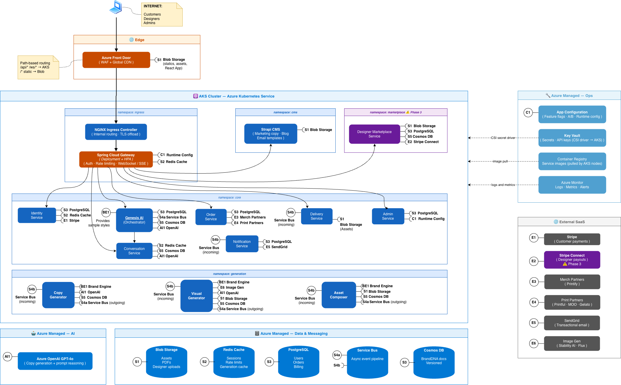
Technology
Genesis AI — Production Architecture
[ INSERT: Genesis AI Architecture Diagram ]

Slide 8
The Brain Engine
Two-layer knowledge architecture — it learns, it reasons, it remembers.
[ INSERT: Brain Engine Detail Diagram ]
Layer 1: structured YAML reasoning modules distilled from 25+ years of brand strategy · Layer 2: vector store of all past engagements — every brand made sharpens the next

Slide 9
Market
5.5M
Total Addressable Market
Why now?
New US business registrations per year (US Census Bureau, 2023)
AI now capable of genuine brand reasoning — not just template matching
The idea was ahead of the tech five years ago.
1.5M
Serviceable Market
US tech, creative & service startups requiring brand identity
The tech has caught up.
Nobody has built the full loop yet.
150K
Obtainable Market
10% of serviceable market — fastest-growing segment

Slide 10
Business Model
Four revenue layers — entry, retention, expansion, and growth.
Entry
One-time purchase. Client gets complete brand identity: logo, copy, colour, typography, brand book, all digital assets.
Brand Packages
$229 / $349 / $849
Retention
Ongoing access to the AI consultant who knows their brand. Includes asset regeneration, social media graphics, carousels, post templates. Higher tiers: social calendar management.
Subscription
$39 – $149 / month
Expansion
Branded business cards, banners, roller banners, t-shirts, mugs, and stationery — ordered in-platform, fulfilled via print-on-demand partners. Zero inventory risk.
Physical Products
20–40% margin
Growth
The AI manages the brand's social media presence: generates, schedules, and publishes content autonomously. Brand voice and visual identity always consistent.
AI Social Management
Premium tier — future

Slide 11
Pricing
Brand Packages — one-time
Essential
Premium
Ultimate
$229
$349
$849
• Full digital brand kit
• Everything in Essential
• Everything in Premium
• Logo (SVG + PNG)
• Hard copy brand book
• Full printed stationery pack
• Brand book (PDF)
• Priority processing
• Roller banner
• Colour & typography
• White-glove onboarding
• Copywriting matrix
Subscription — monthly
Starter
$39/mo
Growth
$79/mo
Pro
$149/mo
Consultant access · 10 asset regenerations/month
Unlimited consultant · unlimited assets · social media templates & carousels
Everything in Growth · AI-managed social media calendar · priority support

Slide 12
Competition
Tailor Brands / Looka
Logo-first tools. Template matching, no strategy, no brand memory, no consultant mode. No subscription with real AI value.
Canva
Design tool for managing existing brands. No brand creation, no strategy, no discovery. Subscription but no intelligence.
99designs / Fiverr
Human freelancers. Expensive ($500–$5,000+), slow (1–4 weeks), inconsistent. No ongoing relationship.
Traditional Agency
$15K–$75K+, weeks to deliver, entirely inaccessible to startups and small businesses.
Genesis AI
The only platform that combines AI brand strategy, three creative directions, a quality inspection loop, brand memory, physical products, and an ongoing AI consultant — at startup-accessible pricing.

Slide 13
Team
Darrell Irwin
Saulo Oliveira
Founder & CEO
Co-Founder & CTO
25+ years as brand strategist and agency founder. Built and ran Cre8ion, a full-service brand agency. Every framework, rubric, and creative methodology powering the Genesis AI Brain Engine is distilled from his body of work. The intelligence in the system is his.
Enterprise software architect and AI systems engineer with 25+ years experience. Designed the Genesis AI multi-agent orchestration architecture, the Brain Engine, and the two-layer knowledge base. Previously led platform-level AI and cloud-native architecture at global financial institutions.
$300,000+ in time and expertise invested to date.

Slide 14
Traction & Roadmap
~5 years ago
Decision-tree pipeline producing PDF brand books. Deployed, user-tested across real clients spanning professional services, real estate, and recruitment. Customer testimonials on record.
Alpha built & validated
Today — LIVE
Genesis AI Brain Engine is live. Claude Opus 4 with extended thinking, two-layer knowledge base, consultant mode active. Already providing brand insights and proving its intelligence. Demo scheduled.
Brain Engine operational
Next
Connect specialist agents (Copy, Visual, Logo, Playbook, Brand Book). Test and refine the Brain Engine's ability to brief agents, inspect output quality, and iterate to threshold.
Agent pipeline integration
Then
Build the client-facing discovery experience. AI-guided questionnaire feeding directly into the Brain Engine pipeline.
User interface & questionnaire
End of 2026
Full pipeline connected, tested, and refined. Beta opens to early subscribers.
Beta launch

Slide 15
Financial Projections
Three revenue streams · $349 avg brand package · $59/mo avg subscription · 30% physical product margin
Year
Scenario
Brands/mo
Packages
+ Subscriptions
+ Physical
Total Revenue
High
300
$1,258,800
+$382,000
+$72,000
$1,712,800
Y1
Mid
150
$629,400
+$191,000
+$36,000
$856,400
Low
75
$314,700
+$95,000
+$18,000
$427,700
High
1,000
$4,188,000
+$2,980,000
+$180,000
$7,348,000
Y2
Mid
500
$2,094,000
+$1,490,000
+$90,000
$3,674,000
Low
250
$1,047,000
+$745,000
+$45,000
$1,837,000
High
5,000
$20,940,000
+$8,530,000
+$500,000
$29,970,000
Y3
Mid
2,500
$10,470,000
+$4,265,000
+$250,000
$14,985,000
Low
1,250
$5,235,000
+$2,132,000
+$125,000
$7,492,000
* Investment requirement ~$530K · cost base grows 20% per year · subscriptions assume 25% conversion of brand buyers

Slide 16
Impact
What Genesis AI means for American entrepreneurs.
Democratizing Entrepreneurship
Transforming the Economics
5.5M Americans start a business every year. Fewer than 10% can afford professional branding. Genesis AI removes the most-cited barrier to early-stage success — permanently.
What costs $15,000–$75,000 at an agency and takes weeks now takes minutes and costs hundreds. The value-to-price gap is not incremental — it is categorical.
AI That Gets Smarter Over Time
A New Creative Economy
Every engagement strengthens Layer 2 — the vector store of brand knowledge. The system that serves the 10,000th client is meaningfully smarter than the one that served the first.
Creatives contribute knowledge and earn when it's applied. A responsible AI model that amplifies the creative industry rather than replacing it.

Slide 17
Creating the world's most intelligent brand agency will inspire people to design their future.
The automation race has just begun.
Brain Engine: live · Demo: scheduled · Beta: end of 2026
genesisbrands.ai

