Slide 1

Final Project
Incorporating Mask-Related Transmission Variability into SEIR Models
INF301: System Modeling and Simulation
Saulo Gil
Professor: Prof. Luiz Henrique Bonani do Nascimento

Slide 2
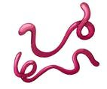

Introduction
Viral epidemics are not uncommon in human history.
Severe acute respiratory syndrome coronavirus (SARS-CoV-1 virus);
Influenza A (H1N1 virus);
Middle East respiratory syndrome coronavirus (MERS-CoV virus);
Ebola virus disease;
COVID-19 (SARS-CoV-2 virus);
These virus diseases have tested national health systems and the global governance architecture for health security.
While forecasting the spread of a virus is a significant challenge, simulating various scenarios of disease transmission within a population can be valuable for enhancing preparedness for future epidemics
Bhadoria et al., 2021, Morens et al., 2020
Wilder-Smith, 2021

Slide 3
Introduction
Viral pandemics are not uncommon in human history.
Severe acute respiratory syndrome coronavirus (SARS-CoV-1 virus);
Influenza A (H1N1 virus);
Middle East respiratory syndrome coronavirus (MERS-CoV virus);
Ebola virus disease;
COVID-19 (SARS-CoV-2 virus);
These virus diseases have tested national health systems and the global governance architecture for health security.
While forecasting the spread of a virus is a significant challenge, simulating various scenarios of disease transmission within a population can be valuable for enhancing preparedness for future epidemics
In this scenario, mathematical models can be used to simulate different scenarios and, thus improving preparedness for future epidemics
Bhadoria et al., 2021, Morens et al., 2020
Wilder-Smith, 2021

Slide 4
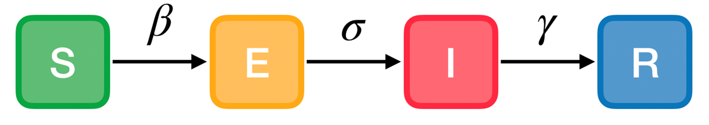
Introduction
SEIR (Susceptible-Exposed-Infected-Recovered) model is widely used to represent the dynamics of viral epidemics in human populations.
SEIR model divides the population into four compartments:
Susceptible (S);
Exposed (E);
Infected (I);
Recovered (R);
Thus, transitions between compartments can be simulated using mathematical approaches, allowing hypothetical scenarios such as the impact of mask-based interventions to be evaluated.
Liu, 2023

Slide 5
Objective
To model the spread of COVID-19 in São Paulo (SP), Brazil using a SEIR model;
To incorporate, experimentally, mask-related changes in transmission rate (λ) to compare infection dynamics under different mask scenarios;
To estimate the impact on severe cases (≈ 15% of infections);
To assess whether mask use helps keep severe cases below the available emergency bed capacity.

Slide 6
SEIR Model Structure
For modeling the spread of COVID-19 transmission during the first wave (2020), four groups of individuals (compartments) were considered:
Compartments:
S(t) – Susceptible,
E(t) – Exposed,
I(t) – Infectious,
R(t) – Recovered.
Total population: N = S + E + I + R.
Key parameters:
λ (infection rate),
σ (incubation rate),
δ (recovery rate).

Slide 7
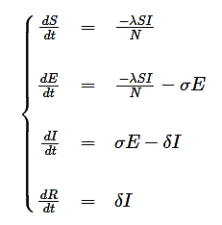
SEIR Model Structure
So, the system of differential equations can be written as follows:
Where:
S(t) – number of susceptible individuals,
E(t) – number of exposed individuals,
I(t) – number of infectious individuals,
R(t) – number of recovered individuals.
N = total of population.
λ = infection rate,
σ = incubation rate,
δ = recovery rate.

Slide 8
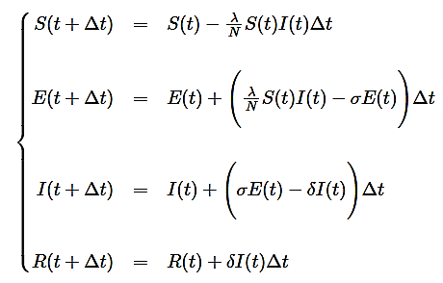
SEIR Model Structure
Due to elevated complexity of differential equations, we can derive it to difference equations using the Euler method to numerically simulate the behavior of the system:
Discrete time = step (days)

Slide 9
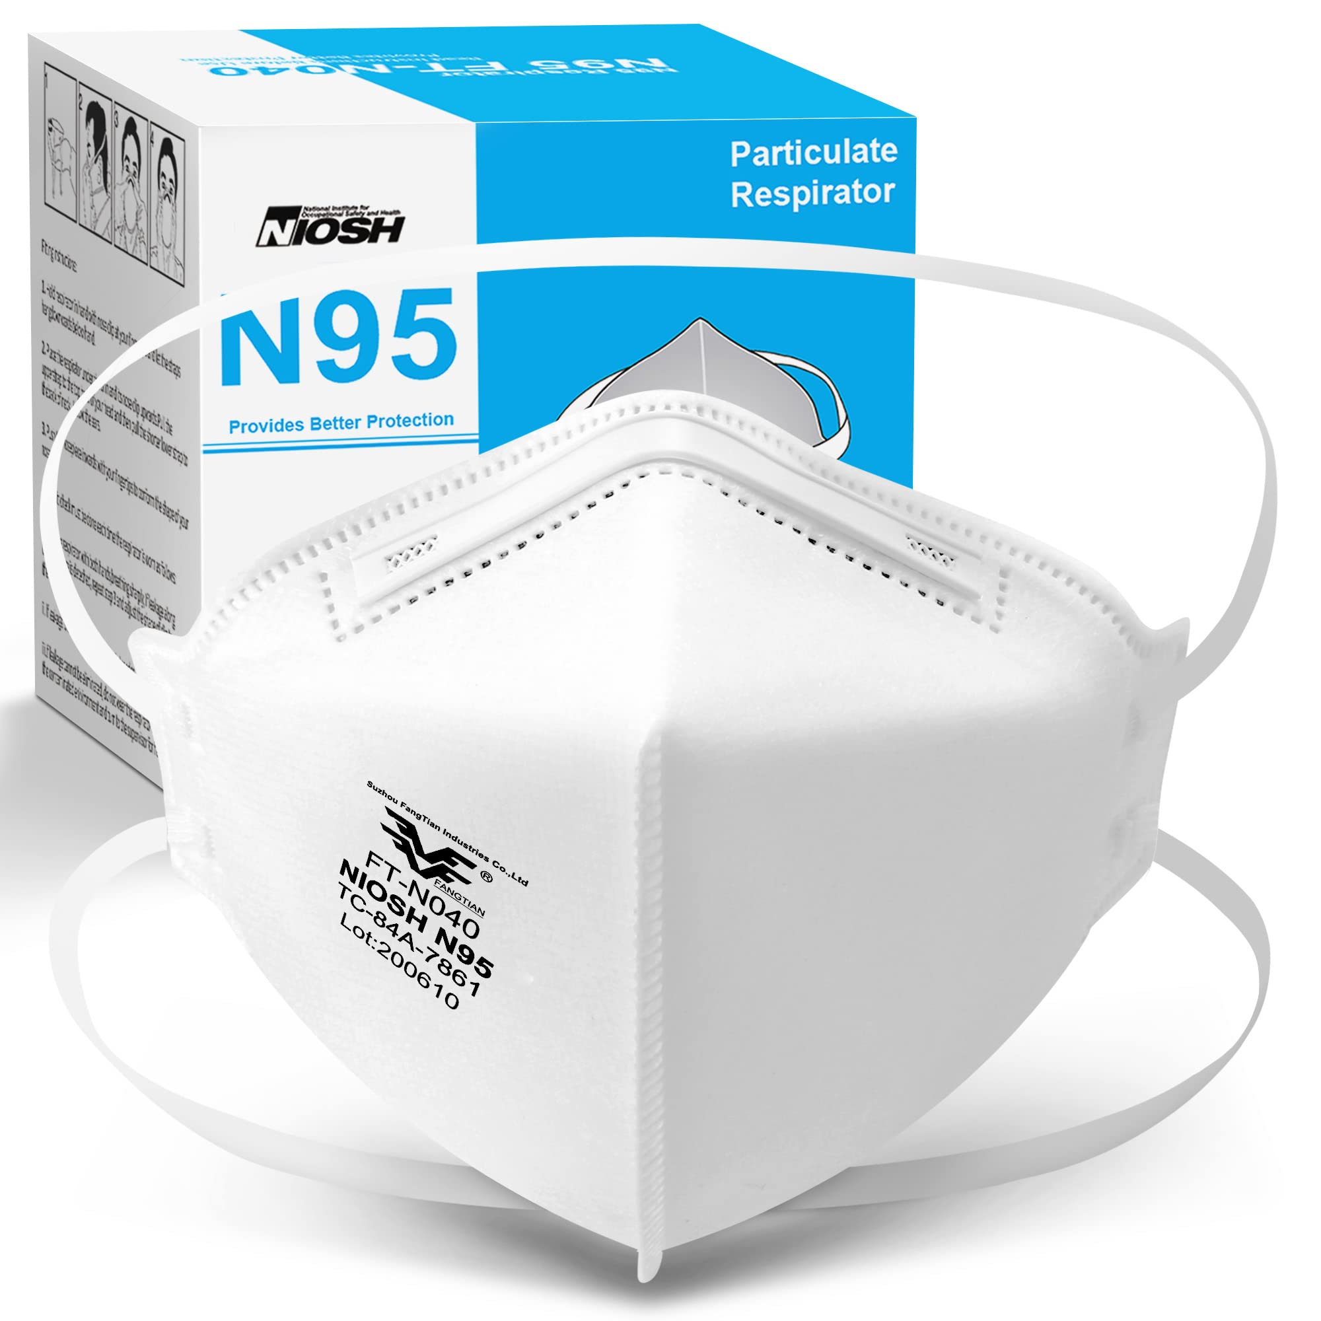
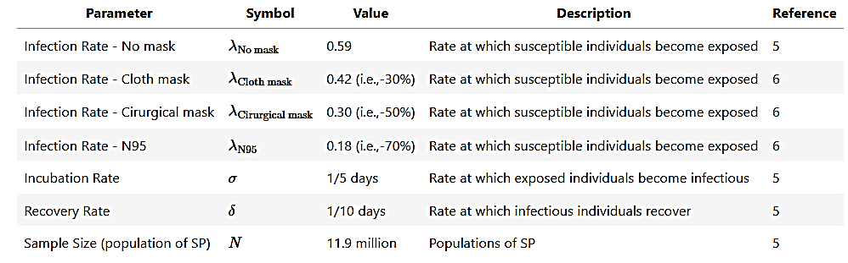
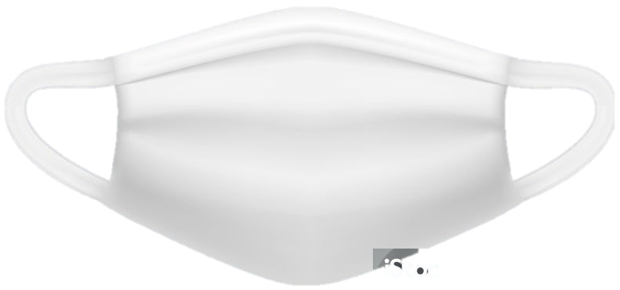
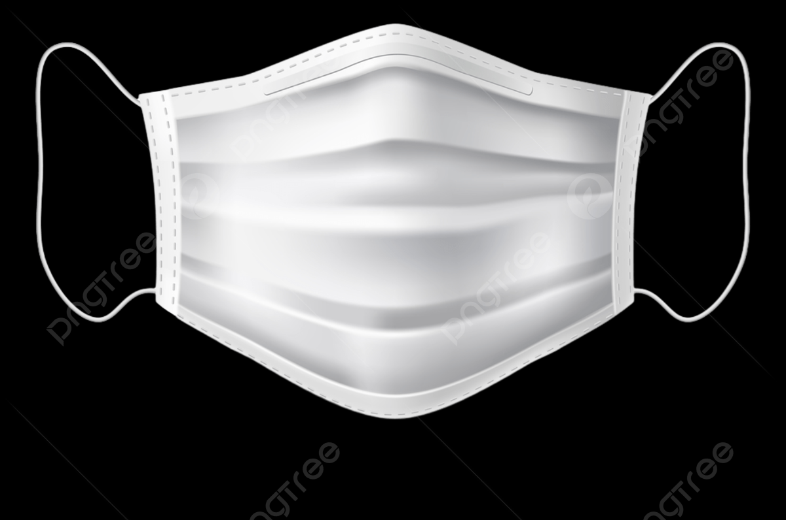
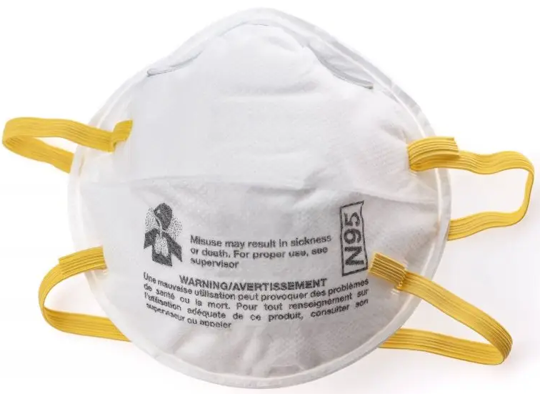
Model Parameters & Mask Scenarios
Base epidemiological parameters (literature):

Slide 10
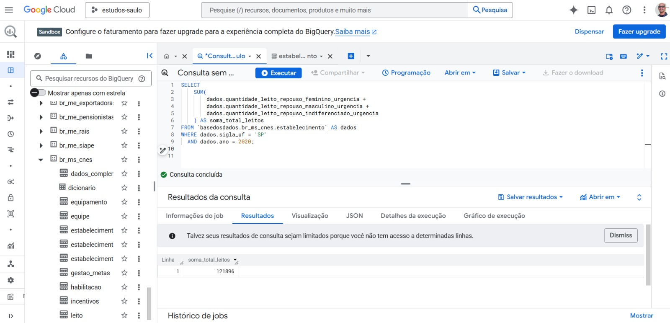
Health-care system capacity
To obtain the number of rest/observation beds in emergency units, data from the CNES (Cadastro Nacional de Estabelecimentos de Saúde) available on basedosdados.org was accessed using a SQL query in BigQuery (Google Cloud) on the basedosdados.br_ms_cnes.estabelecimento table using the code.
SELECT
SUM(
dados.quantidade_leito_repouso_feminino_urgencia +
dados.quantidade_leito_repouso_masculino_urgencia +
dados.quantidade_leito_repouso_indiferenciado_urgencia +
) AS soma_total_leitos
FROM
`basedosdados.br_ms_cnes.estabelecimento` AS dados
WHERE dados.sigla_uf = 'SP'
AND dados.ano = '2020'
121896 beds

Slide 11

Numerical Implementation
Python.
NumPy for numerical computations and;
Matplotlib for visualization.
The model was run for a total of 400 days:
Initial conditions was set up as follows:
number of susceptible (i.e., zero individuals),
number of exposed (i.e., N - 1 individuals),
number of infectious (i.e., zero individuals), and
number of recovered individuals (i.e., zero individuals)
Time step of 1 day.

Slide 12
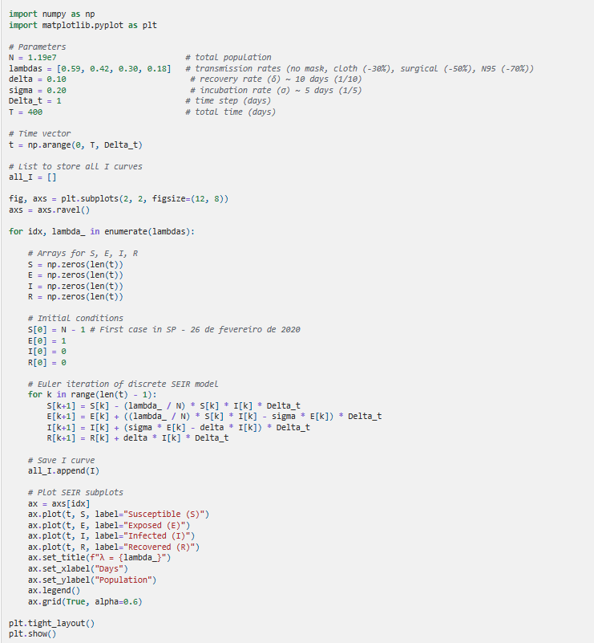
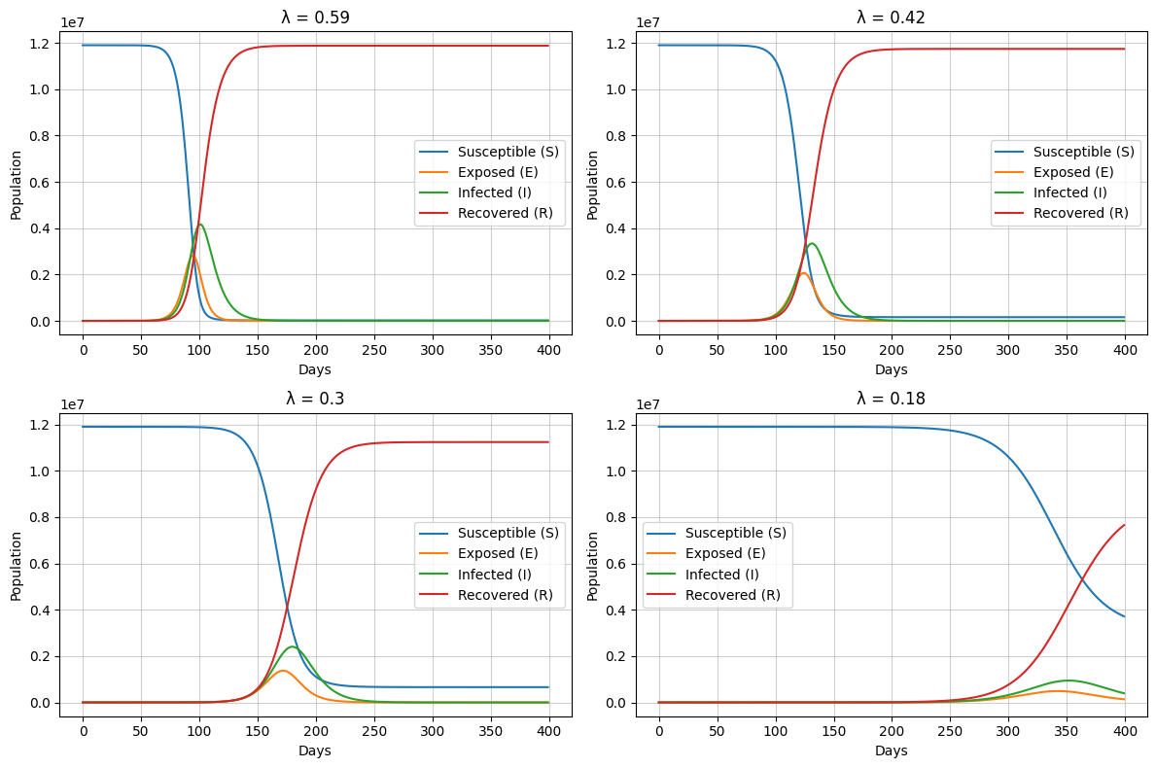
Results I – SEIR Trajectories

Slide 13
Results I – SEIR Trajectories by Mask Scenario

Slide 14
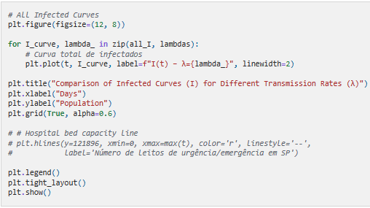
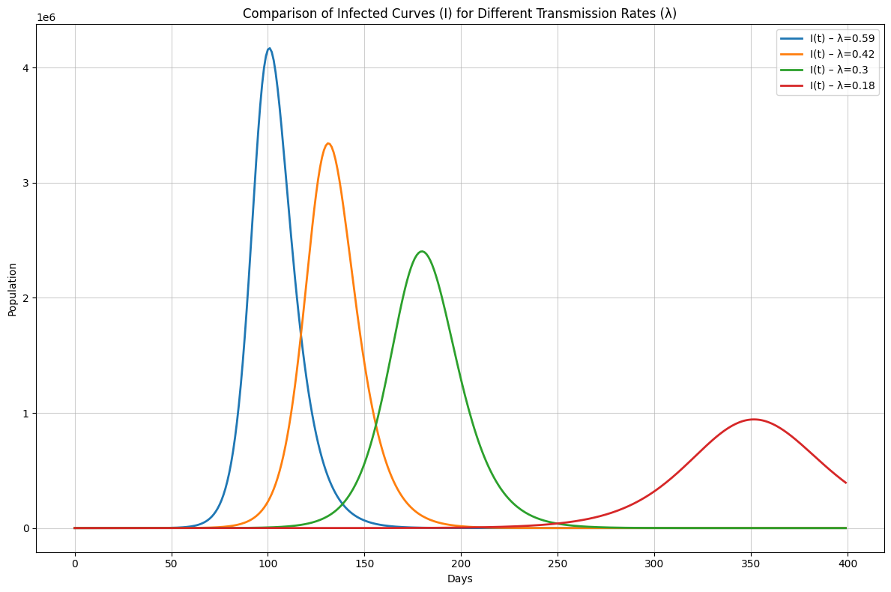
Results II – Comparison of Infected Curves I(t)

Slide 15
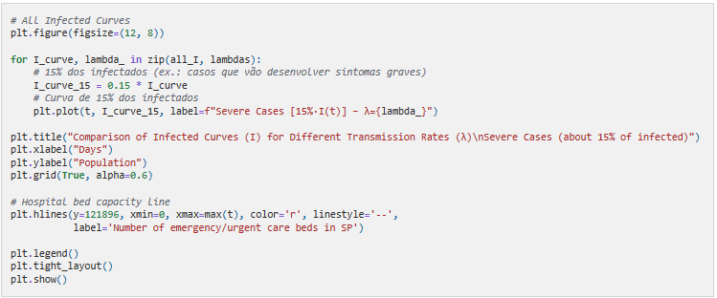
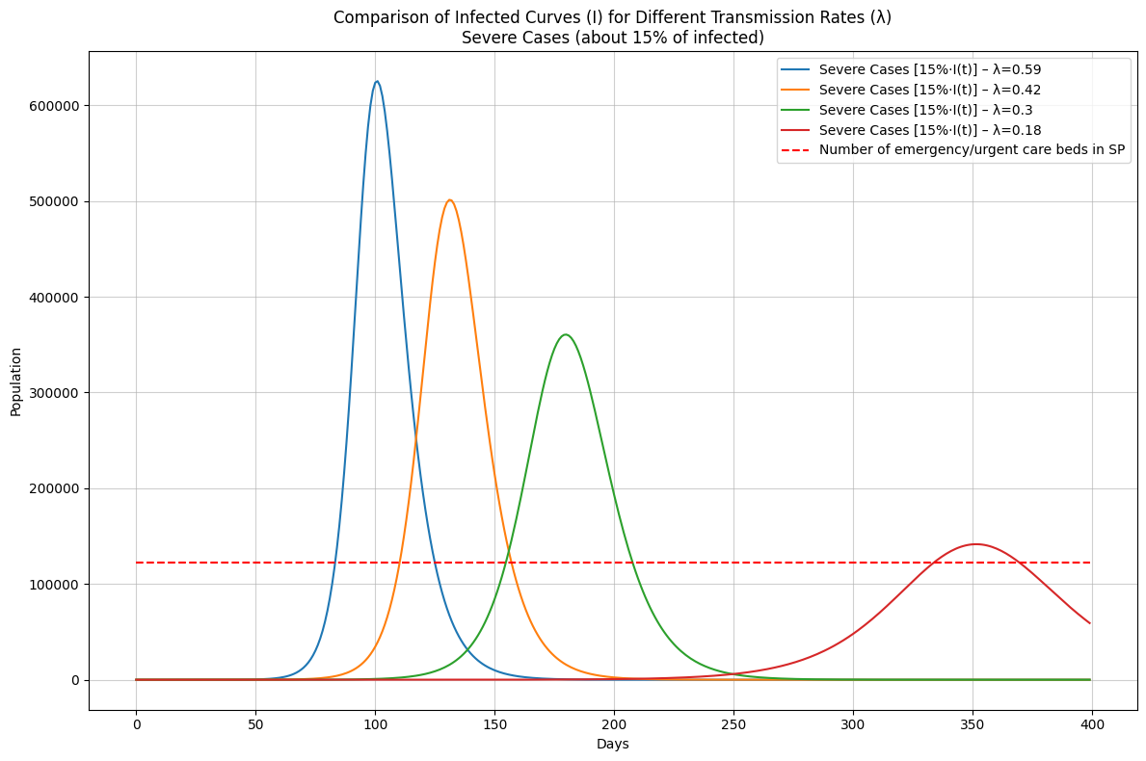
Results III – Severe Cases and Bed Capacity

Slide 16
Conclusion
SEIR model is a useful approach to explore spread of virus diseases like COVID-19.
As λ decreases from values representing no mask use to cloth, surgical, and finally N95/PFF2 masks, both the total number of infections and the peak prevalence of active cases are progressively reduced and delayed, demonstrating a clear flattening of the epidemic curve.
When severe cases are approximated as 15% of infections and compared with the number of rest/observation beds available in emergency units in São Paulo, only the N95/PFF2 mask produces a peak of severe disease that approaches, rather than vastly exceeds, the existing capacity.
Although based on a simplified model and several assumptions, results obtained across mathematical simulations reinforce the importance of high-efficacy masks as a non-pharmaceutical intervention capable of mitigating health-system overload during viral pandemics, particularly in the early phases when vaccines and specific treatments may not yet be widely available.

Slide 17
Limitations
Although SEIR framework is useful to explore hypothetical scenarios related to impact of mask-based interventions and to generate insights that can aid preparedness and response planning for future epidemics, some issues should be considered:
First, it assumes homogeneous mixing of the population, ignoring heterogeneity in contact patterns by age, occupation, household structure, or geography;
Second, model parameters such as transmission, incubation, and recovery rates were assumed to be constant, which may not capture rapid changes in behavior, policy measures, viral variants, or health-care capacity over time;
Third, classical SEIR models are deterministic and do not incorporate stochastic effects that can be relevant, especially in the early phase of an outbreak or in smaller populations.
Fourth, the model usually assumes that recovered individuals acquire complete and lasting immunity, overlooking waning immunity, reinfections, and the impact of vaccination.
Finally, when SEIR models are used to evaluate interventions such as mask use, they often encode these effects as static reductions in the transmission rate, without explicitly accounting for imperfect adherence, incorrect use, or differences in risk across settings (e.g., households vs. workplaces)

Slide 18
References
Bhadoria P, Gupta G, Agarwal A. Viral Pandemics in the Past Two Decades: An Overview. J Family Med Prim Care. 2021;10(8):2745-50.
Morens DM, Fauci AS. Emerging Pandemic Diseases: How We Got to COVID-19. Cell. 2020;182(5):1077-92.
Wilder-Smith A. COVID-19 in comparison with other emerging viral diseases: risk of geographic spread via travel. Trop Dis Travel Med Vaccines. 2021;7(1):3.
Liu X. Analytical solution of l-i SEIR model-Comparison of l-i SEIR model with conventional SEIR model in simulation of epidemic curves. PLoS One. 2023;18(6):e0287196.
Pinto Neto O, Kennedy DM, Reis JC, Wang Y, Brizzi ACB, Zambrano GJ, de Souza JM, Pedroso W, de Mello Pedreiro RC, de Matos Brizzi B, Abinader EO, Zângaro RA. Mathematical model of COVID-19 intervention scenarios for São Paulo-Brazil. Nat Commun. 2021 Jan 18;12(1):418.
Floriano I, Silvinato A, Bacha HA, Barbosa AN, Tanni S, Bernardo WM. Effectiveness of wearing masks during the COVID-19 outbreak in cohort and case-control studies: a systematic review and meta-analysis. J Bras Pneumol. 2024 Jan 5;49(6):e20230003.

Slide 19
Incorporating Mask-Related Transmission Variability into SEIR Models
Thank you for your attention!
INF301: System Modeling and Simulation
Saulo Gil
Professor: Prof. Luiz Henrique Bonani do Nascimento

