Slide 1
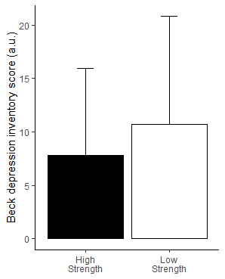
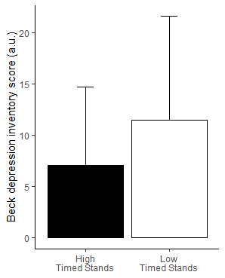
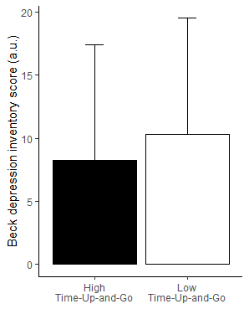
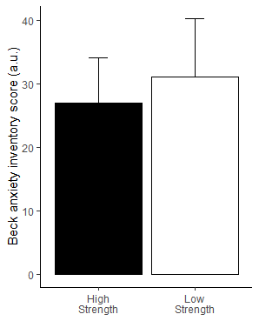
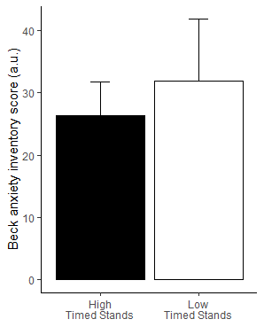
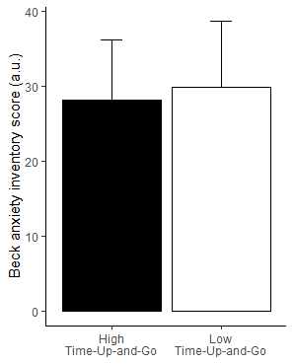
Beck Depression Inventory Score
HGS
Timed Stands
Time-Up-and-Go
P=0.0219
P=0.0003
Beck Anxiety Inventory Score
HGS
Timed Stands
Time-Up-and-Go
P=0.0003
P<0.0001

Slide 2
