Slide 1


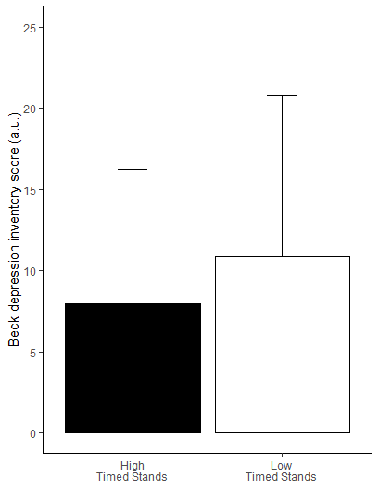
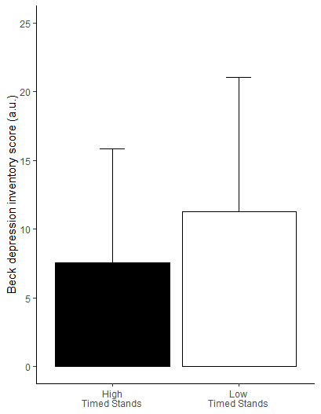




Beck Depression Inventory Score
A)
HGS
B)
Timed Stands
P=0.0214
P=0.0030
Beck Anxiety Inventory Score
C)
HGS
D)
Timed Stands
P=0.0008
P<0.0001

Slide 2



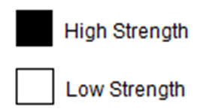
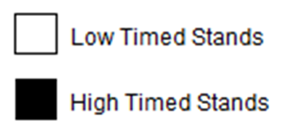
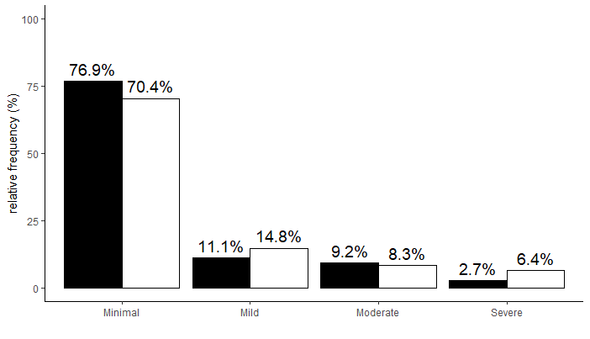
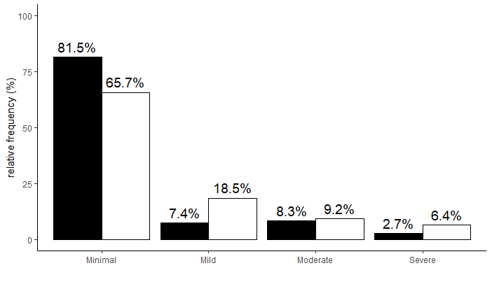
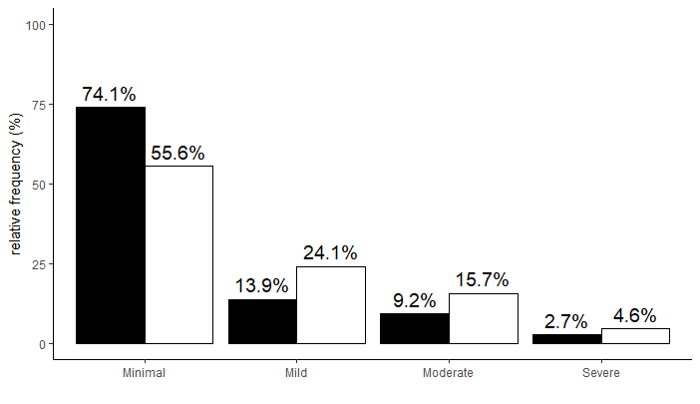

Beck Depression Inventory Score
A)
HGS
B)
Timed Stands
Beck Anxiety Inventory Score
C)
HGS
D)
Timed Stands

Slide 3
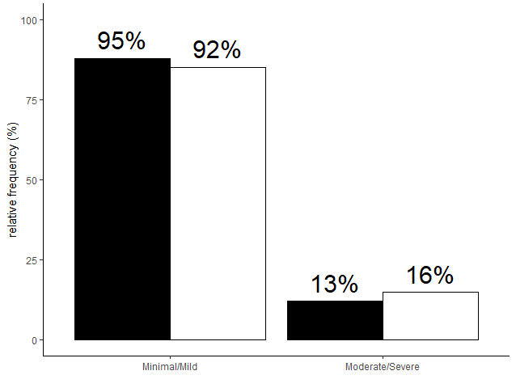
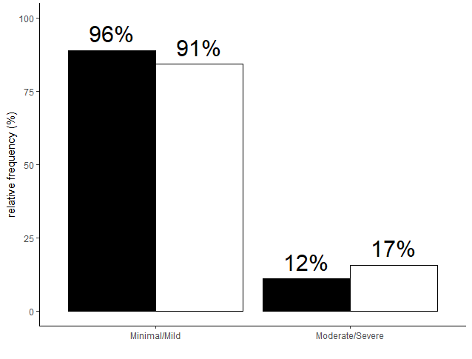
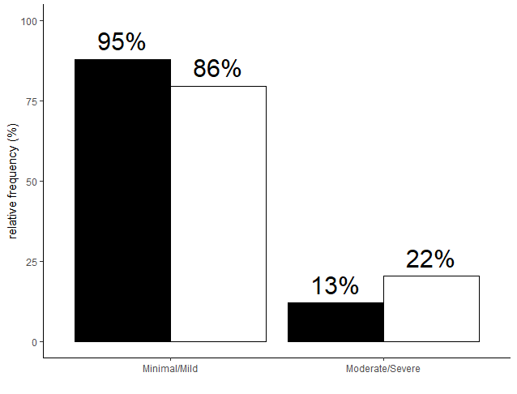
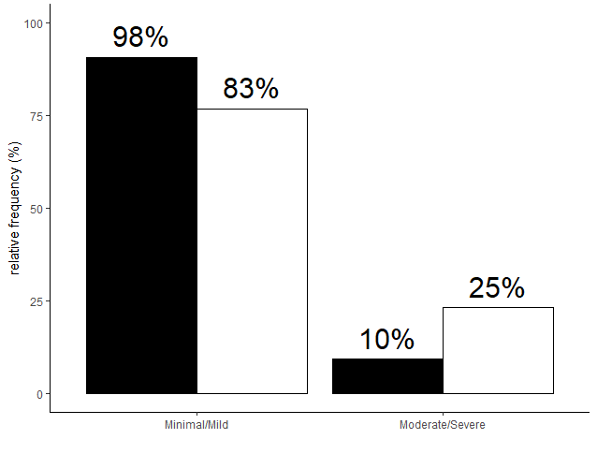
Beck Depression Inventory Score
A)
HGS
B)
Timed Stands
Beck Anxiety Inventory Score
C)
HGS
D)
Timed Stands *

Slide 4
