Slide 1
Bayesian Statistics

Slide 2
Before we Start
The content of this lecture is a very brief introduction to Bayesian Statistics.
I highly recommend to have a look at the book from which I took my examples, “Think Bayes” available here : http://greenteapress.com/thinkbayes/
It is also useful to download some material from
Prof Allen Downey :
https://github.com/AllenDowney/BayesMadeSimple.git
Associated youtube video :
https://www.youtube.com/watch?v=5W715nfJNJw

Slide 3
Probability
You have very likely learned the frequentist approach :
It defines an event's probability as the limit of its relative frequency in a large number of trials.
From now (and until the end of the lecture) you need to think of a probability as a degree of belief

Slide 4
Probability as a Degree of Belief
If P=1 : The fact is certainly true
or the prediction will come true
If P=0 : The fact is certainly false
or the prediction won't happen
If P=0.5 : The fact is as likely true as false
or the prediction is as likely to
happen as not

Slide 5
Joint Probability
A and B are two events/facts/predictions.
P(A & B) is the probability that A and B happen/are true
Mathematically we have :
  P(A & B) = P(A) . P(B) if A and B are independent
  P(A & B) = P(A) . P(B|A) if A and B not independent
P(B|A) is the conditional probability that B is true knowing the A is true.

Slide 6
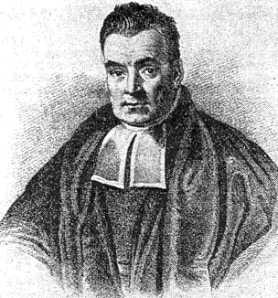
Bayes' Theorem
In the last expression A and B are interchangeable
  P(A & B) = P(A) . P(B|A) = P(B) . P(A|B)
We can rewrite it as :
BAYES' THEOREM
Thomas Bayes 1701-1761

Slide 7
Little Reformulation
Let H be my hypothesis and D the data and replace A by H and B by D :
where :
  P(H) is my belief in H before seeing the data D
  named prior probability or prior
  P( H | D ) is my updated belief in H after seeing D
  named the posterior

Slide 8
Little Reformulation
Let H be my hypothesis and D the data and replace A by H and B by D :
where :
  P( D | H) is the probability of D under the hypothesis H
  named the likelihood
  P( D ) is the probability of D under any hypothesis
  named normalizing constant or marginal probability

Slide 9
Little Reformulation
prior
likelihood
posterior
normalizing
constant

Slide 10
1st Simple Example
Two Bowls with cookies in the kitchen :
  Bowl 1 : 10 chocolate and 30 vanilla
  Bowl 2 : 20 chocolate and 20 vanilla
The kid has a vanilla one in his hand, what is the probability that he picked it from bowl 1?
Formulation :
  H : cookie from bowl 1
  D : cookie is vanilla

Slide 11
1st Simple Example
Prior P(H) = 1/2
Likelihood P(D|H) = 30/40 = 3/4
Norm. Factor P(D) = 50/80 = 5/8
Hence : P(H|D) = 1/2 * 3/4 * 8/5 = 3/5
Prior : 50% chance – Posterior : 60% chance

Slide 12
1st Simple Example
What the kid has another cookie and it's chocolate? (I still want to know if comes from the 1st Bowl)
  H : cookie from Bowl 1 (still the same)
  D : my cookie is chocolate
  Likelihood has changed P(D|H) = 10/39
  Normalizing Factor P(D) = 30/79
  The prior is now my previous posterior :
  P(H) = 0.6
  Then the posterior is P(H|D) ≃ 0.41

Slide 13
Updating Posterior
In the previous example we have updated our belief in the hypothesis H as we get new data D.
Reminder :
  Prior P(H):
  Our belief in H before seeing the data D
  Posterior P(H|D):
  Our updated belief in H after seeing the data D
Assuming we evaluate likeliness of an hypothesis on a data set we can update our belief as we get more data.

Slide 14
Multiple Hypothesis
Previously we worked on a single hypothesis but we could have included a second one H₂ : cookie from Bowl2
and compute independently the degree of belief for H_{2 .}
Another example with more classes :
Someone has a 4-sided, 6-sided, 8-sided, 12-sided and 20-sided dices in his pocket, picks one and tells me :
“I got a 6”.
  What is the probability that the person rolled each dice ?

Slide 15
2nd Example
H_{i} : picked i-sided dice
D : outcome is a 6
Prior belief P(H_{i}):
P(H₄) = P(H₆) = P(H₈) = P(H₁₂) = P(H₂₀) = 1/5
Likelihood P(D|H_{i}):
P(D|H₄) = 0
P(D|H₆) = 1/6
P(D|H₈) = 1/8
P(D|H₁₂) = 1/12
P(D|H₂₀) = 1/20

Slide 16
2nd Example
Normalizing Factor P(D)
P(D) = sum[P(H_{i}).P(D|H_{i})] = 51/600
Posterior P(H_{i}|D) :
P(H₄|D) = 0.0
P(H₆|D) ≃ 0.39
P(H₈|D) ≃ 0.29
P(H₁₂|D) ≃ 0.20
P(H₂₀|D) ≃ 0.12
Obviously we have the relation:

Slide 17
2nd Example
2nd draw : “I got a 8”
  Use the previous posteriors as priors, recompute the likelihood P(D|H_{i}) and normalizing factor P(D) and find the new posteriors.
If we define X as the number of sides of my dice (discrete variable) I can actually work directly on the Probability Mass Function (PMF) :

Slide 18
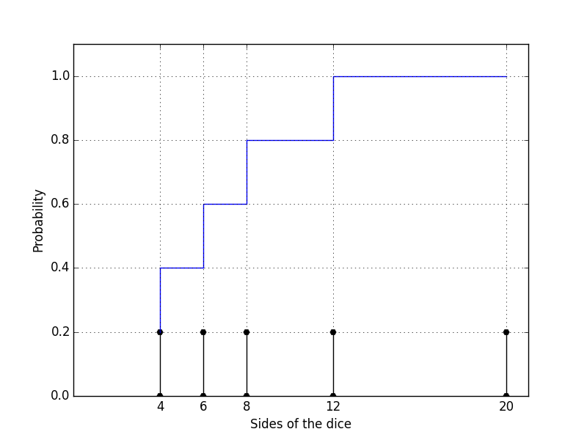
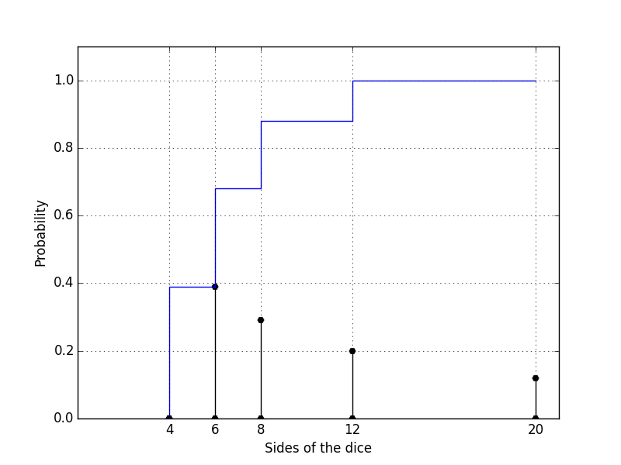
2nd Example
Probability Mass Function (before/after):

Slide 19
The German Tank Problem
A famous application of Bayes' theorem is the “German Tank Problem” :
During WWII german tanks had a serial number and allies were collecting these numbers. The question was :
  Knowing the serial number, how many tanks do the ennemy approximatly has?
Bayes statistics appears to give a very good estimation

Slide 20
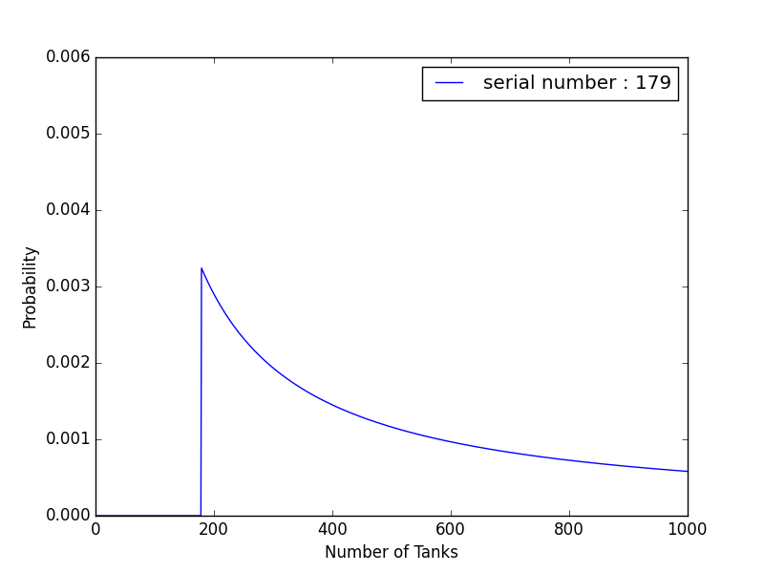
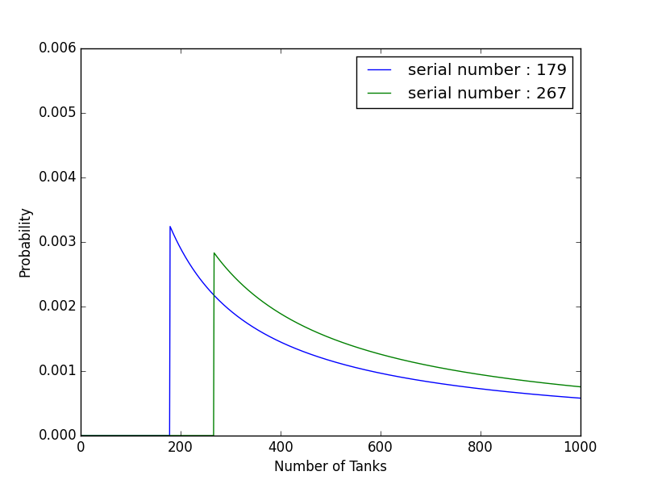
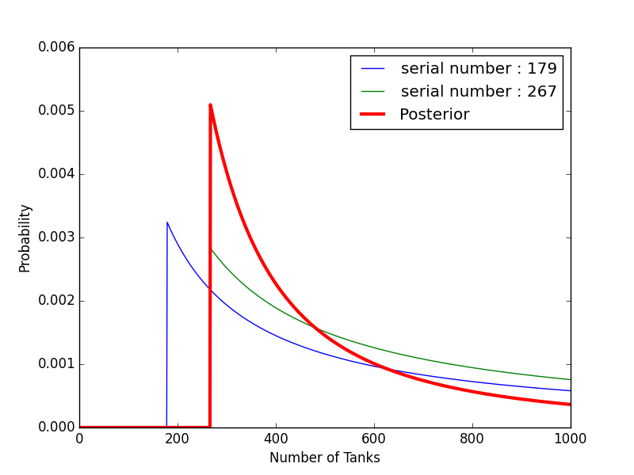
German Tank Problem
Probability Mass Function (before/after):

Slide 21
The Prior
One big criticism of Bayes' Theory was the prior choice.
It was/is said that guessing a prior distribution, especially when you don't know which one to choose, could not be mathematically rigorous.
Therefore results would be too prior-biased.
… well, we can actually test this statement

Slide 22
The Euro Coin Problem
Belgian euro coin was accused of unfair flipping :
"When spun on edge 250 times, a Belgian one-euro coin came up heads 140 times and tails 110. 'It looks very suspicious to me,' said Barry Blight, a statistics lecturer at the London School of Economics. 'If the coin were unbiased, the chance of getting a result as extreme as that would be less than 7%.' "
From "The Guardian"

Slide 23
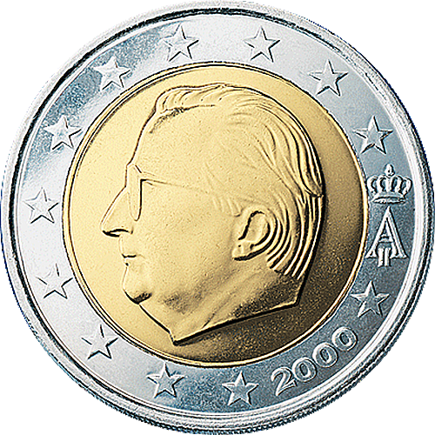
The Euro Coin Problem
Is the test really proving a bias?
What is the probability that the coin is fair?
Let's take x representing the probability that the coin lands Head 'H' such that :
  x=0.0 the coin gives always Tail 'T'
  x=1.0 the coin gives always Head 'H'

Slide 24
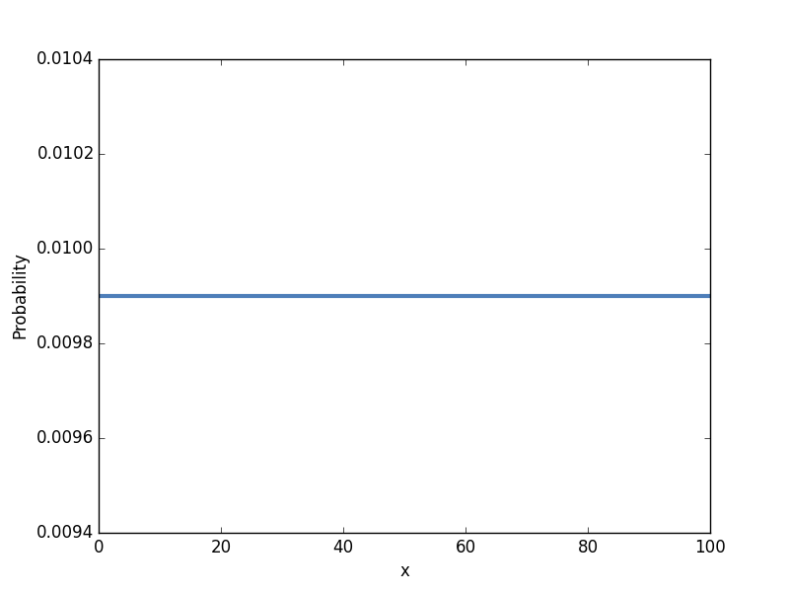
The Euro Coin Problem
We can first make no assumption about the probability that the coin returns 'H' or 'T'
Any value of x is equally likely
'T' biased
'H' biased

Slide 25
The Euro Coin Problem
From here let me show you using the material from :
https://github.com/AllenDowney/BayesMadeSimple.git
'T' biased
'H' biased

Slide 26
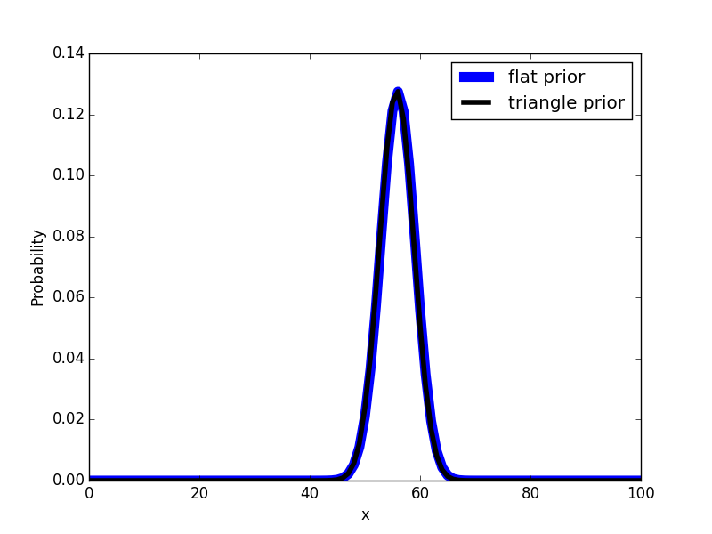
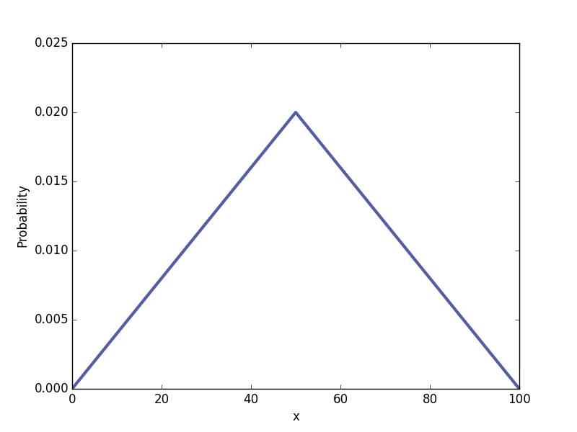
The Euro Coin Problem

Slide 27
The Euro Coin Problem
Actually the work is not done yet (but time is running) and I have proved that from two different prior distributions we find the same posterior.
To answer the euro coin issue we need to investigate if the data set is an evidence of the coin being biased or not…
See Prof Allen Downey video to know the truth :
https://www.youtube.com/watch?v=5W715nfJNJw
  (or read the book)

Slide 28
What We Have Learned
If our data set is large enough the choice for the prior is not important (just don't choose zero).
Think carefully when computing the Likelihood
(from my own experience you can waste some weeks fighting with unexpected results… :( )
...

Slide 29
Bayesian Recipe
Get data (obviously)
Make Hypothesis
(no need to have a null hypothesis)
Choose a prior distribution
Compute Likelihoods
Compute Posteriors
  Note : Normalization might not always be necessary, e.g. model comparison

Slide 30
And Then...
I don't want to debate about the Bayesian approach and its pros and cons.
Let's rather have look at some applications...

