Slide 1
Support Vector Machine
Classification II

Slide 2
Linearly separable… or not
We have seen that SVM provides a method to find the best decision boundary between two linearly separable ensembles …
… but very often ensembles are not fully linearly separable.

Slide 3
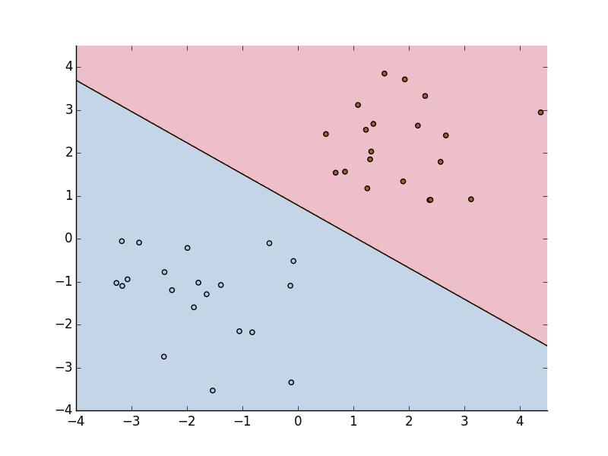
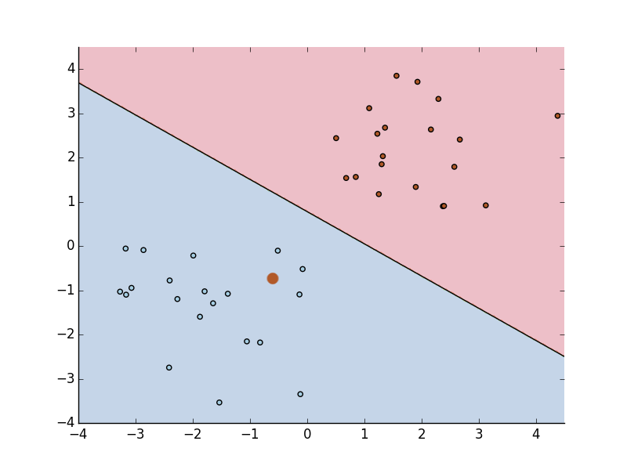
The Problem
It happens that few points are the problem

Slide 4
Soft Margin SVM
One solution is to allow for misclassified points by introducing slack variables ζ in the constraints such that :
This is the Soft Margin SVM while the fully linearly separable case is named Hard Margin SVM.

Slide 5
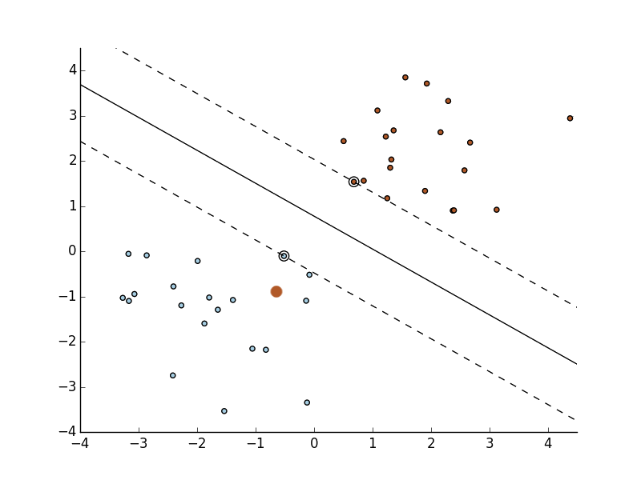
Soft Margin SVM
ζ

Slide 6
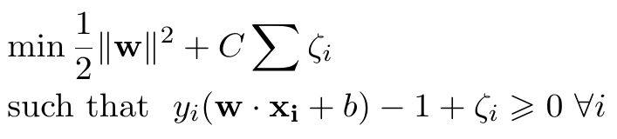
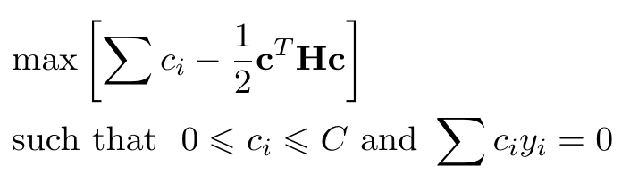
C-SVM
Primary formulation of the problem :
Dual formulation :
Penalty Parameter

Slide 7

Coding Time (1)
The LinearSVC in scikit is a soft-margin algorithm, find a nice case where two classes are not fully separable and apply the algorithm.
Play with the different parameters (especially C).

Slide 8
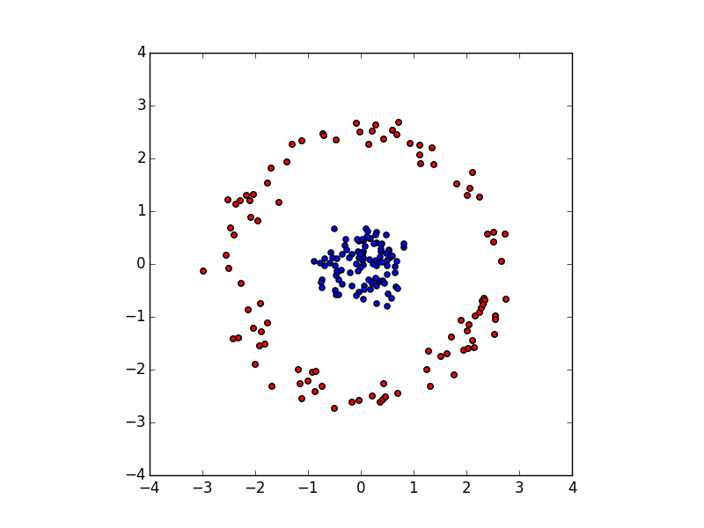
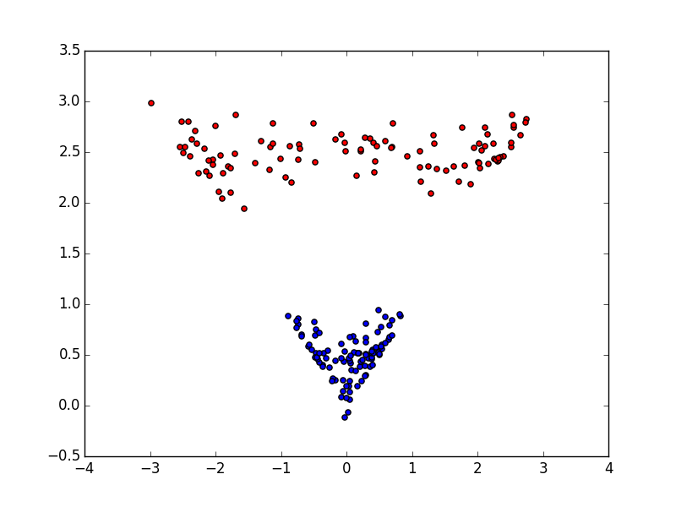
The Kernel Trick
Is the following case linearly separable?

Slide 9
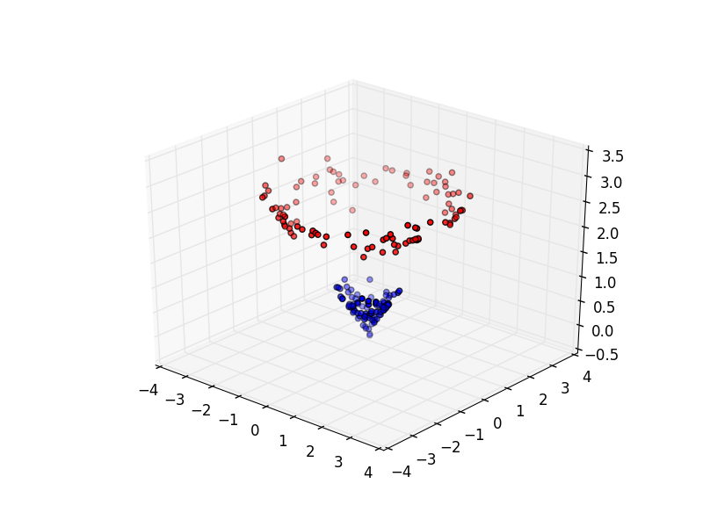
The Kernel Trick
It is actually the same data set!

Slide 10
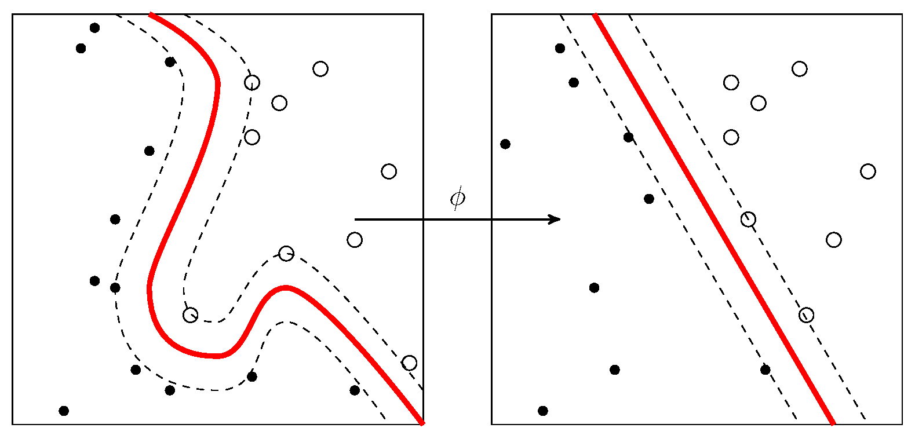
The Kernel Trick
The idea is simply to project the data in a new space to apply the soft margin approach.
The transformation is done by using a kernel K
  K(xi,xj) = Φ(xi)^{T} Φ(xj)

Slide 11
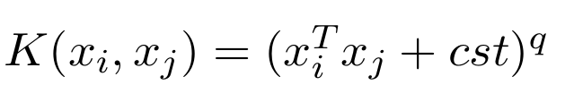
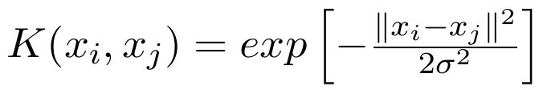
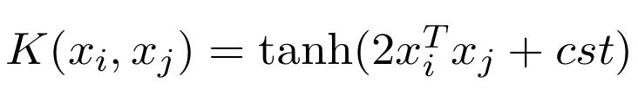
Common Kernels
Polynomial (degree q):
Radial-Basis Functions (RBF) :
Sigmoidal Functions :

Slide 12
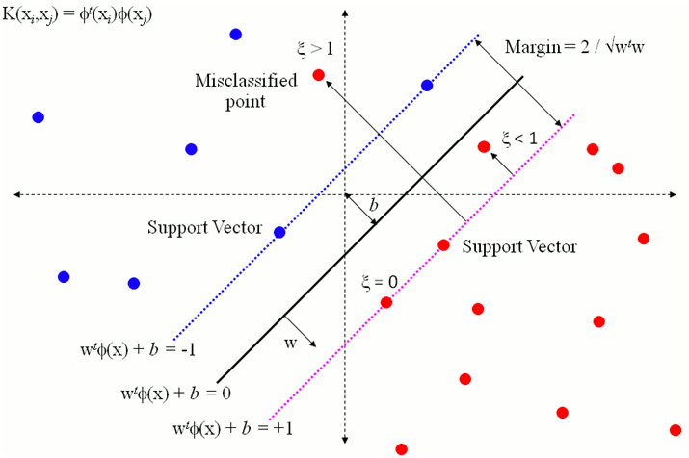
Visual Summary
Source : http://research.microsoft.com/en-us/um/people/manik/projects/trade-off/svm.html

Slide 13
Multivariate Case
In a multivariate case , N classes :
  one versus the rest (ovr) :
    We separate each class individually from the other classes.
    N classifiers trained.
  one versus one (ovo):
    We separate classes two by two.
    N*(N-1)/2 classifiers trained.

Slide 14
Coding Time (2)
Using the good old iris data set perform SVM Classification using different kernels with different parameters.
Try first on two classes and then three classes
(BONUS : Try with another data set)

Slide 15
Afterword
Othe developments :
  Nu-SVM : is another version of SVM introducing an additional factor ν
  One-class SVM : for outliers detection
  SVM can also be used for Regression
  (Assignment 2)

